Slide 1
Visual Studio 2017 Help Screenshots
Jim Fawcett
Fall 2018

Slide 2
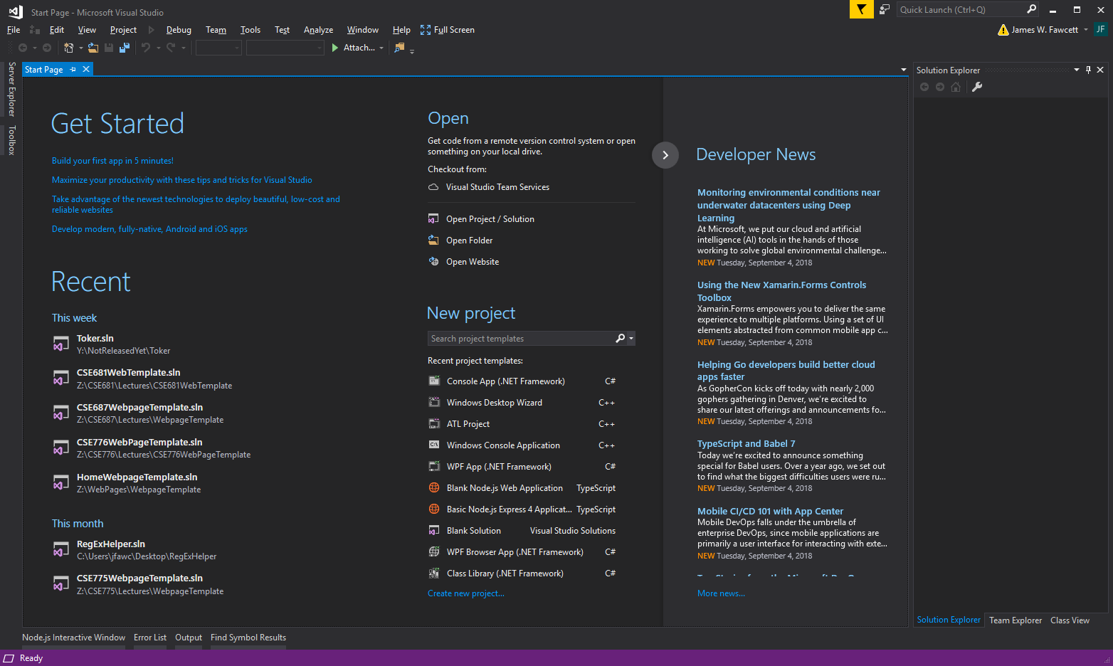
Opening Screen

Slide 3
View Existing Projects
Perhaps code you’ve downloaded from College Server

Slide 4
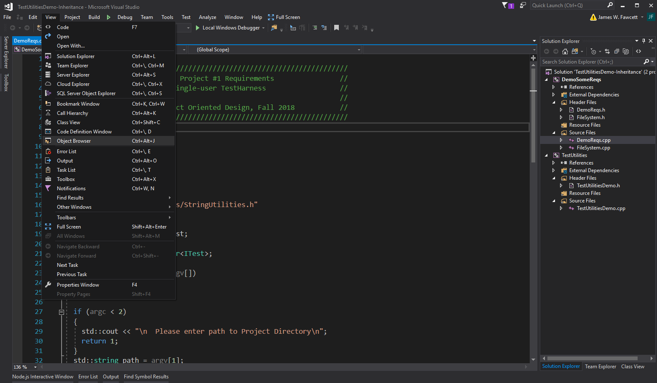
View

Slide 5
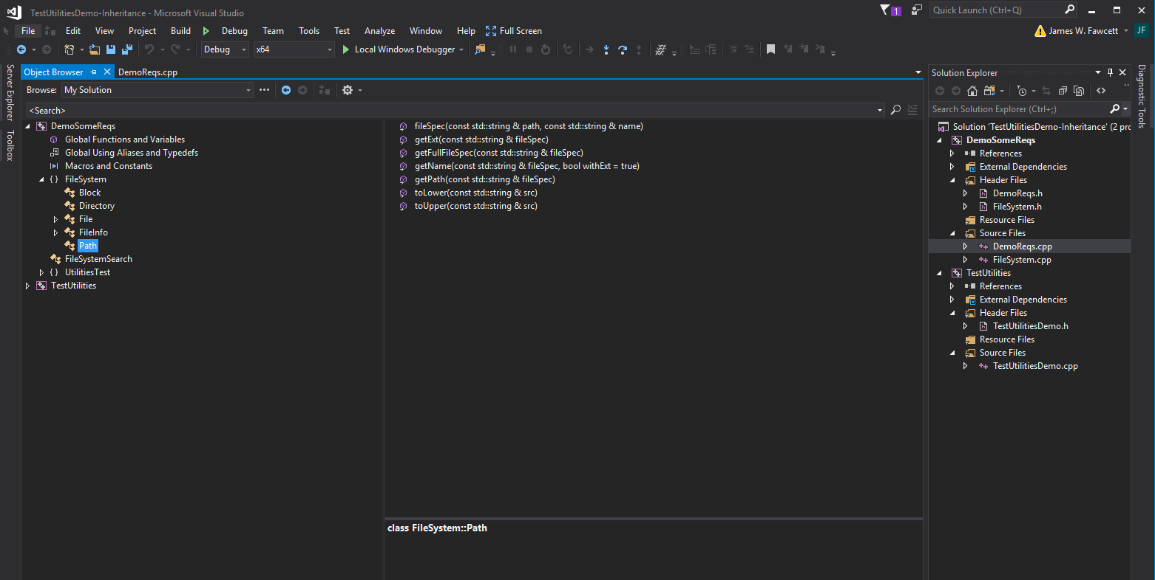
View > Object Browser

Slide 6
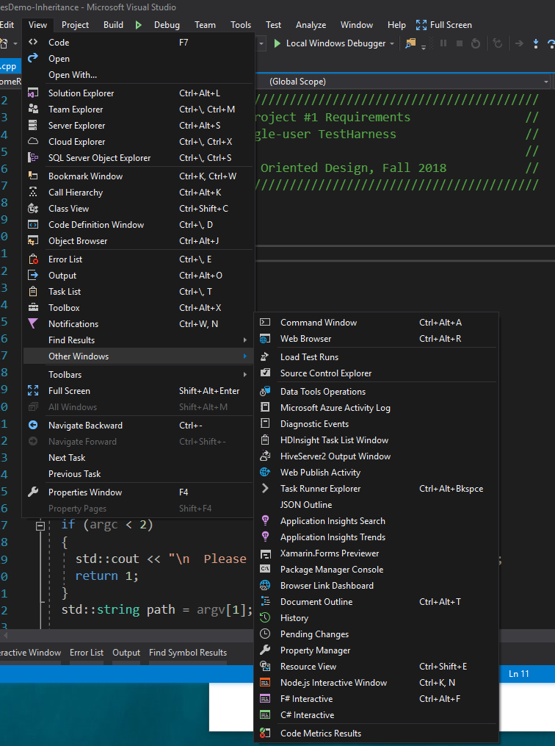
View > Other Windows

Slide 7
Start a new solution

Slide 8
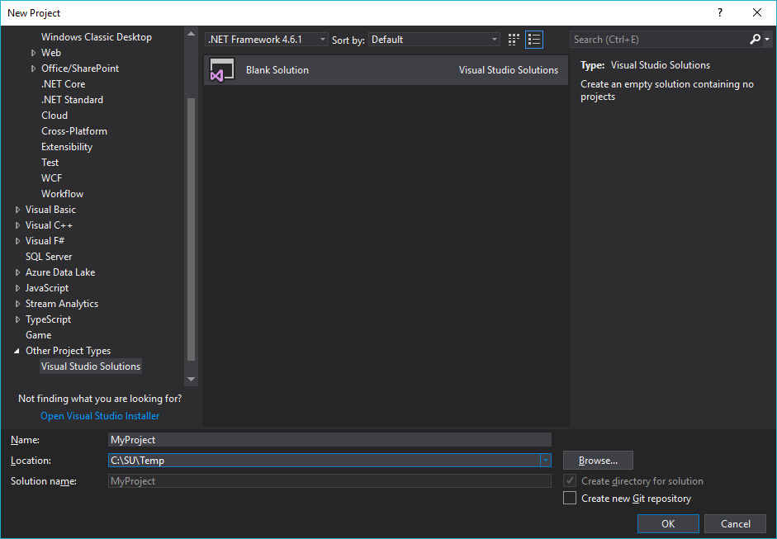
File > New > Project > Other Project Types
Start a new solution

Slide 9
Starting and Building Projects
Perhaps to add a project to an existing solution

Slide 10
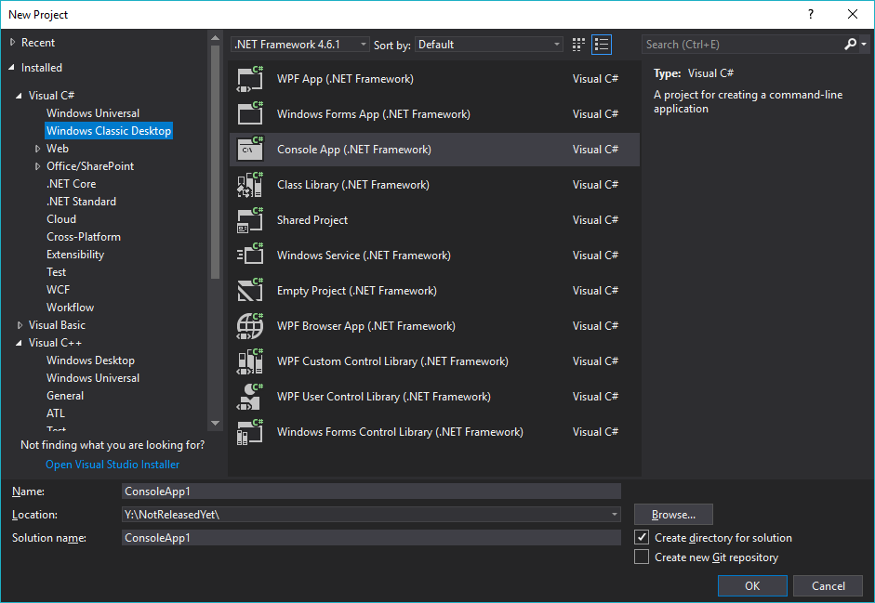
File > New > Project > C#

Slide 11
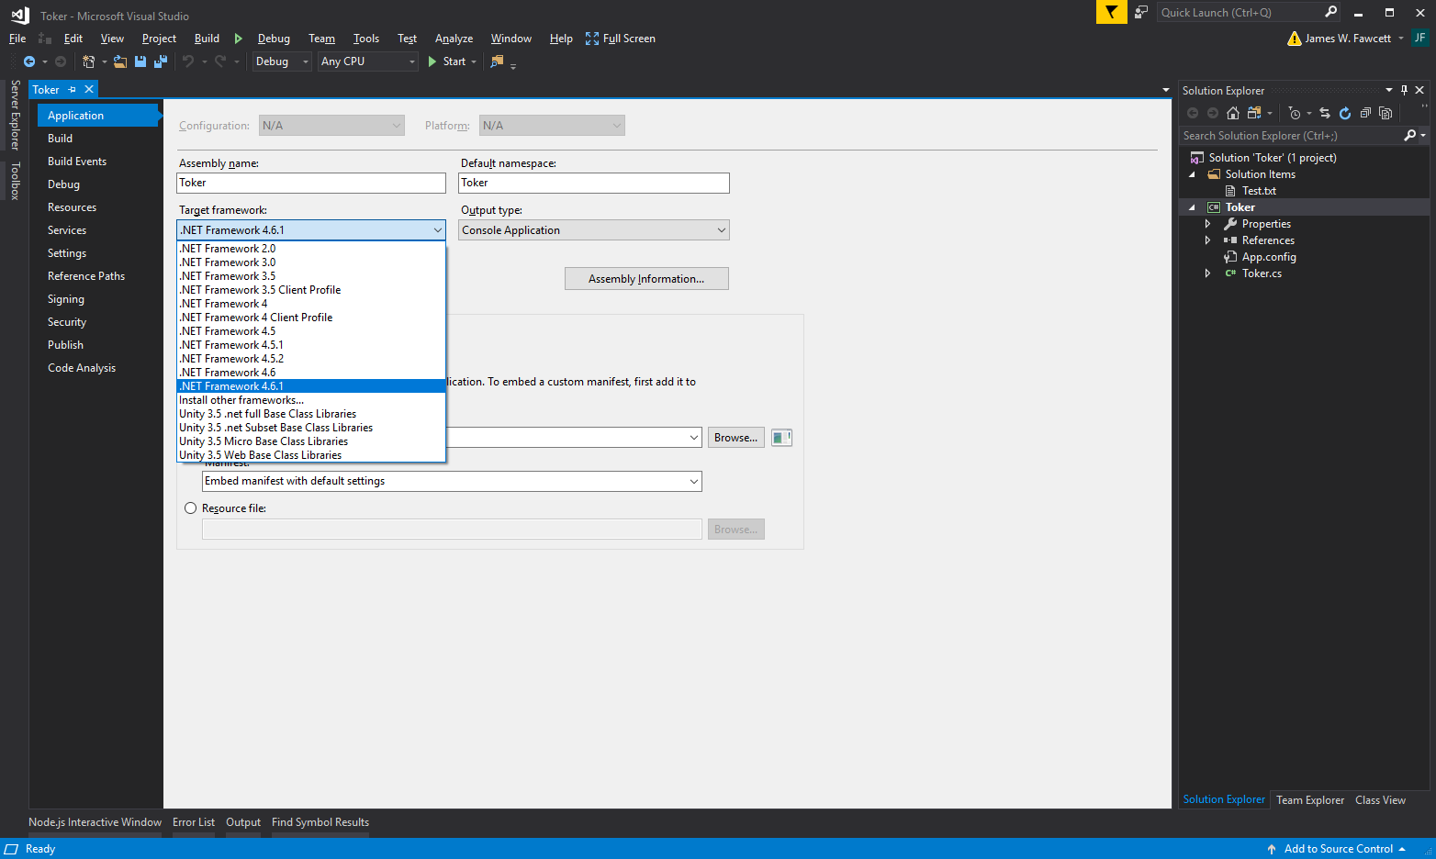
C# Project > Properties > Application
You may need to change Framework version used for builds, e.g., an old solution may require a Framework version you don’t have on your machine.

Slide 12
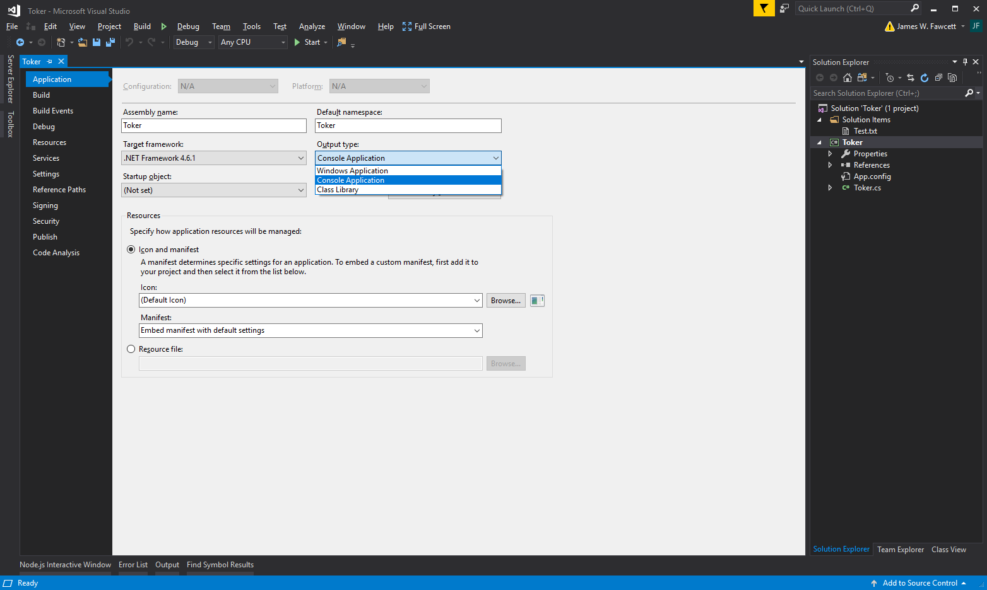
C# Project > Properties > Application

Slide 13
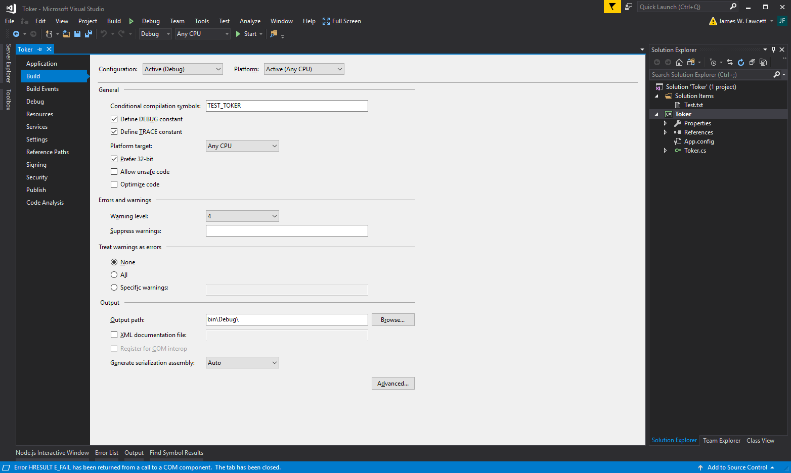
C# Project > Properties > Build
Define to enable compilation of TestStub

Slide 14
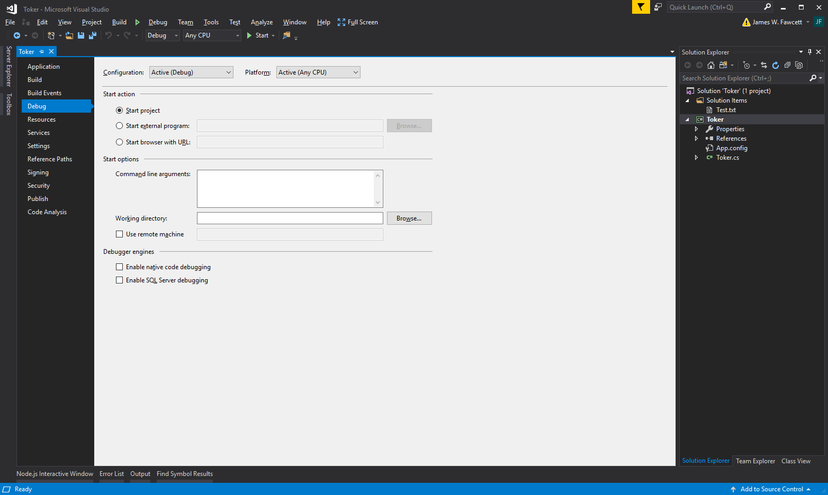
C# Project > Properties > Debug
Put command line arguments here

Slide 15
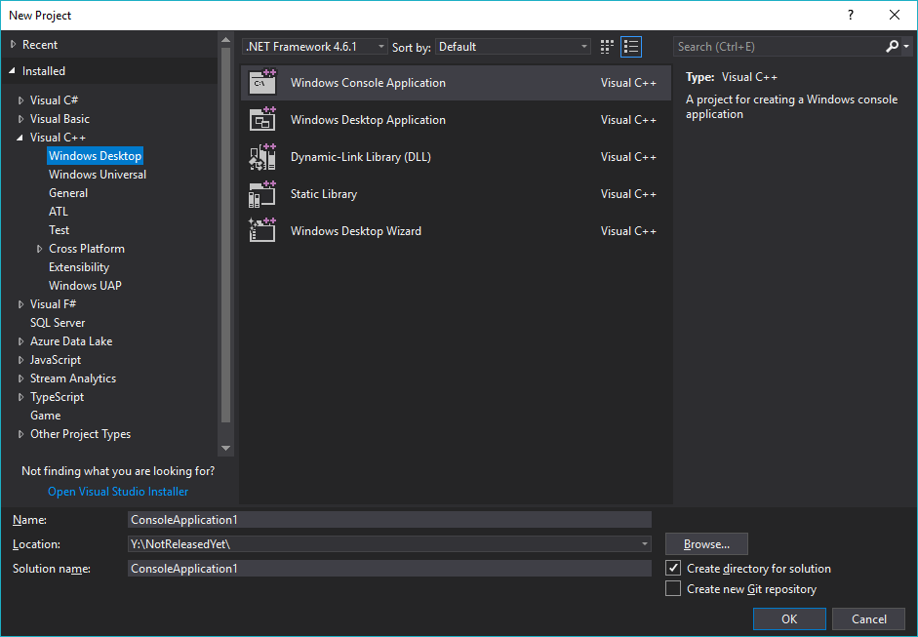
File > New > Project > C++

Slide 16
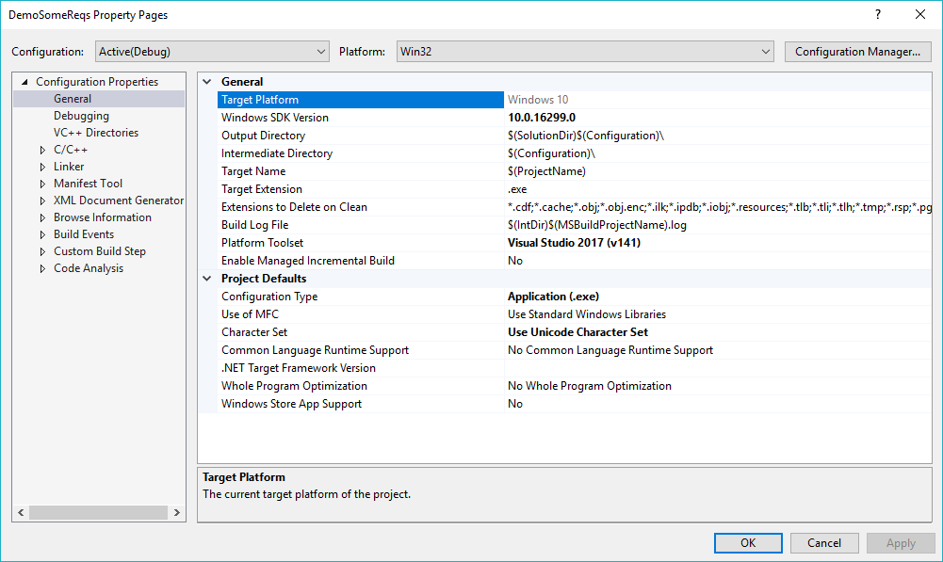
C++ Project > Properties > General
You may need to change these to match your environment and compiler version

Slide 17
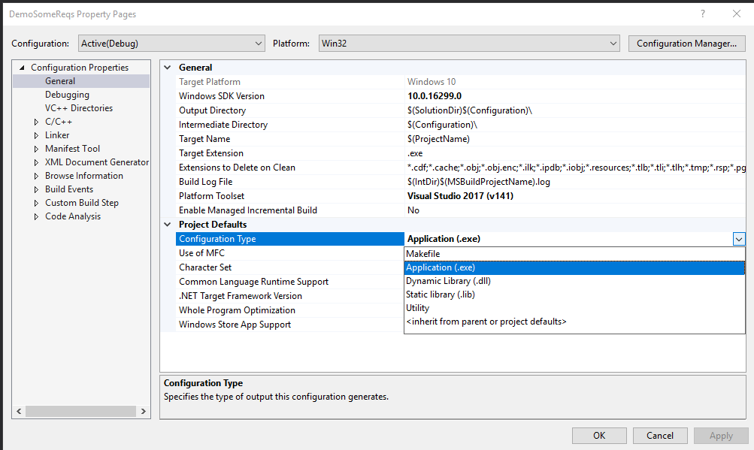
C++ Project > Properties > Configuration Type

Slide 18
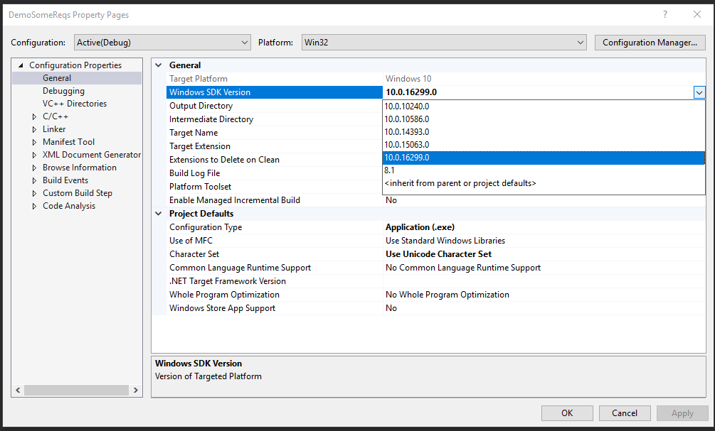
C++ Project > Properties > Configuration Type

Slide 19
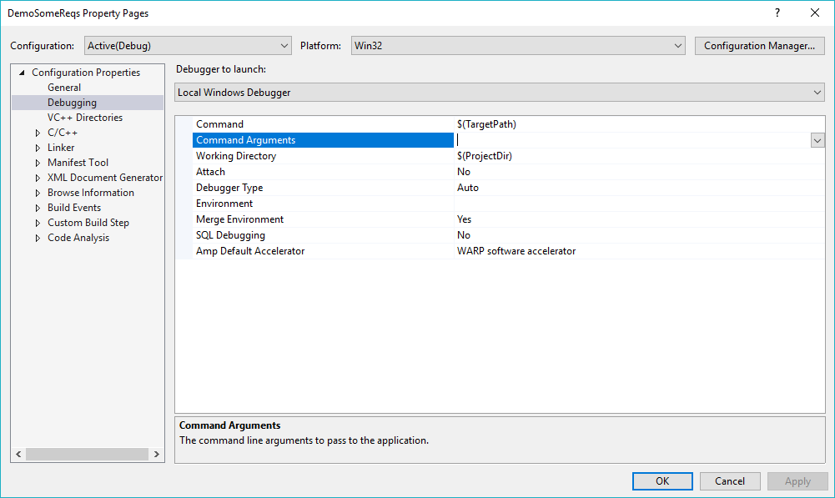
C++ Project > Properties > Debugging
Put command line arguments here

Slide 20
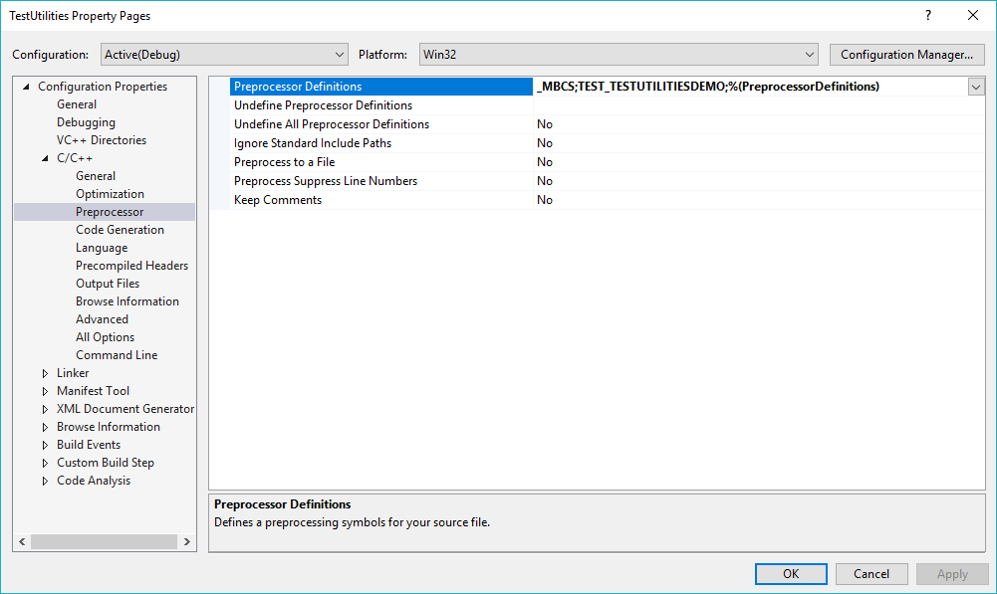
C++ Project > Properties > C/C++
This is where you define whether to
compile a package’s TestStub
(see next slide)

Slide 21
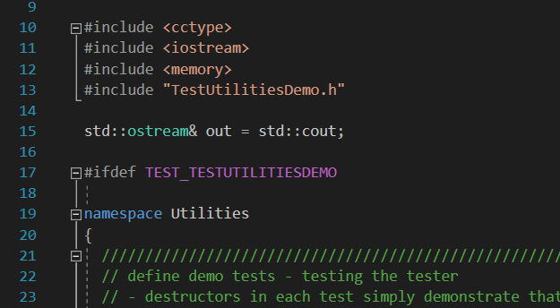
Option to compile package’s main function

Slide 22
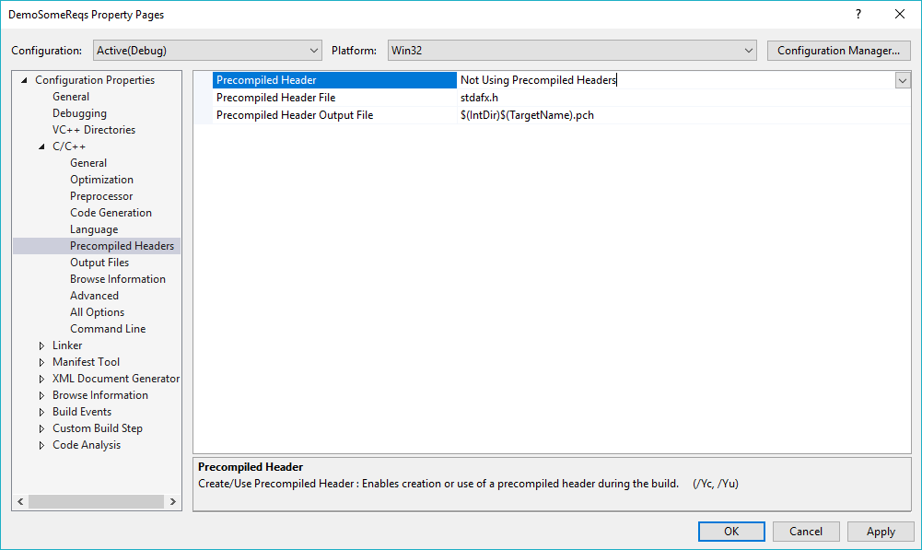
C++ Project > Properties > C/C++
Precompiled headers seem to cause more problems than the modest improvement in build times warrant, so I usually don’t use them.

Slide 23
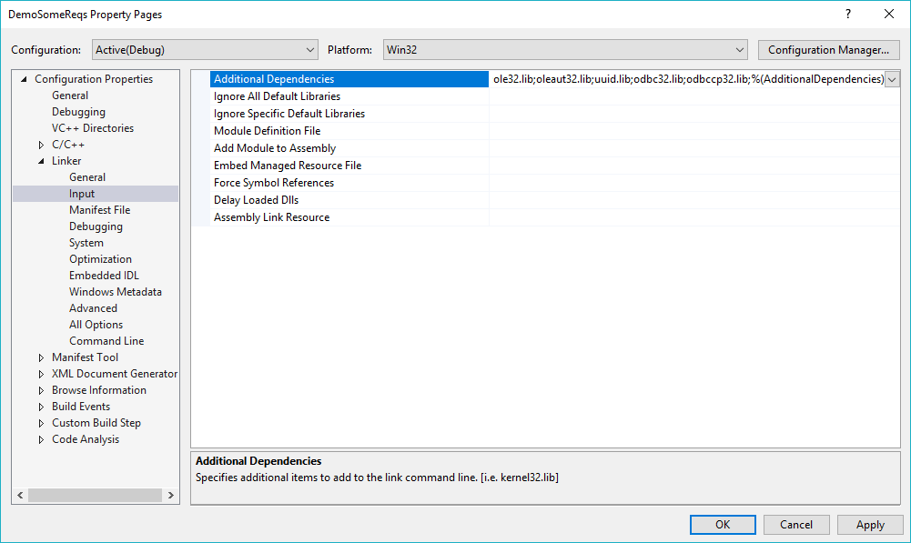
C++ Project > Properties > Linker > Input
If your project depends on other libraries, add them here.

Slide 24
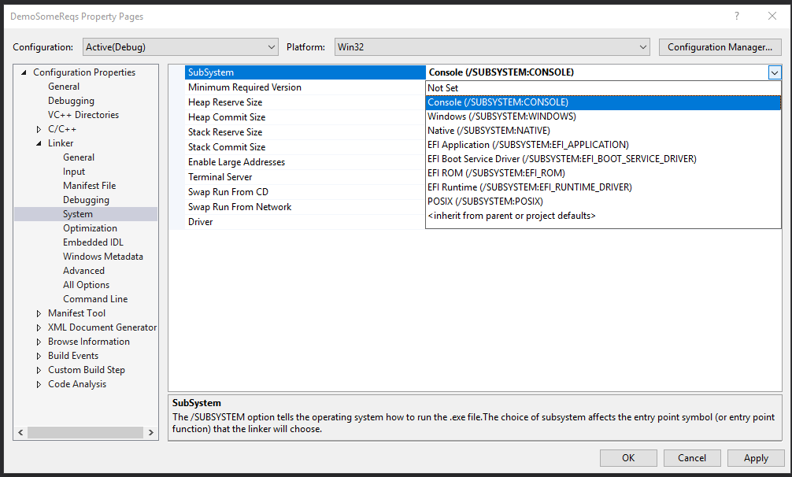
C++ Project > Properties > Linker > System
If, when you run in Visual Studio, the program’s output appears briefly, then disappears, you fix that by setting SubSystem to Console.

Slide 25
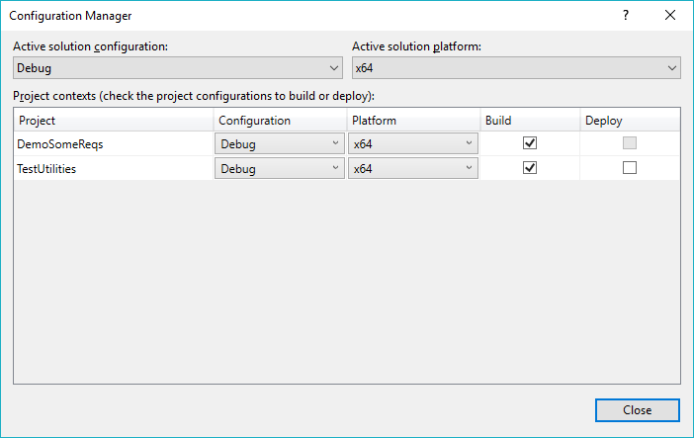
Build > Configuration Manager
All the projects in a solution normally target the same platform.

Slide 26
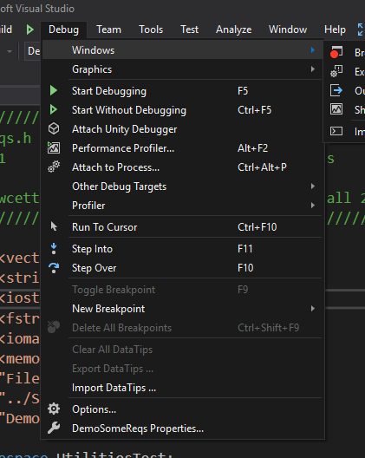
Debug
Degugging Commands
F5: jump to next breakpoint
F10: step next
F11: step into function
^F10 : run to cursor
Set or remove breakpoint by clicking on margin
I added Run to Cursor to the Debug menu, as shown in the next slide.

Slide 27
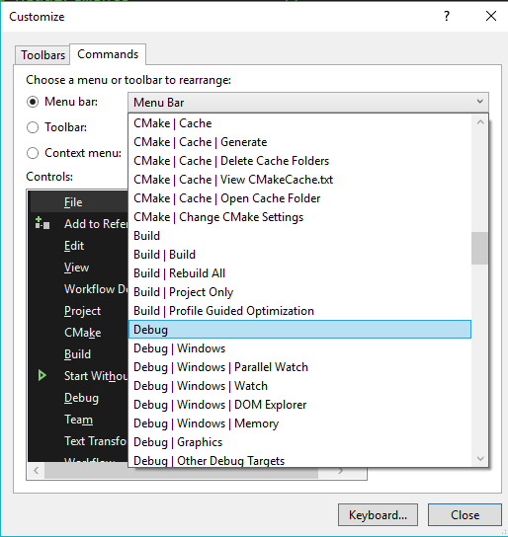
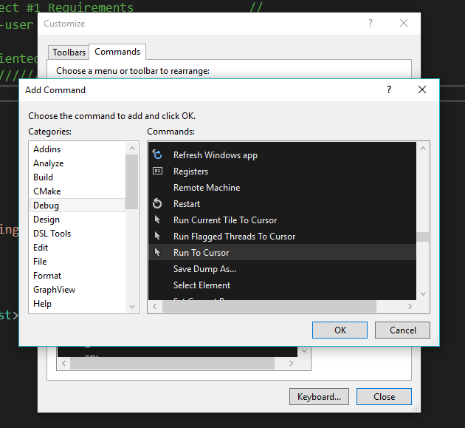
Tools > Customize > Commands

Slide 28
The End

