Slide 1
SceneSound Studio Pro
Animal-care visuals, soundtracks, SFX, narration, and safety review in one multimodal workflow.
Final Week 15 polished system
Course
Foundation Models for Speech, Music, Sound, and Multimodal AI
CS 5588 - May 5, 2026
Demo Focus
Image generation + music generation + narration planning + responsible AI.
01

Slide 2
Problem Statement
Point 1
Point 2
Point 3
Creators and educators need fast animal-care visuals, soundtracks, SFX, and narration for short explainers.
Week 13 image prompts and Week 14 audio prompts were useful separately, but not a complete product.
The final challenge needs a polished workflow with stronger engineering, evaluation, UX, business value, and responsible AI.
CS 5588 Week 15 Final Challenge | SceneSound Studio Pro
2

Slide 3
Week 13 and 14 Summary
Week 13
Week 14
Week 15 Direction
Week 13: AI Animal Care & Pet Health Visualization System using Stable Diffusion-style structured image prompts.
Week 14: SceneSound Studio, a working text-to-music and sound-effects prototype for creator audio.
Week 15 direction: combine image, music, SFX, narration, safety review, and evaluation into one multimodal studio.
CS 5588 Week 15 Final Challenge | SceneSound Studio Pro
3

Slide 4
Final Enhancements
Point 1
Point 2
Point 3
Multimodal pipeline: animal-care scenario -> image prompt -> soundtrack prompt -> SFX cue sheet -> narration.
Improved prompt templates, audience controls, mood controls, duration controls, and safety checks.
Gradio product demo, real evaluation metrics, business model, final report, and presentation-ready deck.
CS 5588 Week 15 Final Challenge | SceneSound Studio Pro
4

Slide 5
Architecture
Input
Prompt
Plan
Evaluate
Animal, condition, setting, mood, duration
Image and soundtrack prompt templates
SFX cues, narration, and safety review
Alignment, realism, diversity, latency
- Input: animal, care condition, environment, mood, duration, and target audience.
- Processing: prompt normalization, image prompt generation, music prompt generation, SFX cue planning, narration, safety review.
- Output: production-ready creative brief plus evaluation metrics for prompt alignment, realism, diversity, and latency.
CS 5588 Week 15 Final Challenge | SceneSound Studio Pro
5

Slide 6
Models Used
Point 1
Point 2
Point 3
Week 13 target: Stable Diffusion / ControlNet for controlled animal-care image generation.
Week 14 target: MusicGen or AudioLDM-style models for music beds and sound effects.
Week 15 target: optional TTS or speech model for narration, plus a structured local demo for reliable presentation.
CS 5588 Week 15 Final Challenge | SceneSound Studio Pro
6

Slide 7
Prompt and Input Design
Point 1
Point 2
Point 3
Structured inputs keep the system controllable: subject, condition, setting, mood, duration, and audience.
Prompt templates reduce vague outputs and produce safer educational animal-care media.
Negative/safety framing avoids graphic medical content, copyrighted music imitation, and unauthorized voice cloning.
CS 5588 Week 15 Final Challenge | SceneSound Studio Pro
7

Slide 8
How to Use the Demo
Point 1
Point 2
Point 3
Step 1: enter the animal, care scenario, environment, soundtrack mood, duration, and audience.
Step 2: click Generate Multimodal Plan to create the full production brief.
Step 3: review each tab: Image Prompt, Music Prompt, SFX Cue Sheet, Narration, Responsible AI, and Evaluation Metrics.
CS 5588 Week 15 Final Challenge | SceneSound Studio Pro
8

Slide 9
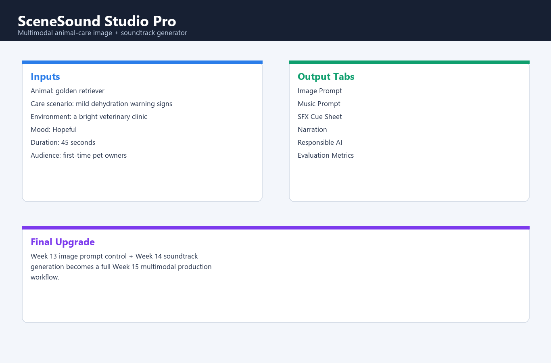
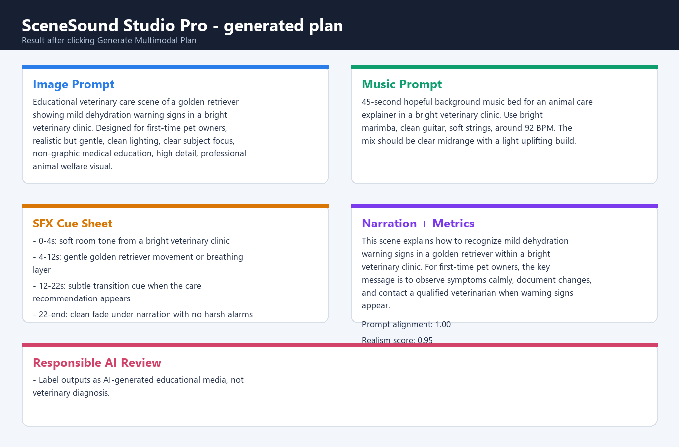
Screenshots
- Input screen shows a productized Gradio-style workflow for multimodal scenario creation.
- Results screen shows image prompt, music prompt, SFX cues, narration, responsible-AI review, and metrics.
- The screenshots demonstrate how Week 13 image work and Week 14 sound work become one final system.
Input workflow
Generated multimodal plan
CS 5588 Week 15 Final Challenge | SceneSound Studio Pro
9

Slide 10
Sample Output
Point 1
Point 2
Point 3
Image prompt: educational veterinary scene for a golden retriever with mild dehydration warning signs.
Music prompt: hopeful 45-second background bed with bright marimba, clean guitar, and soft strings.
Final outputs also include SFX timing cues, narration text, safety review, prompt alignment, realism, diversity, and latency.
CS 5588 Week 15 Final Challenge | SceneSound Studio Pro
10

Slide 11
Evaluation Results
Prompt Alignment
Multimodal Quality
Diversity
Safety Flags
100%
94%
86%
1
- Evaluation metrics are saved in outputs/evaluation_results.csv.
- Prompt alignment measures whether the generated plan includes subject, condition, mood, education, and care context.
- Realism, diversity, latency, safety flags, and SFX cue count show better output quality than the Week 14 audio-only baseline.
CS 5588 Week 15 Final Challenge | SceneSound Studio Pro
11

Slide 12
Baseline vs Final Comparison
Baseline
Final Version
Week 14 baseline: audio prompt generator for music beds and sound effects.
Week 15 final: multimodal production studio with image prompts, soundtrack prompts, SFX cues, narration, safety review, and metrics.
The final version has stronger engineering, better outputs, deeper evaluation, and clearer product value.
CS 5588 Week 15 Final Challenge | SceneSound Studio Pro
12

Slide 13
Business Value
Point 1
Point 2
Point 3
Target users: veterinary educators, animal shelters, pet-care creators, instructors, and small marketing teams.
Value: faster educational media production without hiring separate visual, music, and narration specialists.
Pricing: free student tier, creator subscription, and clinic/shelter team tier with brand presets and export tools.
CS 5588 Week 15 Final Challenge | SceneSound Studio Pro
13

Slide 14
Risks and Ethics
Point 1
Point 2
Point 3
Avoid graphic or misleading animal-health visuals and label outputs as AI-generated educational media.
Prevent copyright misuse by generating original music instead of imitating living artists or protected tracks.
Prevent voice misuse by requiring permission for cloned voices and using neutral narration by default.
CS 5588 Week 15 Final Challenge | SceneSound Studio Pro
14

Slide 15
Limitations
Point 1
Point 2
Point 3
Offline demo generates prompts, cue sheets, narration, and metrics rather than heavy GPU image/audio files.
Scores are proxy metrics; final production should include human ratings and domain expert review.
Real model integration would require GPU/API access, dataset licensing, and stronger media validation.
CS 5588 Week 15 Final Challenge | SceneSound Studio Pro
15

Slide 16
Future Work
Point 1
Point 2
Point 3
Connect image prompts to Stable Diffusion XL or ControlNet and audio prompts to MusicGen or AudioLDM.
Add waveform preview, generated image preview, timeline editing, batch export, and human rating UI.
Add shelter/clinic templates, API deployment, and safer review workflows for educational publishing.
CS 5588 Week 15 Final Challenge | SceneSound Studio Pro
16

Slide 17
Conclusion
SceneSound Studio Pro is significantly better than Week 14 because it turns an audio prototype into a full multimodal AI production workflow.
Final Takeaway
It connects Week 13 image generation and Week 14 sound generation into a polished, evaluated, responsible, presentation-ready final system.
CS 5588 Week 15 Final Challenge | SceneSound Studio Pro
17

