Slide 1
Predicting Diabetes Progression: Health Data Analysis
Decision-Maker Presentation

Slide 2
The Question and the Data
Objective: Identify which baseline clinical characteristics can predict the rate of diabetes progression one year later.
Sample: The analysis is based on real clinical measurements from a sample of 442 patients.
Predictors: We examined demographic factors (age, sex), physical metrics (Body Mass Index - BMI), blood pressure (BP), and six specific blood serum measurements (s1-s6).

Slide 3
Key Patient Characteristics
Disease progression shows significant variability among patients, with no drastic differences between sexes.
Body Mass Index (BMI) follows a normal, symmetric distribution, providing a solid foundation for reliable statistical modeling.
Blood pressure (BP) is mostly concentrated in normal ranges, with very few extreme values.

Slide 4
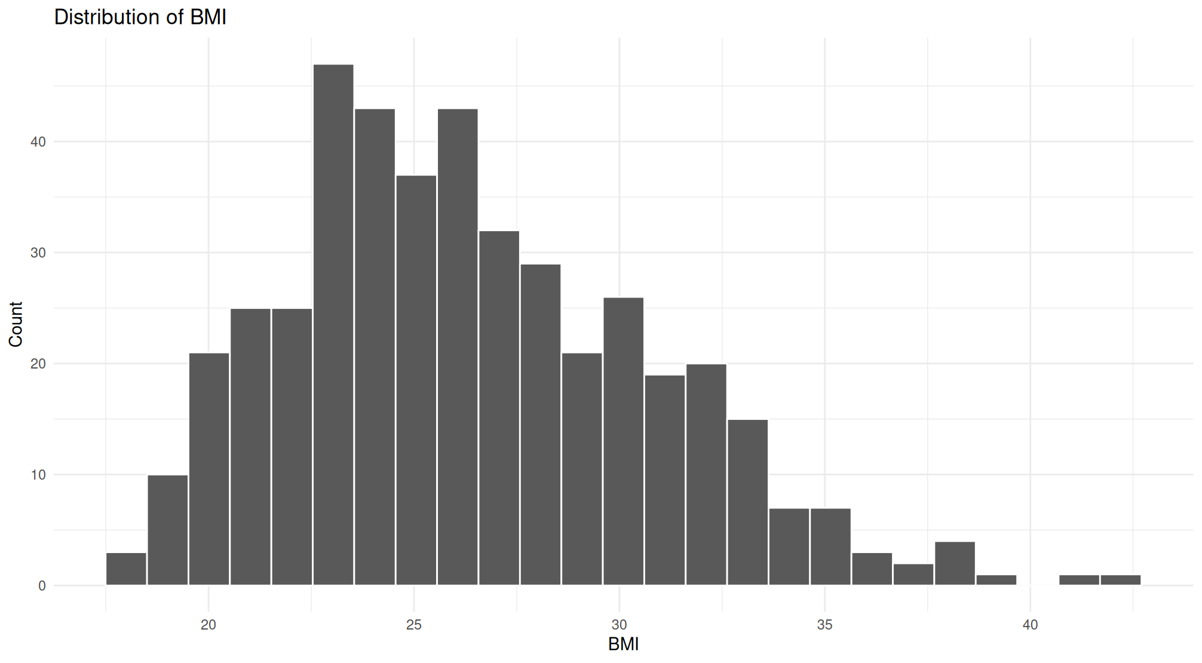
Data Distribution: Body Mass Index (BMI)
Distribution of BMI

Slide 5
What Drives Disease Progression?
We built a multiple regression model (using BMI, Blood Pressure, and serum s5) that successfully explains nearly 50% of the variance in diabetes progression.
The dominant predictor: The blood serum measurement s5 is by far the strongest predictive factor, overshadowing traditional metrics.
Secondary factors: BMI and blood pressure also contribute to disease progression, but with a smaller practical impact compared to s5.

Slide 6
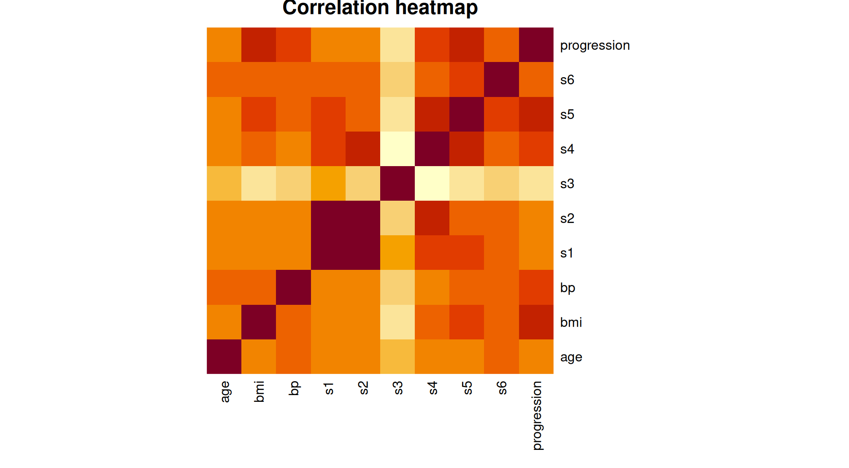
Predictor Relationships
Correlation Heatmap

Slide 7
Practical Implications for Healthcare
Patients presenting with an elevated BMI and, crucially, high s5 serum levels belong to a very high-risk group for rapid clinical deterioration over the next 12 months.
Even minor increases in the s5 index translate to a rapid, tangible spike in the disease progression measure.
Strategic Action: Strict and frequent monitoring of the s5 index and body weight is the most critical tool for early patient prioritization.

Slide 8
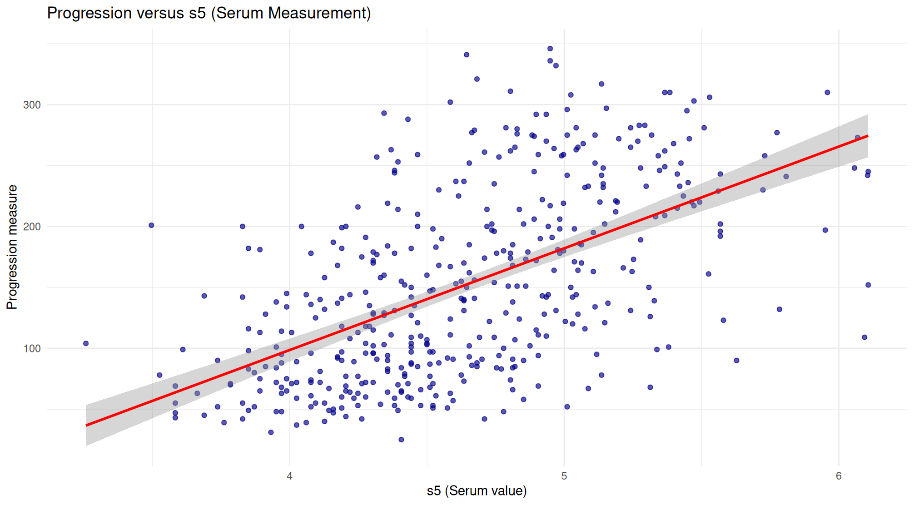
Progression vs. Serum s5
Progression versus s5

Slide 9
What is Missing? (Uncertainty & Limitations)
Despite the strong predictive power of our predictors, more than 50% of the disease progression remains unexplained by the model (unexplained variance).
Main Limitation: Our analysis completely lacks critical lifestyle data (dietary habits, physical activity levels) and genetic/family history information.
These missing confounding factors likely influence both the patients’ baseline metrics (like BMI) and their diabetes progression simultaneously.

Slide 10
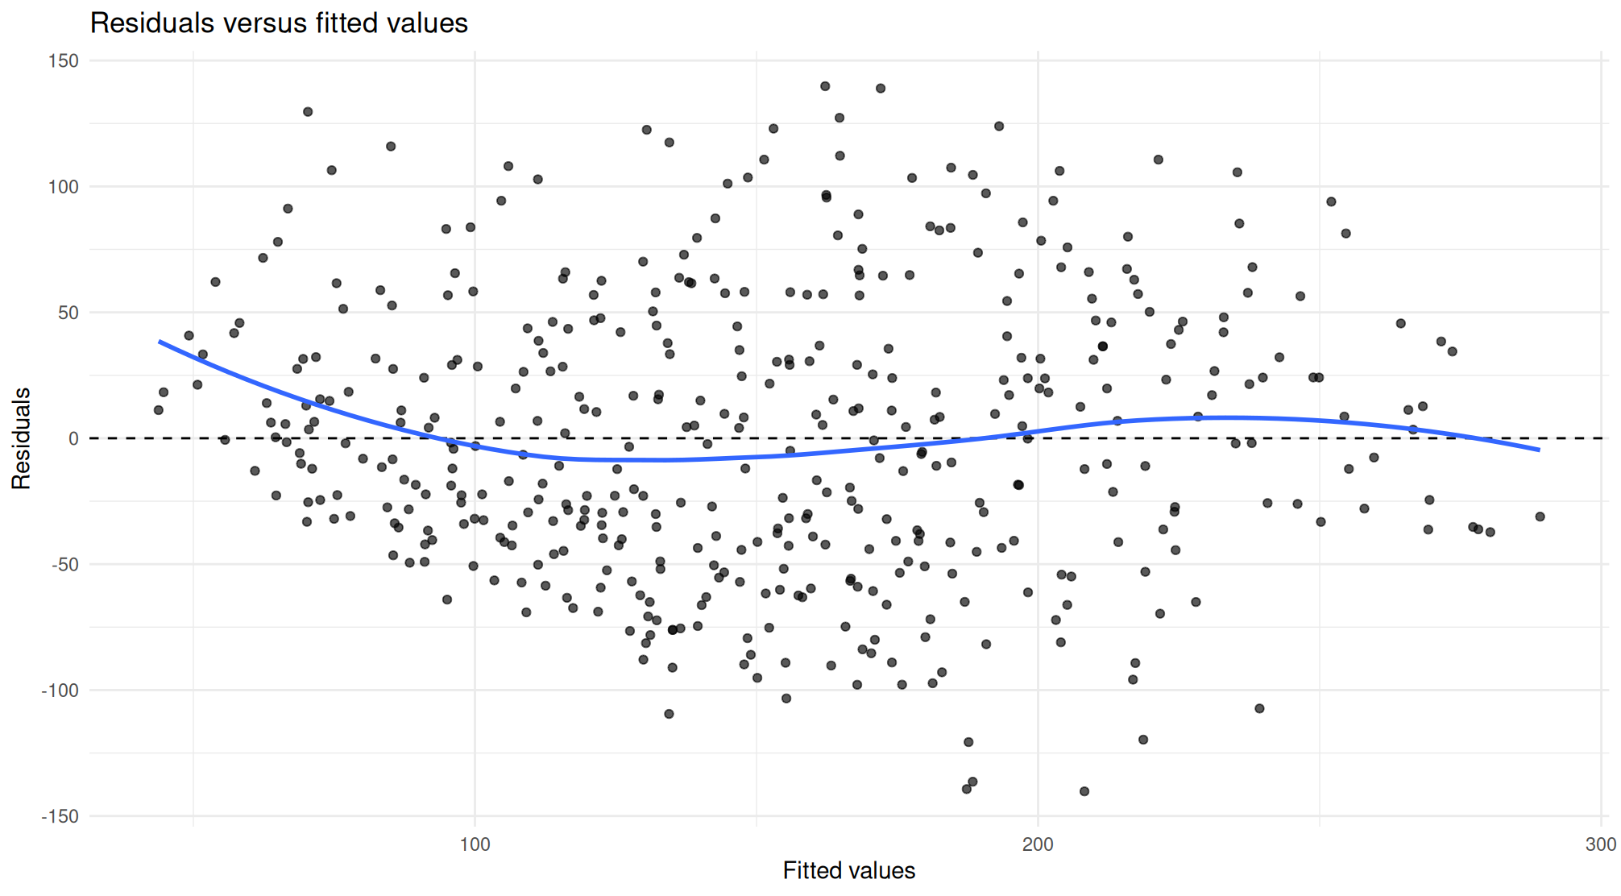
Unexplained Variance (Model Residuals)
Residuals versus fitted values

Slide 11
Final Conclusions and Next Steps
Supported Claims: BMI and the s5 index are excellent, reliable early-warning tools. Healthcare administration can use them immediately to identify and prioritize vulnerable patients.
Beyond the Evidence: This research is strictly observational, not experimental. It does not prove causation. We cannot guarantee that a targeted clinical intervention simply reducing a patient’s BMI or s5 will automatically halt or cure the progression of their diabetes.

