Slide 1
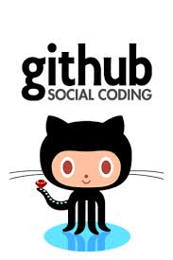
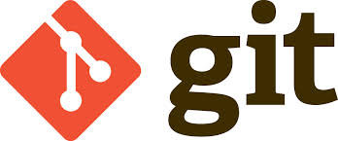

Welcome: (Very) Short Course on Sustainable Software
Scott Collis, Jonathan Helmus and Michael Nowak

Slide 2
What are Sustainable Software Practices?
Following Conventions
Using Version Control
(where applicable)
Using open source and community based platforms

Slide 3
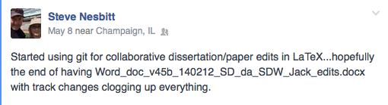
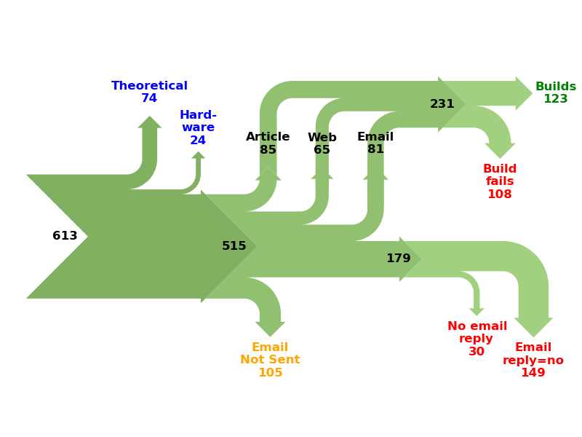
Why bother?
Almost everything we do is done by collaboration.
Large teams need to work together, software engineers, Scientists, managers.
Cross lab, cross agency, international!
Increasingly your code is your CV. Papers and indices will get your foot in the door, your ability to code and manage software lands you the job.
Not just for code!
http://reproducibility.cs.arizona.edu/

Slide 4
But REALLY? Why bother?
Reproducibility!
… If I have seen further it is by standing on the shoulders of giants. - Isaac Newton

Slide 5
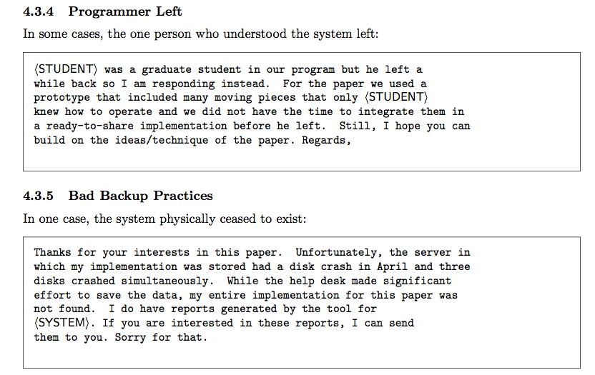

Slide 6
What is Version Control? (Wikipedia)
Revision control, also known as version control and source control (and an aspect of software configuration management), is the management of changes to documents, computer programs, large web sites, and other collections of information. Changes are usually identified by a number or letter code, termed the "revision number", "revision level", or simply "revision". For example, an initial set of files is "revision 1". When the first change is made, the resulting set is "revision 2", and so on. Each revision is associated with a timestamp and the person making the change. Revisions can be compared, restored, and with some types of files, merged.
The need for a logical way to organize and control revisions has existed for almost as long as writing has existed, but revision control became much more important, and complicated, when the era of computing began. The numbering of book editions and of specification revisions are examples that date back to the print-only era. Today, the most capable (as well as complex) revision control systems are those used in software development, where a team of people may change the same files.

Slide 7
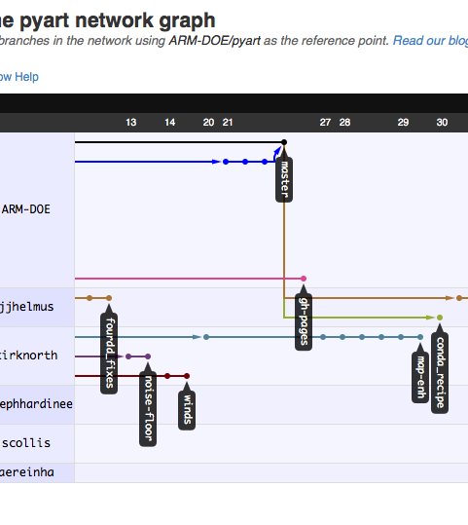
Course outcomes
Familiarity with coding standards, what it means and why you should do it!
Introduction to the Git Version Control system, ability to:
Start a project
Add files
Commit changes
Compare changes
Introduction to social coding concepts:
Forking
Submitting a Pull Request
Intermediate Git:
Using Branches to manage complex projects

