Slide 1
Conventions and Standards: Examples from Python
Mike Nowak,
Jon Helmus,
Scott Collis

Slide 2
Why use coding conventions
Enables the programmer to use a common language and format to communicate to other programmers
Makes code easier to read
Makes code easier to understand
Makes code consistent, consistent code is a trait of a skilled programmer

Slide 3
When to ignore coding conventions
When the coding convention gets in the way of your work
When you are spending too much time on coding conventions rather than solving the problem
When specific conventions do not fit the architecture of the system you are working in
When your project has discovered a better coding convention that everyone agrees upon

Slide 4
Why would you ignore coding conventions?
When using conventions makes the code less readable.
To be consistent with surrounding code.
Because you would have to re-write code only to apply coding conventions. (you would want to apply conventions if you have to re-write code for other purposes)
When the convention breaks code compatible with other Python versions.

Slide 5
What to do when you have doubts
Check with a senior Software Engineer or Computer Programmer
Check with the architect of the system
If working on an open source project, check the forums or email the owner of the repository for guidance
Take a moment to learn about standards and conventions to ensure you have the tools in your toolbox when you need it.

Slide 6
Coding Conventions
PEP 8 (PEP 257 for older versions of python)
Guido van Rossum <guido at python.org>, Barry Warsaw <barry at python.org>, Nick Coghlan <ncoghlan at gmail.com

Slide 7
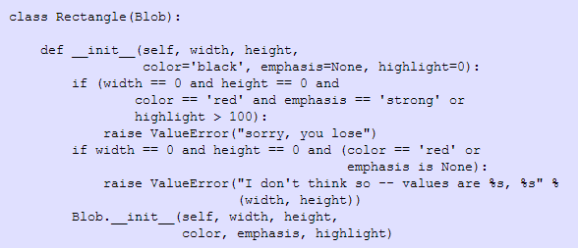
Pep 8
Indenting code = 4 spaces (no tabs)
Max Line Length = 79 characters
Many groups decide against thing convention due to nice monitors that allow for longer lines

Slide 8
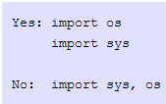
Functions, Methods, and Imports
Top level functions and class definitions must be separated by two blank lines.
Method definitions inside a class must be separated by a single blank line.
Imports must be on separate lines.
Imports must be grouped in this order.
Standard library imports
Related third party imports
Local application/library specific imports
Wildcard imports must be avoided.

Slide 9

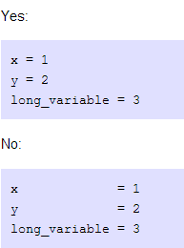



Spacing patterns

Slide 10
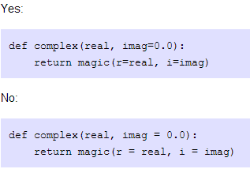
Whitespaces with operators
Always surround operators with a single space. A = 1+2
But don’t surround the = sign with a white space when it’s part of a keyword argument or a default parameter value.

Slide 11
Comments
Never add a comment that contradicts what the code is doing.
Comments shall always be complete sentences and in English.
Block comments must apply to some or all code that follows it.
Block comments start with a # and a single space (unless text inside it is indented)
Separate paragraphs with a single line containing #
Inline comments shall be used sparingly.

Slide 12

Pep 8 cont.
Write docstrings for all public modules, functions, classes, and methods. Docstrings are not necessary for non-public methods, but you should have a comment that describes what the method does. This comment should appear after the def line.

Slide 13
Naming Conventions
Avoid caps that look like numbers or lowercase letters that look like numbers or caps (l I O)
Modules must have short all-lowercase names
Class names should use CapWords or CamelCase
Exception names shall be named as Class names but with Error as the suffix
Global variables and function names must be lowercase with words separated by underscores

Slide 14
Naming Conventions
Method names must be lowercase words separated by underscores
One leading underscore for non-public methods and instance variables
Avoid name clashes with subclasses by using two leading underscores
Method_one
Function and method arguments must always use self for the first argument to instance methods
source_path(self, fullname)
Always use cls for the first argument to class methods
Namespace clashes with reserved words shall append an underscore to the end of the name ex: class_

Slide 15
Naming Conventions
Constants are defined on a module level and written in all caps ex: TOTAL
As a general rule, use non-public methods and instance variables. It’s easier to make it public later if you change your mind.
“Private” isn’t a term in python since no attribute is ever really private.
“subclass API” is often called “protected” in other languages
Take care when designing classes so you can make these explicit decisions on items that are only necessary for your base class

Slide 16
Blurb on documentation
Documentation in code is both popular and dreaded depending on who you ask.
Self documenting code
Great variable names
Awesome conventions and easy to understand operators
Liberal comments inside the code
Great if you keep it up to date
Easy to understand if you know how to communicate well to others

Slide 17
Pep 8 cont.
For more details on Python conventions, please see…
http://legacy.python.org/dev/peps/pep-0008/
Other standards…
Google Python Style Guide
For the chromium project
http://google-styleguide.googlecode.com/svn/trunk/pyguide.html

Slide 18
Other Standards Guides in the World
MATLAB (https://sites.google.com/site/matlabstyleguidelines/)
Kernel Normal Form, C (http://www.freebsd.org/cgi/man.cgi?query=style&sektion=9)
Linux Kernel Coding Style, C (https://www.kernel.org/doc/Documentation/CodingStyle)
C++ Coding Standards By Sutter and Alexandrescu (Book) Google's Style guide (https://code.google.com/p/google-styleguide/)

Slide 19
Further reading and exploring
The Pragmatic Programmers by Hunt and Thomas
Code Analysis tools and guides
pylint: http://www.pylint.org
autopep8: https://pypi.python.org/pypi/autopep8
pyflakes: https://pypi.python.org/pypi/pyflakes
Flake8: https://pypi.python.org.pypi/flake8
pychecker: http://pychecker.sourceforge.net

