Slide 1
The Battle of Neighbourhoods
8 October 2018

Slide 2
Introduction and Business Problem
Background:
An investor wants to set up a modern mid-priced Chinese restaurant within the downtown area in Toronto
Target Customers :
People who work in the area (for weekday lunch and dinner)
People who live within the vicinity (for weekday dinner and weekend meals)
Key Concerns:
Competition from other Chinese restaurants
Customer traffic based on venue mix
Business Problem:
Recommend most suitable neighbourhood to set up restaurant

Slide 3
Data
Location Data for Toronto
From previous assignment.
FourSquare Data
To understand the top venues in each neighbourhood, determine their mix and characteristics, as well as the presence of Chinese restaurants
To perform search queries to get the overall rating for specific Chinese restaurants to determine competition strength (if needed).

Slide 4
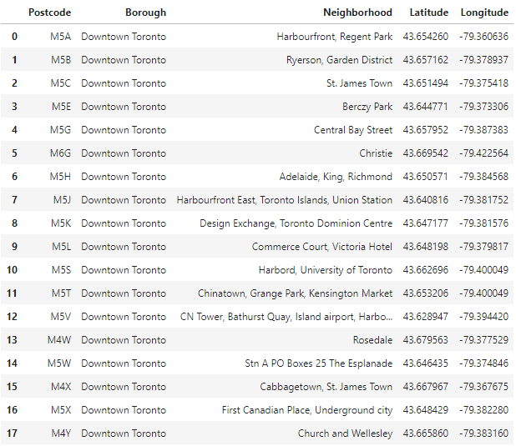
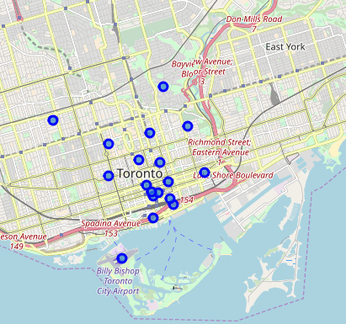
Methodology
Load Location Data for Toronto and Subset to “Downtown Toronto”

Slide 5
Methodology
Use FourSquare API to Get Top Venues in Each Neighbourhood in “Downtown Toronto”
Retrieve top 100 venues within 1km radius in each of the 18 neighbourhoods.
Eliminate Neighbourhoods Based on Filters
Less than 100 venues retrieved – Suggests neighbourhoods may be too quiet with insufficient potential customer base for the restaurant.
Presence of Chinese restaurants – Addresses the competition concern of the investor. With only several neighbourhoods having a Chinese restaurant, we can exclude them.
Presence of hotels – Neighbourhood with higher number of hotels preferred as they would be a good potential customer base. Hotels are a proxy for people who live in the area.
Shortlist Final 3 Neighbourhoods
Explore mix of the top 100 venues within each neighbourhood to determine the diversity of activities, paying attention to venue categories that could boost customer traffic.
Recommend 1 Neighbourhood
Additionally, perform cluster analysis to determine if there was any particular location within the neighbourhood that may stand out in terms of density of venues.

Slide 6
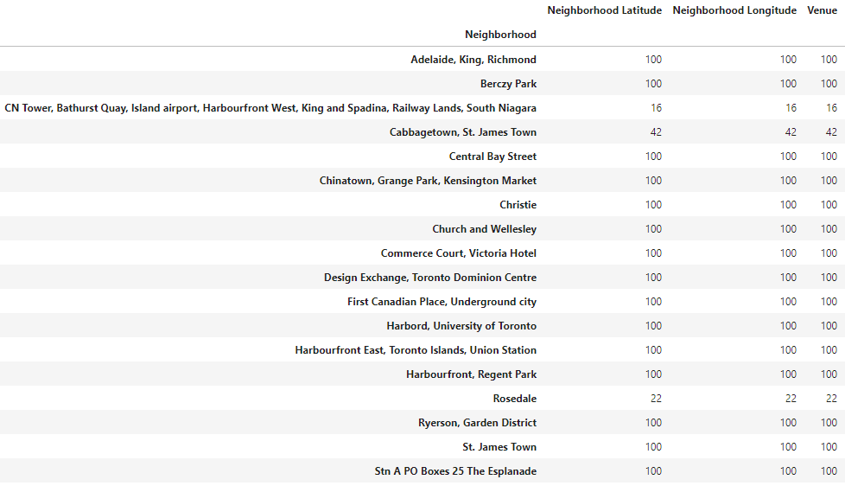
Results (1/4)
Applying the set of filters to the top 100 venues within 1km in each neighbourhood in “Downtown Toronto”, we progressively dropped neighbourhoods from the initial list of 18 neighbourhoods
3 of the 18 neighbourhoods had fewer than 100 venues retrieved

Slide 7
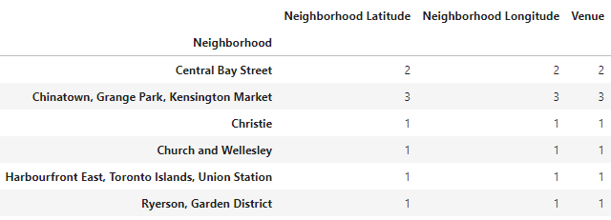
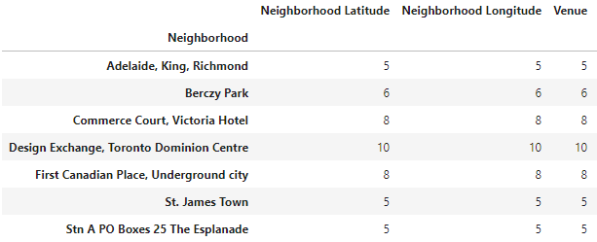
Results (2/4)
6 of remaining 15 neighbourhoods had at least one Chinese restaurant
2 of remaining 9 neighbourhoods did not have a hotel
On the other hand, 3 neighbourhoods had 8 or more hotels

Slide 8
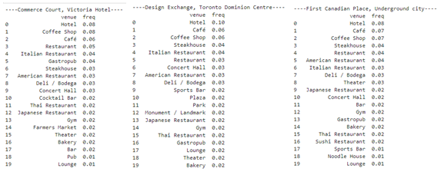
Results (3/4)
Remaining 3 Neighbourhoods for Consideration
Commerce Court, Victoria Hotel
Design Exchange, Toronto Dominion Centre
First Canadian Place, Underground city
No Distinct Differences in Venue Mix in Each Remaining Neighbourhood

Slide 9
Results (4/4)
Recommend “Design Exchange, Toronto Dominion Centre” Neighbourhood
Highest concentration of hotels, which is a key source of customer traffic for the restaurant.

Slide 10
Discussion
Our step-by-step elimination process based on an interpretation of the investor’s criteria reduced the initial 18 neighbourhoods to a final 3 shortlisted neighbourhoods.
Among these 3 remaining neighbourhoods, there was no distinct difference in terms of venue mix. Summary of the key venue categories is shown below.
Commerce Court, Victoria Hotel -- Hotel (8), Concert Hall (3), Gym(2), Farmer's Market (2), Theatre (2)
Design Exchange, Toronto Dominion Centre -- Hotel (10), Concert Hall (3), Park (2), Gym (2), Theatre (2)
First Canadian Place, Underground city -- Hotel (8), Theatre (3), Concert Hall (2), Gym (2)
If we were limited to just one neighbourhood, our neighbourhood pick would be “Design Exchange, Toronto Dominion Centre”, which had the highest number of hotels.
We further applied cluster analysis based on the top 100 venues within this neighbourhood, but did not find clear distinction between clusters. Hence, we recommend an on-site visit to scout for suitable premises for the restaurant.

Slide 11
Conclusion
Starting from 18 neighbourhoods in Downtown Toronto borough, we methodically narrowed the list down to a final 3 neighbourhoods using the investor’s requirements and concerns as a guide.
Eventually, the recommended choice of “Design Exchange, Toronto Dominion Centre” for setting up the restaurant came down to the higher concentration of hotels in this neighbourhood compared to the other 2 choices.
Cluster analysis did not reveal any discerning patterns within the recommended neighbourhood, so an on-site visit to identify potential premises for the restaurant is the next suggested step, along with further due diligence work.

