Slide 1
DAY 3 · MODULE 5 · 30 MIN
MCP with Agent Framework
Discover and invoke external tools through a controlled client boundary
Source: https://learn.microsoft.com/en-us/agent-framework/agents/tools/local-mcp-tools?tabs=python
Building AI Apps and Agents
Notes:
• MCP standardizes how an application discovers and invokes tools exposed by a server. Keep the focus on the MAF client boundary, not undocumented wire-level protocol details. • GROUNDING SOURCE: https://learn.microsoft.com/en-us/agent-framework/agents/tools/local-mcp-tools?tabs=python

Slide 2
MCP Base Protocol
Day 3 · Module 5
Messages — JSON-RPC 2.0 requests, responses, and notifications are the only message shapes the protocol defines
Lifecycle — The initialize → initialized handshake negotiates protocol version and capabilities before normal operation begins
Transports — stdio (client launches the server as a subprocess) and Streamable HTTP (with optional SSE) are the two standard transports
Authorization — Optional OAuth 2.1-based framework for HTTP transports; stdio implementations use environment credentials instead
Utilities — Ping (liveness check), Cancellation (notifications/cancelled), and Progress (progressToken updates) support long-running or unreliable connections
Source: https://modelcontextprotocol.io/specification/2025-06-18/basic · +3 in notes
Notes:
• Maps to the spec's "Base Protocol" section and its Utilities sub-pages (ping, cancellation, progress). All implementations MUST support Messages and Lifecycle; Authorization and the individual Utilities are optional. This is the layer MAF's MCP tools sit on top of — worth grounding once so later slides about tool calls make sense in context. • GROUNDING SOURCE: https://modelcontextprotocol.io/specification/2025-06-18/basic • GROUNDING SOURCE: https://modelcontextprotocol.io/specification/2025-06-18/basic/lifecycle • GROUNDING SOURCE: https://modelcontextprotocol.io/specification/2025-06-18/basic/transports • GROUNDING SOURCE: https://modelcontextprotocol.io/specification/2025-06-18/basic/authorization

Slide 3
MCP Client Features
Day 3 · Module 5
Roots — Servers can query which filesystem/URI boundaries a client exposes, so they know where they're allowed to operate
Sampling — Servers can request an LLM completion through the client, keeping model access, prompt content, and approval under client control
Elicitation — Servers can ask the user for additional structured input mid-interaction, validated against a JSON schema
Source: https://modelcontextprotocol.io/specification/2025-06-18/client/roots · +2 in notes
Notes:
• Maps to the spec's "Client Features" section. These are capabilities a client (the MAF MCP tool, in our case) may optionally offer back to servers — all three require the client to declare the matching capability during initialization, and all three keep a human in the loop by design (the spec is explicit about this for sampling and elicitation). • GROUNDING SOURCE: https://modelcontextprotocol.io/specification/2025-06-18/client/roots • GROUNDING SOURCE: https://modelcontextprotocol.io/specification/2025-06-18/client/sampling • GROUNDING SOURCE: https://modelcontextprotocol.io/specification/2025-06-18/client/elicitation

Slide 4
MCP Server Features
Day 3 · Module 5
Tools — Model-callable functions that let an agent perform actions or invoke external systems — the loop covered next
Resources — Context and data (files, schemas, app-specific info) a user or model can bring into the conversation
Prompts — Reusable, user-triggered templates and workflows a server exposes, e.g. as slash commands
Utilities — Completion (argument autocomplete), Logging (structured log levels), and Pagination (cursor-based paging for large list results)
Source: https://modelcontextprotocol.io/specification/2025-06-18/server/tools · +3 in notes
Notes:
• Maps to the spec's "Server Features" section and its Utilities sub-pages (completion, logging, pagination). Tools is the one this module focuses on end to end; Resources and Prompts are the other two things a server can expose, each with a different user-interaction model (application-driven vs. user-invoked). • GROUNDING SOURCE: https://modelcontextprotocol.io/specification/2025-06-18/server/tools • GROUNDING SOURCE: https://modelcontextprotocol.io/specification/2025-06-18/server/resources • GROUNDING SOURCE: https://modelcontextprotocol.io/specification/2025-06-18/server/prompts • GROUNDING SOURCE: https://modelcontextprotocol.io/specification/2025-06-18/server/utilities/logging

Slide 5
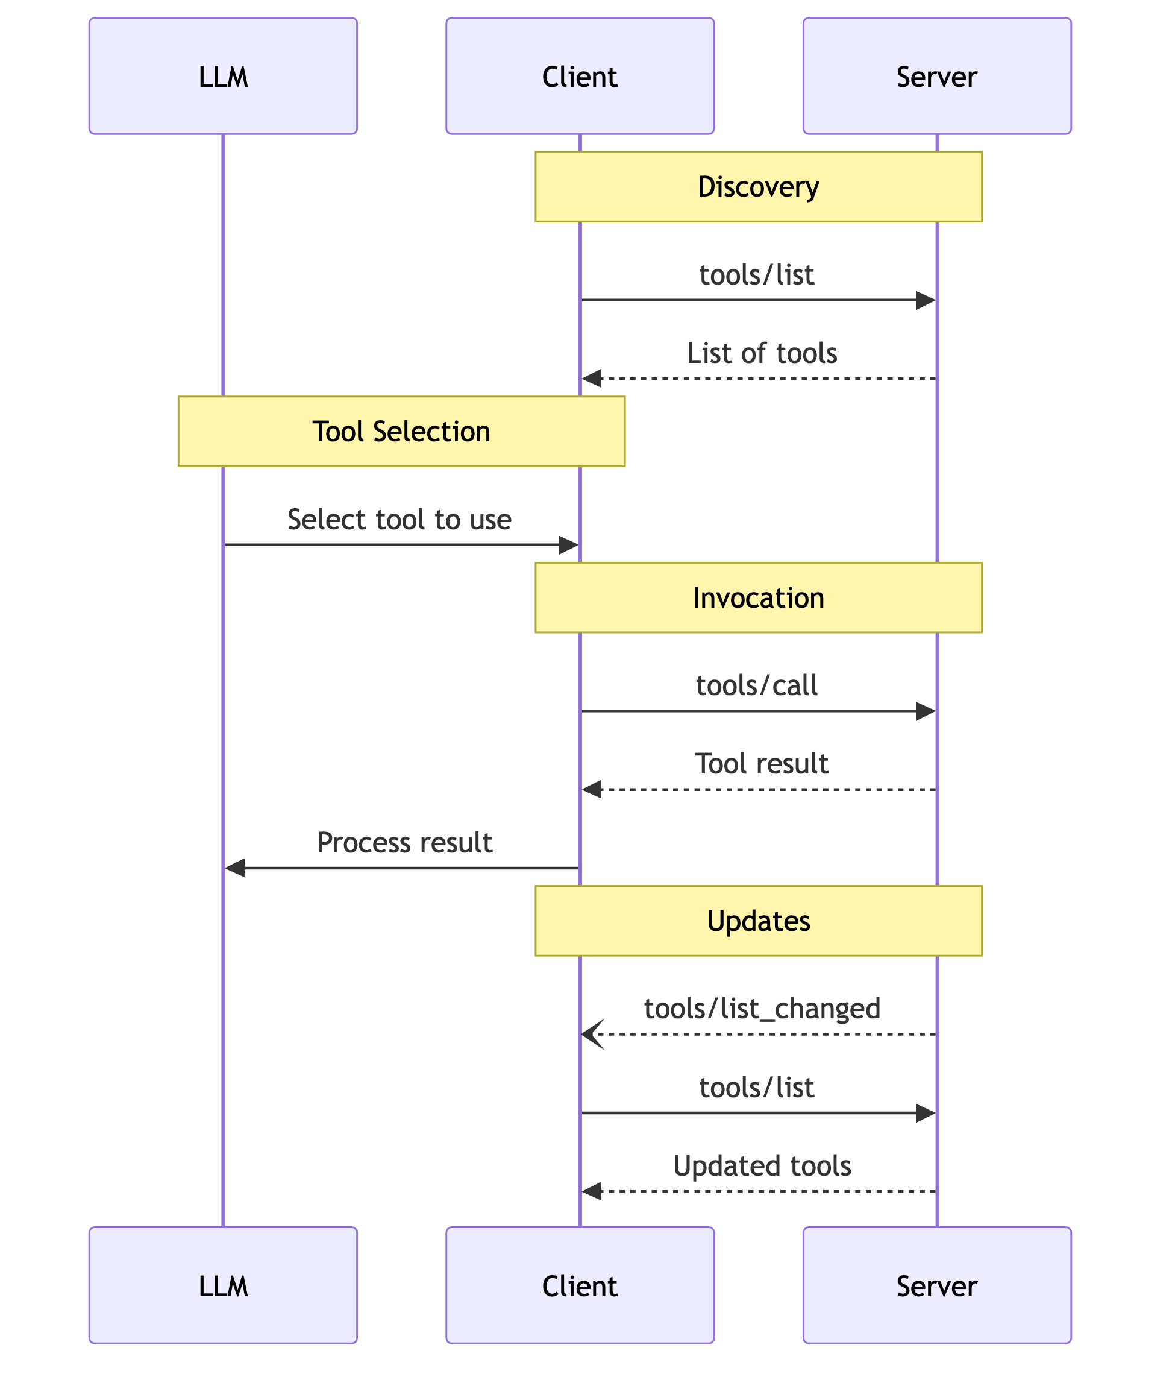
MCP Tool Message Flow
Day 3 · Module 5
Source: https://modelcontextprotocol.io/specification/2025-06-18/server/tools
Notes:
• This is the MCP specification's own sequence diagram for the tools message flow, reproduced verbatim (not redrawn) from the Tools page at modelcontextprotocol.io. The MAF MCP tool plays the "Client" role. Note this diagram starts at Discovery — the earlier connection-level handshake (capability negotiation) is defined separately on the spec's Lifecycle page and isn't shown here. • GROUNDING SOURCE: https://modelcontextprotocol.io/specification/2025-06-18/server/tools

Slide 6
Pick the transport that matches the server
Day 3 · Module 5
MAF type | Connection | Use when
MCPStdioTool | Local child process over stdin/stdout | You launch and trust a local server
MCPStreamableHTTPTool | Remote HTTP with streamable responses/SSE | A hosted endpoint exposes MCP over HTTP
MCPWebsocketTool | WebSocket | The server explicitly provides a WebSocket endpoint
Source: https://learn.microsoft.com/en-us/agent-framework/agents/tools/local-mcp-tools?tabs=python
Notes:
• These are the three documented Python classes. WebSocket support requires the mcp[ws] optional package. Transport choice follows the server; it is not an application preference you can swap unilaterally. • GROUNDING SOURCE: https://learn.microsoft.com/en-us/agent-framework/agents/tools/local-mcp-tools?tabs=python

Slide 7
Local stdio is a child-process boundary
Day 3 · Module 5
async with MCPStdioTool(
name="calculator",
command="uvx",
args=["mcp-server-calculator"],
) as mcp:
result = await agent.run(
"Calculate the total.",
tools=mcp,
)
Source: https://learn.microsoft.com/en-us/agent-framework/agents/tools/local-mcp-tools?tabs=python
Notes:
• Use only commands and packages you have reviewed and pinned. The official pattern uses an async context manager so the local process and connection are closed. • GROUNDING SOURCE: https://learn.microsoft.com/en-us/agent-framework/agents/tools/local-mcp-tools?tabs=python

Slide 8
Day 3 · Module 5 · Demo
DEMO
~5 min
Local stdio MCP tool call, end to end
Run the previous slide's exact code live: connect to a local mcp-server-calculator child process, watch the agent discover and invoke a tool through it, and close the connection — client/server loop end to end.
Runbook: demos/day3/module-5-demo-1-stdio-mcp.md
Source: https://learn.microsoft.com/en-us/agent-framework/agents/tools/local-mcp-tools?tabs=python
Notes:
• Placeholder marker slide — the runbook has full narration, setup, and fallback plan. Runs the previous slide's exact MCPStdioTool + mcp-server-calculator pattern live; no matching sample file exists in the repo's 02-agents/mcp folder, so this demo is grounded directly in the Learn doc's own documented code. • GROUNDING SOURCE: https://learn.microsoft.com/en-us/agent-framework/agents/tools/local-mcp-tools?tabs=python

Slide 9
Remote HTTP belongs behind explicit auth
Day 3 · Module 5
async with MCPStreamableHTTPTool(
name="docs",
url="https://learn.microsoft.com/api/mcp",
allowed_tools=["microsoft_docs_search"],
) as mcp:
result = await agent.run(
"Find the current guidance.",
tools=mcp,
)
Source: https://learn.microsoft.com/en-us/agent-framework/agents/tools/local-mcp-tools?tabs=python · +1 in notes
Notes:
• The documented FoundryChatClient sample uses MCPStreamableHTTPTool for a remote endpoint. Do not put tokens in slide code or source control; use a provider that acquires or refreshes credentials. • GROUNDING SOURCE: https://learn.microsoft.com/en-us/agent-framework/agents/tools/local-mcp-tools?tabs=python • GROUNDING SOURCE: https://learn.microsoft.com/en-us/python/api/agent-framework-core/agent_framework.mcpstreamablehttptool?view=agent-framework-python-latest

Slide 10
header_provider has two call shapes
Day 3 · Module 5
Tool-call request
Ambient request
Receives function_invocation_kwargs
Can derive request-scoped headers
Keep secrets outside model-visible arguments
Receives {}
Includes initialization, discovery, and pings
Provider must still acquire required connection auth
Source: https://learn.microsoft.com/en-us/agent-framework/agents/tools/local-mcp-tools?tabs=python
Notes:
• During a tool call, header_provider receives function_invocation_kwargs. Ambient requests such as initialization, discovery, and pings receive an empty dictionary. Therefore connection-time auth cannot depend only on a per-run value. • GROUNDING SOURCE: https://learn.microsoft.com/en-us/agent-framework/agents/tools/local-mcp-tools?tabs=python

Slide 11
Reduce the model's tool surface
Day 3 · Module 5
allowed_tools
Clear names
Expose an explicit MCP allow-list
Avoid collisions by selecting or wrapping distinct tool names
Progressive exposure — EXPERIMENTAL
Reset
Add tools for the next loop iteration only
Progressive tool changes re-arm on each new agent run
Source: https://learn.microsoft.com/en-us/python/api/agent-framework-core/agent_framework.mcpstreamablehttptool?view=agent-framework-python-latest · +1 in notes
Notes:
• allowed_tools is a documented MCP constructor option. Progressive exposure is a separate experimental Python function-loop feature, not an MCP transport feature. Use it only if you need staged discovery and accept its experimental status. • GROUNDING SOURCE: https://learn.microsoft.com/en-us/python/api/agent-framework-core/agent_framework.mcpstreamablehttptool?view=agent-framework-python-latest • GROUNDING SOURCE: https://learn.microsoft.com/en-us/agent-framework/agents/tools/controlling-tool-availability?tabs=python

Slide 12
approval_mode creates a human boundary
Day 3 · Module 5
Setting | Effect | Appropriate use
always_require | Every exposed MCP tool needs approval | Unknown or high-risk server
never_require | Calls proceed without approval | Trusted, low-risk read tools
Per-tool mapping | Different rules by tool name | Read automatically; review writes
Source: https://learn.microsoft.com/en-us/python/api/agent-framework-core/agent_framework.mcpstreamablehttptool?view=agent-framework-python-latest · +1 in notes
Notes:
• approval_mode can require approval for all tools, waive it for all tools, or apply a per-tool mapping on the MCP tool. A run that needs approval returns a user-input request; the application displays the name and arguments and resumes with the decision. • GROUNDING SOURCE: https://learn.microsoft.com/en-us/python/api/agent-framework-core/agent_framework.mcpstreamablehttptool?view=agent-framework-python-latest • GROUNDING SOURCE: https://learn.microsoft.com/en-us/agent-framework/agents/tools/tool-approval?tabs=python

Slide 13
Day 3 · Module 5 · Demo
DEMO
~5 min
approval_mode pauses a write tool for review
Set approval_mode="always_require" on the MCP tool and run a request that needs it: the run pauses with a user-input request naming the tool and arguments, and only resumes after an explicit approval decision — the same pause/resume mechanic the official function-tool sample demonstrates, wired onto an MCP tool.
Runbook: demos/day3/module-5-demo-2-approval-mode.md
Source: https://learn.microsoft.com/en-us/python/api/agent-framework-core/agent_framework.mcpstreamablehttptool?view=agent-framework-python-latest · +1 in notes
Notes:
• Placeholder marker slide — the runbook has full narration, setup, and fallback plan. Adapts the approval pause/resume mechanic from function_tool_with_approval.py onto an MCP tool's approval_mode constructor option; no MCP-specific approval sample exists in the repo yet, so the API reference is the primary grounding source for the MCP-side wiring. • GROUNDING SOURCE: https://learn.microsoft.com/en-us/python/api/agent-framework-core/agent_framework.mcpstreamablehttptool?view=agent-framework-python-latest • GROUNDING SOURCE: https://github.com/microsoft/agent-framework/blob/main/python/samples/02-agents/tools/function_tool_with_approval.py

Slide 14
Security is broader than authentication
Day 3 · Module 5
Trust
Least privilege
Review the server operator and package provenance
Narrow identity scopes and allowed_tools
Prompt injection
Audit
Treat tool metadata and results as untrusted
Log selected tool, arguments, approval, result status, and caller
Source: https://learn.microsoft.com/en-us/agent-framework/agents/tools/local-mcp-tools?tabs=python
Notes:
• Treat remote tool descriptions, annotations, and results as untrusted input. Review the operator, data sharing, retention, costs, and permissions. Prefer first-party hosted servers over proxies when available. • GROUNDING SOURCE: https://learn.microsoft.com/en-us/agent-framework/agents/tools/local-mcp-tools?tabs=python

Slide 15
Local or remote?
Day 3 · Module 5
Question | Prefer local stdio | Prefer remote HTTP
Who hosts it? | Your process or workstation | Trusted service provider
Updates | You pin and manage | Provider manages
Authentication | Local environment / server mechanism | Headers or service identity
Network | No remote endpoint required | Endpoint must be reachable
Operational burden | Higher | Lower
Source: https://learn.microsoft.com/en-us/agent-framework/agents/tools/local-mcp-tools?tabs=python
Notes:
• Choose remote when a trusted service hosts and updates the endpoint. Choose local when the server is local-only or the client cannot complete remote authentication. Local means you own package and process security. • GROUNDING SOURCE: https://learn.microsoft.com/en-us/agent-framework/agents/tools/local-mcp-tools?tabs=python

Slide 16
Takeaways
Day 3 · Module 5
✓
You let the server transport determine the MAF MCP class.
✓
You constrain discovery with an explicit allow-list.
✓
You design header_provider for both tool-call and ambient requests.
✓
You require approval for risky operations and inspect arguments.
✓
You use async context managers to clean up every connection.
Source: https://learn.microsoft.com/en-us/agent-framework/agents/tools/local-mcp-tools?tabs=python
Notes:
• Transition to the official Azure DevOps remote server. It is a strong example of remote-first hosting, Entra authentication, server-side filtering, and distinct read/write tools. • GROUNDING SOURCE: https://learn.microsoft.com/en-us/agent-framework/agents/tools/local-mcp-tools?tabs=python

