Slide 1





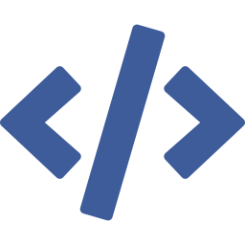

DAY 5 · AGENDA
What we'll cover today
Seven modules, from the signal path to your capstone charter.
MODULE 1
Observability in Generative AI
MODULE 2
Identity and Security
MODULE 3
Responsible AI Boundaries
MODULE 4
Cost, Latency, and Model Routing
MODULE 5
Production Evaluation
MODULE 6
Foundry Toolkit for VS Code
MODULE 7
Capstone Scoping Working Session
Building AI Apps & Agents · Microsoft Foundry · Day 5
Notes:
• Allow 2 minutes. Walk the seven modules in order so the room has the shape of the day before the first deep dive. Each module keeps its own accent colour on its label here and through its own deck, so attendees can tell at a glance which module a slide belongs to. The arc runs from the signal path (what the system emits and how you read it) through the boundaries that govern it, the economics of running it, how quality is measured, the developer surface, and finally the capstone scoping session where each team writes its own charter. Timings and demo details live in each module's own deck — keep this slide to the overview.

