Slide 1
DAY 4 · MODULE 2 · 40 MIN
Orchestration Patterns
Five built-in ways to coordinate multiple agents — and when each earns its cost
Source: https://learn.microsoft.com/en-us/agent-framework/workflows/orchestrations/
Building AI Apps and Agents
Notes:
• Five prebuilt workflow templates for common multi-agent coordination scenarios. Each removes the boilerplate of wiring agents together for one well-defined shape. • GROUNDING SOURCE: https://learn.microsoft.com/en-us/agent-framework/workflows/orchestrations/

Slide 2
Five patterns, five shapes
Day 4 · Module 2
Pattern | When to use it
Sequential | Agents execute one after another in a defined order — each builds on the previous agent's output
Concurrent | Agents execute in parallel — useful when tasks are independent and you want to reduce latency
Handoff | Agents transfer control to each other based on context — good for routing to specialists
Group Chat | Agents collaborate in a shared conversation — useful for debate, review, or brainstorming
Magentic | A manager agent dynamically coordinates specialized agents — balances structure with flexibility
Source: https://learn.microsoft.com/agent-framework/journey/workflows
Notes:
• This is the framework's own "when to use it" table from the journey page, reproduced verbatim. Use it as the day's map — the rest of this module walks each row in order. • GROUNDING SOURCE: https://learn.microsoft.com/agent-framework/journey/workflows

Slide 3
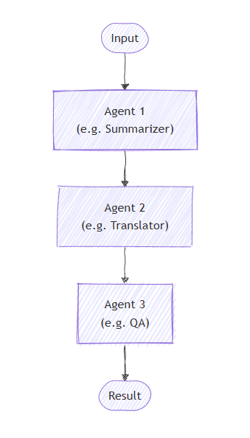
Sequential — a pipeline
Day 4 · Module 2
Agents run one after another; each builds on the previous agent's output
By default, each agent consumes the full prior conversation (input + every response so far)
chain_only_agent_responses=True narrows this to just the previous agent's response — useful for translation pipelines and progressive refinement
Order Matters: agents execute strictly in the order given — there is no built-in way to route back to an earlier agent
Source: https://learn.microsoft.com/en-us/agent-framework/workflows/orchestrations/sequential
Notes:
• Ideal for document review, data pipelines, multi-stage reasoning. By default each agent sees the full prior conversation; chain_only_agent_responses=True narrows that to just the previous agent's response — useful for translation pipelines and progressive refinement. Diagram reproduced verbatim from the official Sequential orchestration Learn page. • GROUNDING SOURCE: https://learn.microsoft.com/en-us/agent-framework/workflows/orchestrations/sequential

Slide 4
Sequential in code
Day 4 · Module 2
from agent_framework.orchestrations import SequentialBuilder
workflow = SequentialBuilder(
participants=[drafter, editor, finalizer]).build()
result = await workflow.run("Write a brief introduction to artificial intelligence.")
The terminal output is the last participant's response; pass intermediate_output_from=[...] to also surface earlier agents' output as observational events.
Source: https://learn.microsoft.com/en-us/agent-framework/workflows/orchestrations/sequential
Notes:
• SequentialBuilder is the simplest orchestration builder — a flat participants list. The terminal output is the last participant's AgentResponse; intermediate_output_from surfaces earlier participants' output too. • GROUNDING SOURCE: https://learn.microsoft.com/en-us/agent-framework/workflows/orchestrations/sequential

Slide 5
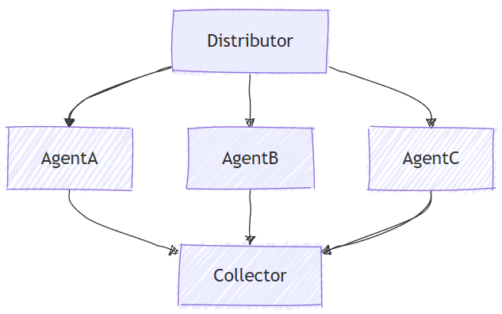
Concurrent — parallel perspectives
Day 4 · Module 2
Every agent processes the same input independently, at the same time
Well suited to diverse perspectives: brainstorming, ensemble reasoning, voting systems
The default aggregator returns one AgentResponse with one assistant message per participant — no synthesis, just collection
Override the aggregator when you need domain-specific synthesis of the parallel results
Source: https://learn.microsoft.com/en-us/agent-framework/workflows/orchestrations/concurrent
Notes:
• All agents run the same input independently and simultaneously — good for brainstorming, ensemble reasoning, voting. The superstep model (Module 3) is what actually runs them concurrently. Diagram reproduced verbatim from the official Concurrent orchestration Learn page. • GROUNDING SOURCE: https://learn.microsoft.com/en-us/agent-framework/workflows/orchestrations/concurrent

Slide 6
Concurrent in code
Day 4 · Module 2
from agent_framework.orchestrations import ConcurrentBuilder
workflow = ConcurrentBuilder(participants=[researcher, marketer, legal]).build()
outputs = (await workflow.run("Launch plan for a budget electric bike.")).get_outputs()
for msg in outputs[0].messages:
print(f"[{msg.author_name}]: {msg.text}")
Source: https://learn.microsoft.com/en-us/agent-framework/workflows/orchestrations/concurrent
Notes:
• ConcurrentBuilder is as flat as SequentialBuilder — same participants list, different edge topology (fan-out/fan-in) under the hood. • GROUNDING SOURCE: https://learn.microsoft.com/en-us/agent-framework/workflows/orchestrations/concurrent

Slide 7
Day 4 · Module 2 · Demo
DEMO
~5 min
ConcurrentBuilder proves it, wall-clock
The previous slide's code prints three agents' responses one after another, which LOOKS sequential on the page. This demo times it for real: a small AgentMiddleware timestamps each agent's start/finish under ConcurrentBuilder and draws an ASCII overlap timeline, then the SAME three agents run again with plain sequential await agent.run(...) calls. Concurrent's total wall-clock lands close to one agent's own time; sequential lands close to the sum of all three — that gap is the proof.
Runbook: demos/day4/module-2-demo-1-concurrent-parallelism.md
Source: https://github.com/microsoft/agent-framework/blob/main/python/samples/03-workflows/orchestrations/concurrent_agents.py
Notes:
• Placeholder marker slide — the runbook has full narration, setup, and fallback plan. Grounded in the official concurrent_agents.py sample (same researcher/marketer/legal agents and eBike prompt), adapted with a timing middleware and a sequential comparison to prove the overlap live instead of asserting it. • GROUNDING SOURCE: https://github.com/microsoft/agent-framework/blob/main/python/samples/03-workflows/orchestrations/concurrent_agents.py

Slide 8
Handoff — control transfers, not delegation
Day 4 · Module 2
Agents as tools (Module 1 recap)
Handoff
Agents as tools (Module 1 recap)
Outer agent keeps ownership; delegates a subtask
Control returns to the outer agent when the inner agent finishes
The receiving agent takes full ownership of the task
No central orchestrator — agents connect directly in a mesh topology
Good for customer support, expert systems, dynamic routing
Source: https://learn.microsoft.com/en-us/agent-framework/workflows/orchestrations/handoff
Notes:
• This is the framework's own contrast, worth dwelling on since Module 1 already covered agents-as-tools — attendees will otherwise conflate the two. Handoff has no central orchestrator; agents connect directly in a mesh so every agent shares context with every other. • GROUNDING SOURCE: https://learn.microsoft.com/en-us/agent-framework/workflows/orchestrations/handoff

Slide 9
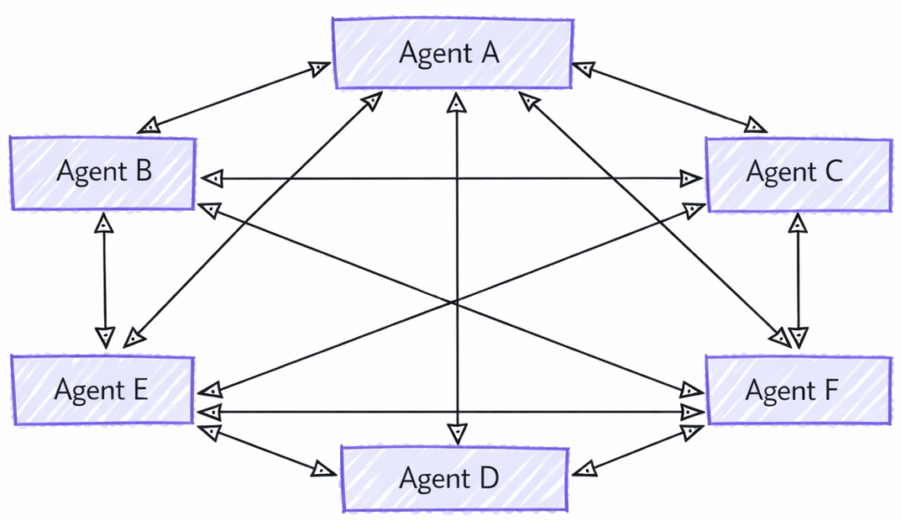
Handoff — a mesh, not a hierarchy
Day 4 · Module 2
Agents connect directly to each other — a mesh, not a star with a middle orchestrator
Any agent can hand the conversation fully to another agent it's configured to reach
Full conversation history travels with the handoff — the receiving agent has complete context
Interactive by default: control returns to the user whenever an agent responds without handing off
Source: https://learn.microsoft.com/en-us/agent-framework/workflows/orchestrations/handoff
Notes:
• A dedicated shape slide, separate from the previous compare slide's agents-as-tools contrast — Handoff's mesh topology (every agent connects to every other, no central orchestrator) is easiest to see as a picture rather than another bullet. Diagram reproduced verbatim from the official Handoff orchestration Learn page. • GROUNDING SOURCE: https://learn.microsoft.com/en-us/agent-framework/workflows/orchestrations/handoff

Slide 10
Handoff in code
Day 4 · Module 2
from agent_framework.orchestrations import HandoffBuilder
workflow = (
HandoffBuilder(
name="customer_support",
participants=[triage_agent, refund_agent, order_agent, return_agent],
)
.with_start_agent(triage_agent)
.add_handoff(triage_agent, [order_agent, return_agent])
.add_handoff(return_agent, [refund_agent])
.build()
)
Handoff is interactive by default — when an agent responds without handing off, control returns to the user for the next input.
Source: https://learn.microsoft.com/en-us/agent-framework/workflows/orchestrations/handoff
Notes:
• add_handoff restricts routing (by default every agent can hand off to every other); the mesh topology for context-sharing stays intact regardless — restricting handoff rules only governs who can take over next, not who sees the conversation. Interactive by default: when an agent responds without handing off, control returns to the user for the next input. • GROUNDING SOURCE: https://learn.microsoft.com/en-us/agent-framework/workflows/orchestrations/handoff

Slide 11
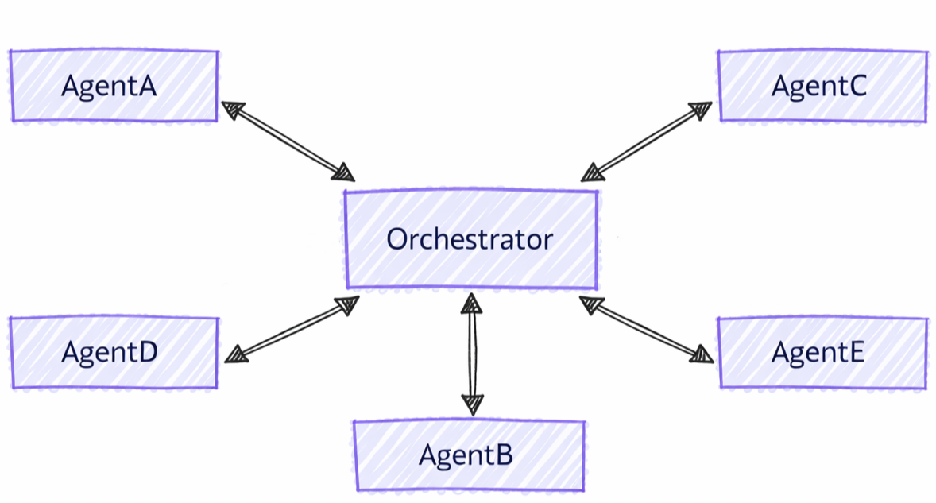
Group Chat — a coordinated conversation
Day 4 · Module 2
Star topology: an orchestrator in the middle selects who speaks next (round-robin, prompt-based, or custom logic)
Agents can review and build on each other's responses across multiple rounds
Context Synchronization: agents do NOT share one AgentSession instance — the orchestrator broadcasts each response so every agent's own session stays current before its next turn
Bounded by a maximum round/iteration count
Source: https://learn.microsoft.com/en-us/agent-framework/workflows/orchestrations/group-chat
Notes:
• Star topology with an orchestrator in the middle — the key contrast with Handoff's mesh, no-orchestrator design. Context Synchronization is worth stating precisely: agents do NOT share one AgentSession instance (different agent types may implement it differently); the orchestrator broadcasts each response so every agent's own session stays in sync before its next turn. Diagram reproduced verbatim from the official Group Chat orchestration Learn page. • GROUNDING SOURCE: https://learn.microsoft.com/en-us/agent-framework/workflows/orchestrations/group-chat

Slide 12
When to use Group Chat
Day 4 · Module 2
Good fit
Consider an alternative when
Iterative refinement across multiple rounds
Collaborative problem-solving, multi-perspective analysis
Writer-reviewer content creation
You need strict sequential processing → Sequential
Agents should work fully independently → Concurrent
You need direct agent-to-agent handoffs → Handoff
You need complex dynamic planning → Magentic
Source: https://learn.microsoft.com/en-us/agent-framework/workflows/orchestrations/group-chat
Notes:
• This "consider alternatives" list is the framework's own — reproduced verbatim rather than paraphrased, since it's a direct decision aid. • GROUNDING SOURCE: https://learn.microsoft.com/en-us/agent-framework/workflows/orchestrations/group-chat

Slide 13
Magentic — a planning manager
Day 4 · Module 2
Same star-topology architecture as Group Chat, with a more powerful, planning-based manager
Based on AutoGen's Magentic-One design; well suited to open-ended tasks where the solution path isn't known in advance
Framework's own caveat: *"it is untested how well the Magentic orchestration will perform outside of the original Magentic-One design"*
If your scenario doesn't need complex planning, the docs themselves recommend Group Chat instead
Source: https://learn.microsoft.com/en-us/agent-framework/workflows/orchestrations/magentic
Notes:
• Same star-topology architecture as Group Chat, but the manager plans and tracks progress rather than just picking a speaker. Based on AutoGen's Magentic-One design. The docs' own caveat about untested generalization is worth stating plainly, not softening. • GROUNDING SOURCE: https://learn.microsoft.com/en-us/agent-framework/workflows/orchestrations/magentic

Slide 14
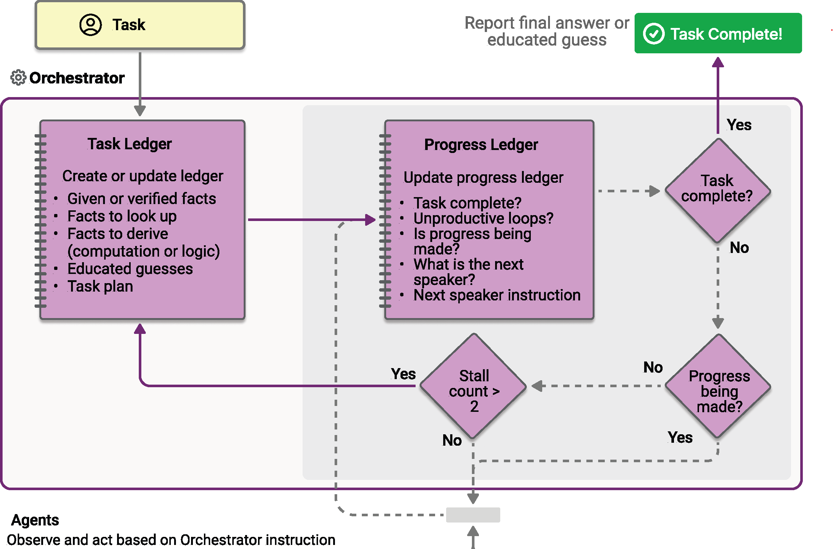
Magentic — task and progress ledgers
Day 4 · Module 2
Source: https://learn.microsoft.com/en-us/agent-framework/workflows/orchestrations/magentic
Notes:
• Full-width, not paired with bullets — this diagram (task ledger, progress ledger, stall-count decision, replan loop) has far more detail and smaller text than the other four patterns' diagrams, and would be illegible if squeezed into the same narrow list-image column. Reproduced verbatim from the official Magentic orchestration Learn page; note its visual style (flat decision-diamond flowchart) differs from the other four patterns' hand-drawn diagrams — it comes from the Magentic-One design, not the same source illustration set. • GROUNDING SOURCE: https://learn.microsoft.com/en-us/agent-framework/workflows/orchestrations/magentic

Slide 15
Magentic's built-in guardrails
Day 4 · Module 2
from agent_framework.orchestrations import MagenticBuilder
workflow = MagenticBuilder(
participants=[researcher_agent, coder_agent],
manager_agent=manager_agent,
max_round_count=10,
max_stall_count=3,
max_reset_count=2,
).build()
A progress ledger tracks whether the team is making progress; consecutive non-progressing rounds increment a stall counter, and exceeding max_stall_count triggers an automatic reset and replan (up to max_reset_count times) — a concrete, built-in instance of the guardrail pattern Module 6 covers generically.
Source: https://learn.microsoft.com/en-us/agent-framework/workflows/orchestrations/magentic
Notes:
• This is a genuinely useful bridge into Module 6 — Magentic ships with its own bounded-loop parameters and a stall-detection/replan mechanism, the most concrete built-in example of the guardrails Module 6 discusses generically. • GROUNDING SOURCE: https://learn.microsoft.com/en-us/agent-framework/workflows/orchestrations/magentic

Slide 16
Strengths, weaknesses, and cost profile
Day 4 · Module 2
Pattern | Predictability | Typical cost driver
Sequential | High — fixed order every run | Sum of every agent's tokens; grows if full context is chained
Concurrent | High — all agents always run | Sum of every agent's tokens, but latency is the slowest agent, not the sum
Handoff | Low — path depends on the conversation | Scales with how many handoffs actually occur; hard to predict up front
Group Chat | Medium — bounded by max rounds | Grows with round count; every round re-broadcasts full context to every agent
Magentic | Lowest — planning can replan | Highest and least predictable; planning/replanning adds overhead beyond the specialist agents
Source: https://learn.microsoft.com/en-us/agent-framework/workflows/orchestrations/ · +1 in notes
Notes:
• This table synthesizes the mechanics from every pattern page above plus the superstep execution model (Module 3) — it is this workshop's own engineering judgment, not a verbatim framework table. Flag that explicitly if asked: cost/latency direction is reasoned from documented behavior (parallel supersteps, full-context broadcasts, bounded rounds), not a quoted benchmark. • GROUNDING SOURCE: https://learn.microsoft.com/en-us/agent-framework/workflows/orchestrations/ • GROUNDING SOURCE: https://learn.microsoft.com/en-us/agent-framework/concepts/workflows/builder-and-execution

Slide 17
Takeaways
Day 4 · Module 2
✓
You pick a pattern by asking who controls the next step and whether the path is fixed or dynamic.
✓
Sequential and Concurrent are predictable and cheap to reason about; Handoff, Group Chat, and Magentic trade predictability for flexibility.
✓
Sequential cannot loop back to an earlier agent — that gap is exactly what Module 3's custom workflow graphs are for.
✓
Magentic's max_round_count/max_stall_count/max_reset_count are a real, shipped example of the guardrails Module 6 covers next.
Source: https://learn.microsoft.com/en-us/agent-framework/workflows/orchestrations/
Notes:
• Ask attendees which pattern the lab's Planner/Retriever/Critic revision loop maps to. The honest answer, per Module 3: none of them directly — Sequential can't loop back, so the lab builds a custom graph. That's the bridge into Module 3. • GROUNDING SOURCE: https://learn.microsoft.com/en-us/agent-framework/workflows/orchestrations/

