Slide 1
DAY 1 · MODULE 2 · 45 MIN
Foundry Portal Tour
Projects, models, deployments, connections, Toolbox, Foundry IQ
Building AI Apps and Agents
Notes:
• Mostly a live walkthrough — share screen early • Slides are attendee reference, not primary teaching • Have the Foundry portal open before this module starts • Have at least one existing project + model deployment ready to show • Time budget: 45 min — 25 in portal, 20 on slides for reference

Slide 2
What you'll leave with
Day 1 · Module 2
Navigate a Foundry project confidently
Find and deploy a model
Test a model in the playground
Locate your project endpoint (you'll paste this into your .env in the lab)
Recognize Toolbox and Foundry IQ (deep-dive comes Days 2–3)
Notes:
• Goal: recognize the surfaces, not master any of them • Attendees just need to feel oriented enough for Modules 4–6 • Deep material lands Days 2–3 (IQ, Toolbox) and Module 6 today (agent types) • Attendees should walk out with: their project endpoint + one deployment name

Slide 3
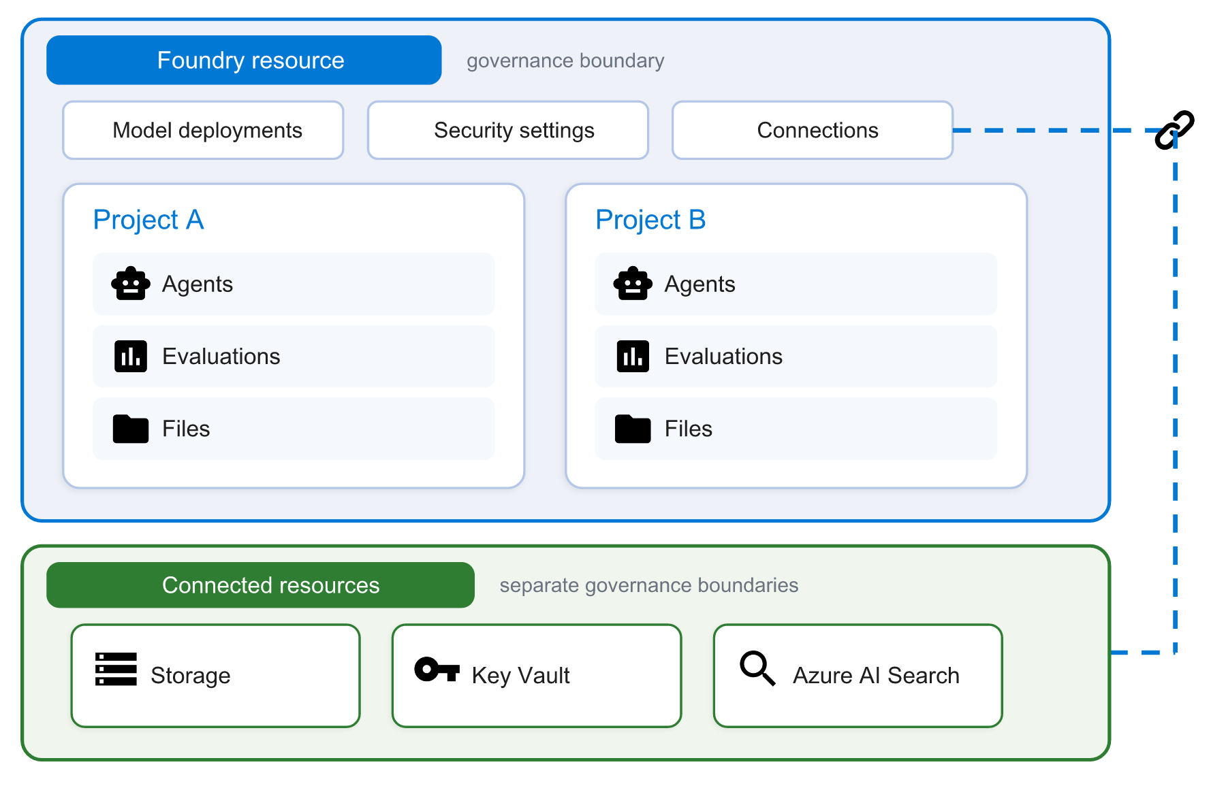
Foundry resource architecture
Day 1 · Module 2
Diagram: Microsoft Learn · aka.ms/foundry/architecture
Four layers to know: Foundry resource → project → project assets → connected resources. Connected resources have their own networking and access policies.
Notes:
• Canonical diagram from Microsoft Learn — walk it in this order: • (1) Foundry resource = the outer box = governance boundary • → contains: model deployments, security & networking, connections • (2) Project = the inner dashed box = development boundary • → contains: agents, files, evaluations (project assets) • (3) Connected resources on the right (Storage, Key Vault, AI Search) • → separate Azure resources, separate governance boundaries • → Foundry references them via connections, doesn't own them • Emphasize: 'connected resources have their own networking and access policies' • Common failure: Foundry connection works, but the target resource's firewall blocks — check the target resource's own policies

Slide 4
Day 1 · Module 2 · Demo
DEMO
~5 min
Create a Foundry project, live
Portal path from + New project → App Insights checkbox → gpt-5.6-luna deployment → project endpoint visible. Then a 90-second look at the az CLI equivalent for the IaC-first path. Attendees who haven't done pre-work realize this is a 5-minute click-through, not a day of Azure ceremony.
Runbook: demos/day1/module-2-demo-1-create-project.md
Notes:
• DEMO 2.1 · ~5 min • Do NOT use the project the labs will use — create a separate demo project • Portal: ai.azure.com → + New project → name it → SELECT App Insights checkbox • Call the checkbox out explicitly — this is what the pre-work doc mentions • Then Deployments → + Deploy model → gpt-5.6-luna → deployment name gpt-5.6-luna • Then a 90s aside showing the az CLI equivalent (do NOT run live) • Portal walkthrough: Overview endpoint URL, Deployments, Connected resources, Agents (empty) • Fallback: pre-created backup project + screenshots • Payoff line: 'Five minutes, one project, App Insights connected. That's Part A's pre-work.' • POST-WORKSHOP: az cognitiveservices account delete + az group delete for the demo project (cost)

Slide 5
What lives where · starter RBAC
Day 1 · Module 2
Foundry resource level
Project level
Model deployments
Security & networking
Connections to connected resources
Resource-scoped RBAC roles (Foundry User, Foundry Owner)
Agents (Prompt agents, Hosted agents)
Files
Evaluations
Project-scoped RBAC assignments
Starter RBAC: assign every developer Foundry User at the Foundry resource scope. That covers Day 1 lab access. Fine-grained project-scoped roles come later.
Notes:
• Starter RBAC for the lab: Foundry User at the Foundry resource scope • Foundry User was previously named Azure AI User — attendees may see either during rollout • RBAC scopes at BOTH resource level and project level • Day 1 lab access is covered by the resource-scope assignment • 401 / 403 in the lab almost always = missing Foundry User at resource scope • If instructor hears '401' in chat: 'check RBAC first, then endpoint, then deployment name'

Slide 6
Project endpoints
Day 1 · Module 2
Every Foundry project has an endpoint like:
https://<foundry-resource>.services.ai.azure.com/api/projects/<your-project>
Set this as FOUNDRY_PROJECT_ENDPOINT in every lab's .env. MAF connects with this endpoint plus a credential — AzureCliCredential in dev, managed identity in production.
Notes:
• Show attendees where the project endpoint lives in the portal • Path (verify live — portal wording moves): Overview → Endpoints and keys • Have them copy it now — they'll need it in every lab • Format: https://<foundry-resource>.services.ai.azure.com/api/projects/<your-project> • Never commit this to source control — it belongs in .env • The credential (AzureCliCredential) authenticates against this endpoint

Slide 7
Model catalog
Day 1 · Module 2
Browse frontier models (OpenAI, Meta, Mistral, others by region)
Filter by capability — chat, embeddings, vision, etc.
See region availability, pricing tier, context window
Not every model is available in every region — check region and quota first
Notes:
• Common gotcha: attendee picks a model, hits a region availability wall • Not every model is available in every region • Not every model has capacity in every region even when available • Sequence: pick region → confirm model availability → confirm quota → deploy • If attendee can't deploy: check region and quota first, not model choice • Ignite 2026 will likely shift which models are where — check current state before workshop

Slide 8
Model deployments
Day 1 · Module 2
A deployment is a named, callable instance of a specific model
Each deployment has:
Deployment name — what you pass to MAF as model=…
Model version
Capacity — tokens per minute
Region — inherited from the project
Rule of thumb: one deployment per (model, role) pair. Don't share prod and dev.
Notes:
• The #1 confusion in the Day 1 lab: deployment name ≠ model name • Model name: 'gpt-5.6-luna' • Deployment name: whatever *you* named the deployment in the portal • In MAF, you pass the DEPLOYMENT name as model= — not the model name • In the .env file, FOUNDRY_MODEL = the deployment name • Have attendees copy the exact deployment name from Portal → Deployments now • Rule of thumb: one deployment per (model, role) pair — don't share prod and dev

Slide 9
Playgrounds
Day 1 · Module 2
Chat playground — test a deployed model interactively
Agent playground — test a Prompt agent or Hosted agent you've created in Foundry
Prompt flow / evaluation playgrounds — for testing eval configurations
Use playgrounds to sanity-check before writing agent code
If it doesn't work in the playground, it won't work in MAF either
Notes:
• This slide is really a debugging tip • Reinforce: iterate in the playground BEFORE writing agent code • If a prompt doesn't work in the playground, it won't work in MAF • Cheap iteration loop: playground → prompt fix → playground → deploy • Attendees who skip this waste a lot of time debugging things that were prompt issues • Three playgrounds worth knowing: chat, agent, evaluation

Slide 10
Connections
Day 1 · Module 2
How a Foundry resource references other Azure services — AI Search, Storage, Key Vault, Fabric, and more
Each connected resource is a separate Azure resource with its own networking and access policies
Configured on the Foundry resource; projects inherit them
Auth via managed identity or service principal — never long-lived keys in production
We wire connections for Foundry IQ knowledge sources on Day 2
Notes:
• Reinforce the architecture diagram: connections = Foundry pointing at connected resources • Connected resources have their OWN governance boundaries • When a connection fails, check the target resource's policies first • Auth: managed identity or service principal — NO long-lived keys in production • Configured on the Foundry resource; projects inherit them • We'll wire IQ knowledge-source connections on Day 2

Slide 11
Toolbox and Foundry IQ
Introductions only — Days 2–3 go deep
Notes:
Transition to portal areas we introduce today and revisit later.

Slide 12
Foundry Toolbox (intro)
Day 1 · Module 2
Curated catalog of ready-to-use tools an agent can attach to
Includes: code interpreter, file search, Bing search, SharePoint, Fabric, Graph, custom skills
Exposed to MAF over an MCP endpoint (same protocol as Day 3)
Attach Toolbox tools to a Foundry-hosted agent from the portal, or from code
Notes:
• Bookmark: Toolbox = curated tool/connector catalog for agents • We use it lightly today (Part B of the lab) and go deep Day 2 • Interesting fact for later: Toolbox is exposed via an MCP endpoint under the hood • That ties Toolbox and Day 3's MCP topic together neatly • Toolbox samples: web search, code interpreter, file search, SharePoint, Fabric, Graph

Slide 13
Foundry IQ (intro)
Day 1 · Module 2
The knowledge / grounding layer of Foundry
Unified retrieval across enterprise sources — AI Search indexes, SharePoint, OneLake / Fabric, and more
Alternative to hand-rolling a RAG pipeline per source
Agents that use it get grounded answers with citations, without you writing retrieval code
Notes:
• Bookmark: Foundry IQ = enterprise knowledge and grounding layer • Day 2 is IQ's main course — don't teach it here • The pitch: unified retrieval across your enterprise data • Alternative to building a RAG pipeline per source • Grounded answers with citations, without writing retrieval code • Preview status — call out that some parts are moving fast

Slide 14
Observability
Day 1 · Module 2
Every agent run in Foundry emits a trace — no code to enable, built-in for Prompt and Hosted agents
A trace records: model calls, tool invocations, decisions, latency, tokens, and errors
View traces in the Foundry portal (Tracing / Observability), or ship them to Application Insights
OpenTelemetry semantics under the hood — same spans you'd expect from any OTel-instrumented service
You'll open a real trace in Part B of today's lab; Day 5 goes deep on production observability
Tracing for Prompt and Hosted agents is GA. Workflow and external-agent tracing is preview — relevant Day 4+.
Notes:
• GROUNDING FIX 2026-08-19: Prompt/Hosted tracing is GA, not preview • Only Workflow + external-agent tracing is preview — comes in Day 4+ • Awareness slide — Day 5 goes deep • Point out: attendees don't have to configure anything for Prompt or Hosted agents; tracing is on by default • BUT: they must have Application Insights connected to the project first (see pre-work checklist) • For Path C (your own code), you enable OTel yourself — Day 5 covers this • A trace makes the abstract concrete: attendees literally SEE their model + tool calls • Best debugging tool most attendees haven't tried yet

Slide 15
Two axes to remember
Day 1 · Module 2
Axis | Feature | What it does
Actions — how the agent does things | Toolbox, MCP, function tools | Callable capabilities
Knowledge — how the agent knows things | Foundry IQ, RAG | Retrieval and grounding
Notes:
• The two-axis mental model attendees should carry all week • Actions = how the agent DOES things — Toolbox, MCP, function tools • Knowledge = how the agent KNOWS things — Foundry IQ, RAG • Day 2 = Knowledge deep dive • Day 3 = Actions deep dive (MCP) • When something breaks, ask: is this an Actions problem or a Knowledge problem?

Slide 16
Portal for learning · CLI for production
Day 1 · Module 2
The portal is a great teacher and a great debugger. For creating resources and shipping changes, real teams use code.
Use the portal for
Use az / azd / SDK for
Exploring what Foundry can do
Sanity-checking a prompt in the playground
Inspecting a trace when something goes wrong
Monitoring dashboards and metrics
Creating projects, deployments, agents
Wiring connections to Storage / Key Vault / AI Search
Deploying Hosted agents (zip + Foundry portal is a shortcut; azd / az is the norm)
Anything that needs a repeatable, reviewable change
IaC-first operating norm: resource creation and programmatic operations live in code. Every lab this week reflects that.
Notes:
• Codifies the IaC-first operating norm — attendees should nod along • Portal is fine for: exploring, playground, tracing, monitoring • Code is the norm for: creating anything, deploying anything, changing anything • az CLI = the general Azure command line • azd = Azure Developer CLI, higher-level (deploy an app end-to-end) • SDK = for programmatic operations from your code (creating agents, indexes, etc.) • Terraform is a common default for IaC-first teams — out of scope for this workshop's content • In today's lab: Part A creates the Prompt agent with the SDK, not the portal • Day 5 deployment: az / azd paths lead, not portal deploy

Slide 17
Common portal gotchas
Day 1 · Module 2
Quota errors on deployment — request a bump in the region before Day 1
Missing role assignments — you need at least Foundry User (previously Azure AI User) at the Foundry resource scope; 401/403 usually means this
Region mismatch — model deployment region must be reachable by IQ / AI Search
Preview features move — Toolbox and parts of IQ are evolving; trust running code over screenshots
Notes:
• Give attendees the diagnostic sequence in a fixed order: • 1. Quota — is your region out of capacity? • 2. RBAC — do you have Foundry User at the resource scope? • 3. Region — does the model live in your region? • This ordering catches ~90% of Day 1 lab failures • Preview features move — trust running code over screenshots

Slide 18
Live walkthrough (in the portal now)
Day 1 · Module 2
Sign into ai.azure.com and open a project
Deploy a model
Copy the project endpoint
Open the chat playground; send a test prompt
Show the Toolbox catalog and one entry
Show the Foundry IQ landing page and one pre-provisioned knowledge source
Try it yourself: do steps 1–4 on your own sub before the module ends.
Notes:
• Screen share the portal — this is a live demo, not a slide read • Move steadily, don't linger • Ask attendees to do steps 1–4 alongside you • Ask them to raise a hand (or emoji in chat) if they hit a block • Fix blocks in real time — do NOT let them accumulate to the lab • Steps 5–6 (Toolbox, IQ) are demo-only for today

Slide 19
Takeaways
Day 1 · Module 2
Everything in Foundry lives inside a project.
Copy your project endpoint and one model deployment name — you'll need both in every lab.
Toolbox and Foundry IQ are today's introductions; Days 2–3 make them real.
If portal pages don't work: quota → RBAC → region, in that order.
Next: Prompt engineering fundamentals — how to talk to models before we wrap them in agents.
Notes:
Short recap. Confirm everyone has their project endpoint copied.

