Slide 1

Jan 28: Colab+Pytorch Tutorial
Junhan Wu

Slide 2
Agenda
Intro to Jupyter Notebook and Colab
Colab: https://colab.research.google.com
Jupyter Notebook
Basics:
Add, run, delete cells
Restart kernel
Magic commands to install packages
Helpful Tips/Tricks

Slide 3
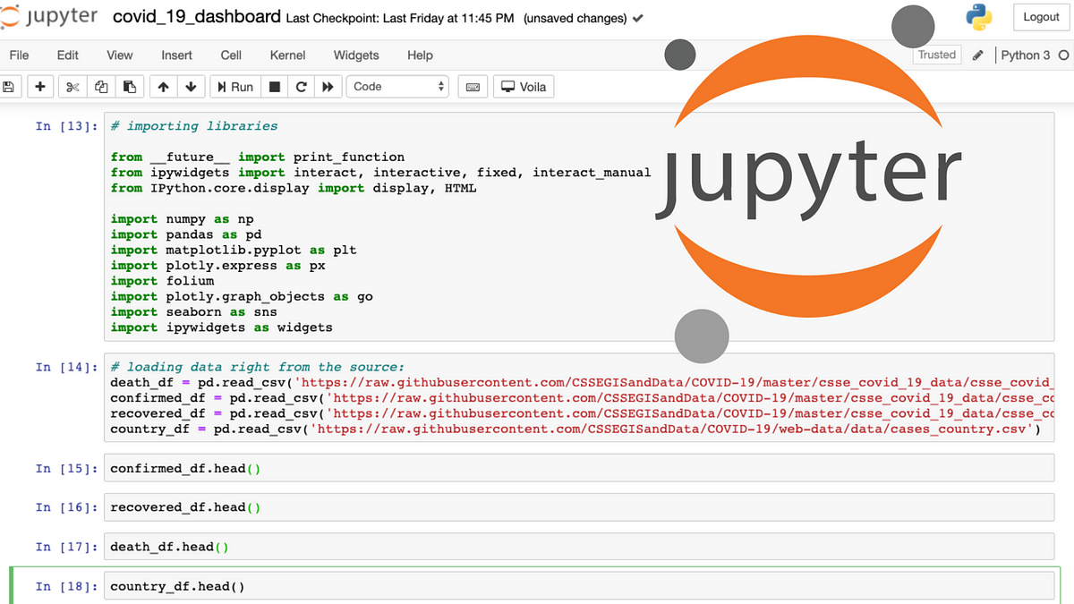
What is Jupyter Notebook?
Web-based application for interactive computing
Visualization and text throughout your code
Create & Share
Notes:
• Jupyter Notebook is an open-source web-based application for interactive computing.
• It allows users to create and share documents that contain live code, equations, visualizations, and narrative text.
• Supports over 40 programming languages, including Python.
• Ideal for data cleaning, transformation, numerical simulation, statistical modeling, and machine learning.

Slide 4
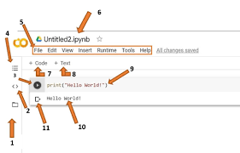
What is Google Colab?
Cloud-based platform from Google that allows you to run Jupyter Notebooks without installing anything locally.
“Free” access to GPUs and TPUs
Access drive files easily
Notes:
• Jupyter Notebook is an open-source web-based application for interactive computing.
• It allows users to create and share documents that contain live code, equations, visualizations, and narrative text.
• Supports over 40 programming languages, including Python.
• Ideal for data cleaning, transformation, numerical simulation, statistical modeling, and machine learning.

Slide 5
Why not Colab?
Session terminates every once and a while
Dependency management (e.g. difficult to use `conda` environments)
Limited resources/access
Waste of money (if you have access to computing hardware already)

Slide 6
Setting up Colab (subscribe)
Go to https://colab.research.google.com
Log in and create account if haven’t
Notes:
• Jupyter Notebook is an open-source web-based application for interactive computing.
• It allows users to create and share documents that contain live code, equations, visualizations, and narrative text.
• Supports over 40 programming languages, including Python.
• Ideal for data cleaning, transformation, numerical simulation, statistical modeling, and machine learning.

Slide 7
Jupyter Notebook Basics

Slide 8
Jupyter Notebook: Adding & Running a cell
Add: ESC + a/b
Run: Shift+Enter

Slide 9
Jupyter Notebook: Deleting a cell
ESC + m d

Slide 10
Jupyter Notebook: Restarting the kernel
In case you messed up your environment
Click “Disconnect and delete runtime”
You will get a clean new environment

Slide 11
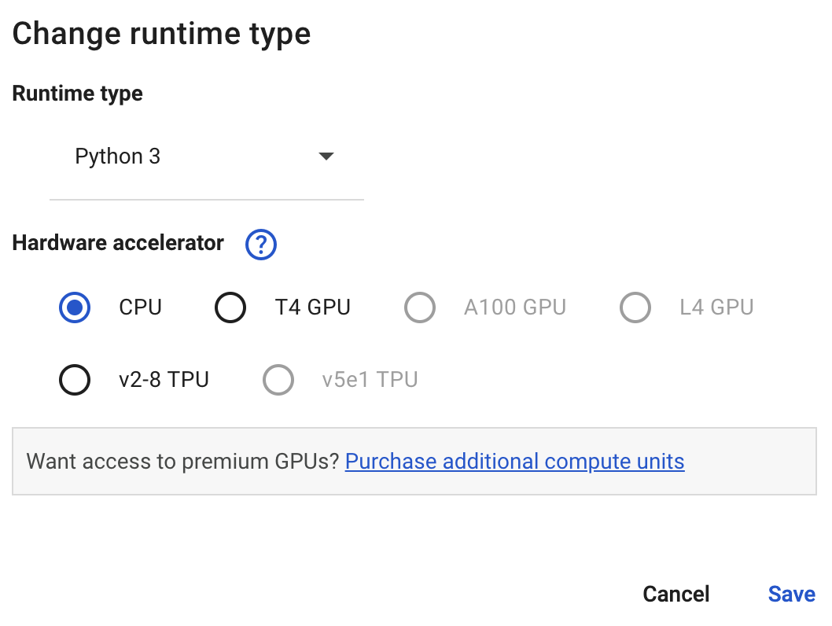
Jupyter Notebook: Changing the Runtime Type
Free users have limited access to computing resources
Select the hardware you want to use, and click save

Slide 12
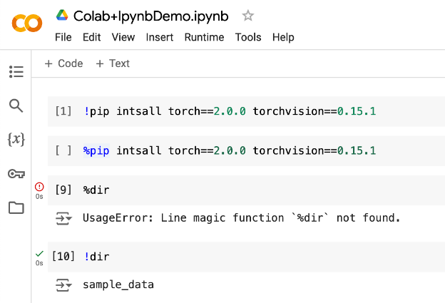
Jupyter Notebook: Magic commands
`!` v.s. `%`
`!`: shell-command
`%`: magic command: package is installed in the python env used by Jupyter kernel
You might have different python environment
/usr/bin/python (system python)
/usr/local/bin/python (user installed python)
Jupyter Notebook (an independent Python environment)
Not a big issue - Colab only has one python environment

Slide 13
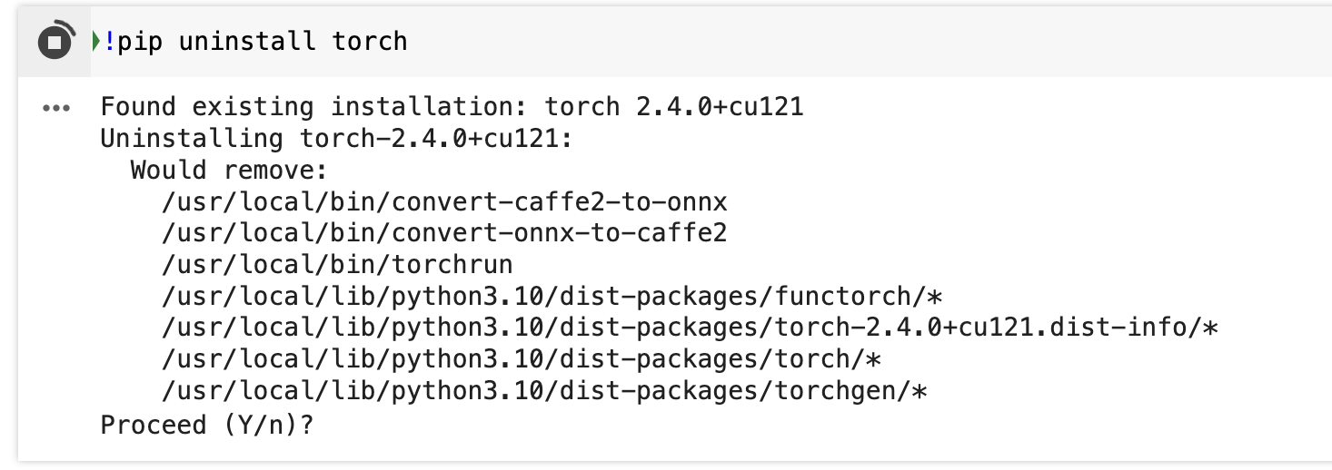
Jupyter Notebook: Using flags/options

Slide 14
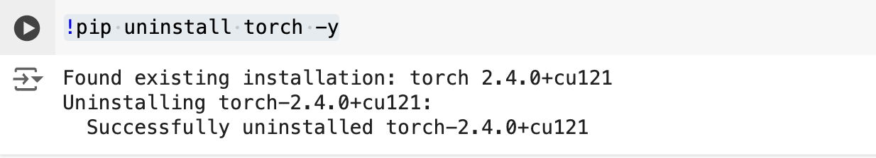
Jupyter Notebook: Using flags/options

Slide 15
Helpful tips/tricks
Scratch code cell - temporary code cell for quick experiments

Slide 16
Helpful tips/tricks
Scratch code cell - temporary code cell for quick experiments
Adding markdown to structure & explain your code

Slide 17
Helpful tips/tricks
Scratch code cell
Adding markdown to structure & explain your code
Viewing variables

Slide 18
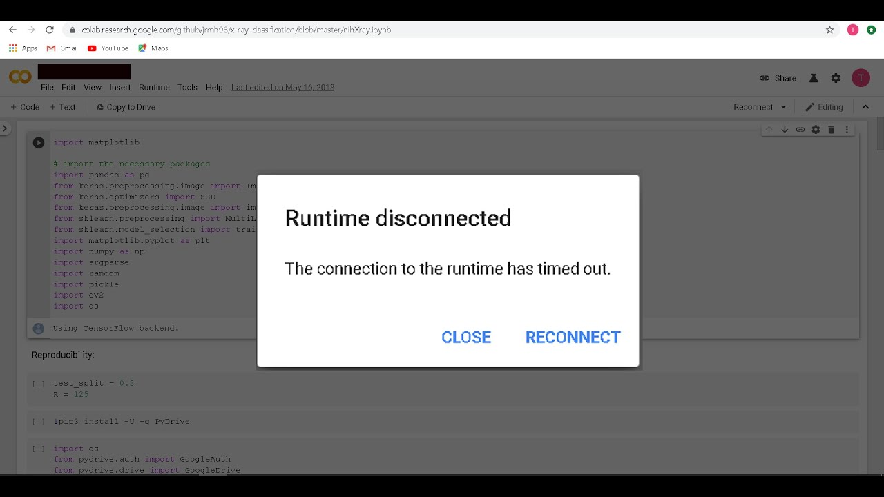
Helpful tips/tricks
Scratch code cell
Adding markdown to structure & explain your code
Viewing variables
Prevent interruption:

Slide 19
Helpful tips/tricks
Scratch code cell
Adding markdown to structure & explain your code
Viewing variables
Prevent interruption:
```
function ConnectButton(){
console.log("Connect pushed");
document.querySelector("#top-toolbar > colab-connect-button").shadowRoot.querySelector("#connect").click()
}
setInterval(ConnectButton,60000);
```

Slide 20
End

