Slide 1
Global convergence in genomic adaptation to climate across plants RepAdapt

Slide 2
The current state of convergence
INTRINSIC
e.g. Genome organisation, genotype-phenotype map, SGV organisation
Mutation is random but occurs nonrandomly in the genome
Demographic history of populations and effects on SGV
Genotype-Fitness map & Pleiotropy
Metapopulation organisation
EXTRINSIC
eg. Environmental selection,
Environmental covariance, temporal selection (seasonality, change through time)
STOCHASTIC
e.g. Random happenstance,
Population size variance, time, de novo mutation
Demographic perturbations
Consistency of selection through time

Slide 3
General Questions
How repeatable/constrained is the genetic response to climate adaptation across diverse plant species?
How does convergence vary among facets of climate?
What are the relative forces (intrinsic/extrinsic/stochastic) mediating repeatability?

Slide 4
The intersection of climate and convergence
High rates of convergent evolution ~ Limited genetic responses to selection
Adaptation limited by limited genotype > phenotype mapping?
Adaptation limited by simple fitness landscape?
Limited genetic responses ~ Decreased adaptive responses to climate change?
How are extinction risk, rapid environmental change, and convergent evolution associated?
Is ‘resilience’ inverse to convergent evolution at the genetic level?

Slide 5
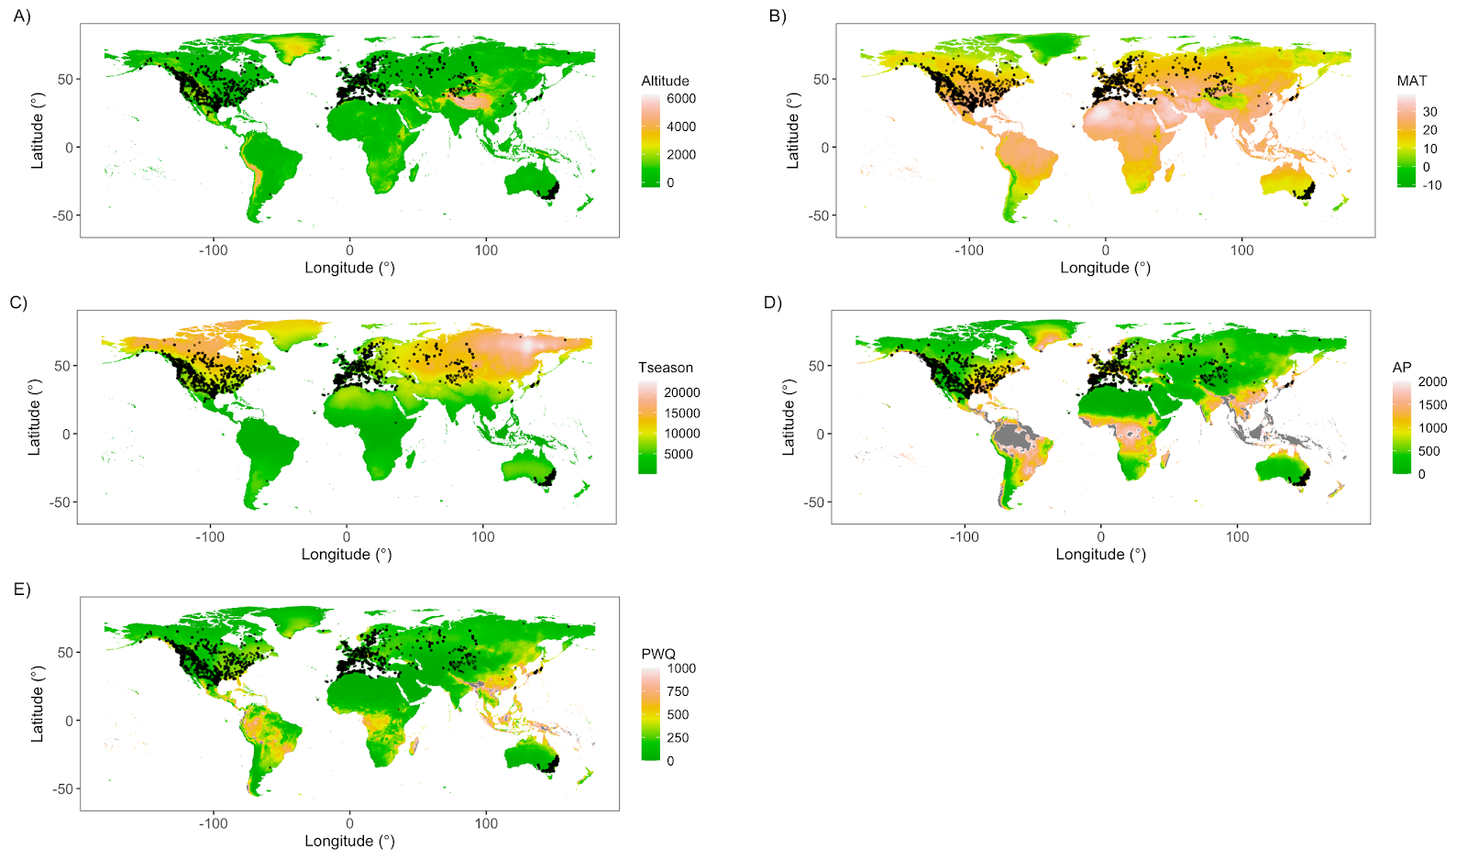

Slide 6
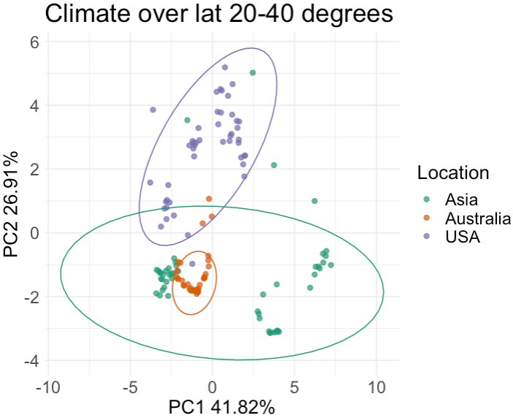
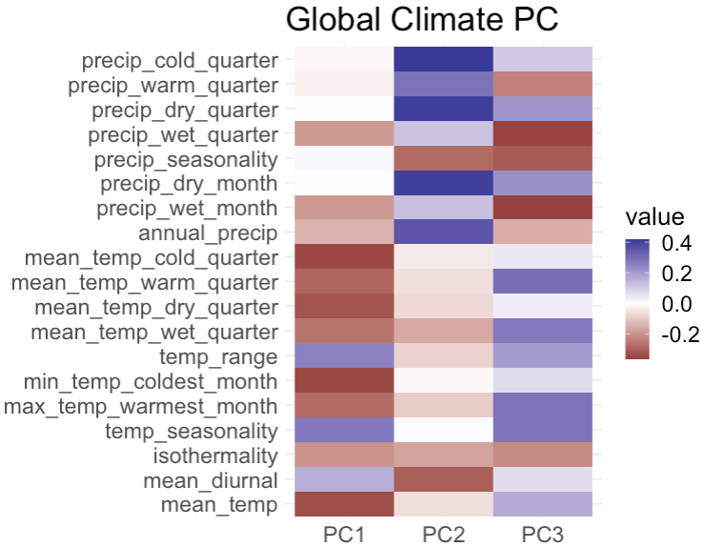

Slide 7
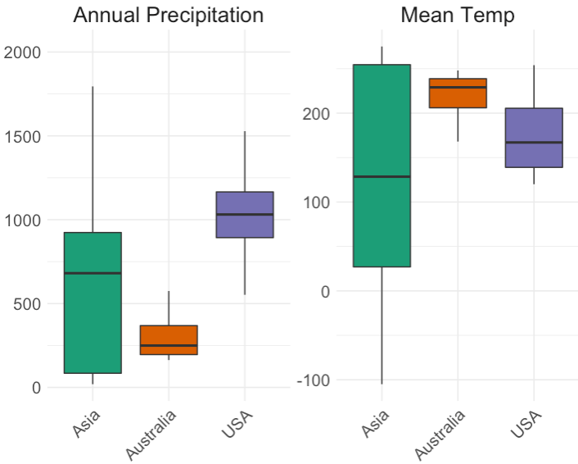

Slide 8
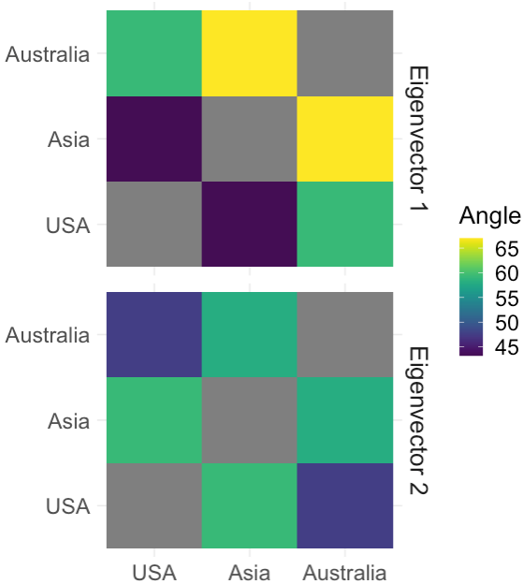
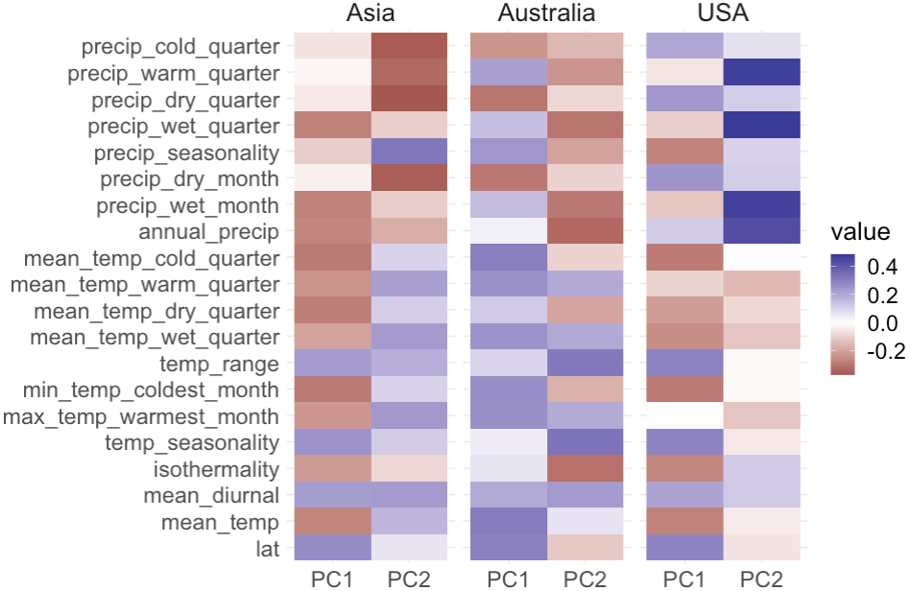

Slide 9
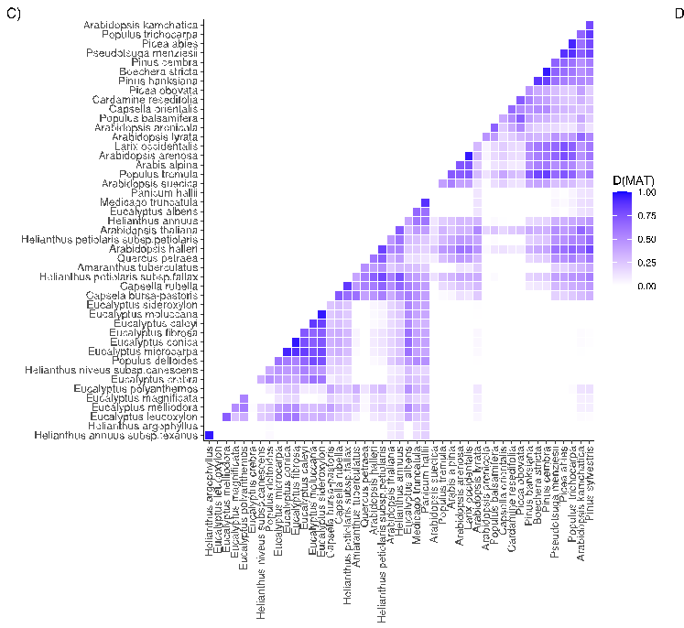
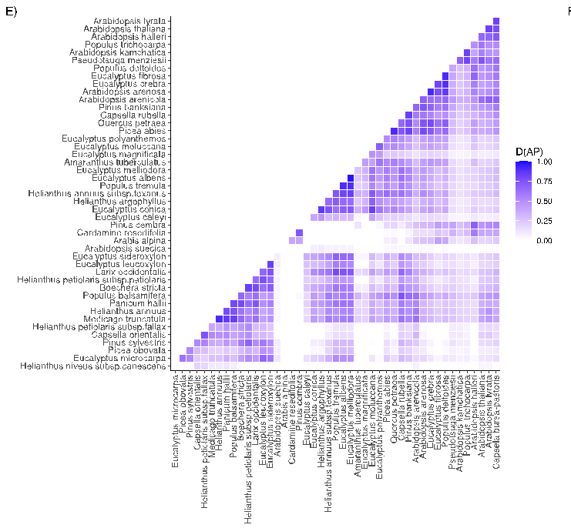
Overlap of Niche-Breadth Ratio (NBR)
Mean Annual Temperature
Annual Precipitation

Slide 10
Quantifying convergence
GEA across bioclim variables
All 19?
Subset? (1,2,4,6/12,15)
PCs? (Angles between PCs between species…)
Survey of original authors
Approach
BayPass (most obvious)
LFMM
PCAdapt
RDA (lends itself to dimensionality)
Sensitivity vs Specificity
2 Datasets for downstream
Top candidate vs WZA
BIO1 = Annual Mean Temperature
BIO2 = Mean Diurnal Range (Mean of monthly (max temp - min temp))
BIO3 = Isothermality (BIO2/BIO7) (×100)
BIO4 = Temperature Seasonality (standard deviation ×100)
BIO5 = Max Temperature of Warmest Month
BIO6 = Min Temperature of Coldest Month
BIO7 = Temperature Annual Range (BIO5-BIO6)
BIO8 = Mean Temperature of Wettest Quarter
BIO9 = Mean Temperature of Driest Quarter
BIO10 = Mean Temperature of Warmest Quarter
BIO11 = Mean Temperature of Coldest Quarter
BIO12 = Annual Precipitation
BIO13 = Precipitation of Wettest Month
BIO14 = Precipitation of Driest Month
BIO15 = Precipitation Seasonality (Coefficient of Variation)
BIO16 = Precipitation of Wettest Quarter
BIO17 = Precipitation of Driest Quarter
BIO18 = Precipitation of Warmest Quarter
BIO19 = Precipitation of Coldest Quarter

Slide 11
Quantifying convergence
Compare OrthoFinder derived Species Tree vs Gene Tree
Per-population protein sequence based on major allele (include AF uncertainty here?)
Gene/Orthogroup Trees
Species Tree
Climate Dendrogram
Not convergent
Convergent

Slide 12
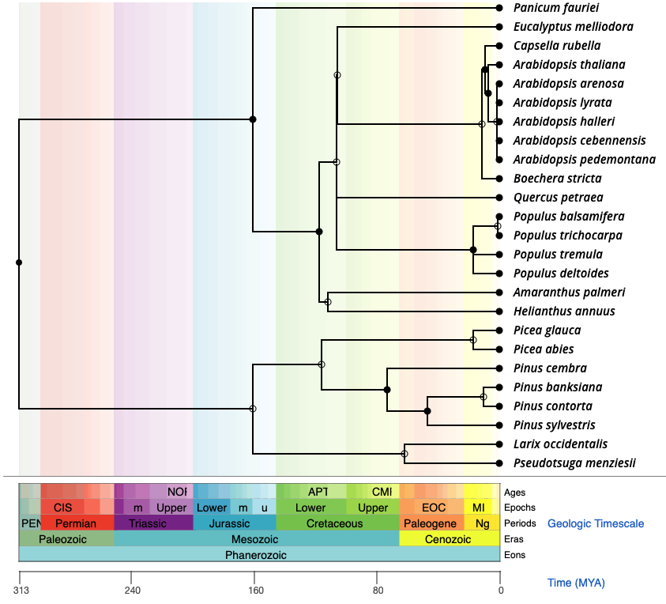
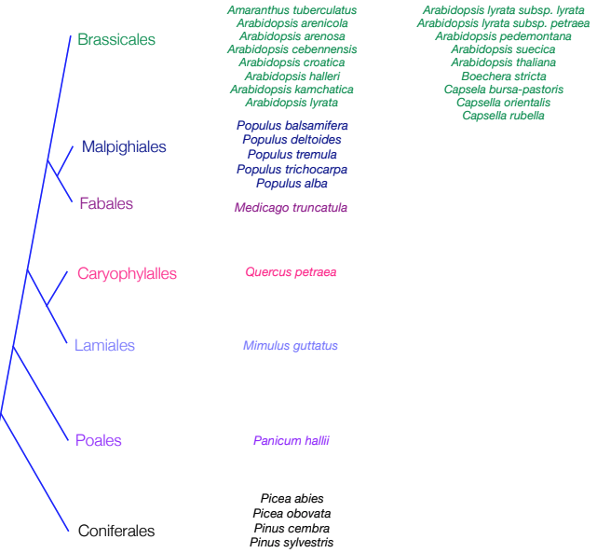
Comparing convergence – Broad scale
TimeTree.org

Slide 13
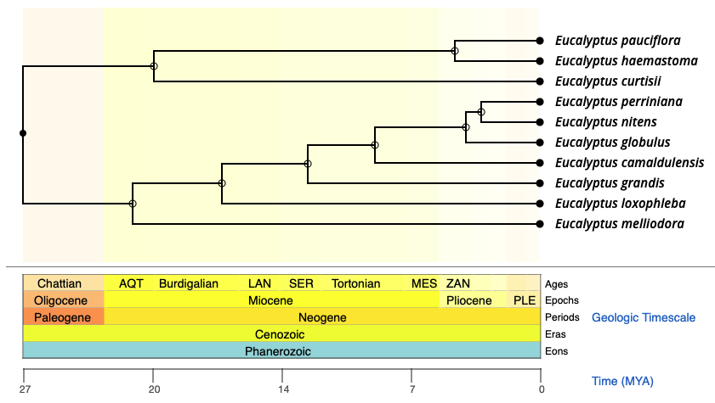
Comparing convergence – Broad scale
Within-clade
Across-clades
TimeTree.org

Slide 14
Comparing convergence – Broad scale
Orthogroups derived from all genomes via OrthoFinder
Fewer, better confidence
What does convergence look like at the whole data level?
Histogram of repeatedly selected genes
Permutation based null?
Modality associated with clades?
What are the features of the ’top overlapping’ genes?
Higher 1:1 Orthology?
Low Paralogy?
Functional pathway membership, fewer = less pleiotropy?
Genome clustering?
Two levels for this analysis: Broad scale over all species, and within-clades (same reference genome, or taxonomic clades?)

Slide 15
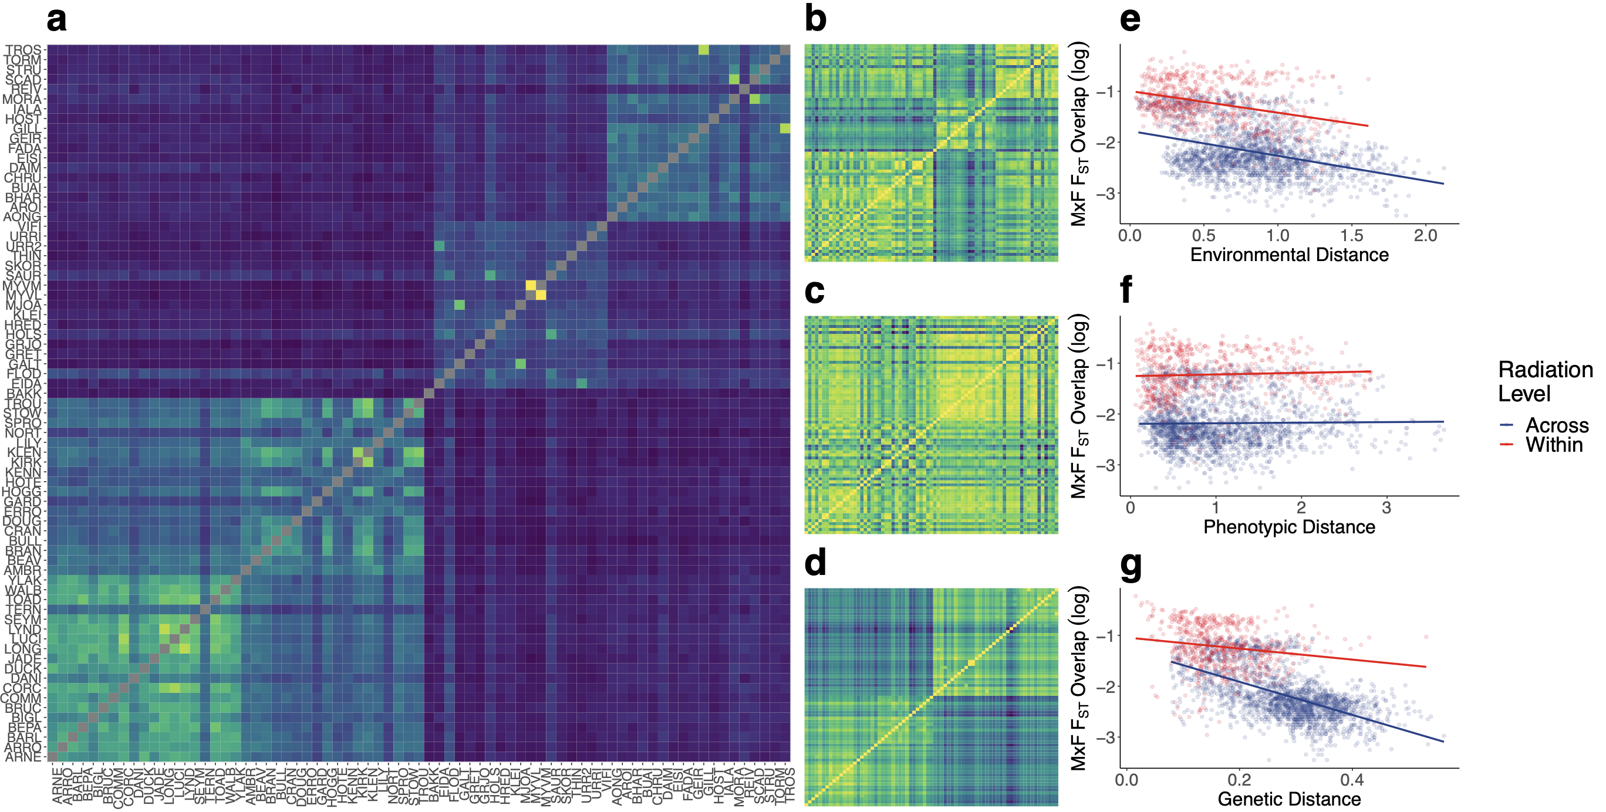
Comparing convergence – Pairwise

Slide 16
Comparing convergence – Pairwise
Orthogroups derived from OrthoFinder/OrthoMCL
Can run in pairwise, different orthogroups for each species pair?
Interesting questions only possible with this approach:
e.g. How does convergent evolution between distant species in very similar climates compare with close species in less similar climates?
Automated pipeline (comparable to Conifers Science) for all pairwise calculations:
2 sets of species-level GEA candidates
Pairwise orthology
Count 1:1 overlap
Count 1:many overlap
Expected overlap given orthology identification

Slide 17
Explaining convergence – Pairwise
INTRINSIC
Comparison of gene content (Redundancy in terms of available genes):
Quantify ‘quality’ of orthogroup identification among pairs
Proportion 1:1, 1:many, many:many, none.
Likelihood of convergence given 1:1 vs 1:many orthology.
C_{chisq} and C_{hyper}
”Realised” measure of redundancy, dependent on GEA results…
EXTRINSIC
Species Distribution Modelling (SDM) and range overlap
How comparable is selection?
Latitudinal overlap of clines
Niche Breadth Ratio – Variance within clines
bioClim covariance
What is the expectation for pleiotropic constraint?
What is the effect of seasonal variance in environmentally similar clines?
Environmental change in 1960 > 2020
STOCHASTIC
Divergence time estimates (within clades…)
Product of variance of species-specific Ne through time (simulate this?)
Per-species summary of population structure
Otherwise may just take residual variance as proxy?

