Slide 1
Microcontrollers and the CAN bus.
Jim Wright
The Whidbey Island Wild Cats 2980

Slide 2
This Workshop is on my Github
https://github.com/JimWright4089/FIRSTWorkshops/FRC/2022
https://github.com/JimWright4089/FIRSTWorkshops

Slide 3
This Workshop is on the Web
Workshop:
https://github.com/JimWright4089/FIRSTWorkshops/FRC/2023
Roborio Code:
https://github.com/JimWright4089/FIRSTRobots/tree/master/Code/TornadoPlatypus/CANTest
Adafruit Feather Code:
https://github.com/JimWright4089/FIRSTRobots/tree/master/Code/Feather/M4CanCode
https://github.com/JimWright4089/FIRSTWorkshops

Slide 4
The CAN bus in general
Controller Area Network
Used in vehicles
The display panel in your car talks to the gear shifter to see if it needs to display the backup camera
Robust
Short packets
https://github.com/JimWright4089/FIRSTWorkshops

Slide 5
In FRC
The green and yellow wires
Starts at the Roborio and goes until the Power Dist Panel.
Both of these have the terminator resistors in them
All the other parts don’t have the terminators, so we usually chain them.
We could make a star topography by using terminators.
https://github.com/JimWright4089/FIRSTWorkshops

Slide 6
Non-Motor FRC CAN devices
Most of these are from Cross the Road Electronics
Pigeon 2.0 IMU
CANcoder Encoder
CANdle LED driver
CANifier General Purpose Processor
https://github.com/JimWright4089/FIRSTWorkshops

Slide 7
Why use a microprocessor on the CAN Bus
You need to look at a number of sensors and return values in an inconvenient location.
At the end of Stealth’s arm we used an external encoder and a break beam sensor.
If your running CAN and power to a location you can pout a microprocessor.
Less costly
https://github.com/JimWright4089/FIRSTWorkshops

Slide 8
Pigeon 2.0 IMU
A Pigeon 2.0 IMU costs $199.99
It can be replaced by:
Adafruit RP2040 CAN Bus Feather with MCP2515 CAN Controller - STEMMA QT for $19.95
Adafruit 9-DOF Orientation IMU Fusion Breakout - BNO085 $24.95
https://github.com/JimWright4089/FIRSTWorkshops

Slide 9
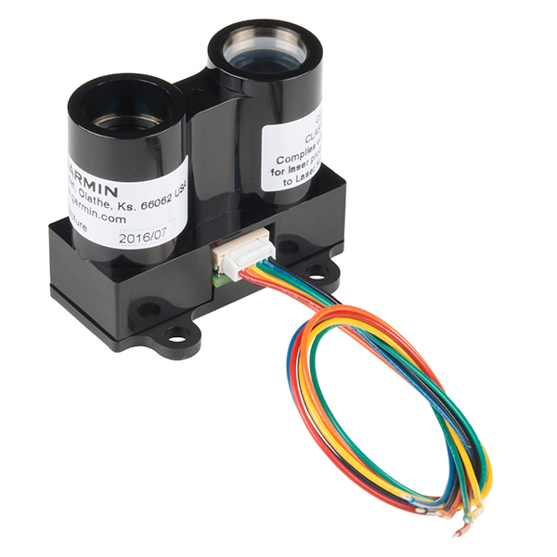
Distance Sensor
In 2020 4089 used a distance sensor from Sparkfun.
We used a CANifier to read it.
The CANifier has “stock” software that can’t be modified.
https://github.com/JimWright4089/FIRSTWorkshops

Slide 10
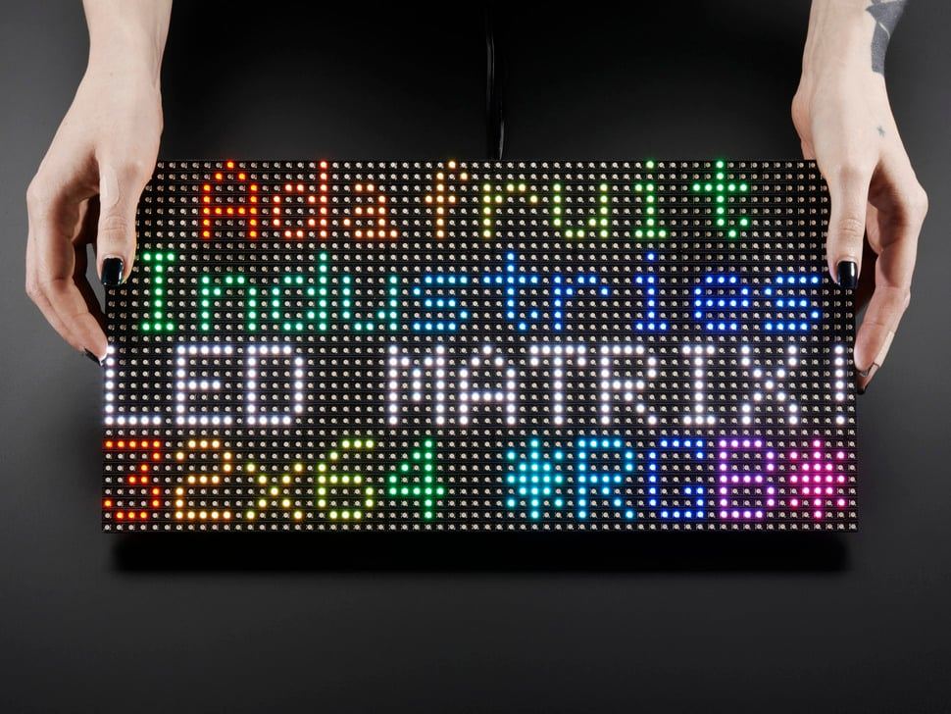
LED Arrays
The CANDLE can run a LED strip.
An Adafruit CAN board can drive an LED array.
https://github.com/JimWright4089/FIRSTWorkshops

Slide 11
WPI CAN specification
In order to use a microprocessor on the FRC CAN bus, there is a specific ID to use.
If you use this specification tools like RevRobotics Hardware Client will be able to understand what it is.
https://github.com/JimWright4089/FIRSTWorkshops

Slide 12
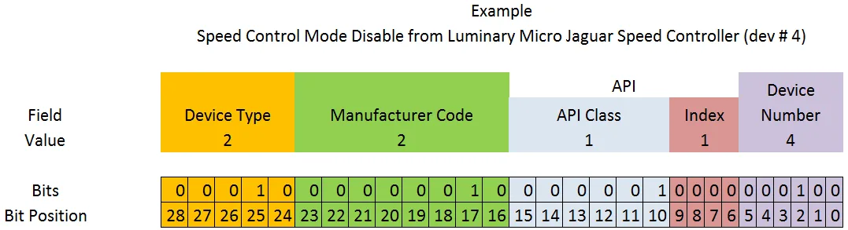
WPI CAN specification
https://docs.wpilib.org/en/stable/docs/software/can-devices/can-addressing.html
https://github.com/JimWright4089/FIRSTWorkshops

Slide 13
WPI CAN specification
Manufacturer
Broadcast 0
NI 1
Luminary Micro 2
DEKA 3
CTR Electronics 4
REV Robotics 5
Grapple 6
MindSensors 7
Team Use 8
Kauai Labs 9
Copperforge 10
Playing With Fusion 11
Studica 12
The Thrifty Bot 13
Redux Robotics 14
Reserved 15-255
Device Types
Broadcast Messages 0
Robot Controller 1
Motor Controller 2
Relay Controller 3
Gyro Sensor 4
Accelerometer 5
Ultrasonic Sensor 6
Gear Tooth Sensor 7
Power Distribution Module 8
Pneumatics Controller 9
Miscellaneous 10
IO Breakout 11
Reserved 12-30
Firmware Update 31
API Class
Voltage Control Mode 0
Speed Control Mode 1
Voltage Compensation Mode 2
Position Control Mode 3
Current Control Mode 4
Status 5
Periodic Status 6
Configuration 7
Ack 8
https://github.com/JimWright4089/FIRSTWorkshops

Slide 14
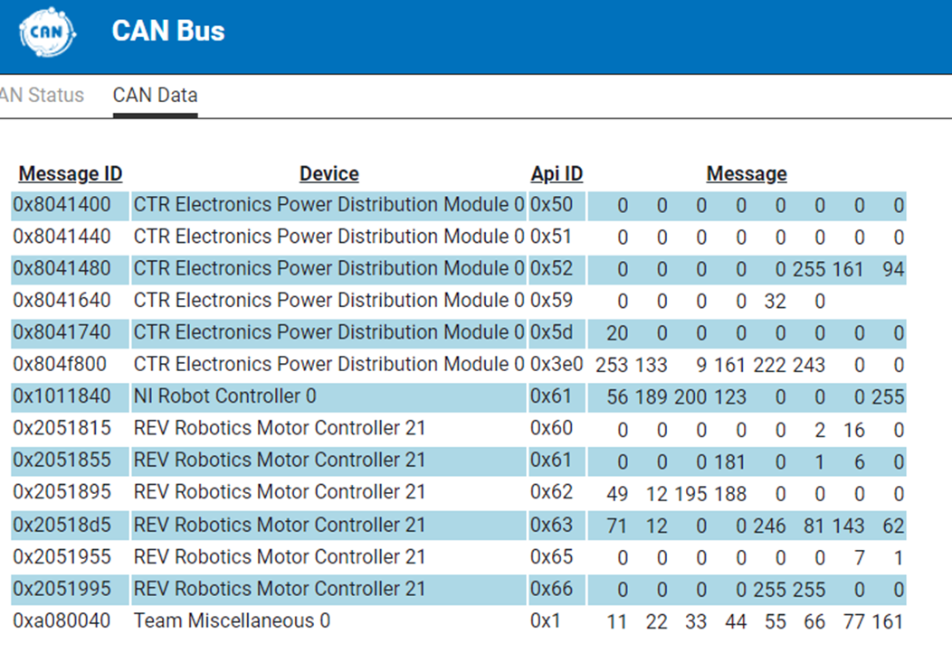
WPI CAN specification
0xA080040
Miscellaneous 10
Team Use 8
API 1 (to receive)
API 2 (to send to)
Device 0
https://github.com/JimWright4089/FIRSTWorkshops

Slide 15
ADAFruit Feather
Follow ADAfruits pages to setup the Microprocessor on the Arduino IDE
Also add the ADAFruit CAN library
https://github.com/JimWright4089/FIRSTWorkshops

Slide 16
ADAFruit Feather
CANSAME5x gCAN;
// start the CAN bus at 1 mbps
if (!gCAN.begin(1000000)) {
Serial.println("Starting CAN failed!");
while (1) delay(10);
}
gCAN.beginExtendedPacket(
0xA080040, 8);
gCAN.write(11);
gCAN.write(22);
gCAN.write(33);
gCAN.write(44);
gCAN.write(55);
gCAN.write(66);
gCAN.write(77);
gCAN.write(gCount);
https://github.com/JimWright4089/FIRSTWorkshops

Slide 17
ADAFruit Feather if(0xA080080 == gCAN.packetId())
https://github.com/JimWright4089/FIRSTWorkshops

Slide 18
Roborio Code
Define a new CAN device and call:
ReadPacketLatest
WritePacket
https://github.com/JimWright4089/FIRSTWorkshops

Slide 19
Roborio Code
frc::CAN mCanDevice;
data.data[0] = (mColor>>8)&0xFF;
data.data[1] = mColor&0xFF;
data.data[2] = 101;
data.data[3] = 102;
data.data[4] = 103;
data.data[5] = 104;
data.data[6] = 105;
data.data[7] = 106;
mCanDevice.WritePacket(data.data,8,2);
mCanDevice(0xA080040)
frc::CANData data;
mCanDevice.ReadPacketLatest(1,&data);
frc::SmartDashboard::PutNumber("CAN Data", data.data[7]);
https://github.com/JimWright4089/FIRSTWorkshops

Slide 20
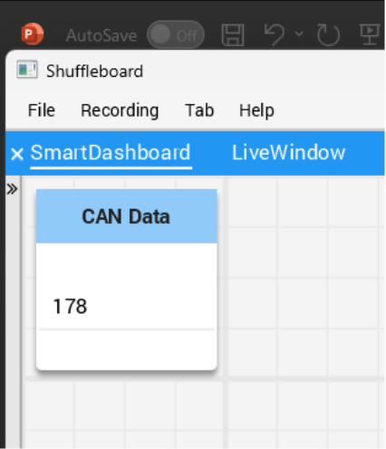
Dashboard
The last byte we send from the Feather is the count.
We get it on the Rio and send it to the Shuffleboard.
https://github.com/JimWright4089/FIRSTWorkshops

Slide 21
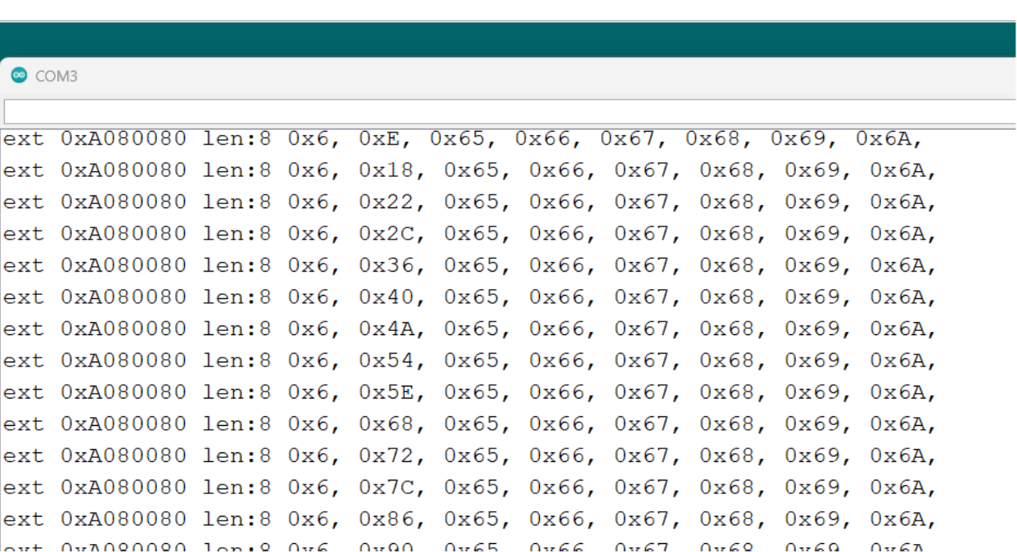
Serial Monitor on the Feather
We can see the bytes flowing to the Feather on the Serial Port:
https://github.com/JimWright4089/FIRSTWorkshops

Slide 22
Questions
Questions?
https://github.com/JimWright4089/FIRSTWorkshops

