Slide 1
Jaci’s Pathfinding
Jim Wright
The Whidbey Island Wild Cats 2980

Slide 2

Jaci Brunning
Moto: I write code for people that write code for robots.
From Perth, Western Australia
Part of the WPI team
https://github.com/JacisNonsense
https://github.com/JimWright4089/FIRSTWorkshops

Slide 3
Jaci’s Pathfinder
Two parts:
Pathfinder
Two versions, the first version was used up to last season
The next version is not quite released for FRC
Pathweaver
Also two versions, the first built the path off the robot and saved CVS files.
The next version is just to check the path.
https://github.com/JimWright4089/FIRSTWorkshops

Slide 4
The Pathweaver
It is located in the WPI Github.
https://github.com/wpilibsuite/PathWeaver
The top of the tree is for V2.
We will talk about PathWeaver-2019.2.1
Click on the releases and choose 2019.2.1
Download that.
https://github.com/JimWright4089/FIRSTWorkshops

Slide 5
The Pathweaver
Building on Windows.
Get Java JDK 11
Set JAVA_HOME=C:\Program Files\Java\jdk-11.0.5\ in your environment variables. Google it
Unzip the zip file into a location.
Start a command line and change into the path
https://github.com/JimWright4089/FIRSTWorkshops

Slide 6
The Pathweaver, Gradle
In the path there is a file called gradlew.bat.
Type ‘gradlew’ in the command prompt.
Gradle will take over and download things it needs.
If it passes then you can run it with ‘gradlew run’
https://github.com/JimWright4089/FIRSTWorkshops

Slide 7
The Pathweaver
https://github.com/JimWright4089/FIRSTWorkshops

Slide 8
The Pathweaver
Project and output point to you folder.
Select game.
The units is SOOOOOO key, once you choose one stay with it.
Time step is how fast can your system run. Choose 0.02
There is a way to characterize your robot to find the Vel, Acc, and Jerk. Or guess.
https://github.com/JimWright4089/FIRSTWorkshops

Slide 9
The Pathweaver
Project and output point to you folder.
Select game.
The units is SOOOOOO key, once you choose one stay with it.
Time step is how fast can your system run. Choose 0.02
There is a way to characterize your robot to find the Vel, Acc, and Jerk. Or guess.
https://github.com/JimWright4089/FIRSTWorkshops

Slide 10
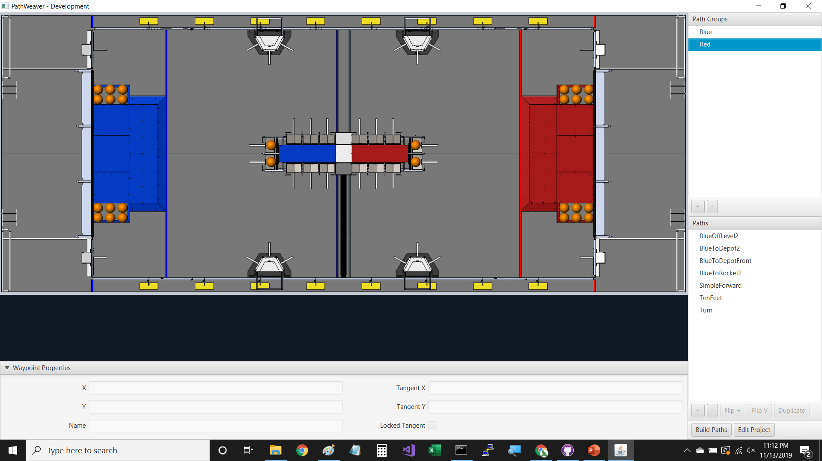
The Pathweaver
https://github.com/JimWright4089/FIRSTWorkshops

Slide 11
The Pathweaver
Not sure what groups does.
Path names are very important.
Keep them space free, because this will be the start of your file name.
When you build them, you rebuild all of them
Edit Project will send you back to the Edit Project screen, this will change vel, acc, jerk.
https://github.com/JimWright4089/FIRSTWorkshops

Slide 12
The Pathweaver
https://github.com/JimWright4089/FIRSTWorkshops

Slide 13
The Pathweaver
https://github.com/JimWright4089/FIRSTWorkshops

Slide 14
The Pathweaver
https://github.com/JimWright4089/FIRSTWorkshops

Slide 15
The Pathweaver
https://github.com/JimWright4089/FIRSTWorkshops

Slide 16
Pathfinder Videos
Blue Position 2 To Depot Position 2:
https://www.youtube.com/watch?v=f9vzAfaiYjs
Blue Position 2 To Rocket Position 2:
https://www.youtube.com/watch?v=bJKUwGRgA0w
Blue 2 To Depot Front:
https://www.youtube.com/watch?v=PGxn4kQ0Uek
https://github.com/JimWright4089/FIRSTWorkshops

Slide 17
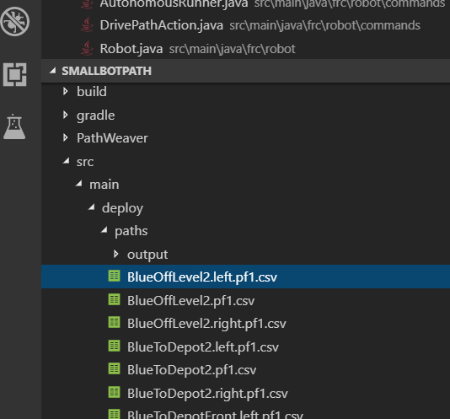
The Pathweaver
Three files per path will be created,
<Name>.left.pf1.cvs
<Name>.pf1.cvs
<Name>.right.pf1.cvs
You just need to move these to src/main/deplay/paths
This will move them to the roboRio in the place the Pathfinder needs them.
https://github.com/JimWright4089/FIRSTWorkshops

Slide 18
Pathfinder
You need to add it like a vendor library.
Like Cross the road.
Manage Vendor Library/Install new library (online)
https://dev.imjac.in/maven/jaci/pathfinder/PathfinderOLD-latest.json
Copy that link into the URL box
https://github.com/JimWright4089/FIRSTWorkshops

Slide 19
Pathfinder
import jaci.pathfinder.Pathfinder;
import jaci.pathfinder.PathfinderFRC;
import jaci.pathfinder.Trajectory;
import jaci.pathfinder.followers.EncoderFollower;
// Jaci's Pathfinder
public static final int k_ticks_per_rev = 4096;
public static final double k_wheel_diameter = .5;
public static final double k_max_velocity = 8;
public static final String k_path_name = "SimpleForward";
public static Notifier sFollowerNotifier;
public static EncoderFollower sLeftFollower;
public static EncoderFollower sRightFollower;
https://github.com/JimWright4089/FIRSTWorkshops

Slide 20
Pathfinder Tuning
https://www.youtube.com/watch?v=pt0w0oHRBEs
Tuning will involve Velocity, and modifying the constants.
The idea is repeatability.
The first path you create will need some tweeking.
Test on carpet if you can
https://github.com/JimWright4089/FIRSTWorkshops

Slide 21
Pathfinder
try
{
System.out.println(name + ".left");
System.out.println(name + ".right");
Trajectory left_trajectory = PathfinderFRC.getTrajectory(name + ".left");
Trajectory right_trajectory = PathfinderFRC.getTrajectory(name + ".right");
RobotMap.sLeftFollower = new EncoderFollower(left_trajectory);
RobotMap.sRightFollower = new EncoderFollower(right_trajectory);
<Next Page>
}
catch(Exception e)
{
System.console().printf(e.toString());
}
https://github.com/JimWright4089/FIRSTWorkshops

Slide 22
Pathfinder
RobotMap.sLeftFollower.configureEncoder(-1 *RobotMap.sMotorLeftA.getSelectedSensorPosition(0),
Constants.k_ticks_per_rev, Constants.k_wheel_diameter);
// You must tune the PID values on the following line!
RobotMap.sLeftFollower.configurePIDVA(1.0, 0.0, 0.0, 1 / Constants.k_max_velocity, 0);
RobotMap.sRightFollower.configureEncoder(-1 *RobotMap.sMotorRightA.getSelectedSensorPosition(0),
Constants.k_ticks_per_rev, Constants.k_wheel_diameter);
// You must tune the PID values on the following line!
RobotMap.sRightFollower.configurePIDVA(1.0, 0.0, 0.0, 1 / Constants.k_max_velocity, 0);
RobotMap.sFollowerNotifier = new Notifier(this::followPath);
RobotMap.sFollowerNotifier.startPeriodic(left_trajectory.get(0).dt);
https://github.com/JimWright4089/FIRSTWorkshops

Slide 23
Pathfinder
private void followPath()
{
if ((isFinished())||(false == mRunLoop))
{
// Stop the motors and stop the follower
RobotMap.sFollowerNotifier.stop();
RobotMap.sMotorLeftA.set(0);
RobotMap.sMotorRightA.set(0);
}
else
{
PigeonIMU.FusionStatus fusionStatus = new PigeonIMU.FusionStatus();
double[] xyz_dps = new double[3];
RobotMap.sPigeonIMU.getRawGyro(xyz_dps);
RobotMap.sPigeonIMU.getFusedHeading(fusionStatus);
double left_speed = RobotMap.sLeftFollower.calculate(RobotMap.sMotorLeftA.getSelectedSensorPosition(0));
double right_speed = RobotMap.sRightFollower.calculate(RobotMap.sMotorRightA.getSelectedSensorPosition(0));
double heading = fusionStatus.heading*-1;
double desired_heading = Pathfinder.r2d(RobotMap.sLeftFollower.getHeading());
double heading_difference = Pathfinder.boundHalfDegrees(desired_heading - heading);
double turn = 0.8 * (-1.0/80.0) * heading_difference;
RobotMap.sMotorLeftA.set((left_speed + turn));
RobotMap.sMotorRightA.set((right_speed - turn));
}
}
https://github.com/JimWright4089/FIRSTWorkshops

Slide 24
Pathfinder Backwards
private void followPath()
{
if ((isFinished())||(false == mRunLoop))
{
// Stop the motors and stop the follower
RobotMap.sFollowerNotifier.stop();
RobotMap.sMotorLeftA.set(0);
RobotMap.sMotorRightA.set(0);
}
else
{
PigeonIMU.FusionStatus fusionStatus = new PigeonIMU.FusionStatus();
double[] xyz_dps = new double[3];
RobotMap.sPigeonIMU.getRawGyro(xyz_dps);
RobotMap.sPigeonIMU.getFusedHeading(fusionStatus);
double left_speed = RobotMap.sLeftFollower.calculate(RobotMap.sMotorLeftA.getSelectedSensorPosition(0)*-1);
double right_speed = RobotMap.sRightFollower.calculate(RobotMap.sMotorRightA.getSelectedSensorPosition(0)*-1);
double heading = fusionStatus.heading*-1;
double desired_heading = Pathfinder.r2d(RobotMap.sLeftFollower.getHeading());
double heading_difference = Pathfinder.boundHalfDegrees(desired_heading - heading);
double turn = 0.8 * (-1.0/80.0) * heading_difference;
RobotMap.sMotorLeftA.set(-1*(left_speed + turn));
RobotMap.sMotorRightA.set(-1*(right_speed - turn));
}
}
https://github.com/JimWright4089/FIRSTWorkshops

Slide 25
Pathfinder V2.0
try
{
System.out.println(name + ".left");
System.out.println(name + ".right");
Trajectory left_trajectory = PathfinderFRC.getTrajectory(name + ".left");
Trajectory right_trajectory = PathfinderFRC.getTrajectory(name + ".right");
RobotMap.sLeftFollower = new EncoderFollower(left_trajectory);
RobotMap.sRightFollower = new EncoderFollower(right_trajectory);
<Next Page>
}
catch(Exception e)
{
System.console().printf(e.toString());
}
https://github.com/JimWright4089/FIRSTWorkshops

Slide 26
Pathfinder V2.0
Pathweaver produces one file, with only the data for the way points.
Pathfinder V2.0 source is on the web, but has not been FRC-ized.
Not sure if the engine will read the file from Pathweaver.
The path can be generated at run time with way points.
Both Tank drive and Swerve drives supported.
https://github.com/JimWright4089/FIRSTWorkshops

Slide 27
Pathfinder V2.0
List<HermiteCubic.Waypoint> wps = new ArrayList<>();
wps.add(new HermiteCubic.Waypoint(Vec2.cartesian(2, 2), Vec2.cartesian(5, 0)));
wps.add(new HermiteCubic.Waypoint(Vec2.cartesian(5, 5), Vec2.cartesian(3, 2)));
wps.add(new HermiteCubic.Waypoint(Vec2.cartesian(10, 5), Vec2.cartesian(0, 5)));
nativeSplines = HermiteFactory.generateCubic(wps);
start = new HermiteQuintic.Waypoint(Vec2.cartesian(0, 0), Vec2.polar(5, 0), Vec2.polar(3,3 ));
end = new HermiteQuintic.Waypoint(Vec2.cartesian(5, 4), Vec2.polar(5, -Math.PI / 2.0), Vec2.polar(-2, 3));
spline = new HermiteQuintic(start, end);
https://github.com/JimWright4089/FIRSTWorkshops

