Slide 1
OpenCV
Seattle Robotics Society

Slide 2
Overview
Find Cone
Chess Arm
Sign Maze
OpenCV
Tesseract
Putting it all together

Slide 3
Find Cone
Demo

Slide 4
Chess Arm
Arm the plays chess
Dump the pieces on to a board
Robot moves it piece
Robot un-moves your incorrectly played piece.

Slide 5
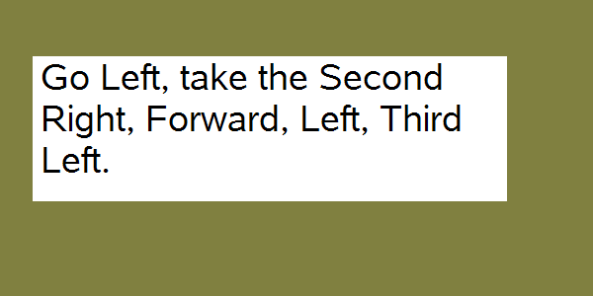
Sign Maze

Slide 6
OpenCV
IplImage
cvLoadImage
cvNamedWindow
cvShowImage
cvWaitKey
cvReleaseImage
Con
Present possible counter arguments here

Slide 7
OpenCV
cvCreateImage
cvSplit
cvOr
cvAnd
cvXor
cvAdd
cvSub
cvMul
cvDiv

Slide 8
OpenCV
cvCvtColor
cvThreshold
cvSet
cvCopy

Slide 9
Tesseract
TessDllAPI api("eng")
api.BeginPageUpright(text_image->width, text_image->height, buffer);
ETEXT_DESC* output = api.Recognize_all_Words();
const EANYCODE_CHAR* ch = &output->text[i];

Slide 10
Putting it together
ConvertToTessImage(unsigned char* buff_in, unsigned char* buff_out, int length)

