Slide 1
2015 Intro to C++
Jim Wright Team ????

Slide 2
Hard To Teach
This and Intro to Java are the hardest to teach
Various levels of skill
No Robot experience, no code experience
Code Experience, no Robot experience
You are a mentor who just wants the environment setup

Slide 3
Interweave all of them
We are going to interweave all topics together
Start with some setup
Show some intro to C++ code
Show some robot code

Slide 4
Setting up the environment
Easier than the cRio!
Still takes a long time

Slide 5
Follow the WPI doc
Installing Eclipse (C++_Java) _ FRC C++ Programming _ 2015 FRC Control System.html
3 thumb drives being distributed.
All file should be on them

Slide 6
A normal simple C program
#include <stdio.h>
void doSomething(int x);
int main(void)
{
int countIndex = 0;
for(countIndex = 0; countIndex<5; countIndex++)
{
if(3 != countIndex)
{
printf("Count:%d\n",countIndex);
}
else
{
doSomething(countIndex);
}
}
return 0;
}
void doSomething(int x)
{
printf("In Func:%d\n",x);
}
Notes:
6

Slide 7
#include <stdio.h>
This brings in other libraries.
The libraries are the hardest part of C
You need to know what is in each one and what it's named
Just ignore this for now.
This one is for the function “printf”
Notes:
7

Slide 8
void doSomething(int x);
Forward function declaration.
It tells the compiler that somewhere in this file is a function called 'doSomething'
The void tells the compiler nothing will be returned from this function (more on that to come).
The 'int x' tells us that a number is going to be passed in.
The forward declaration ends in a ';'
Notes:
8

Slide 9
int main(void)
This is the main function.
This is where the program will begin.
The function will return a number (int).
The function does not have anything passed in (void).
Notes:
9

Slide 10
int countIndex = 0;
This is a variable. Its a label that holds 'stuff'
The label is called 'countIndex'.
The stuff is a number = 0.
A int is a type of variable. It means a number from -2,147,483,648 to 2,147,483,647
Other type are char (-128 to 127), short (32,768 to -32,767)
Just stick with int for numbers.
Notes:
10

Slide 11
for(countIndex = 0; countIndex<5; countIndex++)
For loop. It counts things.
This one counts from 0 to 4.
countIndex = 0 tells us where to start.
countIndex<5 tells us to keep counting while countIndex is less than 5.
countIndex++ means to add 1 to countIndex each time though the loop.
for(countIndex = 1; countIndex<=10; countIndex+=2)
Counts from 1 to 10 by 2s
Notes:
11

Slide 12
if(3 != countIndex)
The If statement makes decisions
This one says do the following if countIndex is not equal to 3.
The 3 does not need to be first.
!= is not equal. Equal is == (note the double =). < less than, > greater than. <= less than of equal to. && is AND, || is OR
Complex: ((3 != countIndex) && (4 == somethingElse))
If countIndex is not 3 and somethingElse is 4
Notes:
12

Slide 13
printf("Count:%d\n",countIndex);
The printf statement prints stuff out.
The %d says print a number at this point.
The \n says print a new line.
The %d corresponds to countIndex. The %d match to the parameters after the “ “.
printf(“Count:%d %d\n”,countIndex,somethingElse);
The the first %d would print countIndex, the second %d would print somethingElse.
Notes:
13

Slide 14
else
The else is the other half of the 'if' statement.
In our case it's 3 == countIndex.
Note the '{' and '}'. The braces tell the compiler that this is a block of code and goes with either the function, for loop, if statement or else statement.
Notes:
14

Slide 15
doSomething(countIndex);
Call the function and pass in countIndex.
If doSomething returned a value the statement would be:
somethingElse = doSomething(countIndex);
Notes:
15

Slide 16
return 0;
Return a number to the next 'level' up.
This just returns a number '0'.
Could pass back a variable: return countIndex;
Notes:
16

Slide 17
void doSomething(int x) {
This is the body of the function doSomething.
Note this does not have a ';' and it is followed by a body '{' '}'
Notes:
17

Slide 18
printf("In Func:%d\n",x);
Another print statement.
Notes:
18

Slide 19
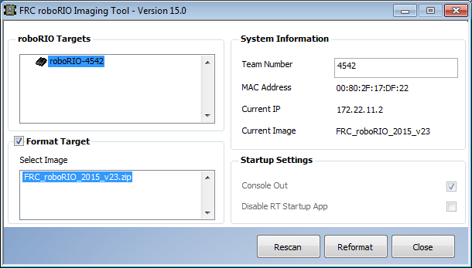
2015 roboRio Image Tool

Slide 20
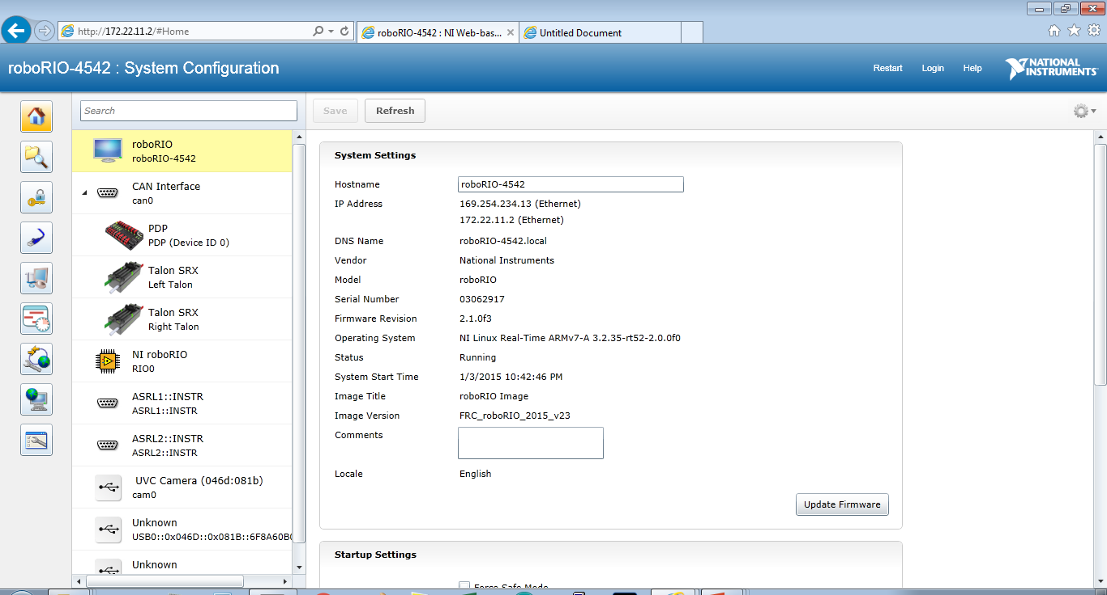
172.22.11.2 is your friend

Slide 21
Talon SRX setup

Slide 22
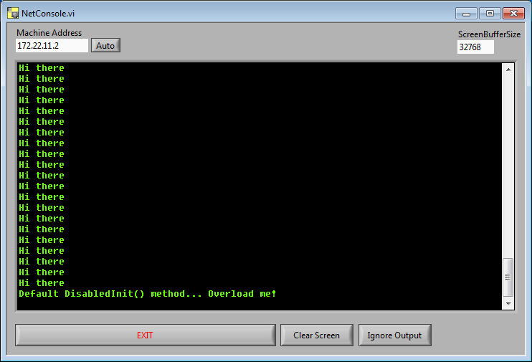
Console

Slide 23
API Document
Google wpi api doc

