Slide 1
The Lawfirm of Kalman and Pid
Two Algorithms for controlling robots

Slide 2
You, the audience
I only get one hour with you
A lot of you know Java
A lot of you know the Control System, if not October 15th all day at the Field House
I want more higher control in our autonomous

Slide 3
The Gyro is your friend
The gyro keeps your robot going straight.
Hard to turn
You need a gain on the gyro control to turn.
You can also use it as a rough compass.

Slide 4
The Gyro is your Enemy
The gyro is noisy
The gyro is noisy
Whoa! The gyro is noisy
It also ‘drifts’ however, for us the drift does not need to be taken into account

Slide 5
Hooking a Gyro up
Find the gyro you want to use:
SparkFun IMU Breakout - MPU-9250
Adafruit 9-DOF IMU Breakout - L3GD20H + LSM303
Both have example code from the Web Sites.
Both use I2C.

Slide 6
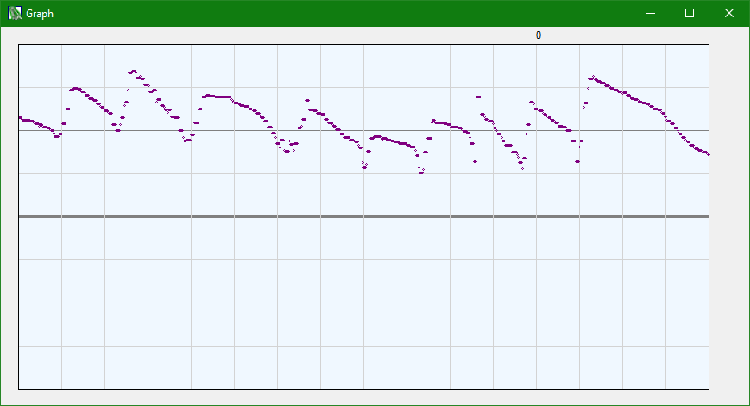
Raw Gyro

Slide 7
The Running average
Average you add up all the numbers and divide by the count.
Take reading every 5ms 30000 counts is a lot of data to keep.

Slide 8
The Running average
Take the average you have.
Multiply that average by 31/32
Take the new reading and multiply that by 1/32
Add those together.

Slide 9
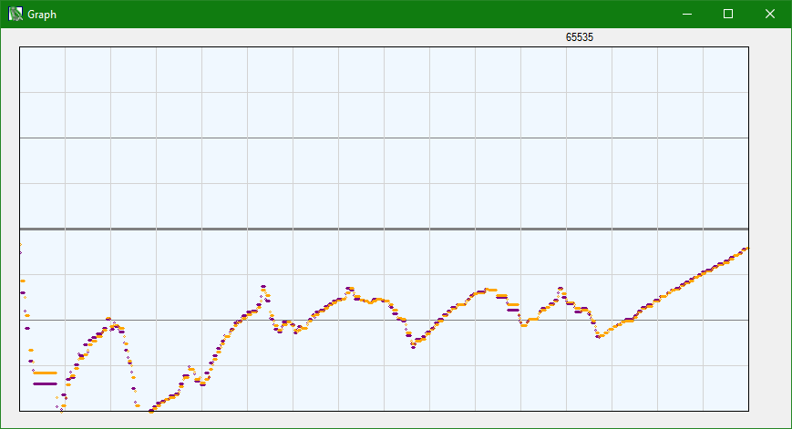
Running Average

Slide 10
That is not that great either
We need a better filter.

Slide 11
Kalman filter
There are a lot of implementations of the Kalman filter on the internet.
Treat it as a black box, send data into it and get data out of it.
You need to tune it, this is where the real problem is.

Slide 12
Kalman filter
Depending on the implementation you send in different things.
The one I found you pass in, qAngle, qBias, rMeasure.
I really have not idea of what those mean. Next year I will.

Slide 13
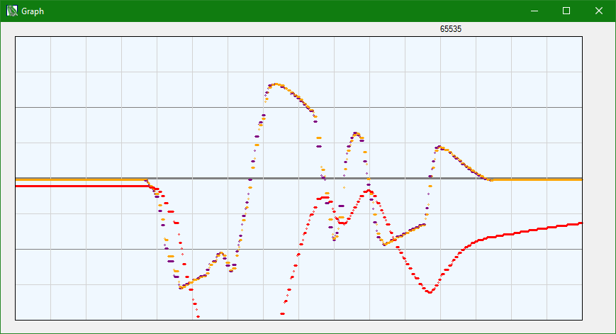
Badly Tuned KAlman

Slide 14
Tuning the Kalman filter
I just change the initial inputs until things work
I’m using .1, 1.015, .001
I’m also using the LSM9DS0 gyro.

Slide 15
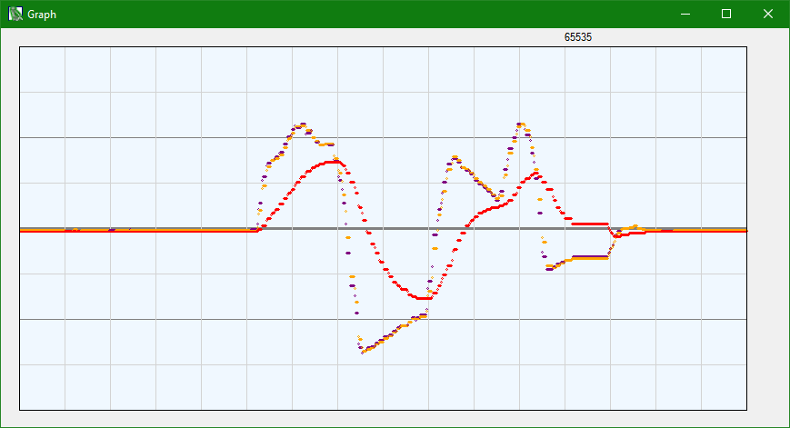
WELL Tuned KAlman
LSM9DS0

Slide 16
PID
The cornerstone of the control algorithms.

Slide 17
Give me a ‘P’
The P stands for Proportional.
The most important of the control params
error = requestedTicks - countTicks;
motorPower = error * Kp;
Could be requestedResistance if we are using a potentiometer

Slide 18
Give me a ‘D’
The D stands for Derivative.
The second most important
Sometimes people just use a PD loop.
deriv = error - lastError;
motorPower = error * Kp + deriv * Kd;

Slide 19
Give me aN ‘I’
The I stands for Integral.
Do not make this too big
A bit tricky to tune you have to know your system.
Make sure Requested Ticks can be met or else evil happens.
acumError += error;
motorPower = error * Kp + deriv * Kd + acumError * Ki;

Slide 20
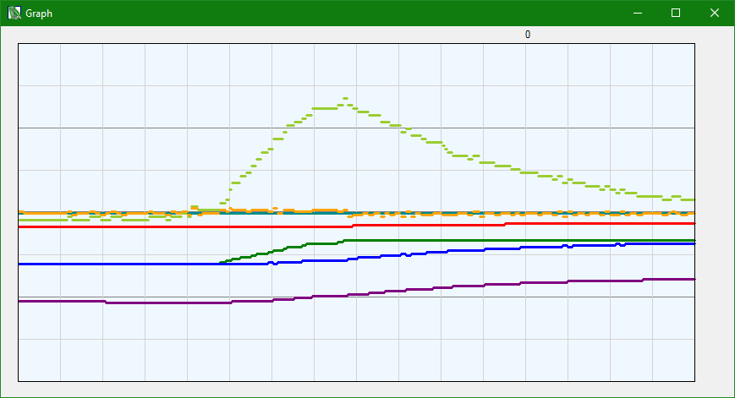
Constants too low
LSM9DS0

Slide 21
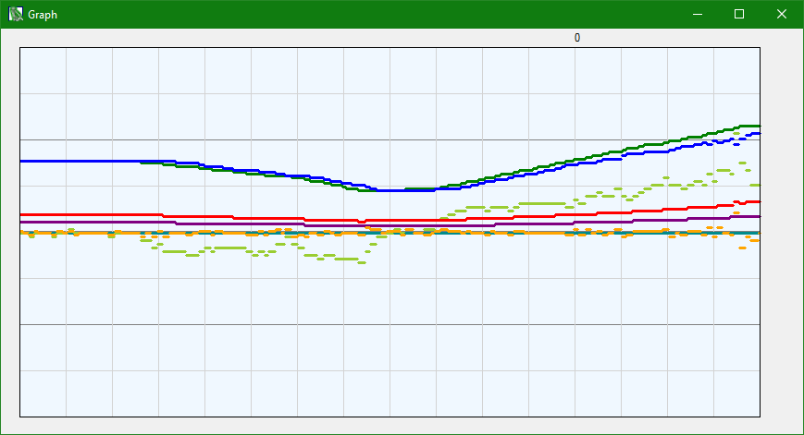
WELL Tuned PID

Slide 22
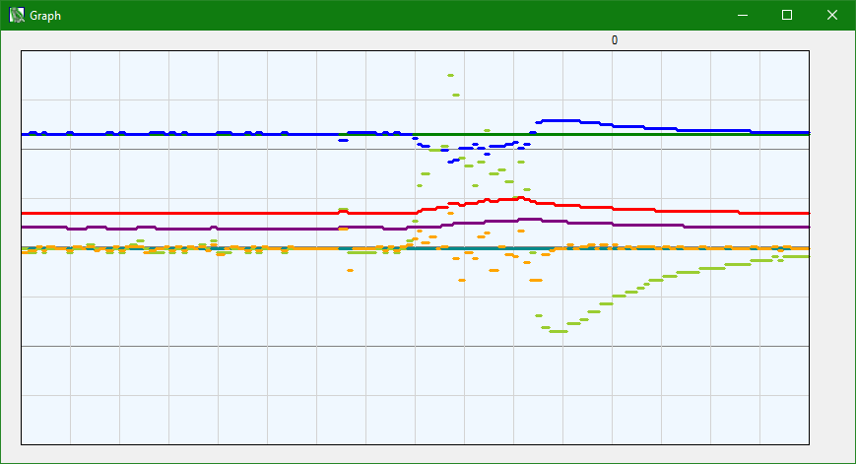
PID Hitting friction

Slide 23
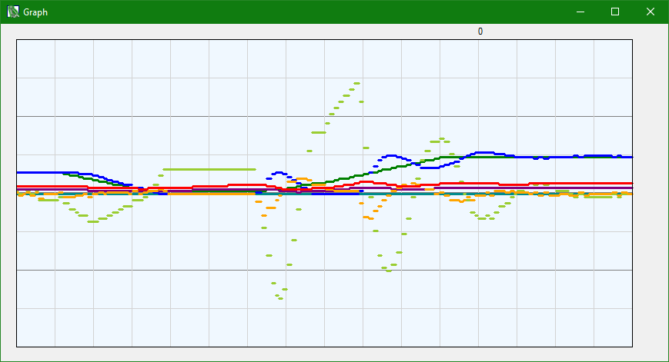
Ki is bigger than kp

Slide 24
Putting them together
requestedGyro = 0;
error = requestedGyro – Kalman(ReadGyro());
acumError += error;
deriv = error - lastError;
lastError = error;
gyroPower = error * Kp + deriv * Kd + acumError * Ki;
leftMotorPower += gyroPower * Kg;
rightMotorPower -= gyroPower * Kg;

Slide 25
Finished
I’m done

