Slide 1
Nettables
Jim Wright
Stealth 4089

Slide 2
NetTable
Used for debugging
Sends data from Roborio to driver station
You can build your own dashboard.
You can set data for Autonomous. Like what side of the field are you on.

Slide 3
Sample Code
import edu.wpi.first.wpilibj.networktables.NetworkTable;
double sinCount = 0.0;
private NetworkTable netTable;
netTable = NetworkTable.getTable("sin");
public void teleopPeriodic() {
double sinValue = Math.sin(sinCount);
sinCount += 0.01;
netTable.putNumber("sin", sinValue);
}

Slide 4
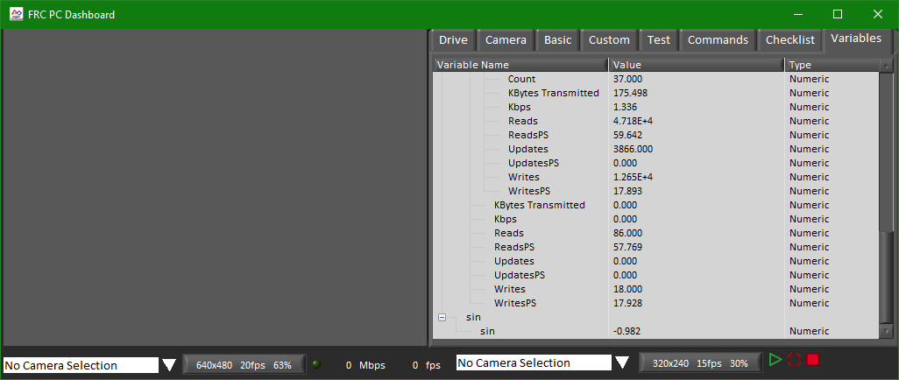
Running the program

Slide 5
Graph program
It’s a work in progress so it’s a bit rough
On jim’s GitHub:
https://github.com/JimWright4089
https://github.com/JimWright4089/FIRSTWorkshops/tree/master/FRC/2018/NetworkTables
Code:
https://github.com/JimWright4089/FIRSTWorkshops/tree/master/FRC/2018/Potentiometer%20PID

Slide 6
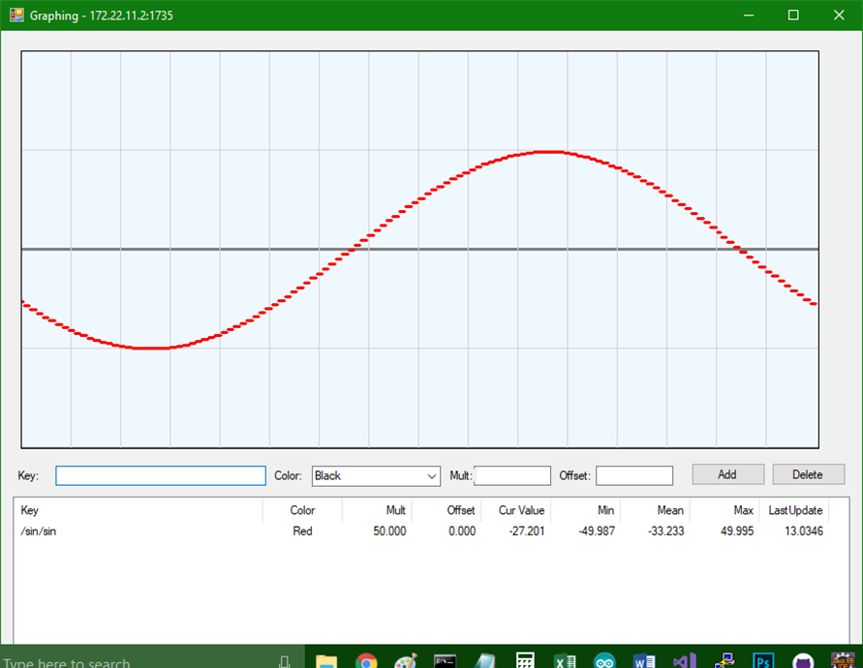
Graph program
Under Debug
NetworkTablesSettings.xml
<Settings>
<IPAddress>172.22.11.2</IPAddress>
<Port>1735</Port>
</Settings>

