Slide 1
Arduinos, Jetsons, and PI, OH MY!
Jim Wright
Stealth 4089

Slide 2
Things we will talk about
WPILib
Roborio
Arduino
Raspberry PI
Jetson
LimeLight
https://github.com/JimWright4089/FIRSTWorkshops

Slide 3
This talk
I thought I could do this in one hour, however, after writing the presentation I learned that it is very full or stuff at a high level.
This is a very bread crumb presentation.
https://github.com/JimWright4089/FIRSTWorkshops

Slide 4
WPILib
The only thing that can control motors and talk to the Drivers Station.
Most of the source code is on Github, https://github.com/wpilibsuite
Repository is allwpilib.
Gradle build for: Windows (Visual C++, Java), Roborio (GCC, Java), and Rasberrien (GCC, Java).
All other environment (Ubuntu) uses Cmake.
https://github.com/JimWright4089/FIRSTWorkshops

Slide 5
WPLib parts
Wpilibc
All of the classes for writing in C++. This also includes the entry point
Wpilibj
All of the classes for Java
Cemeraserver
The server for sending video to the drivers station.
Cscore
The interface for OpenCV
https://github.com/JimWright4089/FIRSTWorkshops

Slide 6
WPLib parts
Hal
Hardware abstraction layer.
Ntcore
Nettables core code.
Wpiutil
Suporting classes for the other parts
https://github.com/JimWright4089/FIRSTWorkshops

Slide 7
WPILib Network tables
By far the most important piece of the WPI for external processors
Publish/Subscribe server
The Roborio is the server!
It does need WPIUtils
As long as you can build the NTCore and WPIUtils you can use that device easily in your robot.
Several version of this, backwards compatible.
https://github.com/JimWright4089/FIRSTWorkshops

Slide 8
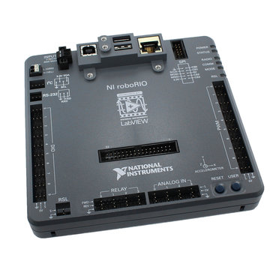
ROBORIO
Old device, had an amazing amount of processing power seven years ago.
The core of WPILib goes on this.
5V tolerant device. The I2C port is 5 volt. Pay attention to devices you want to hook to it for voltage compatibility.
Eithernet, I2C, UART, and USB.
Can run vision processing, but it can’t run it very well.
You want to keep this processing motion commands and not slow it down.
https://github.com/JimWright4089/FIRSTWorkshops

Slide 9
Roborio is a linux device
You can SSH and FTP into it. You can browse the FTP with Windows Explorer.
In debugging things you can SSH into it and ping the other parts to see if you have the networking setup correctly.
The user is ‘admin’ the password is blank. Don’t change the password!!!
https://github.com/JimWright4089/FIRSTWorkshops

Slide 10

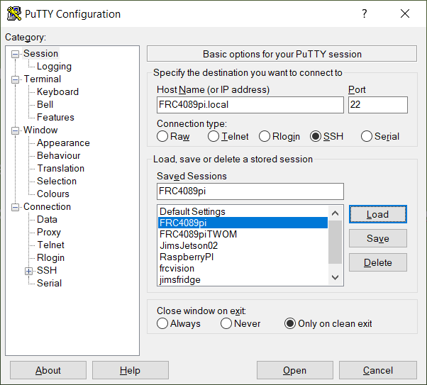
SSH and PUTTY
A free Windows SSH client.
The address of the Roborio is roborio-team#-frc.local
https://github.com/JimWright4089/FIRSTWorkshops

Slide 11
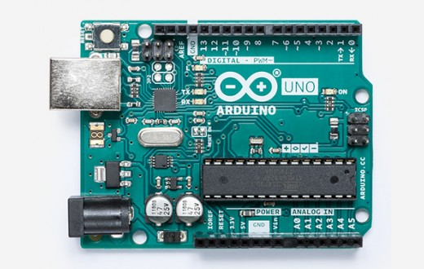
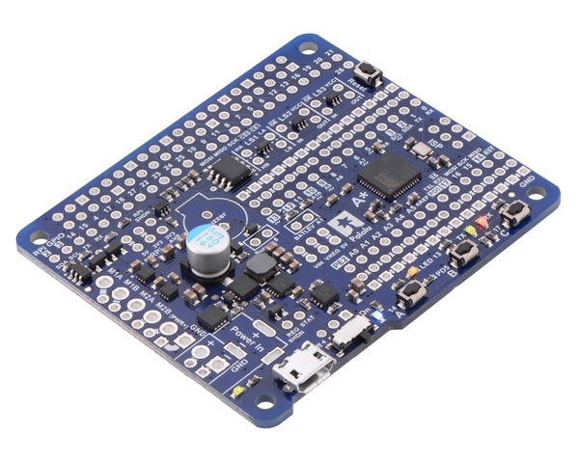
Arduino
A lot of boards are named Arduino. We will be talking about an UNO and a Pololu A-Star 32U4 Robot Controller.
5V tolerant devices.
I2C and UART communication.
Digitals pins, Analog pins.
No OS, very good at critical timing things.
LED rings and strips.
UNO barrel plug can handle 12V.
https://github.com/JimWright4089/FIRSTWorkshops

Slide 12
ARDUINO I2C
I2C is a multi-device protocol. One server can talk to several clients.
I2C is the best communication protocol to use with a Roborio, Raspberry PI, and NVIDIA Jetson.
A great example selections for I2C.
You want this to be a client and keep track of addresses.
https://github.com/JimWright4089/FIRSTWorkshops

Slide 13
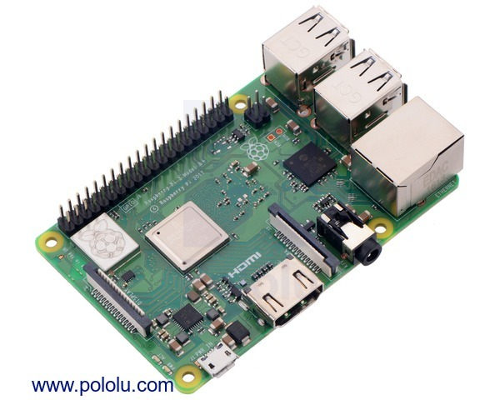
Raspberry PI
The current version of the PI is V4.0.
It’s a Linux device, so dealing with it you will use Putty.
The Linux version is called Raspberrian. You can put Ubuntu on it, but don’t. The NTCore and WPIUtil builds with gradle on Raspberrian.
The OS has to be put on a micro SD card. No built in flash.
It’s a 3 volt tolerant device!!!!
The USB ports are 5 volt.
https://github.com/JimWright4089/FIRSTWorkshops

Slide 14
Raspberry PI and WPI
You could copy the allwpilib over and build it, however, WPI has done that for you.
Not only did they build it but there are screen steps for it as well.
https://wpilib.screenstepslive.com/s/currentCS/m/85074
This image it a bit slow, however, it is very easy to work with. It also has OpenCV and NTCore built into it.
The interface to this is through a web browser.
The OS is locked after the first boot. To unlock it use the web browser.
You may have to find a Raspberry PI 3 for it.
https://github.com/JimWright4089/FIRSTWorkshops

Slide 15
LINUX and SAMBA
If you are new to Linux it will be a bit rough to get going. Think about this for a summer activity.
One of the first things to install on a Linux box is Samba.
Samba allows you to map Windows drives onto a folder on the Raspberry PI.
For a headless Linux box it allows you to edit files using a windows IDE.
Spend some time installing Samba.
My smb.conf file will be in the file section on my GITHub
https://github.com/JimWright4089/FIRSTWorkshops

Slide 16
Raspberry PI and Arduino
The Raspberry PI is a 3v I2C port and the Ardiuno is 5V.
A Pololu A-Star 32U4 Robot Controller solves these problems.
It has level shifters to convert 3V signals to 5V signals.
The A-Star also has a little buzzer on it so you can hear the boot up.
The Raspberry Pi communicates with the RoboRio and then turns around to talk to the Arduino.
The PI does vision processing and then turns the LED ring on and off.
https://github.com/JimWright4089/FIRSTWorkshops

Slide 17
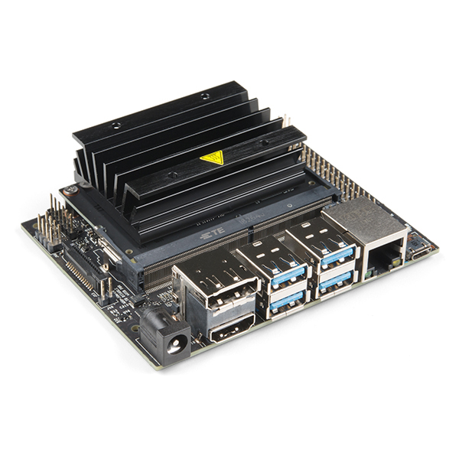
JETSON NANO
The Nano is a Raspberry PI with a video card bolted onto it.
The video card does the heavy vision processing. The PI part does the communicating.
It’s a 3volt tolerant device. The barrel plug is 5V.
There is a pin port which is the same pin out as the Raspberry PI
https://github.com/JimWright4089/FIRSTWorkshops

Slide 18
JETSON NANO Linux
The image to put onto it is Ubuntu based.
However, the image from the NVIDIA sight also has OpenCV and Tensorflow built in.
You have to build the NTCore to comm using Cmake.
https://github.com/JimWright4089/FIRSTWorkshops

Slide 19
OPENCV
OpenCV is a industry wide vision processing.
The code will be the same on a PC as a Pi orr
The Raspberry PI WPI build has very good debugging for a headless device, it has the images sent back to the web page.
For Nano, the best way to debug is sending back the image through a socket call. See file on my github for this.
https://github.com/JimWright4089/FIRSTWorkshops

Slide 20
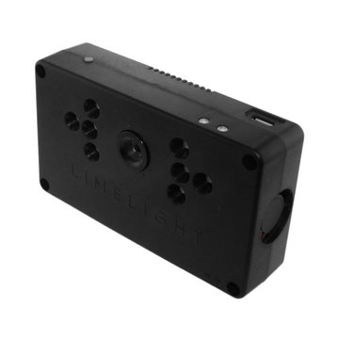
LimeLight
The Limelight is a Raspberry PI based vision processor.
Basically it is everything you need to see the reflective tape
It is the best plug and play device for FRC.
The setup uses something called GRIP to decide what to do.
GRIP is based on OpenCV.
Anything in it can be done in raw C++/Python code in OpenCV.
https://github.com/JimWright4089/FIRSTWorkshops

