Slide 1
The Other Languages
Don’t panic!
https://github.com/JimWright4089/FIRSTWorkshops

Slide 2
Intro
Things covered in this class:
Microsoft MakeCode
CMU RobotC

Slide 3
I do not like Block Programing
I do not like Block Programing
I do not like it with a ring
I do not like it while I sing
I will not write it for anything
https://github.com/JimWright4089/FIRSTWorkshops

Slide 4
I do not like Block Programing
I do not like with my cat
I do not like it on a mat
I want to swat it like a gnat
It annoys me like a flying bat
https://github.com/JimWright4089/FIRSTWorkshops

Slide 5
I do not like Block Programing, why?
The most important tool a programmer uses is Version Control (GitHub)
You can see the differences between version of your code.
You can find a something in a very lary project.
https://github.com/JimWright4089/FIRSTWorkshops

Slide 6
I do not like Block Programing, why?
https://github.com/JimWright4089/FIRSTWorkshops

Slide 7
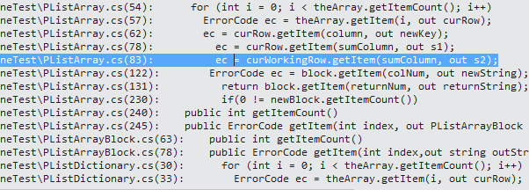
I do not like Block Programing, why?
https://github.com/JimWright4089/FIRSTWorkshops

Slide 8
Microsoft MakeCode
To be honest I was not looking forward to writing this.
Searched for MakeCode

Slide 9
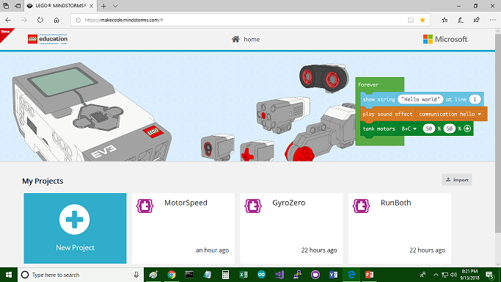
Microsoft MakeCode

Slide 10
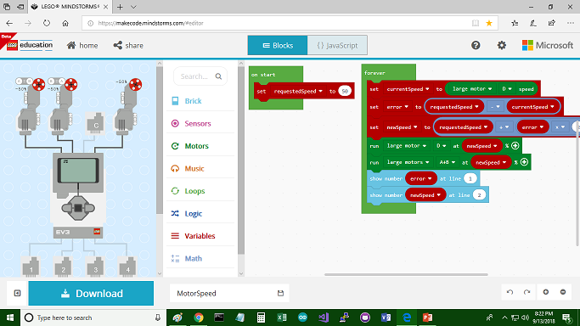
Microsoft MakeCode

Slide 11
Needs a browser, and Internet connection?
Will it work without a Internet connection?
Yes!
It’s a HTML5 app that can run without a connection

Slide 12
The Wire Digram takes up too much space
You can hide it.
New programs use the same name as Arduino Programs

Slide 13
First Program, go forward 1 second

Slide 14
Wait, what is that button!

Slide 15
Functions

Slide 16
Functions

Slide 17
The Help is brillianrt

Slide 18
Downloading to EV3
Before downloading works you need to put LME-EV3_Firmware_1.10E.bin on the brick.
Follow the instructions on the site to get the file.
I used the old LEGO software to reflash the EV3 brick.

Slide 19
Downloading to EV3
Once the firmware is on, a new drive will appear on your computer.
Click download and the Save/Save As option will appear. Save As the file to the new drive.
The EV3 will reset and start running the program.
You can stop and restart from the EV3 controls.

Slide 20
RobotC
It was my favorite language for the EV3.
It is C based.
It cost money.
If you learn it you can program NXT and VEX robots.

Slide 21
RobotC
Like MakeCode, it also has a version of the firmware that it needs.
The IDE has an option to put the firmware on.
When you run the program it handles downloading and starting

Slide 22
RobotC
It is standard C, with #prama statements it links up the hardware to variables.
#pragma config(Sensor, S4, Gyro, sensorEV3_Gyro)
#pragma config(Motor, motorC, motorLeft, tmotorEV3_Large, PIDControl, driveLeft, encoder)
#pragma config(Motor, motorD, gerald, tmotorEV3_Large, PIDControl, driveRight, encoder)

Slide 23
RobotC
int angle = DeadBand(SensorValue[Gyro]);
if(0 == angle)
{
motor[motorLeft] = 0;
motor[gerald] = 0;
}

