Slide 1
Userspace Game using Qt - Snake
EC535
Jiaming Yu
U72316560

Slide 2
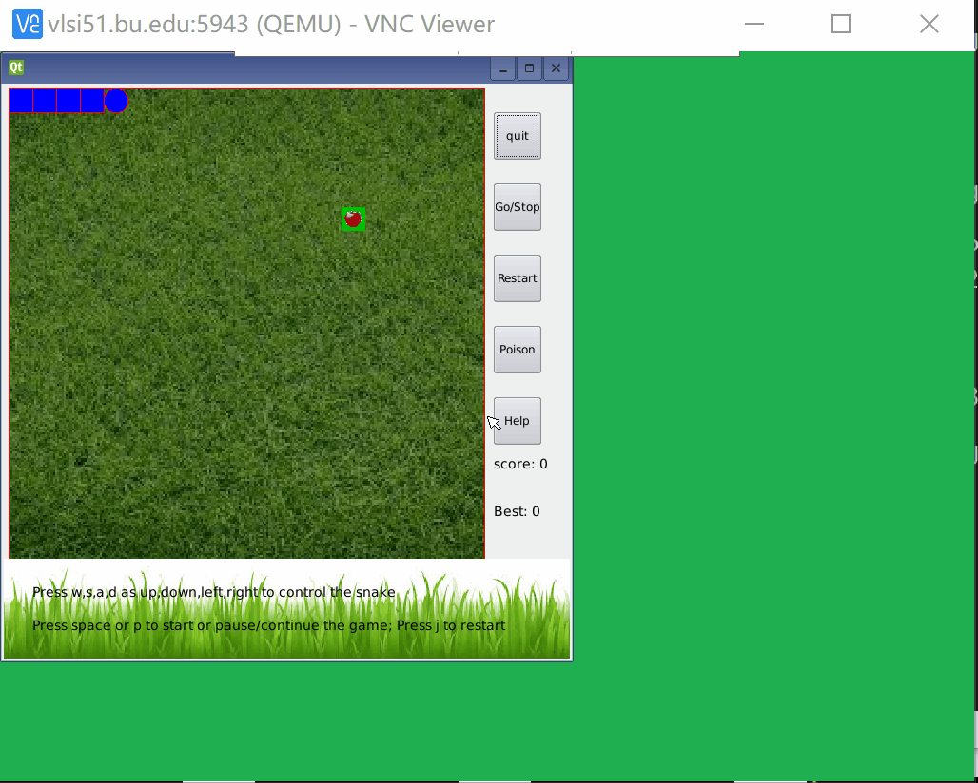
Snake game
Presentation Title
^{2/3/08 <number>}
Snake is the common name for a video game concept where the player maneuvers a line which grows in length, with the line itself being a primary obstacle.
    Game interface
    keyPress control the snake move
    snake grows when ate food
    Generate food randomly

Slide 3
Code
Presentation Title
^{2/3/08 <number>}
Widget:
    QPushButton: connect to slots: quit; pause/continue; restart; help
    QPainter(under PaintEvent): drawRect;drawEllipse; drawPixmap
    QMessageBox
KeyPressEvent to control the snake
    key_A, key_S, key_W,key_D change the direction
    key_P to pause the game
    Snake updated by Slot Update()
Pause Game using QTimer
    gameTimer->stop();
    gameTimer->start(TIME_INTERVAL);

Slide 4
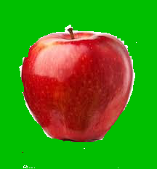
Code
Presentation Title
^{2/3/08 <number>}
Under Update slot (connected to QTimer):
QList<QPoint> to implement sanke grow
    add head according to the direction: snake.push_front
    delete tail or not according to whether snake contains the food: snake.pop_back
Food Generate
    randomly generate apple coordinates using rand()
Check GameOver
    against the wall: x<0||x>NUM_COL-1||y<0||y>NUM_ROW-1
    against the snake itself: snake[i]==snake.front()

Slide 5

Code
Presentation Title
^{2/3/08 <number>}
Added Poison Part:
PoisonGenerate
    if isPoison true: randomly generate poison coordinates
    Added to Init, Update, restart
QPushButton
    connected to slot ActivatePoison: set isPoison true
PaintEvent
    if(isPoison) { painter.drawPixmap(...,QPixmap("poison.png"))}
Check GameOver
    against the wall
    against the snake itself
    against the poison: snake.contains(poisonPoint) && isPoison

Slide 6
Thank you
Any Questions?
^{2/3/08 <number>}

