Slide 1
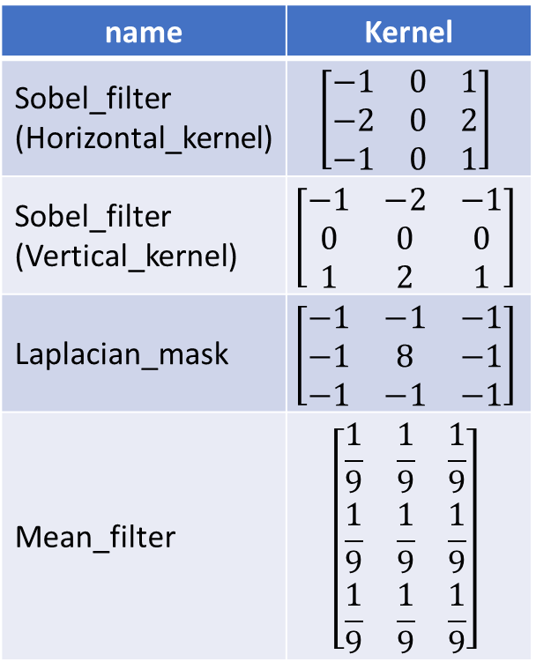
name | Kernel
Sobel_filter (Horizontal_kernel) | $$\left[\begin{matrix}−1 & 0 & 1 \\ −2 & 0 & 2 \\ −1 & 0 & 1\end{matrix}\right]$$
Sobel_filter (Vertical_kernel) | $$\left[\begin{matrix}−1 & −2 & −1 \\ 0 & 0 & 0 \\ 1 & 2 & 1\end{matrix}\right]$$
Laplacian_mask | $$\left[\begin{matrix}−1 & −1 & −1 \\ −1 & 8 & −1 \\ −1 & −1 & −1\end{matrix}\right]$$
Mean_filter | $$\left[\begin{matrix}\frac{1}{9} & \frac{1}{9} & \frac{1}{9} \\ \frac{1}{9} & \frac{1}{9} & \frac{1}{9} \\ \frac{1}{9} & \frac{1}{9} & \frac{1}{9}\end{matrix}\right]$$

