Slide 1
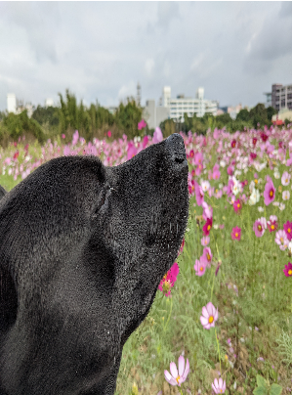
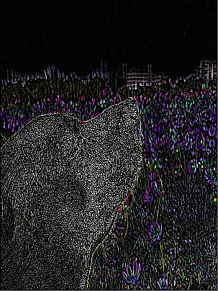
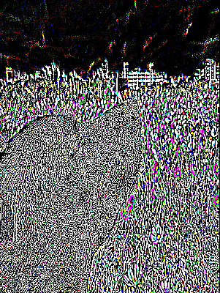
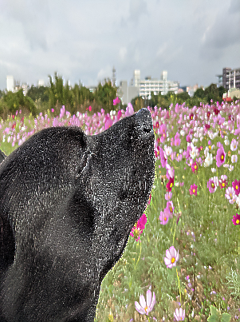
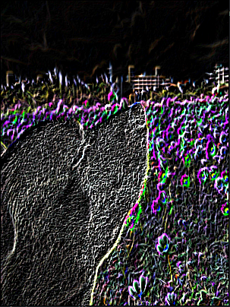
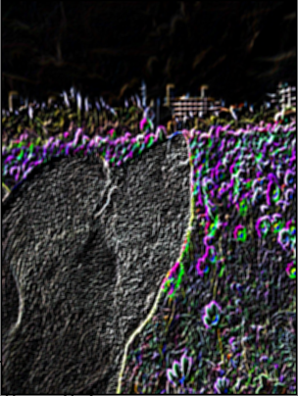
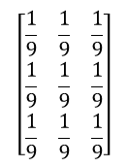

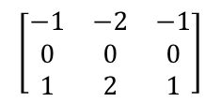

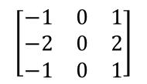
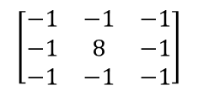

Source_img
Second-order differential
$$add$$
laplacian
Result
$$\left[\begin{matrix}−1 & −1 & −1 \\ −1 & 8 & −1 \\ −1 & −1 & −1\end{matrix}\right]$$
Laplacian_mask
Sobel
$$multiplied$$
first order differential
Unsharp mask
Mean
$$normalization$$
$$\left[\begin{matrix}−1 & 0 & 1 \\ −2 & 0 & 2 \\ −1 & 0 & 1\end{matrix}\right]$$
$$\left[\begin{matrix}−1 & −2 & −1 \\ 0 & 0 & 0 \\ 1 & 2 & 1\end{matrix}\right]$$
$$\left[\begin{matrix}\frac{1}{9} & \frac{1}{9} & \frac{1}{9} \\ \frac{1}{9} & \frac{1}{9} & \frac{1}{9} \\ \frac{1}{9} & \frac{1}{9} & \frac{1}{9}\end{matrix}\right]$$
Mean_filter
Horizontal_kernel
Vertical_kernel

