Slide 1
Beating the forecast
What Watts Consulting

Slide 2
OUR COMPANY
Founded in 2021, What Watts Consulting is an Australian-based Data Science consultancy firm, founded on the principle of using unconventional methods to solving big problems.

Slide 3




WHO ARE WE?
James
Nee
Chief Reporting Officer
Head of Python & Power BI
Peter
Ruhul
Senior R Consultant
Executive Manager - Modelling

Slide 4
TABLE OF CONTENTS
01
02
03
PROBLEM STATEMENT
METHODS & FINDINGS
SOLUTIONS & RECOMMENDATIONS

Slide 5
01
Problem Statement

Slide 6


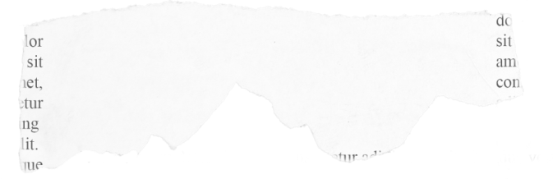

Background
Power Outage
across NSW
Power Crisis
Fires put electricity
grid under stress
Notes:
In February 2021 extreme weather conditions caused catastrophic failure of the TEXAS power grid, this is an issue that we won;t to avoid in Australia. Luckily the AEMO has systems in place to help avoid this, including forecasting and modeling of demand and price, as well as having an integrated grid across all of eastern Australia to ensure that the grid is highly resilient, with each state able to kick in and support each other.

Slide 7
The Business Problems
Energy Supply MUST equal Energy Demand
Discrepancies in Energy Demand forecast causes challenges for energy Supply
Rooftop solar data is not included in models
Drives model inaccuracy
Influences outlier days
Extreme temperatures, driving heating and cooling leading to discrepancies in models
Notes:
Scenario: on days when rooftop solar is high, demand might decrease to an amount that the forecast will be significantly less than traditional forecasts show, resulting in an over supply of Electricity with the base systems providing to much power

Slide 8
The Technical Problems
Forecasting models are dated and need improvements
Outlier Identification
Identify features to use
Modernise the models
Identify measures of success
Notes:
These problems led to our capability needing to have the following characteristics”

Slide 9
74.15
714.42
The RMSE of the AEMO’s forecasted demand to true total demand in 2020
The RMSE of the AEMO’s forecasted demand to true total demand for outliers
Notes:
Due to the amplification of outliers, we chose the RMSE as the measure of success, as it would focus and highlight the outliers to facilitate the learning, and identifying how to resolve

Slide 10
OUR GOAL
BELOW EXPECTATIONS
MEET EXPECTATIONS
EXCEED EXPECTATIONS
Higher RMSEP
Similar RMSEP
Lower RMSEP
Our model has a higher RMSEP to that used by the AEMO
Our model produces an RMSEP 0%-5% less than the AEMO
Our model produces an RMSEP 5%+ less than the AEMO

Slide 11
02
Methods & Findings

Slide 12


OUR MODELS
TIME SERIES
MULTI-LAYER PERCEPTRON
XGBOOST
LSTM
Baseline Model
Neural Network
Supervised Machine Learning Classification
Recurrent Neural Network

Slide 13
OUR PROCESS
DATA GATHERING
MODEL BUILDING
STEP 02
STEP 04
STEP 01
STEP 03
DATA PREP
COMPARISON
Collect and join data from different sources
Run different models and document performance
Clean and transform data
Weighing up pros & cons of different models and RMSEP

Slide 14
RESULTS - 2020
 | Test RMSEP | %Diff | Goal | Notes
Time Series | 82.48 | +11.2% | Meet | Doesn’t account for other features
MLP | 70.99 | -4.3% | Meet | Similar performance
XGBoost | 67.35 | -9.20% | Exceed | Least overfitting
LSTM | 195.59 | +163.8% | Below | Removed from next run

Slide 15
RESULTS - OUTLIERS
 | Test RMSEP | %Diff | Goal | Notes
Time Series | 244.41 | -65.8% | Exceed | Relied more recent past observations
MLP | 710.96 | +0.5% | Below | Similar performance
XGBoost | 741.26 | 3.80% | Below | Similar performance
LSTM | - | - | - | Excluded due to poor performance

Slide 16
PERFORMANCE AGAINST GOALS
BELOW EXPECTATIONS
MEET EXPECTATIONS
EXCEED EXPECTATIONS
Higher RMSEP
Similar RMSEP
Lower RMSEP
LSTM
MULTI-LAYER PERCEPTRON
TIME SERIES (outliers)
XGBOOST (overall)
Notes:
LSTM was to Naive, and lacked the sophistication, it could easily be improved with lag, and tuning parameters.
MLP Regresser was rigorous good all round performers,
ARIMA, handled Outliers well, likely because the outliers didn;t coeratle with the features well, hence the prior demand was a better indicator, 65.79% improvement XGBoost, best for overall accuracy, 9.2% improvement

Slide 17
03
Solution & Improvements

Slide 18


Solution
Solution
Temp
AEMO Forecast
PV
XGBoost
Public Holiday
Predicted Total Demand
Total Demand (past observed data)
Time Series

Slide 19


Implementation
Currently AEMO is already receiving the Temperature, Public Holiday data. We use more granular binning of data such as date, time, temperature to build a more robust model.
We need to provide Solar PV sample data for forecasting events. This can be done either theoretically, or by modelling of the PV Data and rollout

Slide 20
Recommendations
Our Model would perform best in a hybrid mode, where both the Time Series and the XGBoost always being used, If on measuring the forecast has moved away from the XGBoost model then the recommendation is to move to the Time series for several hours until the system returns to normal, this takes advantage of both systems.

Slide 21

Want more information?
https://github.com/Jimbobaus/project---What-Watts---Group-A
What Watts Consulting

Slide 22
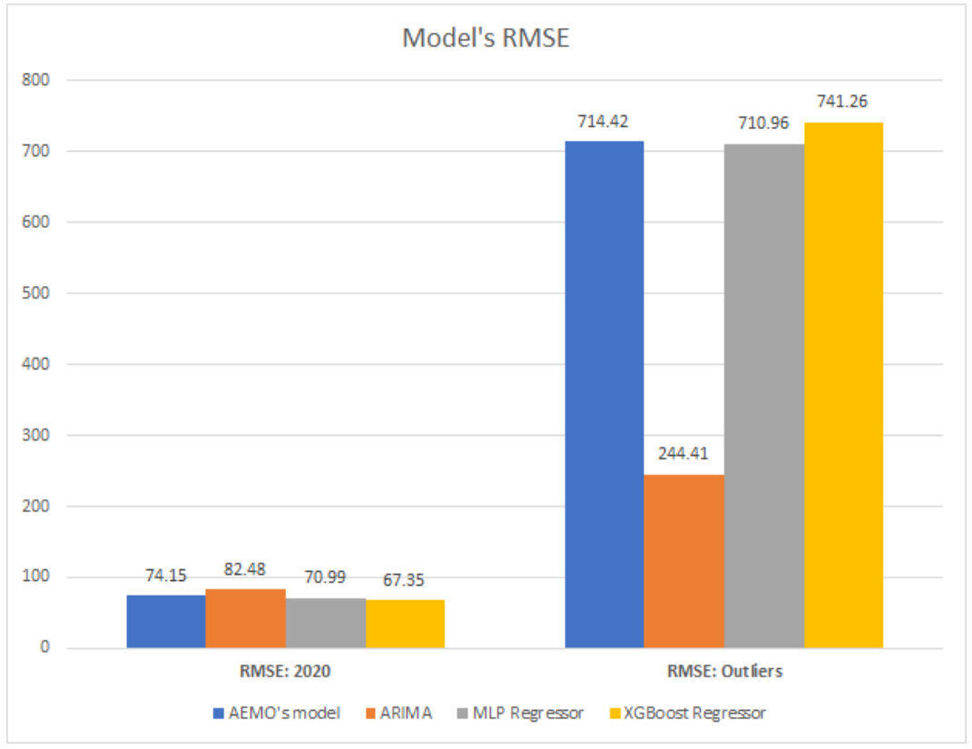

RESULTS - 2020
Notes:
RMSE comparison of the prediction for all data and the outlier subset
for the selected models

Slide 23
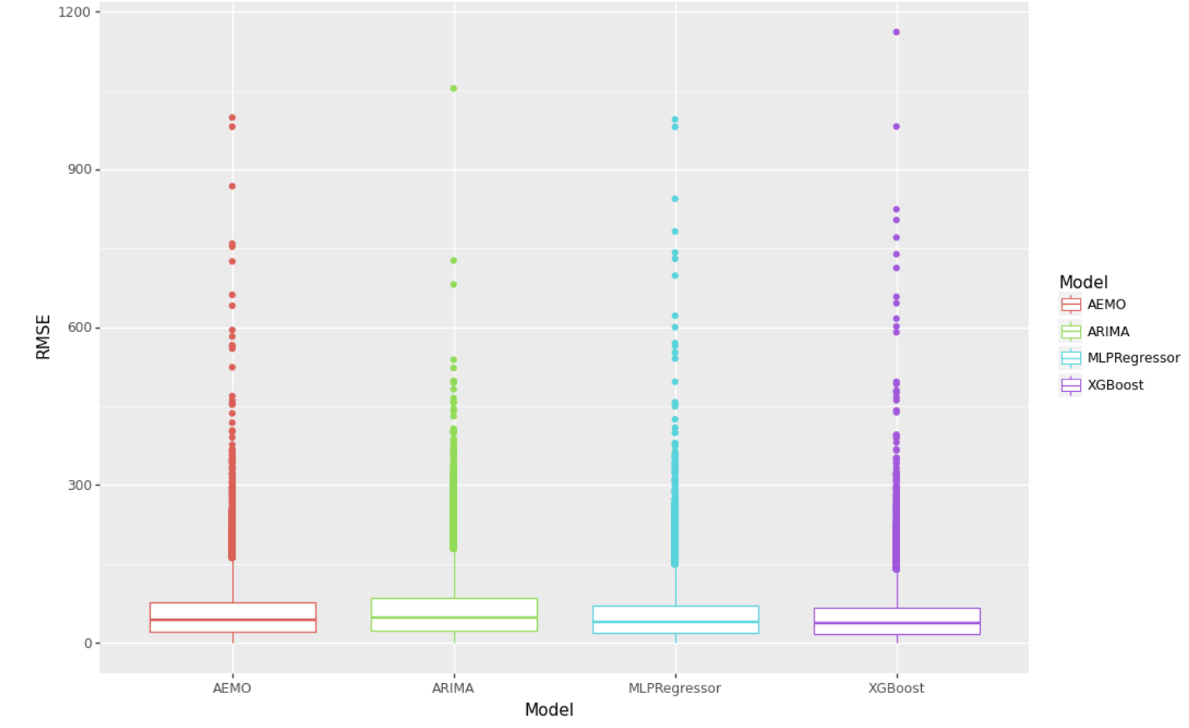
RESULTS - OUTLIERS
Notes:
RMSE comparison of the prediction for different models and to show outliers.
ARIMA has lowest outliers

Slide 24
Solution
ForecastData
Historic Data
Model
Total Demand (observed data)
Temp
AEMO Forecast
Temp
AEMO Forecast
PV
Public Holiday
PV
Public Holiday
XGBoost
ARIMA
Time Series
Total Demand Predicted

