Slide 1



Person Detection from a Top-View Perspective
Computer vision and deep learning project:
Baldascino Giovanni 1097405
Squarcella Loisi 1096539

Slide 2

Person Detection from a Top-View Perspective
Person Detection from a Top-View Perspective by using most recent object detection frameworks.
The aim is to build an efficient model to detect the people in the scene. The provided scenario is a retail environment.

Slide 3

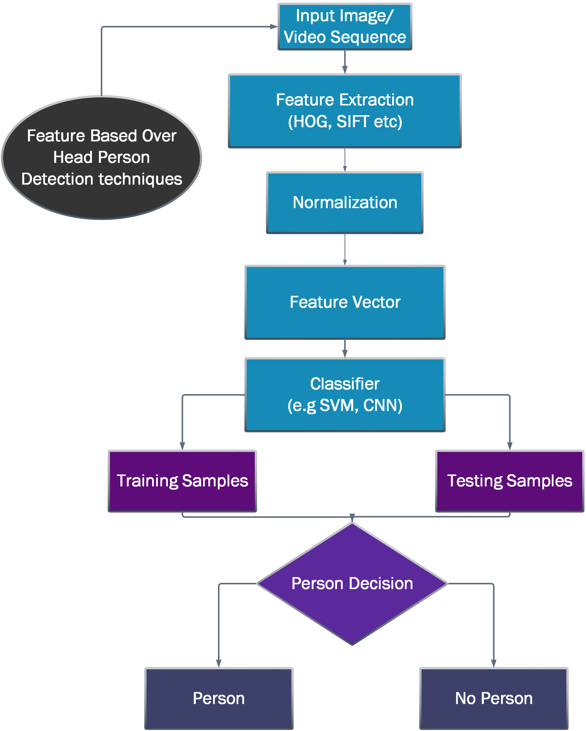
State of the art
PERSON DETECTION:
- Blob based Techniques
- Feature based Techniques
MAIN STEPS:
I. Definition of the ROI (Region of Interest)
II. People localization

Slide 4
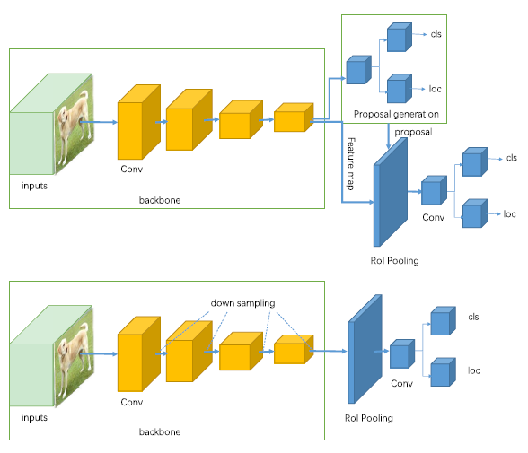
FEATURE BASED TECHNIQUES:
Two-stage detectors (R-CNN, Faster R-CNN, etc..) use a Region Proposal Network to generate regions of interests and send the region proposals down the pipeline for object classification and bounding-box regression.
One-stage detectors (YOLO, SSD, etc..) treat object detection as a simple regression problem by taking an input image and learning the class probabilities and bounding box coordinates.

Slide 5
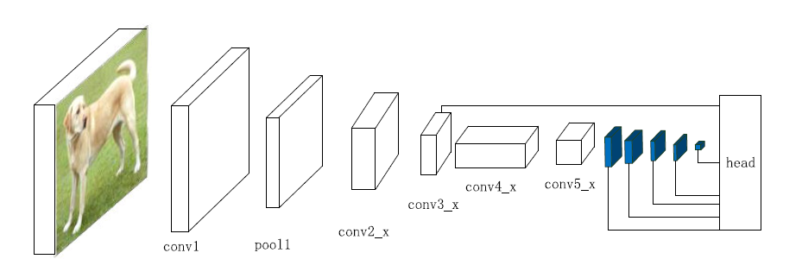
SSD
SSD (single-shot detector) discretizes the output space of bounding boxes into a set of default boxes over different aspect ratios and scales per feature map location.
In SSD the prediction layer is acting on fused features of different levels. Head module
consists of a series of convolutional layers followed by several classification layers and localization layers.

Slide 6
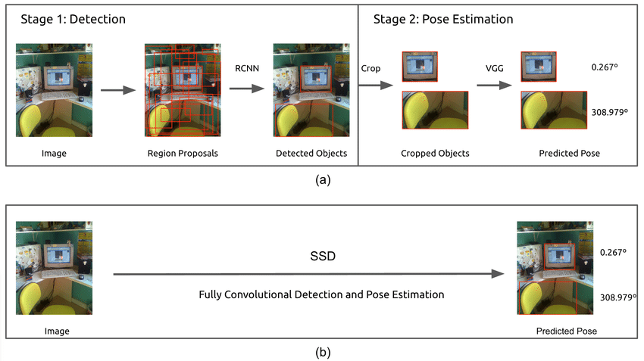
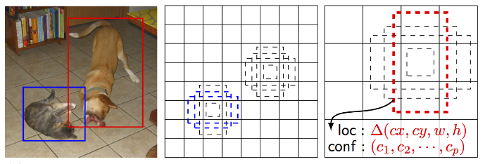


Slide 7
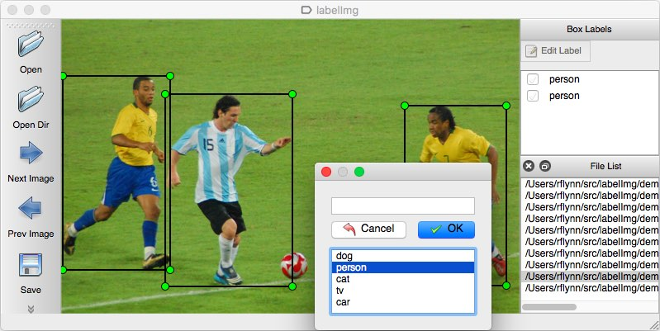
LABEling
Dataset annotation using labelImg.
LabelImg is a graphical image annotation tool.
It is written in Python and uses Qt for its graphical interface.
Annotations are saved as XML files in PASCAL VOC format.
It also supports YOLO format.

Slide 8
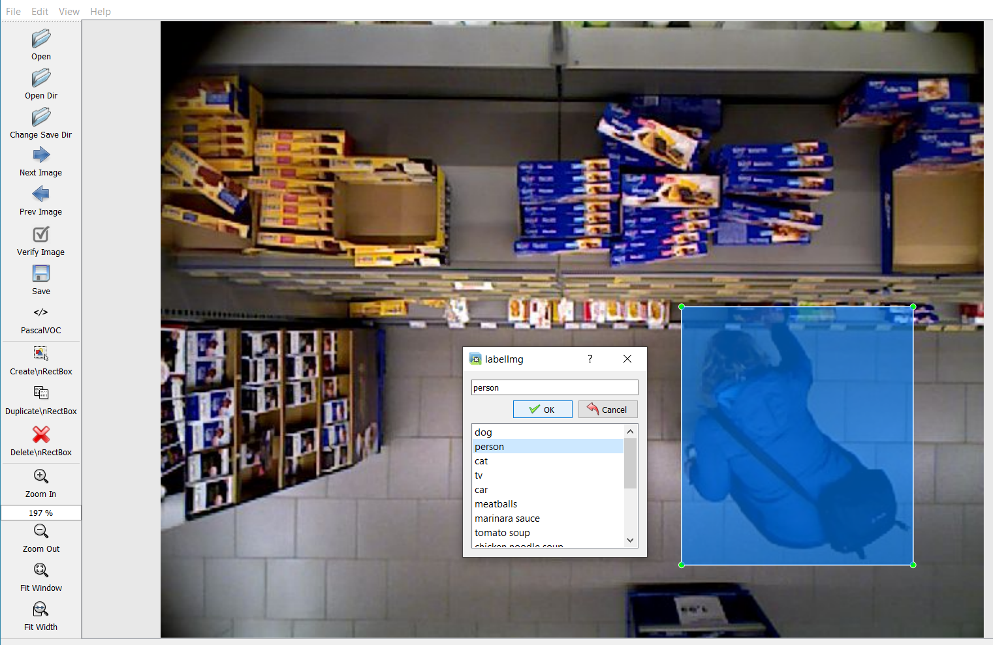
Steps:
I. Build and launch using the instructions above;
II. Click 'Change save dir' in Menu/File;
III. Click 'Open Dir’;
IV. Click 'Create RectBox’;
V. Click and release left mouse to select a region to annotate the rect box and add a label;
VI. Use right mouse to drag the rect box to copy or move it.

Slide 9
Future tasks
What we are going to do?
Get familiar with SSD networks;
Use one-stage possibly other approaches like YOLO, YOLOV3, etc…;
Improve the network after testing;

Slide 10
GRAZIE PER L’ATTENZIONE
YOLOLOLOLOLOLOLOLOLOLOLOLOLOLO

