Slide 1



Person Detection from a Top-View Perspective
Computer vision and deep learning project:
Baldascino Giovanni 1097405
Squarcella Loisi 1096539

Slide 2
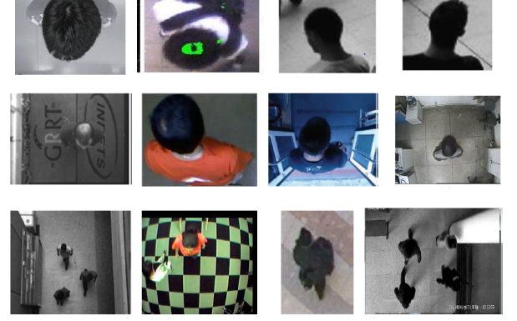
Person Detection from a Top-View Perspective
Person Detection from a Top-View Perspective by using most recent object detection frameworks.
The aim is to build an efficient model to detect the people in the scene. The provided scenario is a retail environment.

Slide 3
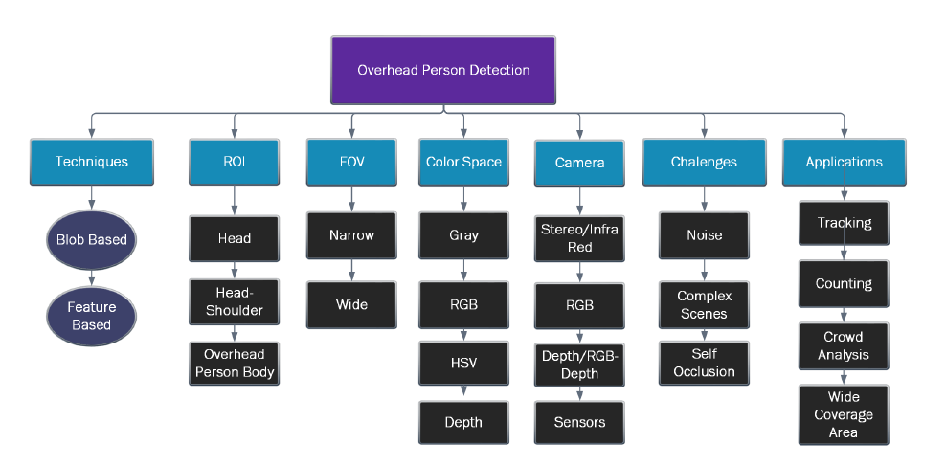
State of the art
PERSON DETECTION:
Blob based Techniques
Feature based Techniques
MAIN STEPS:
Definition of the ROI (Region of Interest)
People localization

Slide 4
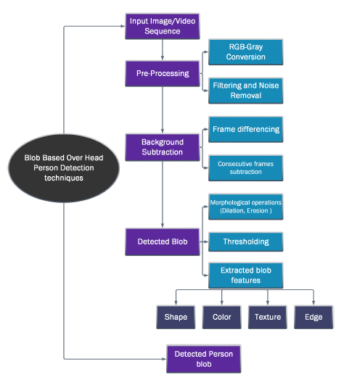
State of the art
In Blob based Techniques a foreground image is obtained from background subtraction. Different pre-processing techniques are also used to remove noise, shadow and illumination.
A threshold is set to get the desired foreground image. From the foreground image the blob is extracted which is further classified into categories. The classification is based on the shape, color, motion or other feature of the blob..

Slide 5
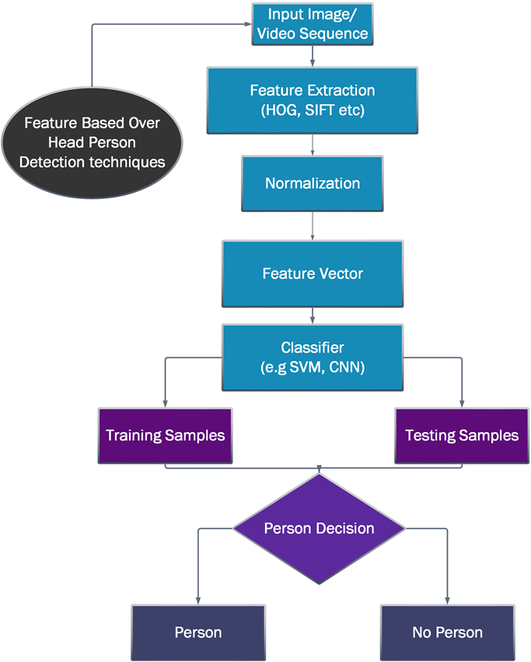
State of the art
These Feature based Techniques operate on features extracted from overhead view videos and images. The extracted features are further used to classify person and non-person images.
The extracted features contain shape, color, texture, etc.… Including SIFT and HOG algorithms to detect person. The images are often divided into samples for training and testing.

Slide 6
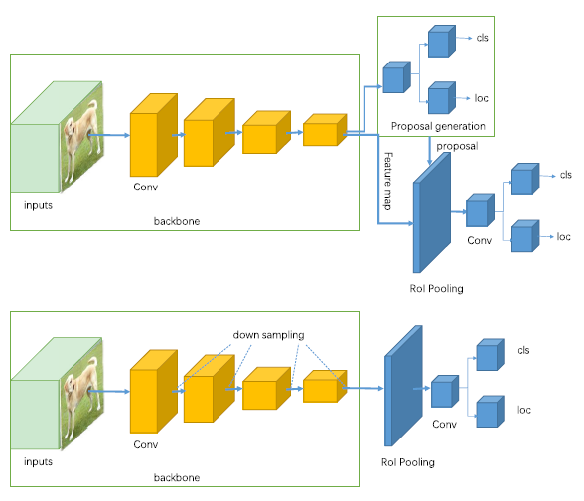
FEATURE BASED TECHNIQUES
Two-stage detectors (R-CNN, Faster R-CNN, etc..) use a Region Proposal Network to generate regions of interests and send the region proposals down the pipeline for object classification and bounding-box regression.
One-stage detectors (YOLO, SSD, etc..) treat object detection as a simple regression problem by taking an input image and learning the class probabilities and bounding box coordinates.

Slide 7

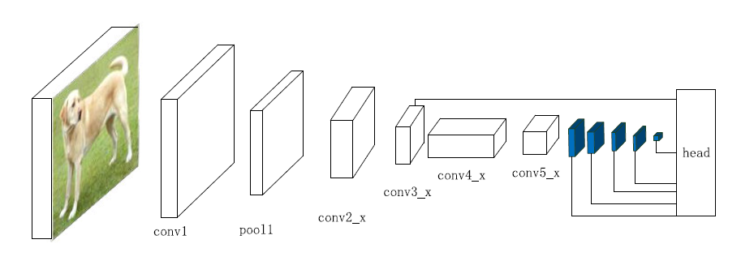
SSD
SSD (single-shot detector) discretizes the output space of bounding boxes into a set of default boxes over different aspect ratios and scales per feature map location.
In SSD the prediction layer is acting on fused features of different levels. Head module
consists of a series of convolutional layers followed by several classification layers and localization layers.

Slide 8
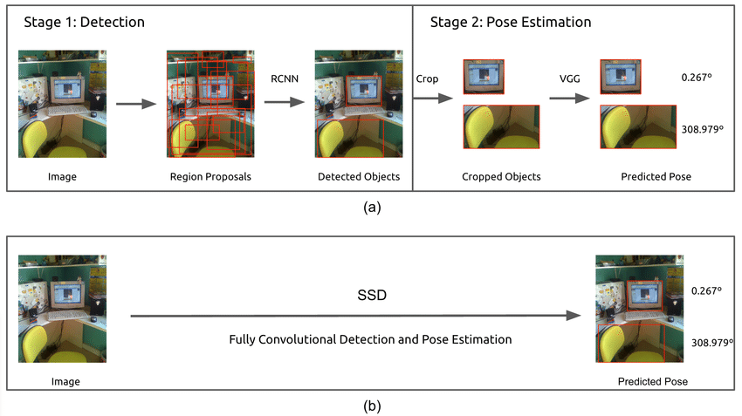
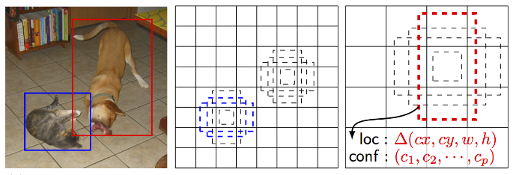


Slide 9
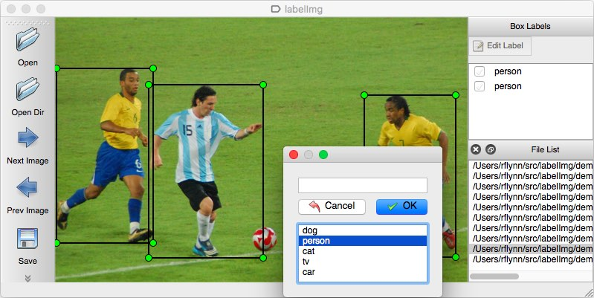
LABEling
Dataset annotation using labelImg.
LabelImg is a graphical image annotation tool.
It is written in Python and uses Qt for its graphical interface.
Annotations are saved as XML files in PASCAL VOC format.
It also supports YOLO format.

Slide 10
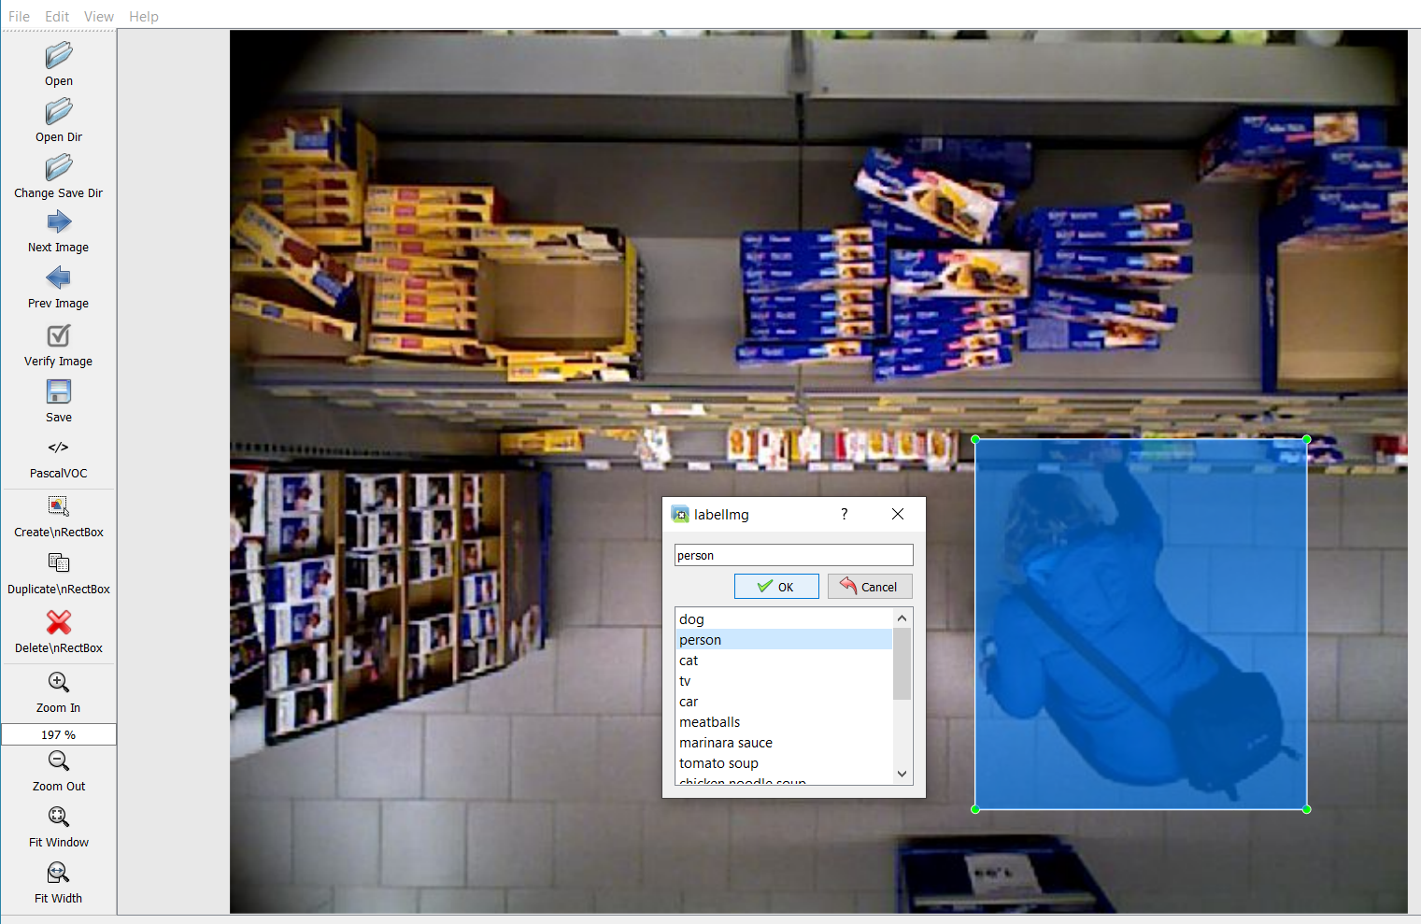
STEPS:
Build and launch using the instructions above;
Click 'Change save dir' in Menu/File;
Click 'Open Dir’;
Click 'Create RectBox’;
Click and release left mouse to select a region to annotate the rect box and add a label;
Use right mouse to drag the rect box to copy or move it.

Slide 11
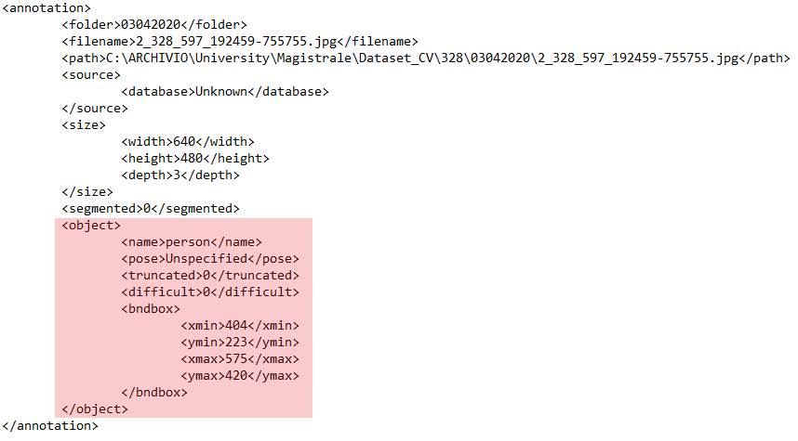
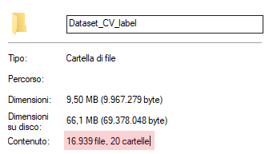
LABEL
The <object> tag defines the label, in this case the only class, person, is identified by the <name> tag.
The bounding box is located inside the <bndbox> tag, through 4 coordinates <xmin> <ymin> <xmax> <ymax>.

Slide 12
Future tasks
What we are going to do?
Get familiar with SSD networks (again);
Use one-stage possibly other approaches like YOLO, YOLOV3, etc.…;
Improve the network after testing;

Slide 13
GRAZIE PER L’ATTENZIONE
YOLOLOLOLOLOLOLOLOLOLOLOLOLOLO

