Slide 1
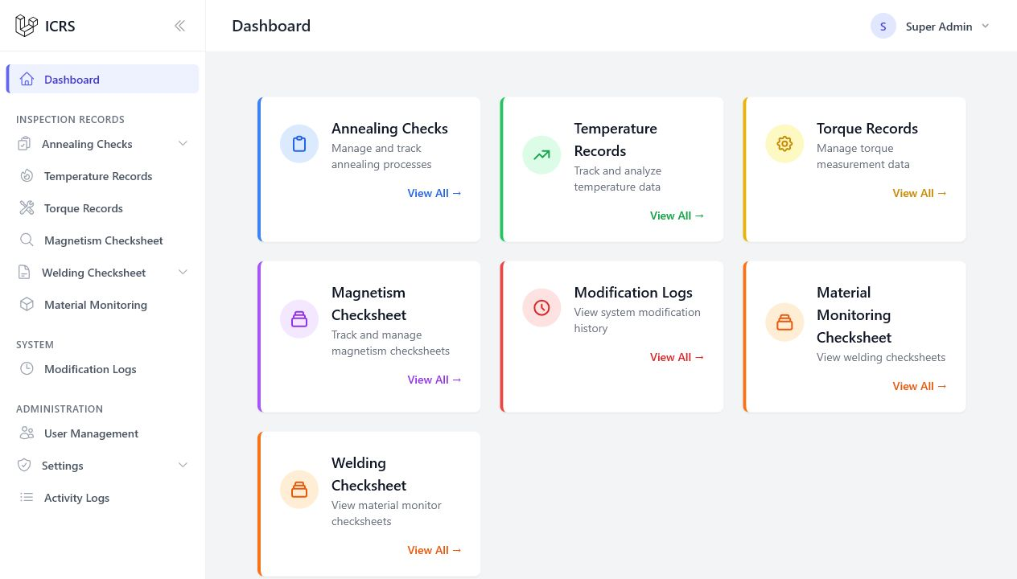
ICRS
Operator / Inspector
Using the Inspection
Checksheet Recording
System
Operator & Inspector Orientation
A practical guide to finding, recording,
reviewing, and updating inspection data.
20–25 minute guided session
Notes:
Welcome the group and explain that this session focuses on the daily operator and inspector workflow.
The screenshots are from the current ICRS interface with personal and production-sensitive details hidden.

Slide 2
ICRS USER ORIENTATION
What you will be able to do
1
2
3
Navigate confidently
Record correctly
Review safely
Move between the dashboard and the inspection modules.
Create a new record and recognize required fields.
Search, verify, update, import, and avoid common mistakes.
Inspection Checksheet Recording System
02
Notes:
Set expectations: this is a practical orientation, not a detailed system-administration session.
Tell participants they will complete two short practice tasks near the end.

Slide 3
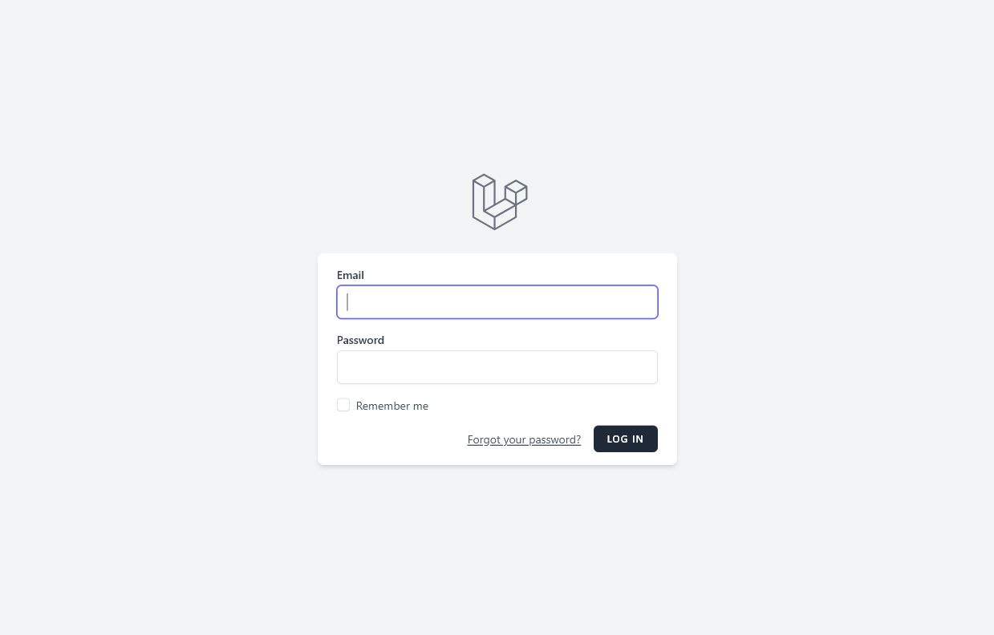
ICRS USER ORIENTATION
Log in securely
1
Enter your assigned email.
2
Enter your password.
3
Use “Remember me” only on an assigned device.
4
Select Log in.
Never share credentials or save them on a public/shared computer.
Inspection Checksheet Recording System
03
Notes:
Point to the email and password fields.
Explain that Remember me is appropriate only for a device assigned to the user and protected by company policy.
If access fails, verify the email first, then contact the assigned system administrator.

Slide 4
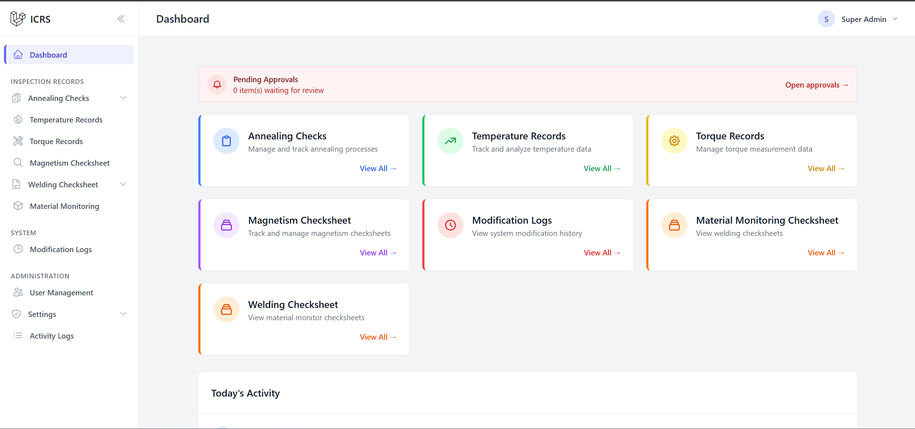
ICRS USER ORIENTATION
Your starting point: the dashboard
3
2
1
1 Sidebar navigation
2 Module shortcuts
3 Profile & log out
Inspection Checksheet Recording System
04
Notes:
The dashboard is the safest place to return when unsure where to go.
The visible modules depend on the user's assigned access.
Use the top-right profile menu to review profile information or log out.

Slide 5
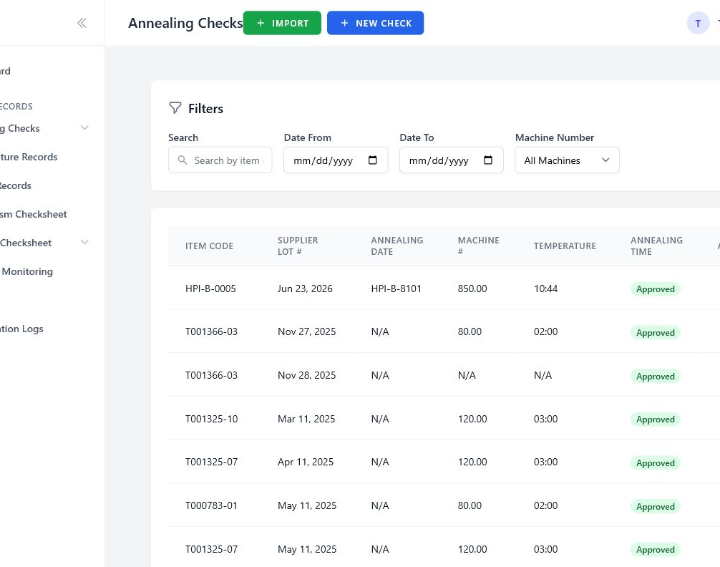
ICRS USER ORIENTATION
Use the sidebar to choose a module
Operator / Inspector
Annealing Checks
Temperature Records
Torque Records
Magnetism Checksheet
Record data hidden
Welding Checksheet
Material Monitoring
Tip: select Dashboard whenever you want to restart your navigation.
Inspection Checksheet Recording System
05
Notes:
Read the sidebar from top to bottom and connect each module to the corresponding inspection process.
Annealing and Welding expand to show additional actions when the user has permission.

Slide 6
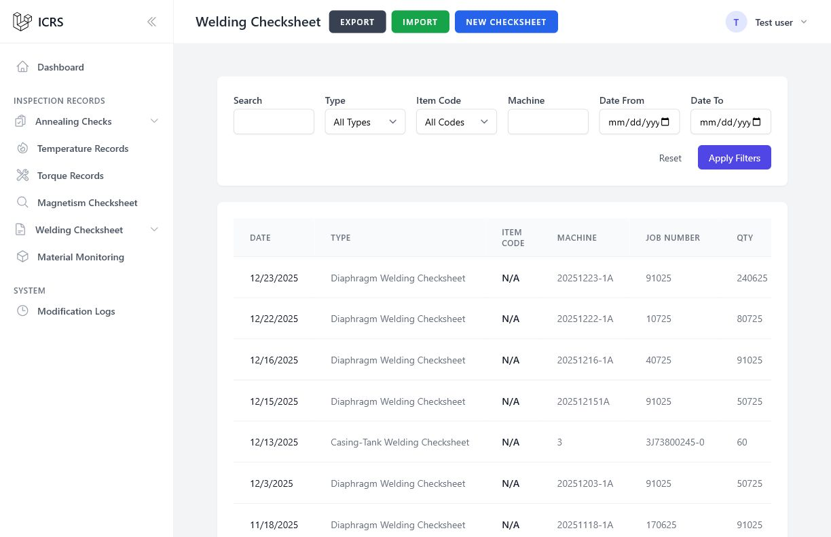
ICRS USER ORIENTATION
Your screen follows your assigned permission
Operator / Inspector
Operator / Inspector
Production records hidden
Operator / Inspector
Different role
Daily inspection modules and only the actions assigned to you.
May see additional menus or buttons. This is expected—not an error.
If a required action is missing, request access—do not use another person’s account.
Inspection Checksheet Recording System
06
Notes:
Permissions determine which modules and actions appear.
A missing Create, Edit, Import, Export, or Delete action normally means the account is not assigned that permission.
Never work around access rules by borrowing another account.

Slide 7
ICRS USER ORIENTATION
The same four-step workflow works across modules
1
FIND
2
CREATE
3
REVIEW
4
UPDATE
Search or filter the list
Enter the required details
Check the saved record
Correct it only when permitted
Accuracy first
Take a final look before leaving the page. Correct item code, date, machine, quantity, readings, and responsible person.
Inspection Checksheet Recording System
07
Notes:
Use this slide as the mental model for the remainder of the training.
Most modules differ in their fields, but the overall find-create-review-update pattern is consistent.

Slide 8
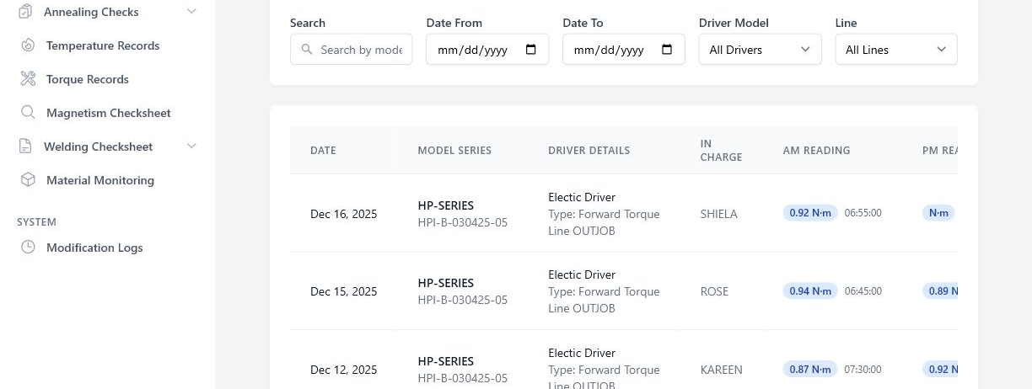
ICRS USER ORIENTATION
Find the correct record before creating another
Operator / Inspector
Example record rows hidden for orientation
1
Use Search for a model, item, person, or code.
2
Use date and module-specific filters.
3
Open the matching row to review it.
Inspection Checksheet Recording System
08
Notes:
Encourage users to search first to avoid duplicate records.
The available filters change by module—for example, machine number, driver model, line, type, or date.
Open and review the matching result before deciding to create a new entry.

Slide 9
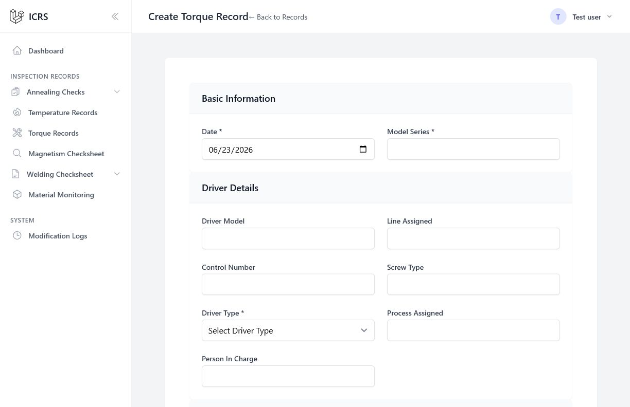
ICRS USER ORIENTATION
Create a record: complete required fields first
Operator / Inspector
1
Start with fields marked *
2
Use the correct date
3
Match the equipment and process
4
Enter readings exactly as measured
Scroll to the bottom, review the full form, then save.
Inspection Checksheet Recording System
09
Notes:
Demonstrate the required-field asterisk.
Explain that the visible upper section is only part of the form; users must scroll to complete readings and remarks.
Values must come from the actual inspection source, not from memory or a previous entry.

Slide 10
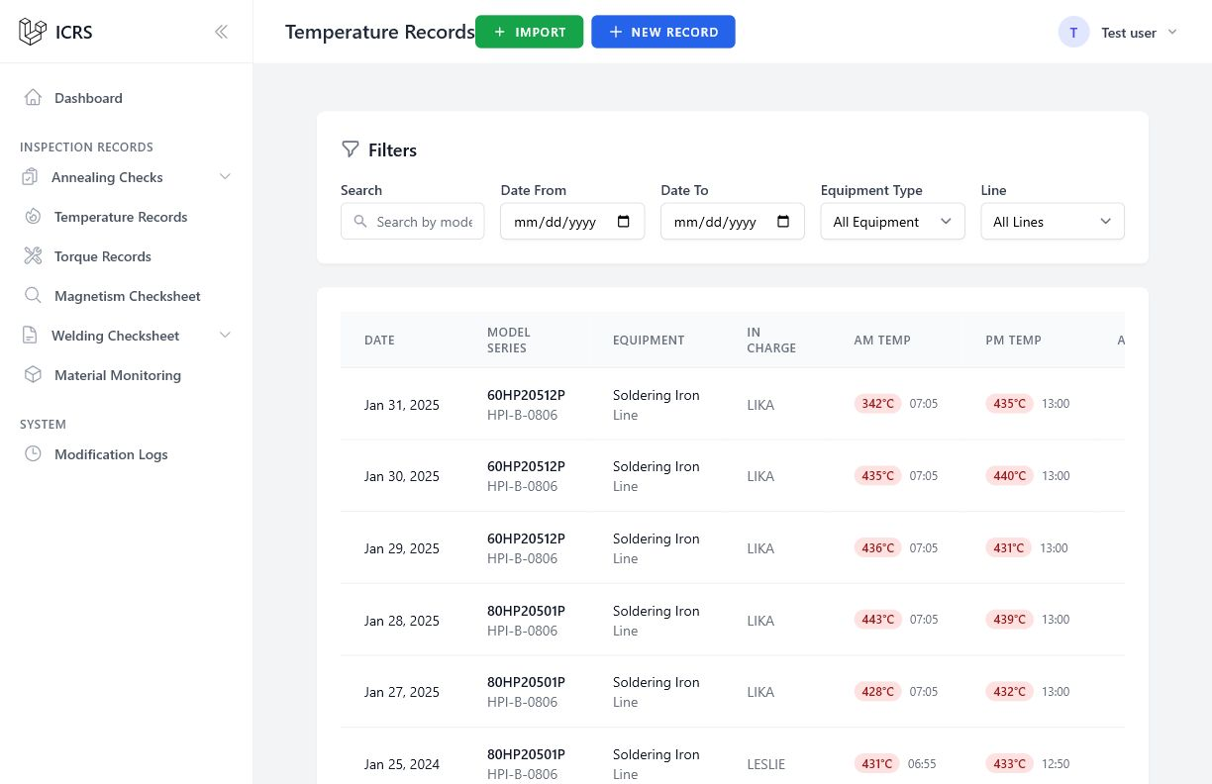
ICRS USER ORIENTATION
Review first; edit or delete only when appropriate
Operator / Inspector
VIEW
Open the record and verify the details.
EDIT
Correct an authorized mistake; do not rewrite history.
DELETE
Record values and names hidden
Use only for an invalid or duplicate record, and confirm carefully.
Actions may be hidden when your account does not have permission.
Inspection Checksheet Recording System
10
Notes:
Show the actions column and explain the difference between viewing, editing, and deleting.
If uncertain whether a record should be deleted, stop and ask the responsible supervisor or inspector.

Slide 11
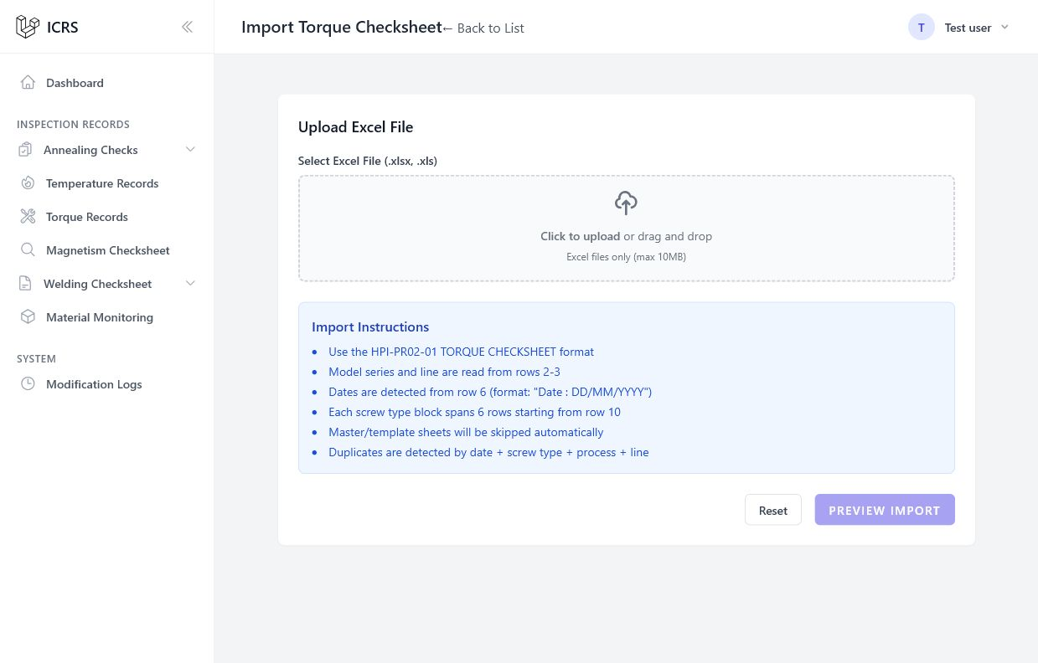
ICRS USER ORIENTATION
Import safely: Upload → Preview → Confirm
Operator / Inspector
1
UPLOAD
2
PREVIEW
3
CONFIRM
Use the correct template.
Read duplicate and error results before confirming.
Inspection Checksheet Recording System
11
Notes:
Import is never a one-click action.
Users upload a supported Excel file, preview the parsed rows, review new records, duplicates, and errors, then confirm.
If the preview looks wrong, cancel and fix the workbook rather than forcing the import.

Slide 12
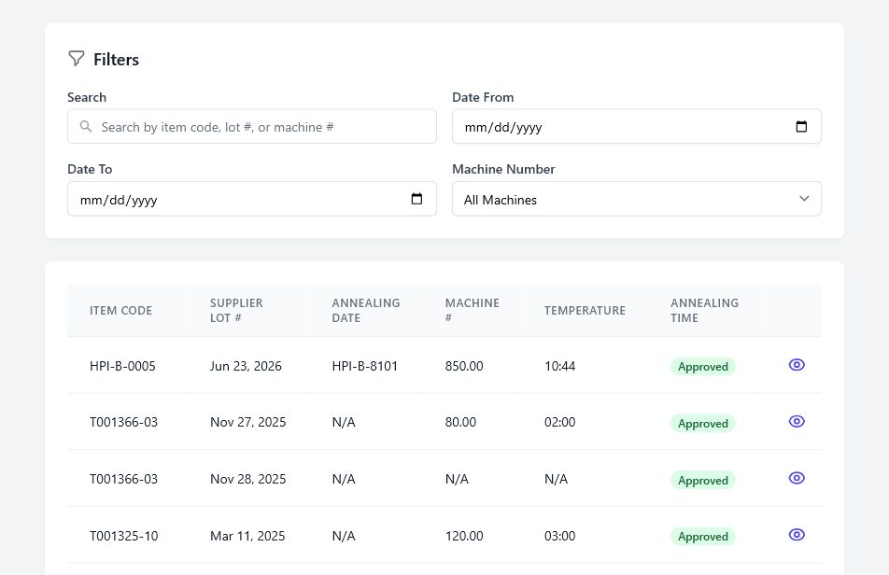
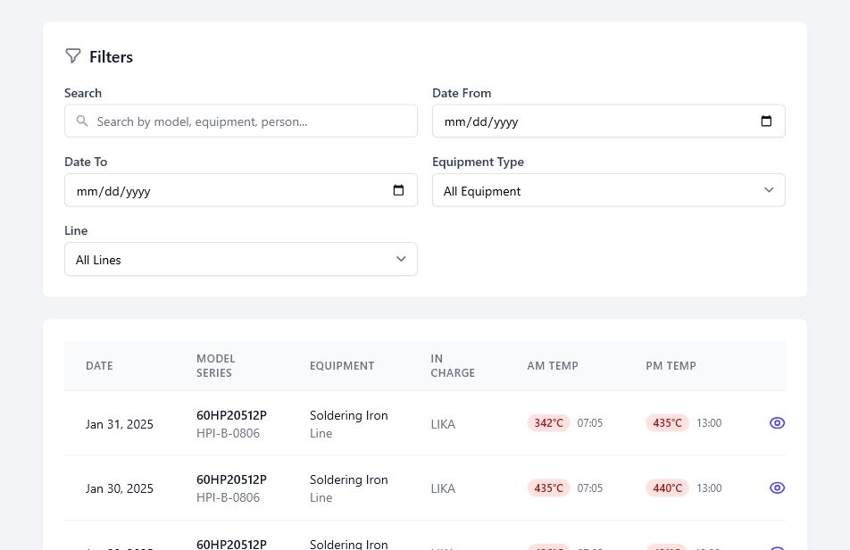
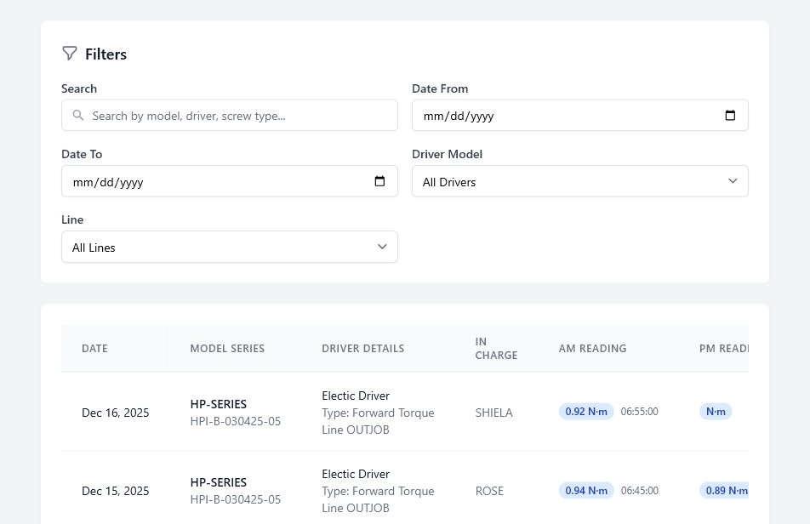
ICRS USER ORIENTATION
Annealing, Temperature, and Torque use the shared pattern
Operator / Inspector
Operator / Inspector
Operator / Inspector
Sample rows hidden
Sample rows hidden
Sample rows hidden
ANNEALING
TEMPERATURE
TORQUE
Item, supplier lot, machine, temperature, and time
Equipment, person in charge, AM/PM readings, and dates
Driver details, line, screw type, process, and readings
Search • Create • Review • Update
Search • Create • Review • Update
Search • Create • Review • Update
Inspection Checksheet Recording System
12
Notes:
Do not repeat the full workflow three times; emphasize that these modules share the same list, filters, create form, details, and edit pattern.
The field names differ according to the inspection being recorded.

Slide 13
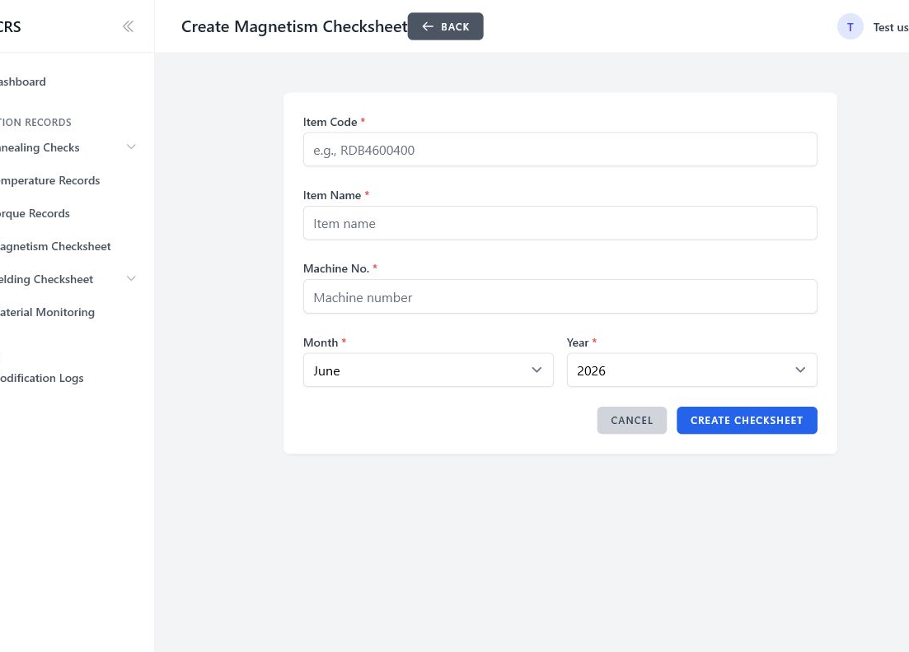
ICRS USER ORIENTATION
Magnetism adds batches and inspection checkpoints
Operator / Inspector
Magnetism workflow
1
Create the checksheet header
2
Add the production batch
3
Enter inspection checkpoints
4
Save and review the result
One checksheet can contain multiple batches.
Inspection Checksheet Recording System
13
Notes:
Magnetism differs from the simple one-form modules.
Start with the checksheet header, then work inside it to create production batches and enter checkpoints.
The current training database has no Magnetism checksheets, so the slide illustrates the live create screen and the verified workflow.

Slide 14
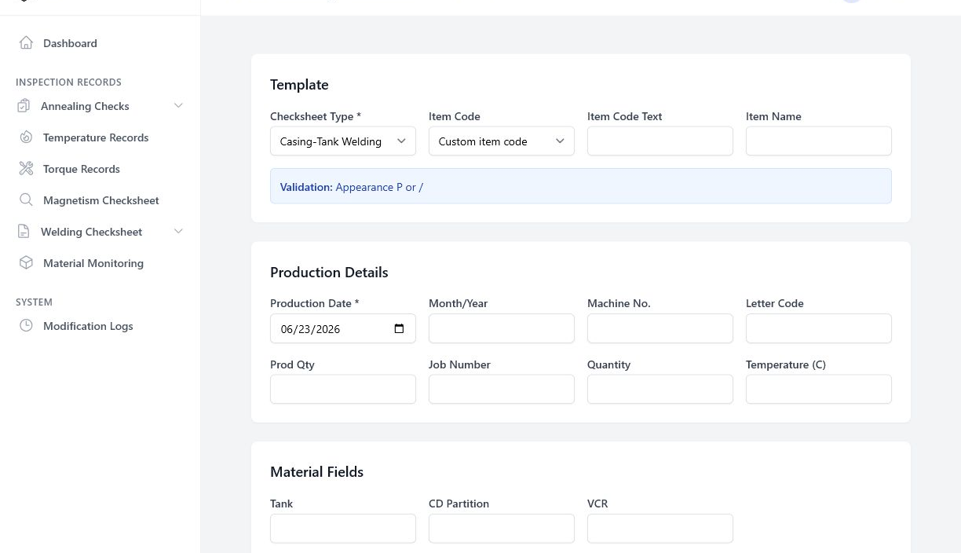
ICRS USER ORIENTATION
Welding is driven by checksheet type and item code
Operator / Inspector
1
Choose the checksheet type.
2
Select the correct item code.
3
Read the validation message.
4
Complete production and material fields.
5
Enter samples, personnel, and remarks.
Inspection Checksheet Recording System
14
Notes:
The selected checksheet type and item code determine which fields and validation guidance apply.
Users should read the blue validation message before entering measurement data.
Continue below the visible area to complete samples, personnel, and remarks.

Slide 15
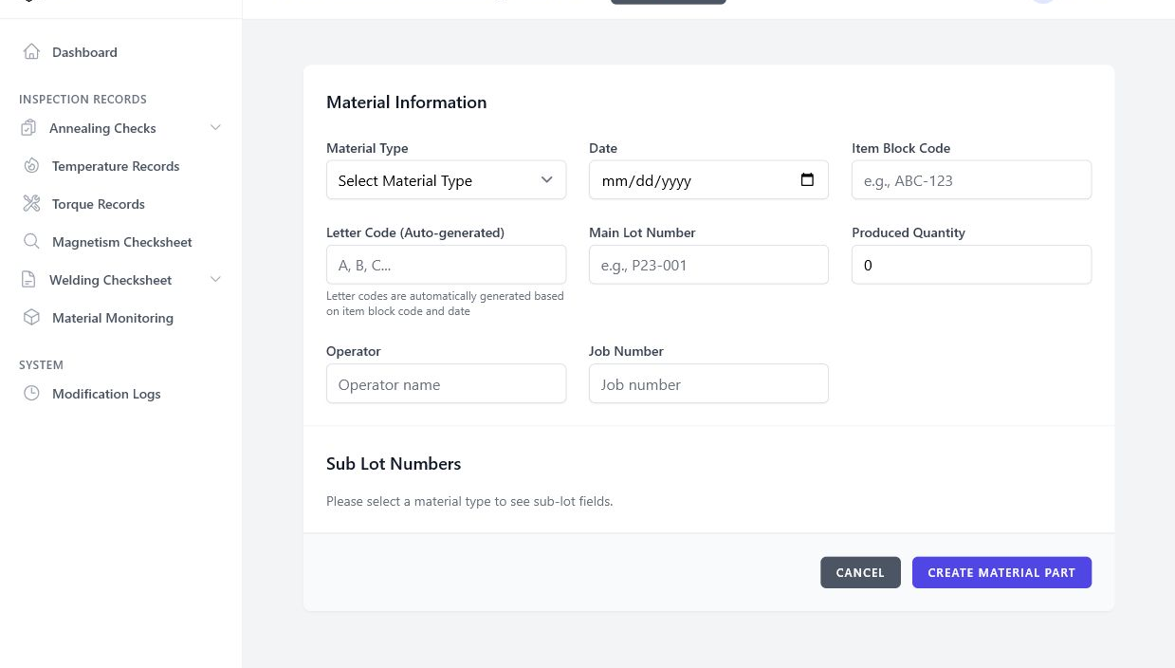
ICRS USER ORIENTATION
Material Monitoring organizes main lots and sub-lots
Operator / Inspector
1
Select Material Type
2
Enter the main lot
3
Confirm the auto-generated letter code
4
Enter the displayed sub-lot fields
Sub-lot fields appear after Material Type is selected.
Inspection Checksheet Recording System
15
Notes:
Material Type controls which sub-lot fields appear.
The letter code is generated by the system and should not be manually guessed.
Verify the main lot, quantity, operator, job number, and all visible sub-lot numbers before saving.

Slide 16
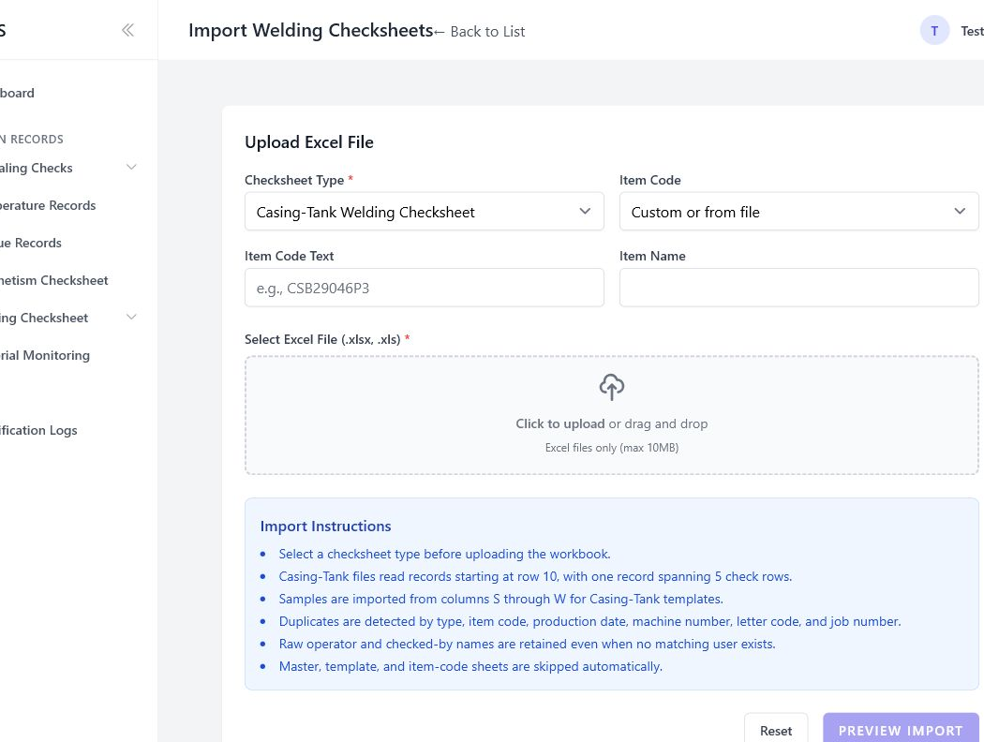
ICRS USER ORIENTATION
Prevent the mistakes that create bad records
Operator / Inspector
DO NOT
Create before searching for an existing record.
DO NOT
Ignore required fields or validation messages.
DO NOT
Confirm an import without reviewing duplicates and errors.
DO NOT
Enter “0” when the instruction means blank or not recorded.
ALWAYS
Review the saved record before moving to the next task.
Inspection Checksheet Recording System
16
Notes:
Slow down here; these are the habits that protect data quality.
Keep literal form semantics. A blank or not-recorded field is not automatically the same as zero.
For imports, the preview is the safety checkpoint.

Slide 17
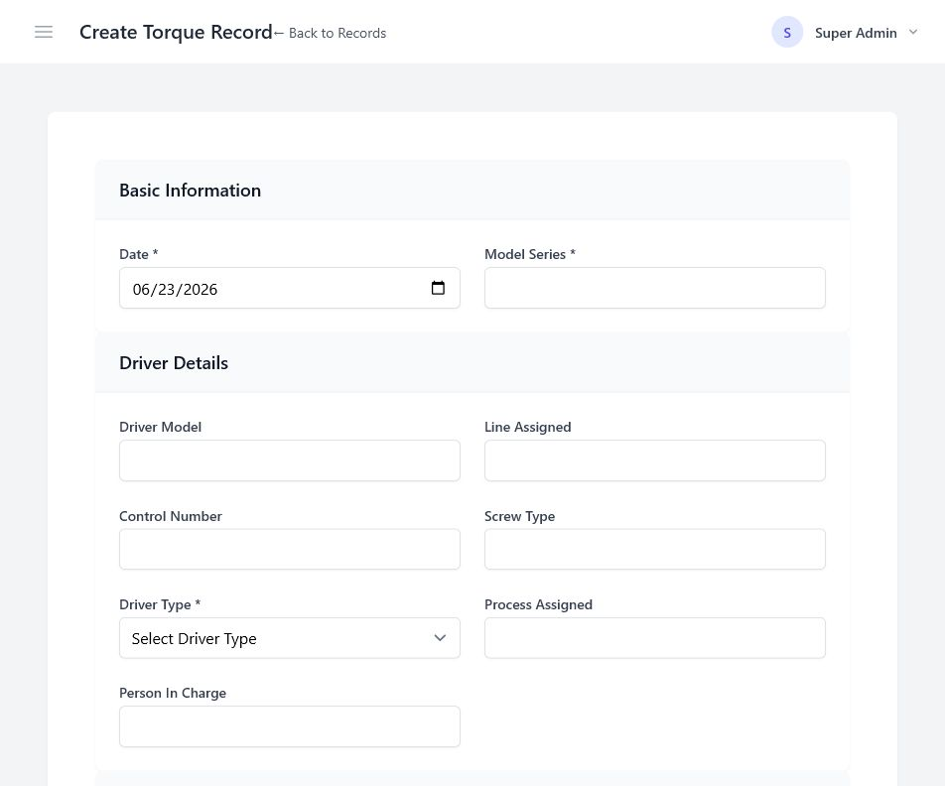
PRACTICE 01
Create a sample Torque record
Operator / Inspector
1
Open Torque Records → New Record.
2
Use the trainer’s sample date and model.
3
Complete every required field.
4
Review the form before saving.
Expected result: a saved record that opens without validation errors.
Use a trainer-approved sample only. Do not enter a fake record into production.
Notes:
Allow three to four minutes.
If this is the production environment, demonstrate without clicking the final save button unless the trainer has authorized a controlled sample record.
Ask participants to point out the required fields and the final review step.

Slide 18
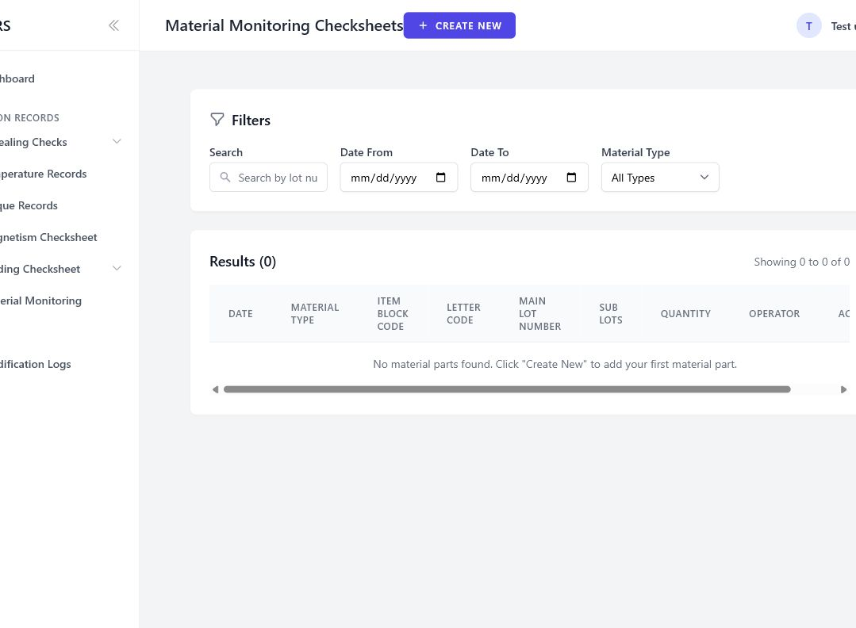
PRACTICE 02
Locate and review an existing record
Operator / Inspector
1
Open the assigned inspection module.
2
Search using the trainer’s reference.
3
Open the matching record.
4
Verify date, code/lot, equipment, values, and responsible person.
Training record details hidden
Expected result: the correct record is identified and its key fields are verified.
Do not edit the record during this exercise.
Notes:
Allow two to three minutes.
Provide a safe reference value that exists in the training environment.
The goal is correct identification and review, not editing.

Slide 19
QUICK REFERENCE
The five habits of reliable ICRS use
1
Search first
Avoid duplicate records.
2
Read the form
Follow required fields and validation.
3
Enter actual data
Never copy unverified values.
4
Preview imports
Resolve errors before confirming.
5
Review after saving
Verify the record while the work is fresh.
When unsure: stop, review, and ask the responsible supervisor or inspector.
Inspection Checksheet Recording System
19
Notes:
Close by asking participants to repeat the five habits.
Invite questions and identify the local contact person for access or data-quality concerns.

