Slide 1

ETL PROJECT
Impact of tourism and economy on the “PUEBLOS MÁGICOS” program
Adriana Avalos Vargas, Edwin Rosales & Jimi Jenneskens

Slide 2
Content
Extract
Transform
Load
Queries
Questions?

Slide 3
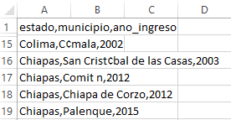
Extract – Magic Towns
A CSV file with columns “State”, “Town” and “Year entered” for every Magic Town
CSV does not recognize specialized characters

Slide 4
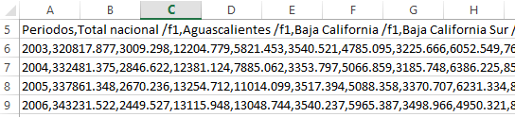
Extract – The gross domestic product
A CSV of the yearly Gross Domestic Product on state level based on tourism which contains the “State”, “Gross domestic product” and “Year

Slide 5
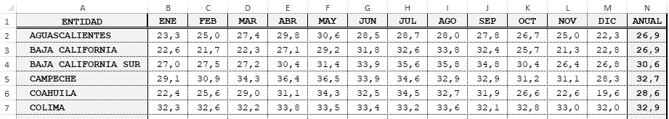
Extract – Weather
Twenty yearly separated Excel files per topic (yearly average rain, minimum temperature, maximum temperature and the average temperature per state)

Slide 6
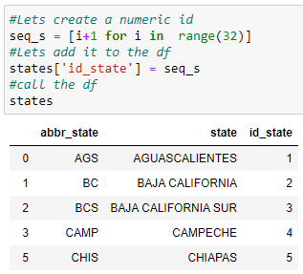
Transform – State_ids table
States are spelled different in every source → Created State_ids table to be able to make relationships between tables in the database

Slide 7
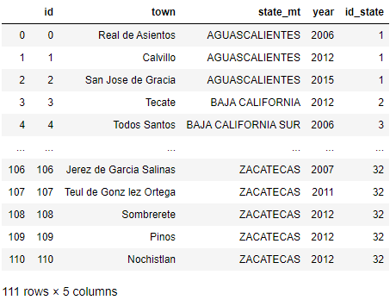
Transform – Magic Towns table
Corrected state and town names manually to without specialized characters and added an id per town and id_state for the relevant state

Slide 8
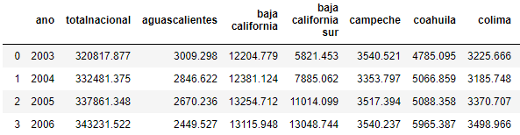
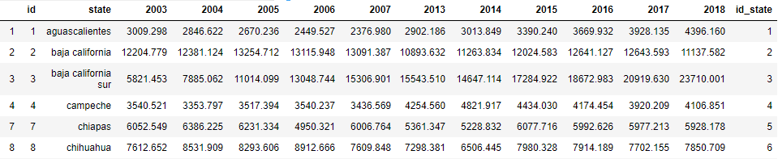
Transform – Gross domestic product table
Swapped the axes of index and columns + an id_state has been added (2) and a for loop has been created to create the right format of the table (3)
1
2

Slide 9
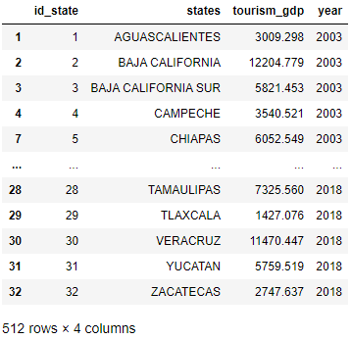
Transform – Gross domestic product table
3

Slide 10
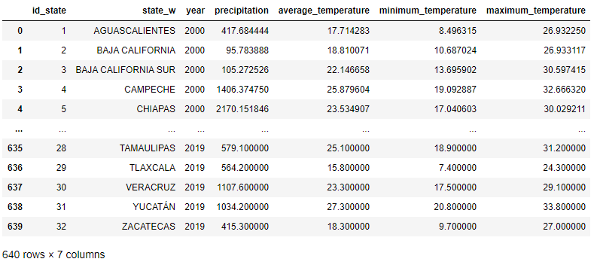
Transform – Weather table
An id_state has been added to determine the state, the yearly separated files have been concatenated in to a CSV file per topic
The separated CSV files have been merged to a table with all information

Slide 11
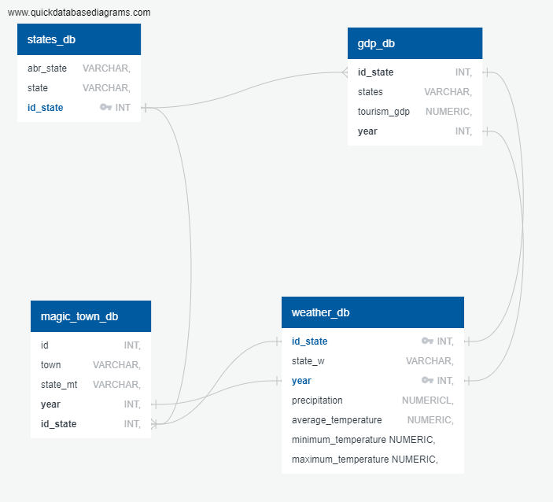
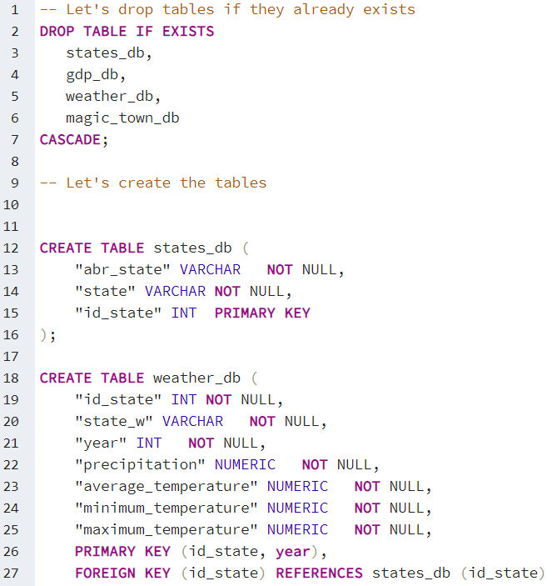
Load – SQL

Slide 12
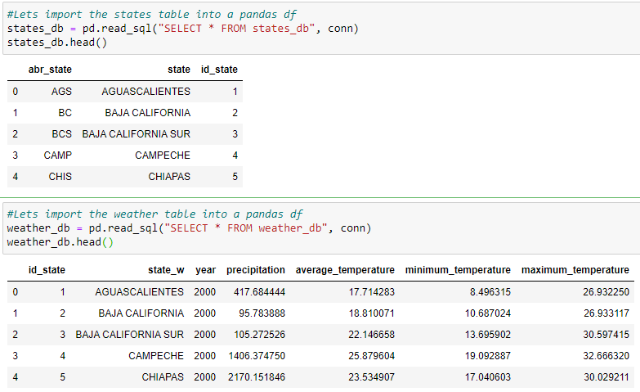
Query – Magic Towns per state

Slide 13
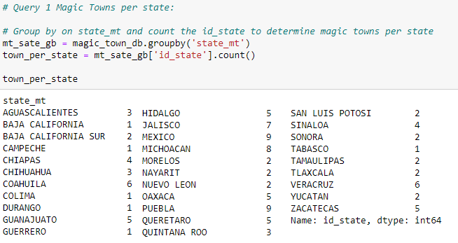
Query – Magic Towns per state

Slide 14
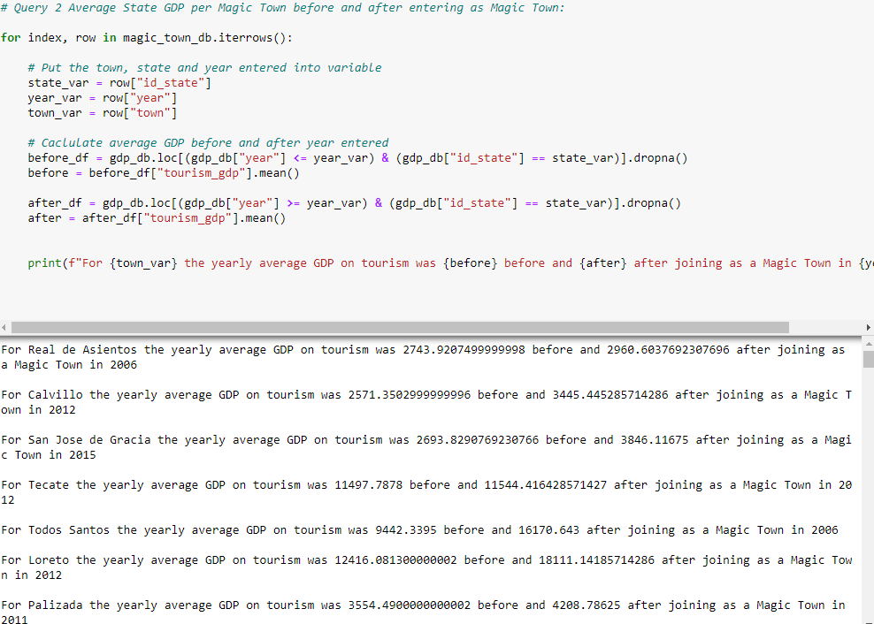
Query – Average State GDP per Magic Town before and after entering as Magic Town
For almost every Magic Town the yearly average GDP on state level increased after entering the Magic Town → Assume program is successful
On state level! Need information on town level

Slide 15
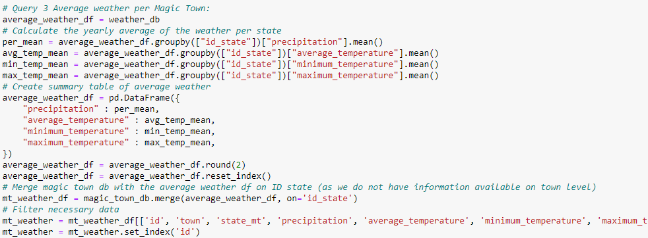
Query – Average weather per Magic Town

Slide 16
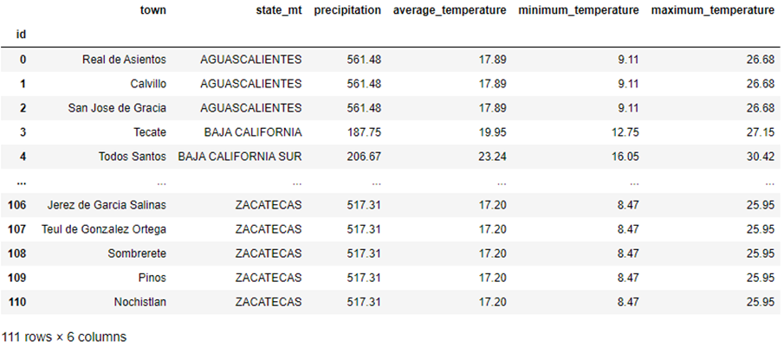
Query – Average weather per Magic Town

Slide 17

Questions?

