Slide 1
Chapter 43
Nuclear Physics

Slide 2
Goals for Chapter 43
To understand some key properties of nuclei
To see how nuclear binding energy depends on the number of protons and neutrons
To investigate radioactive decay
To learn about hazards and medical uses of radiation
To analyze nuclear reactions
To investigate nuclear fission
To understand the nuclear reactions in our sun

Slide 3
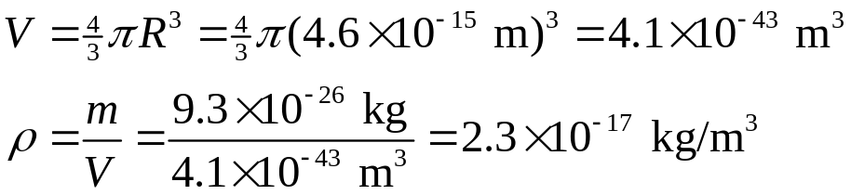
Properties of nuclei
The nucleon number A (also called the mass number) is the total number of protons and neutrons in the nucleus. The nucleon mass is measured in atomic mass units u, slightly less than the mass of the proton:
1 u = 1.660538782(83) × 10⁻²⁷ kg.
The radius of most nuclei is given by R = R₀A^{1/3}, where R₀ is experimentally determined as R₀ = 1.2 × 10⁻¹⁵ m (1.2 fm)
All nuclei have approximately the same density.
Example 43.1: Common iron nuclei have mass number 56. Find the radius, approximate mass, and density of an iron nucleus.
Nucleus is 10¹³ times
the density of iron

Slide 4





Nuclides and isotopes
Electron and nucleon masses (note, a nucleus is defined to have u = 12.0000)
    Proton: m_{p} = 1.007276 u
    Neutron: m_{n} = 1.008665 u
    Electron: m_{e} = 0.000548580 u
The atomic number Z is the number of protons in the nucleus. The neutron number N is the number of neutrons in the nucleus. Therefore A = Z + N.
A nuclide is a single nuclear species having specific values for both Z and N, e.g.
The isotopes of an element have different numbers of neutrons, e.g. Why do you think changing N does not change the element, but changing Z does?
Like electrons, nucleons have ½-integer spin angular momentum, obeying the same relation as before:
The z-component is itself a quantum number, as before:

Slide 5


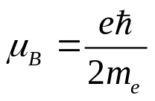
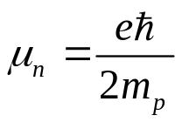


Magnetic Moments
Since every nucleon has its own spin, you can imagine that putting them all into a nucleus would make an overall spin of the vector sum of the individual ones, and the result could be pretty chaotic.
In fact, it turns out that the magnitude of the total angular momentum J of the nucleus is also neatly quantized as:
with quantized z-component
When A is even, j is an integer, but when A is odd, j is a half-integer.
Associated with the nuclear angular moment is a magnetic moment. Recall the Bohr magneton for electrons: In the case of a nucleus, the analogous quantity is the nuclear magneton:
The z-component of the magnetic moment for the proton is:
Surprisingly, for a neutron it is non-zero:

Slide 6

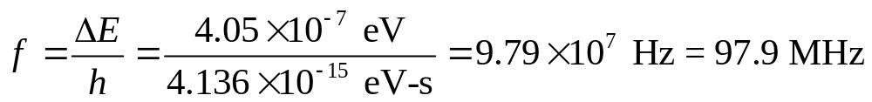
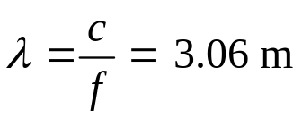
Proton Spin Flips
Recall that the potential energy associated with spin is .
Example 43.2: Proton spin flips: Protons are placed in a 2.30-T magnetic field that points in the positive z-direction. (a) What is the energy difference between states with the x-component of proton spin angular momentum parallel and anti-parallel to the field? (b) A proton can make a transition from one of these states to the other by emitting or absorbing a photon with the appropriate energy. Find the frequency and wavelength of such a photon.
(a) When the spin angular momentum is parallel to B,
  When it is anti-parallel, it is just 2.025 x 10⁻⁷ eV. The energy difference is just twice this.
  (b) The corresponding frequency and wavelength are:

Slide 7
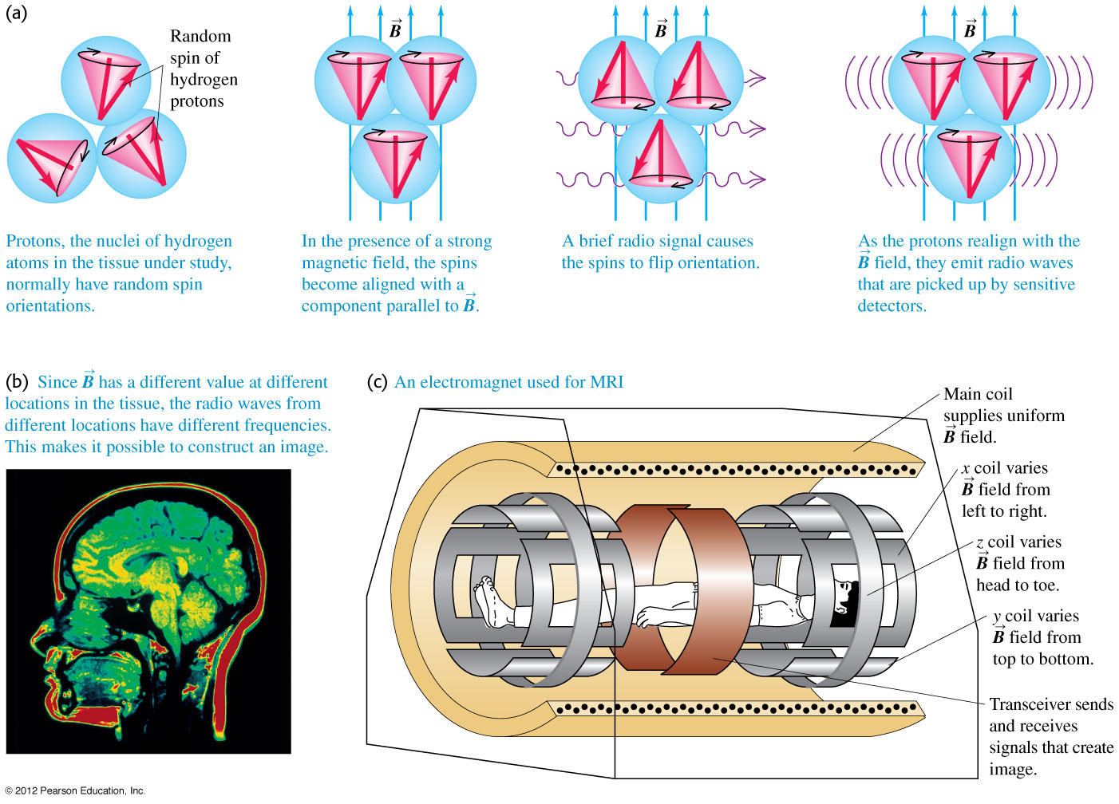
NMR and MRI
Nuclear magnetic resonance and MRI use strong magnetic fields to align the nuclear spins, then flips the spins with radio waves. When the radio waves cease, the spins flip spontaneously and emit radio photons that are measured.

Slide 8

Nuclear binding energy
The mass of the ¹²C atom, made up of 6 protons and 6 neutrons, defines the mass unit u, i.e. it has a mass of exactly 12 u. The individual masses of the protons and neutrons is 6(1.007276 u) + 6(1.008665 u) = 12.095646 u. The difference, 0.0956 u, when converted to energy E = mc², is the binding energy E_{B} of the nucleus. It is convenient to use the mass-energy equivalent of c², which is 931.5 MeV/u, so that 0.0956 u => 89.1 MeV is the binding energy of ¹²C. It is the energy that must be added to separate the nucleons. The quantity E_{B}/c² is called the mass defect.
Note that the nucleus is a collection of positive charges, which all mutually repel each other due to the electrostatic force. Therefore, there must another, attractive force acting in the nucleus to overcome this repulsion, and this is called the nuclear strong force. It binds together both protons and neutrons, and is responsible for the drop in energy (mass) of bound nuclei.
The exact nature of this force is still not fully understood, but we can characterize the binding energy as:
E_{B} = (ZM_{H} + Nm_{n} – )c².
Note that M_{H} is the mass of a hydrogen atom, not just its proton, and also includes the electrons of the atom.

Slide 9

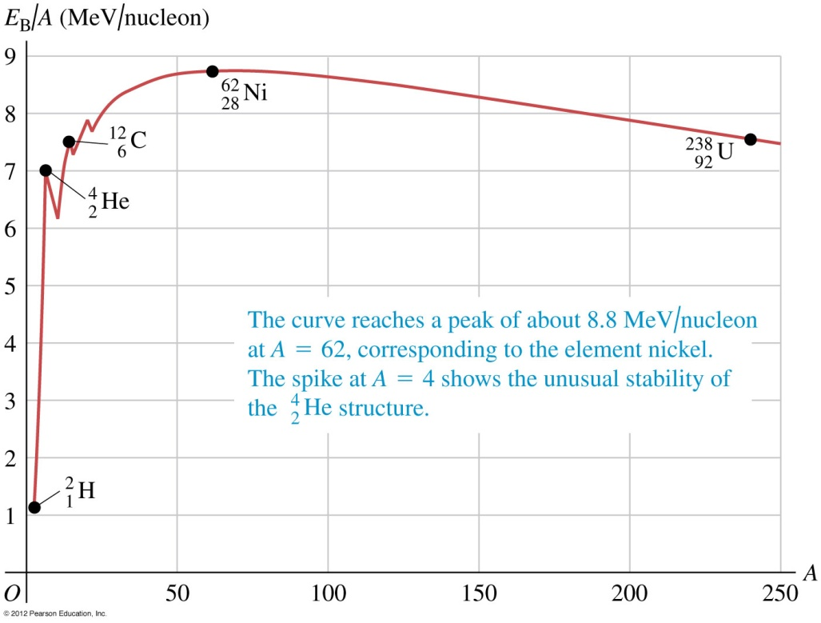
Nuclear binding energy
Example 43.3: Find the mass defect, total binding energy, and binding energy per nucleon of , which has the highest binding energy per nucleon of all nuclides. The neutral atomic mass of is 61.928349 u.
We have Z = 28, M_{H} = 1.007825 u, N = A – Z = 34, m_{n} = 1.008665 u, and
= 61.928349 u. The mass defect is then ΔM = 0.585361 u. The
corresponding binding energy is just E_{B} = (0.585361 u)(931.5 MeV) = 545 MeV.
The binding energy per nucleon is 545 MeV/62 = 8.795 MeV/nucleon.
At left is the binding energy/nucleon for all nuclides. H has the smallest, but notice that He is unusually stable compared to its neighbors. The peaks show that pairing of nucleons improves binding energy.

Slide 10
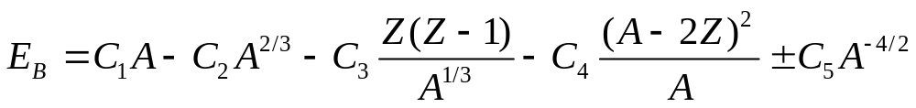
The nuclear force
Important characteristics of the nuclear force:
  It does not depend on charge. Protons and neutrons are bound. It has a short range, of the order of nuclear dimensions.
  Because of its short range, a nucleon only interacts with those in its immediate vicinity. The lack of long-range interaction is called saturation. The electromagnetic force and gravity do not show such saturation.
  It favors binding of pairs of protons or neutrons with opposite spins and with pairs of pairs (a pair of protons and a pair of neutrons, each pair having opposite spins).
  We will discuss two models of the nucleus, the liquid-drop model and the shell model. The liquid drop model is phenomenological (no detailed theory for the numbers, only tweaking to make it fit observations). In this model:
  where C₁ = 15.75, C₂ = 17.80, C₃ = 0.7100, C₄ = 23.69, C₅ = 39, all in MeV.
Surface tension term
Repulsion term
N-Z parity term
Pairing term

Slide 11
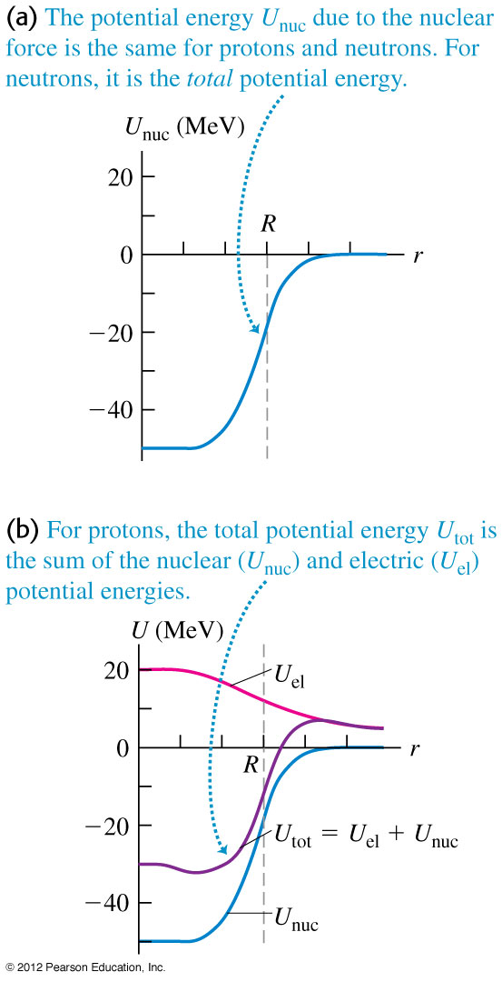

Nuclear models
For the shell model, we start with the concept of the potential energy function for nucleons. From this perspective, the potential well for protons is shallower than for neutrons (see figure at right).
We can use these potentials to calculate wave functions, which leads to the idea of filled or partially filled shells and subshells, just as for electrons around atoms. Before, we found stable electron configurations for values Z = 2, 10, 18, 36, 54 and 86.
For nuclei, the rules are different because U(r) is different, and also the spin-orbit coupling is much stronger. It is found that N or Z = 2, 8, 20, 28, 50, 82 or 128 are particularly stable. These are called magic numbers. Doubly magic nuclides are:

Slide 12
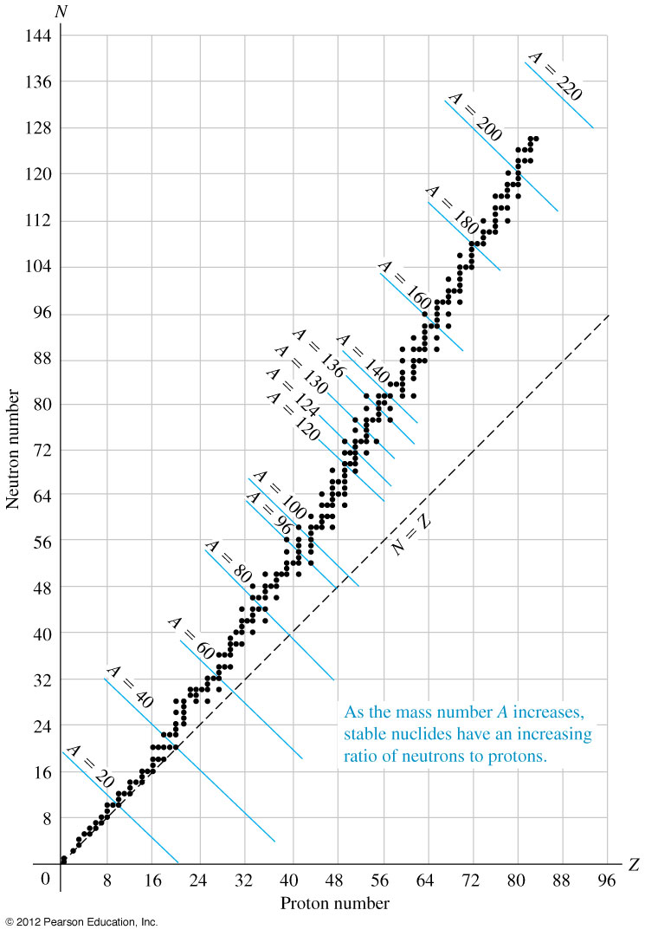

Nuclear stability and radioactivity
Radioactivity is the decay of unstable nuclides by the emission of particles and electromagnetic radiation.
Figure 43.4 (right) is a Segrè chart showing N versus Z for stable nuclides. Notice that as A increases, the stable nuclides leave the N = Z line and prefer more neutrons that protons. This is probably due to the increasing influence of repulsion among the protons.
There are no stable nuclides with A = 5 or 8. The nuclide decays immediately into two He nuclei.
The highest A is 209. There are so-called islands of stability above this.

Slide 13

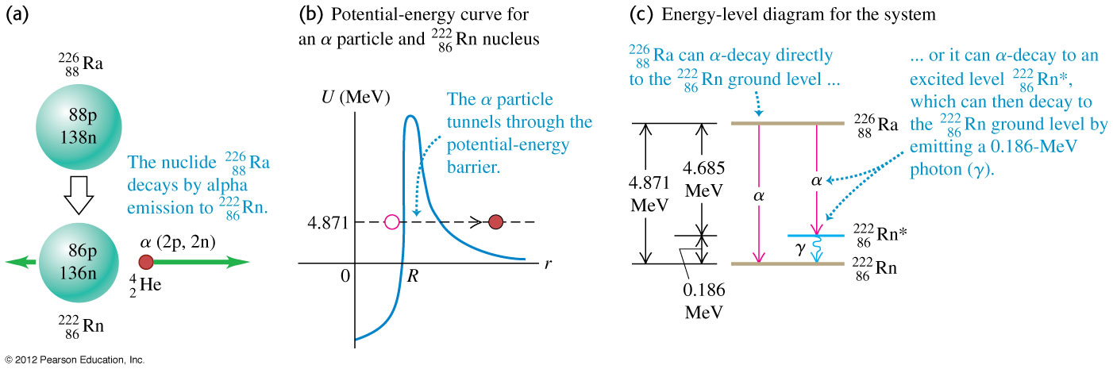
Alpha decay
An alpha particle α is a ⁴He nucleus, which is very stable. Large nuclei can decay by splitting into a smaller nucleus and an alpha particle, e.g.
Alpha decay is possible whenever the parent nuclide is more massive than the sum of the two daughter products, e.g. Example 43.5: Show that α decay is possible in the reaction above, where the Ra isotope is 226.025403 u, the Rn isotope is 222.017571 u, and He is 4.002603 u.
The mass difference is (226.025403 – 222.017571 – 4.002602) u = +0.005229 u
The energy equivalent is (0.005229)(931.5) MeV = 4.871 MeV. The kinetic energy of the α particle can be determined from K = ½ mv² = p²/2m. The momentum is conserved, so the α particle gets 222/(222+4) of the total energy.

Slide 14



Beta and gamma decay
There are three types of beta decay: beta-minus, beta-plus, and electron capture.
    beta-minus decay
    beta-plus decay
    electron capture
Note the second reaction must take place within a nucleus, or else it is energetically impossible, i.e. it takes external energy (as from an excited nucleus) to make it happen.
A beta-minus β – particle is an electron, beta-plus is a positron.
When radium decays to emit an α particle, the α can have kinetic energy of either 4.784 MeV, or 4.602 MeV. The latter is due to the product radon nucleus being left in an excited state. The radon nucleus will then relax to the nuclear ground state, and emit a photon of energy 0.186 MeV. The photon is called a gamma ray.

Slide 15
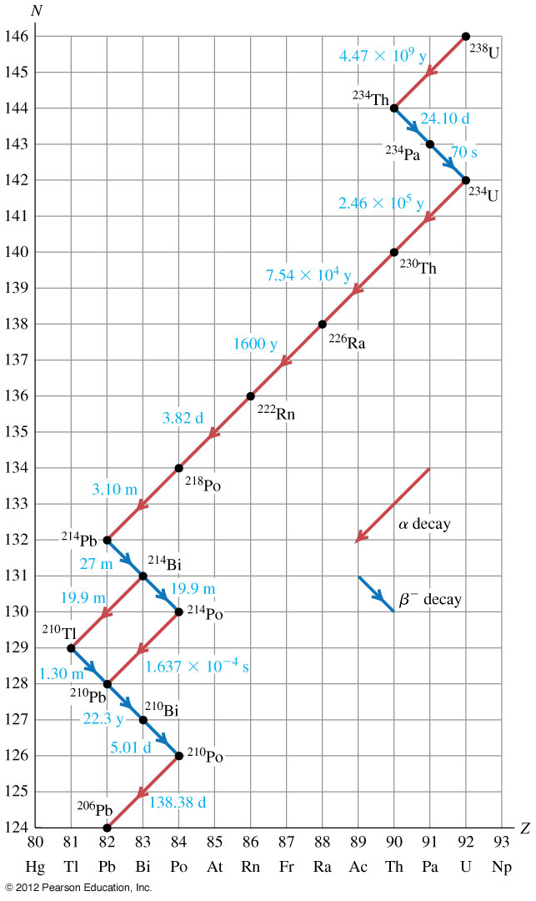
Natural radioactivity
Certain nuclei decay naturally, which is called natural radioactivity. Figure 43.7 (right) shows a Segrè chart for the ²³⁸U decay series.
Each decay is labeled by a time, called the half-life—note that some are very long (billions of years) and some are extremely short (minutes or seconds). This is related to the potential barrier through which the decay product has to tunnel.

Slide 16
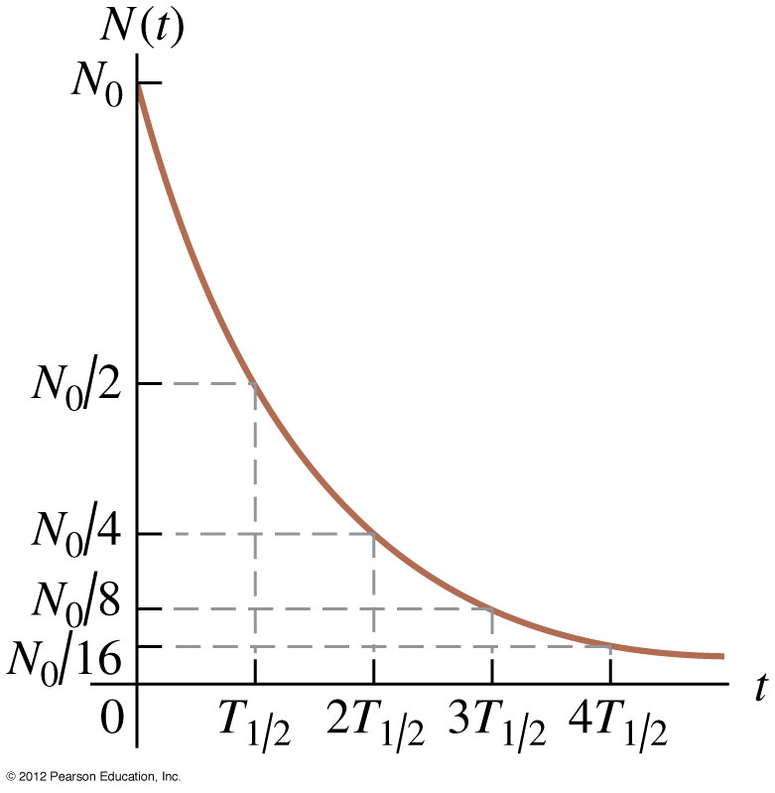

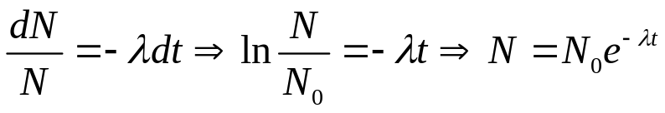

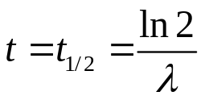
Activities and half-lives
The half-life is the time for the number of radioactive nuclei to decrease to one-half of their original number.
Because the number of decays is proportional to the number of atoms available to decay, e.g.
(the minus sign indicates a loss), the number of remaining nuclei decreases exponentially (see figure at right). The solution to the above equation is found by rearranging and integrating:
To find the half-life, just determine when
N = N₀/2, which is when , or .
If you start with N₀ nuclei, after 1 half-life you will have N₀/2, and after another half-life you will have N₀/4, etc.
The quantity 1/λ is called the mean lifetime.
An established unit of radiation activity (−dN/dt) is called the Curie:
1 Ci = 3.70x10¹⁰ decay/s.
In SI units, 1 decay/s is called the becquerel (Bq).

Slide 17
Activities and half-lives
Example 43.8: Activity of ⁵⁷Co. The isotope ⁵⁷Co decays by electron capture to ⁵⁷Fe with a half-life of 272 d. The ⁵⁷Fe nucleus is produced in an excited state, and it almost instantaneously emits gammy rays that we can detect. (a) Find the mean lifetime and decay constant for ⁵⁷Co. (b) If the activity of a 57Co radiation sources is now 2.00 μCi, how many ⁵⁷Co nuclei does the source contain? (c) What will be the activity after 1 year?
(a) Since the half-life t_{1/2} = ln 2/λ = (272 d)(86400 s/d) = 2.35 × 10⁷ s, the decay constant is λ = ln 2 / 2.35 × 10⁷ s = 2.95 × 10⁻⁸ s⁻¹. T_{mean} = 1/λ = 3.39 × 10⁷ s = 392 d.
(b) The activity
so N = 7.4 × 10⁴ decay/s / 2.95 × 10⁻⁸ s⁻¹ = 2.51 × 10¹² nuclei.
(c) After 1 year, the number of nuclei remaining will be
The activity will decline by a like factor, or 0.394 (2.00 μCi) = 0.788 μCi

Slide 18
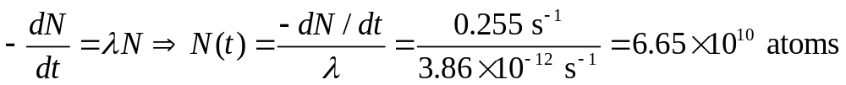
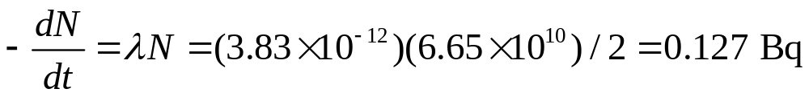
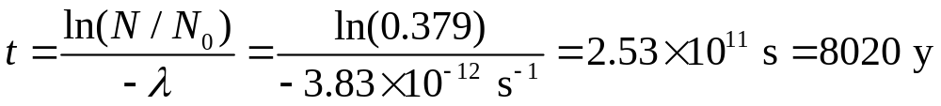
Activities and half-lives
Example 43.9: Radiocarbon Dating. The isotope ¹⁴C decays via beta-minus decay to ¹⁴N with a half-life of 5730 y. Before 1900 the activity per unit mass of atmospheric carbon due to the presence of ¹⁴C averaged about 0.255 Bq per gram of carbon. (a) What fraction of carbon atoms were ¹⁴C? (b) In analyzing an archaeological specimen containing 500 mg of carbon, you observe 174 decays in one hour. What is the age of the specimen?
(a) Since the half-life t_{1/2} = ln 2/λ = (5730 y)(3.156 × 10⁷ s/y) = 1.808 × 10¹¹ s, the decay constant is λ = ln 2 / 1.808 × 10¹¹ s = 3.83 × 10⁻¹² s⁻¹.
We get the number of atoms from the activity
This is the number of ¹⁴C atoms, but how many C atoms are there in 1 gram (1/12.011 mol)? Avogadro’s number is 6.022 × 10²³ atoms/mol, so the total in 1 gram is 6.022 × 10²³ atoms/mol * 1/12.011 mol = 5.01 × 10²² atoms. The fraction of ¹⁴C atoms was 1.33 × 10⁻¹².
(b) The activity when it died would be
Now it is 174 decays/3600 s = 0.048 Bq, or a factor of 0.379 of what it was. Thus, N(t)/N₀ = 0.379. The age is then:

Slide 19
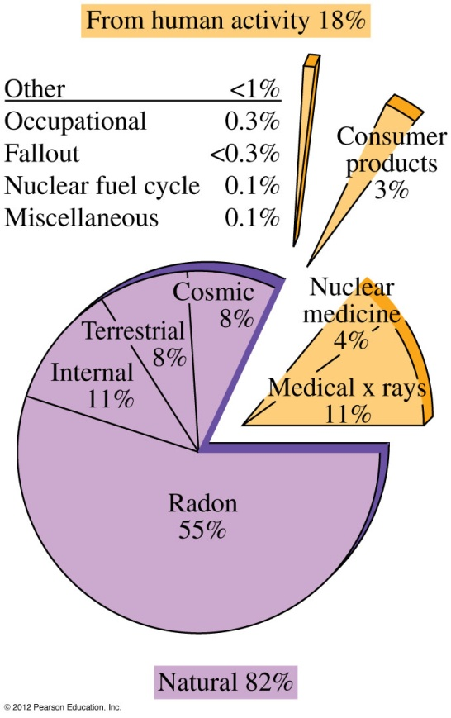
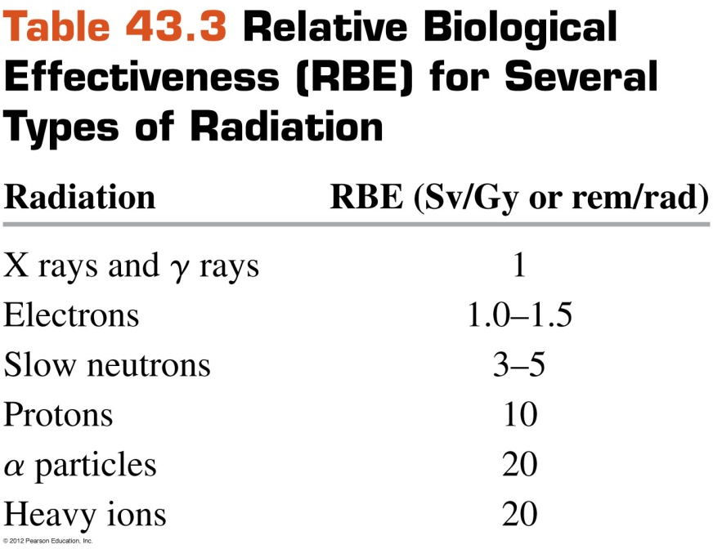
Biological effects of radiation
Follow the text discussion of the biological effects of radiation.
Table 43.3 gives the RBE for several types of radiation.
Figure 43.9 shows sources of U.S. radiation exposure.
Follow Example 43.10 about
a medical x ray.

Slide 20
Nuclear reactions
A nuclear reaction is a rearrangement of nuclear components due to bombardment by a particle rather than a spontaneous natural process.
The difference in masses before and after the reaction corresponds to the reaction energy Q.
Follow Example 43.11, which looks at exoergic and endoergic reactions.

Slide 21
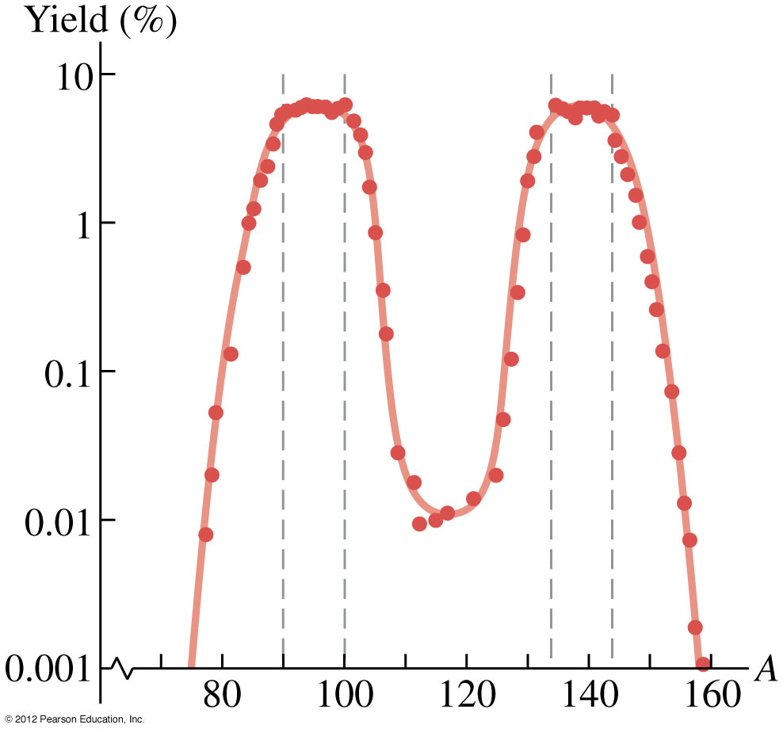
Nuclear fission
Nuclear fission is a decay process in which an unstable nucleus splits into two fragments (the fission fragments) of comparable mass.
Figure 43.11 (right) shows the mass distribution of the fission fragments from the fission of ²³⁶U*.

Slide 22
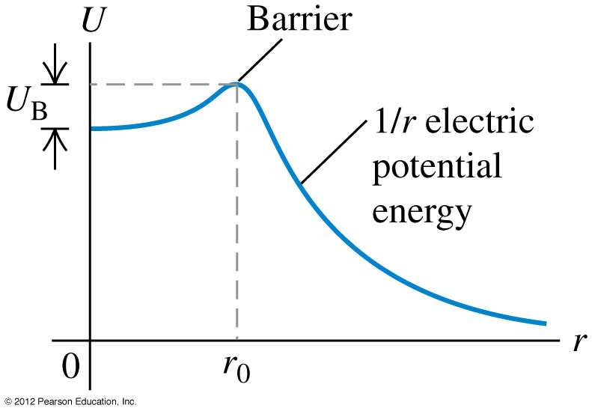
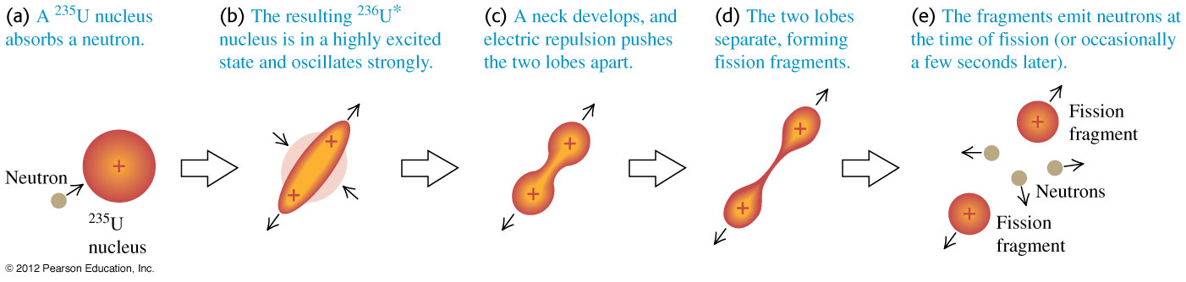
Liquid-drop model
The liquid-drop model helps explain fission. See Figure 43.12 below.
Figure 43.13 (right) shows the potential energy function of two fission fragments.

Slide 23
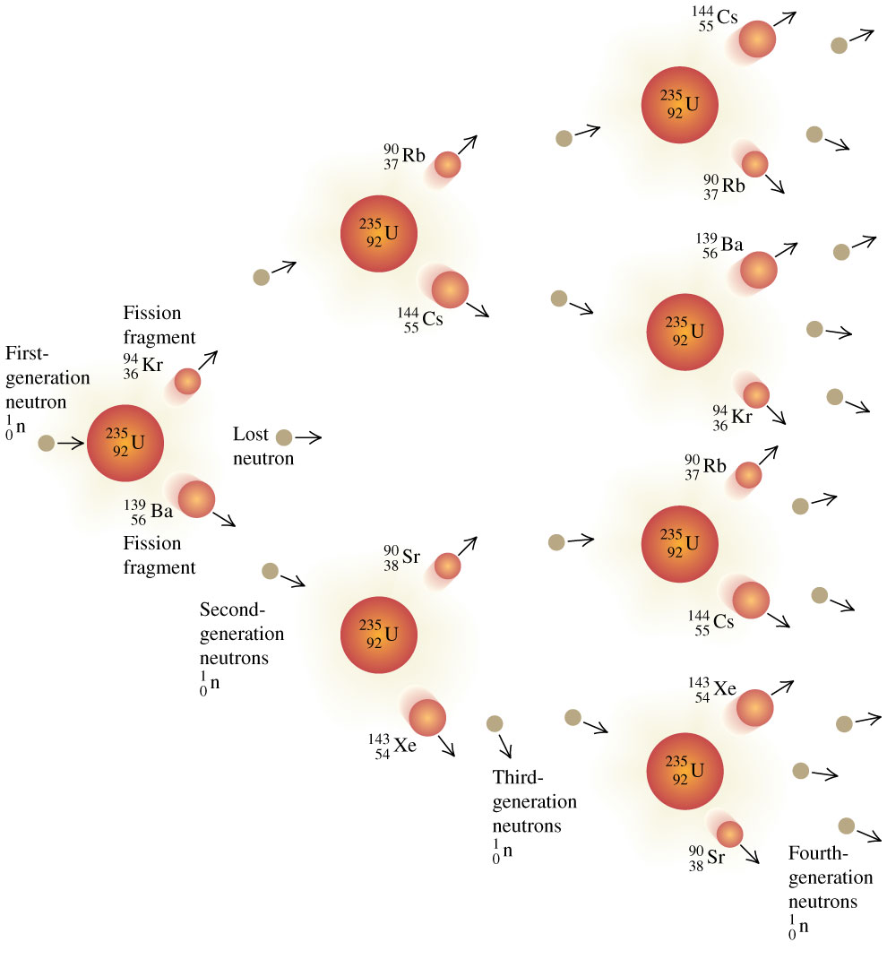
Chain reactions
The neutrons released by fission can cause a chain reaction (see Figure 43.14 below).

Slide 24
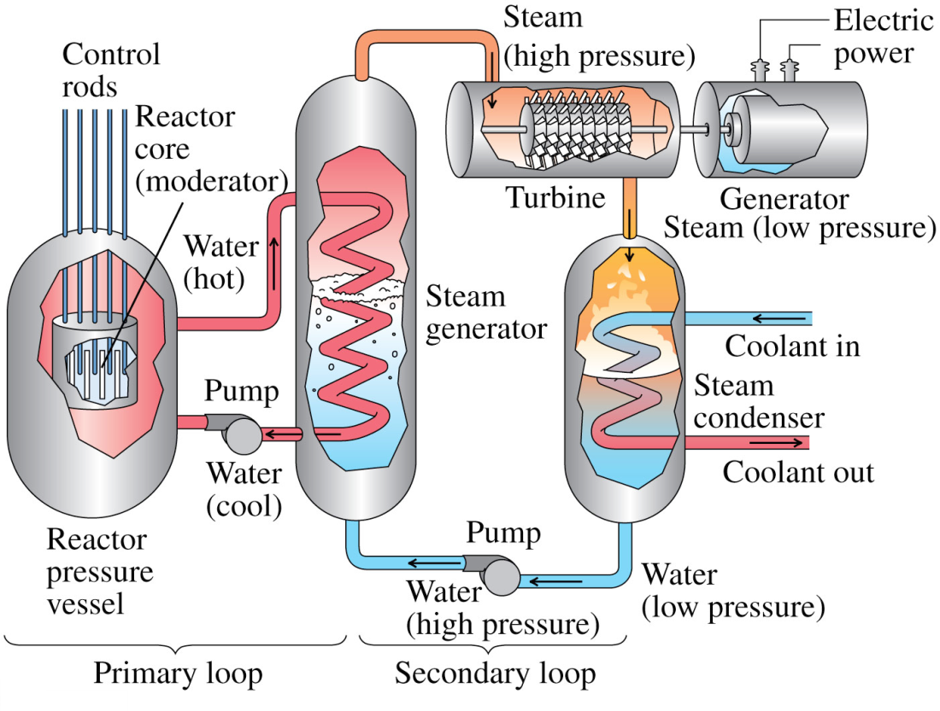
Nuclear reactors
A nuclear reactor is a system in which a controlled nuclear chain reaction is used to liberate energy.
Figure 43.15 below illustrates a nuclear power plant.
Follow Example 43.12.

Slide 25
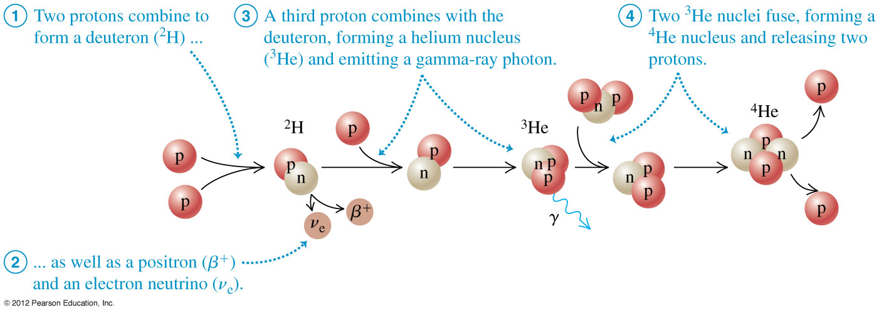
Nuclear fusion
In a nuclear fusion reaction, two or more light nuclei fuse to form a larger nucleus.
Figure 43.16 below illustrates the proton-proton chain, which is the main energy source in our sun.
Follow Example 43.13.

