Slide 1

Radiochemistry
The purpose of this experiment is
to use first-order nuclear decay kinetics to determine the half-life of a nuclear reaction.

Slide 2
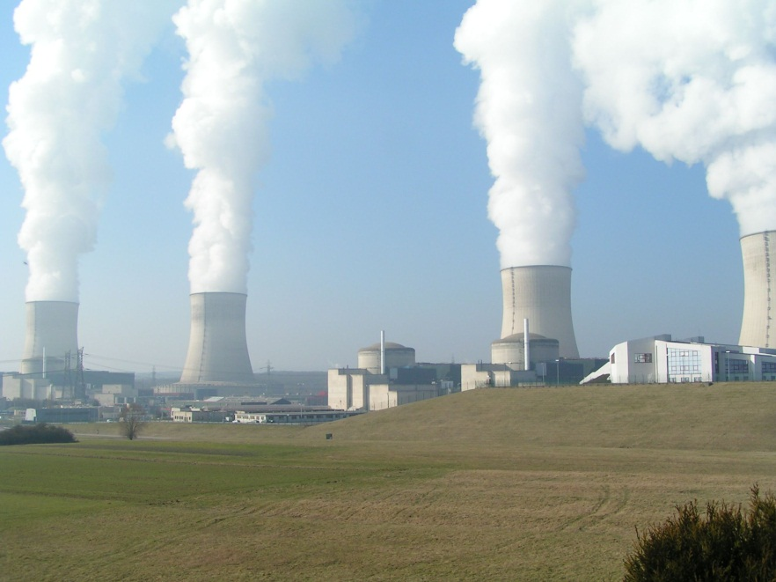
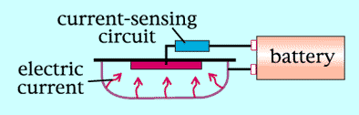
Where might we see radioactive materials in everyday life?
Nuclear Energy
Smoke Detectors
Americium-241
Smoke from a fire can be detected at a very early stage
At a nuclear power station, water vapor rises from the hyperboloid shaped cooling towers. The nuclear reactors are inside the cylindrical containment buildings.
There is a reactor in Fulton, MO.
Notes:
http://en.wikipedia.org/wiki/Nuclear_power
Nuclear power is the controlled use of nuclear reactions to release energy for work including propulsion, heat, and the generation of electricity. Human use of nuclear power to do significant useful work is currently limited to nuclear fission and radioactive decay. Nuclear energy is produced when a fissile material, such as uranium-235 (235U), is concentrated such that nuclear fission takes place in a controlled chain reaction and creates heat — which is used to boil water, produce steam, and drive a steam turbine. The turbine can be used for mechanical work and also to generate electricity. Nuclear power is used to power most military submarines and aircraft carriers and provides 7% of the world's energy and 17% of the world's electricity. The United States produces the most nuclear energy, with nuclear power providing 20% of the electricity it consumes, while France produces the highest percent of its energy from nuclear reactors—80% as of 2006. [1]

Slide 3
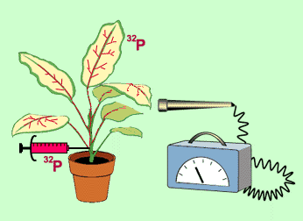
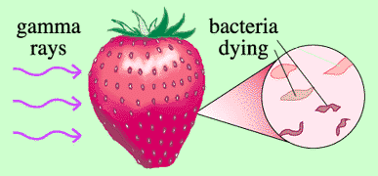
Where might we see radioactive materials in everyday life?
Agricultural applications-radioactive traces
Food irradiation
Gamma rays of a radioisotopes (Cobalt-61) destroy many disease-causing bacteria as well as those that cause food to spoil
Helps scientists to understand the detailed mechanism of how plants utilize phosphorous to grow an reproduce
But what is radioactivity?

Slide 4
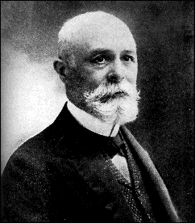
Discovery of Radioactivity
In 1897, Becquerel accidentally discovered radioactivity in pitchblende (a uranium mineral) while studying sunlight induced fluorescence of various minerals. This mineral was found to produce a photographic image, even through black paper.
Henri Antoine Becquerel
French Professor of Applied Physics
Nobel Prize in Physics 1903
(1852 – 1908)
Further experiments demonstrated that a mixture of charged particles and electromagnetic radiation were being emitted and were responsible for the effect on photographic film.
Notes:
http://nobelprize.org/nobel_prizes/physics/laureates/1903/becquerel-bio.html
Becquerel's earliest work was concerned with the plane polarization of light, with the phenomenon of phosphorescence and with the absorption of light by crystals (his doctorate thesis). He also worked on the subject of terrestrial magnetism. In 1896, his previous work was overshadowed by his discovery of the phenomenon of natural radioactivity. Following a discussion with Henri Poincaré on the radiation which had recently been discovered by Röntgen (X-rays) and which was accompanied by a type of phosphorescence in the vacuum tube, Becquerel decided to investigate whether there was any connection between X-rays and naturally occurring phosphorescence. He had inherited from his father a supply of uranium salts, which phosphoresce on exposure to light. When the salts were placed near to a photographic plate covered with opaque paper, the plate was discovered to be fogged. The phenomenon was found to be common to all the uranium salts studied and was concluded to be a property of the uranium atom. Later, Becquerel showed that the rays emitted by uranium, which for a long time were named after their discoverer, caused gases to ionize and that they differed from X-rays in that they could be deflected by electric or magnetic fields. For his discovery of spontaneous radioactivity Becquerel was awarded half of the Nobel Prize for Physics in 1903, the other half being given to Pierre and Marie Curie for their study of the Becquerel radiation.

Slide 5
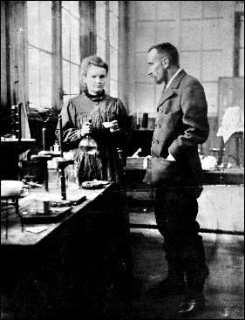
Radioactivity & The Curies
Studied radioactive materials, particularly pitchblende, which was more radioactive than the uranium extracted from it.
Deduced (1898) the obvious explanation:
Pitchblende must contain traces of some unknown radioactive component that was far more radioactive than uranium.
Pierre Curie – French Physicist
Nobel Prize in Physics – 1903
(May 15, 1859, – April 19, 1906)
Marie Sklodowska Curie
Polish/French Physicist & Chemist
Nobel Prize in Physics – 1903
Nobel Prize in Chemistry - 1911
(November 7, 1867 – July 4, 1934)
Notes:
http://en.wikipedia.org/wiki/Marie_Curie
first two-time Nobel laureate and the only person with Nobel Prizes in two different fields of science (physics and chemistry). She also became the first woman appointed to teach at the Sorbonne. She was born a Pole in Warsaw, and spent her early years there, but in 1891 at age 24, moved to France to study science in Paris. She obtained all her higher degrees and conducted her scientific career there, and became a naturalized French citizen. She founded the Curie Institutes in Paris and in Warsaw.
At the Sorbonne, she met and married another instructor, Pierre Curie. Together they studied radioactive materials, particularly the uranium pitchblende ore, which had the curious property of being more radioactive than the uranium extracted from it. By 1898 they deduced a logical explanation: that the pitchblende contained traces of some unknown radioactive component which was far more radioactive than uranium; thus on December 26th Marie Curie announced the existence of this new substance.
Over several years of unceasing labour they refined several tons of pitchblende, progressively concentrating the radioactive components, and eventually isolating the chloride salts (refining radium chloride on April 20, 1902) and then two new chemical elements. The first they named polonium after Marie's native country Poland, and the other was named radium from its intense radioactivity.

Slide 6
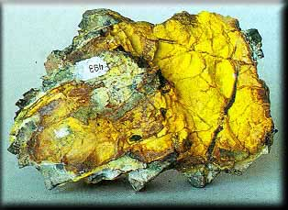
The Curies refined several tons of pitchblende (shown above) progressively concentrating the radioactive components. Eventually they isolated the chloride salts of the two new chemical elements, and then the elements themselves.
The first they named polonium (Po) after Marie's native country Poland; and, the other they named radium (Ra) from its intense radioactivity.

Slide 7
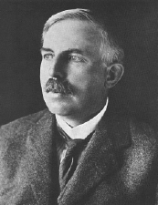
Rutherford – The Father of Nuclear Physics
Pioneered the orbital theory of the atom, in his discovery of “Rutherford scattering” off the nucleus with the gold foil experiment.
Demonstrated that radioactivity was the spontaneous disintegration of atoms.
First to note that in a sample of radioactive material it invariably took the same amount of time for half the sample to decay, thus defining its “half-life”.
Ernst Rutherford
Nuclear Physicist – New Zealand
Nobel Prize in Chemistry - 1908
(August 30, 1871 – October 19, 1937)
Notes:
http://en.wikipedia.org/wiki/Ernest_Rutherford
In 1898 Rutherford was appointed to the chair of physics at McGill University, in Canada, where he did the work which gained him the 1908 Nobel Prize in Chemistry. He had demonstrated that radioactivity was the spontaneous disintegration of atoms. He noticed that in a sample of radioactive material it invariably took the same amount of time for half the sample to decay — its "half-life" — and created a practical application for this phenomenon using this constant rate of decay as a clock, which could then be used to help determine the actual age of the Earth that turned out to be much older than most scientists at the time believed.
In 1907 he took the chair of physics at the University of Manchester. There he discovered the nuclear nature of atoms and was the world's first successful "alchemist": he converted nitrogen into oxygen. While working with Niels Bohr (who discovered that electrons moved in specific orbits) Rutherford theorized about the existence of neutrons, which could somehow compensate for the repelling effect of the positive charges of protons by causing an attractive nuclear force and thus keeping the nuclei from breaking apart.

Slide 8
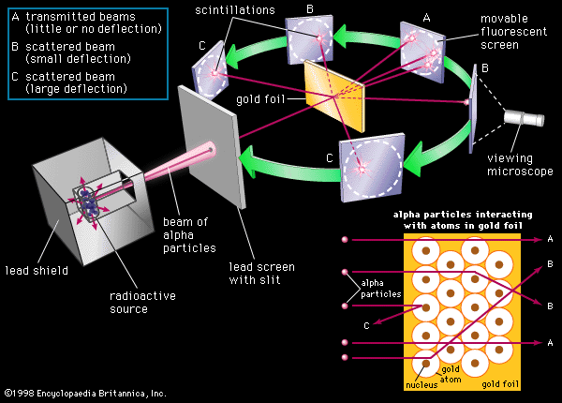
Rutherford’s Gold Foil Experiment
Notes:
http://www.britannica.com/nobel/cap/oruthef002a4.html
The Rutherford gold-foil experiment; the inset accounts for the scattering of alpha particles according to Rutherford's proposed atomic model
http://en.wikipedia.org/wiki/Atom/plum_pudding
The plum pudding model of the atom was proposed by J. J. Thomson, the discoverer of the electron in 1897. The plum pudding model was proposed in March, 1904 before the discovery of the atomic nucleus. In this model, the atom is composed of electrons (which Thomson still called "corpuscles," though Stoney had proposed that atoms of electricity be called electrons in 1894), surrounded by a soup of positive charge to balance the electron's negative charge, like plums surrounded by pudding. The electrons (as we know them today) were thought to be positioned throughout the atom, but with many electron structures possible, particularly rotating rings (see below). Instead of a soup, the atom was also sometimes said to have had a cloud of positive charge.
The model was disproved by the 1909 gold foil experiment, which was interpreted by Ernest Rutherford in 1911 to imply a very small nucleus of the atom containing its full positive charge, thus leading implicitly to the Rutherford model of the atom, and eventually, by 1913, to the solar-system-like (but quantum-limited) Bohr model of the atom.

Slide 9
Implications of Radioactivity
Radioactive materials undergoing nuclear decay reactions violated the idea that atoms are the unchanging, indivisible, ultimate building blocks of matter.
Additional experiments with cathode ray tubes, accelerators and mass spectrometers eventually showed atoms do consist of smaller components: protons, neutrons, and electrons.

Slide 10
Some Important Terminology
Nuclear reactions involve the atomic
nucleus (i.e., protons and neutrons).
Regular chemical reactions involve only
the outer electrons of atoms.
An atom is the smallest entity that retains
the properties of an element.
Atoms are composed of one or more
electrons and a nucleus.
The nucleus is the central portion of an atom and contains one or more protons and zero
or more neutrons.

Slide 11
Element = The simplest stable building blocks of materials, consisting of protons, neutrons and electrons.
Isotope = An atom of an element with the same number of protons, but a different number of neutrons.*
Radioisotope = An unstable isotope that undergoes nuclear decay.
Radiochemistry = The study of radioisotopes.
*Note: Atomic weights given on the periodic table are the
weighted average of all the natural isotopes of each element,
as determined using mass spectrometry.

Slide 12

Nuclear Notation
A
For example:
X
Z
A = mass number (sum of protons + neutrons)
X = element symbol
Z = atomic number (number of protons or charge)

Slide 13
Isotopes are atoms that have identical atomic numbers but different mass numbers as the result of differing numbers of neutrons.
carbon-12
carbon-13
For each carbon isotope, there are how many…
electrons? protons? neutrons?

Slide 14
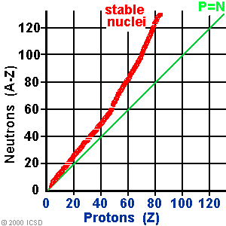
The Chart of the Nuclides
As the number of protons, Z, increases the neutron to proton ratio required for nuclear stability also increases.
Nuclides with Z > 83 (Bismuth) are unstable.
Light nuclides are stable when the neutron to proton ratio is close to one.
Even numbers of protons and neutrons seem to favor nuclear stability.
Certain specific numbers of protons or neutrons produce highly stable nuclides. The magic numbers are 2, 8, 20, 28, 50, 82, and 126.

Slide 15
Thermodynamics
When the energies of all 2850 isotopes are plotted vs. their charge density, the nuclides form a parabola.
The free neutron has the highest M/A & is unstable. It decays to form a proton, ¹H, in 10.6 minutes.
As the radioactive elements decay, they go from higher M/A values to lower M/A values thus becoming more thermodynamically stable.
The ⁵⁶Fe atom has the lowest value of M/A. So all elements on the periodic table beyond ⁵⁶Fe, must have been formed by a Super Nova.
The open symbols are radioactive nuclides;
the filled symbols are stable and long lived.
Notes:
Open symbols represent radioactive nuclides; filled symbols represent stable and long-lived nuclides.

Slide 16
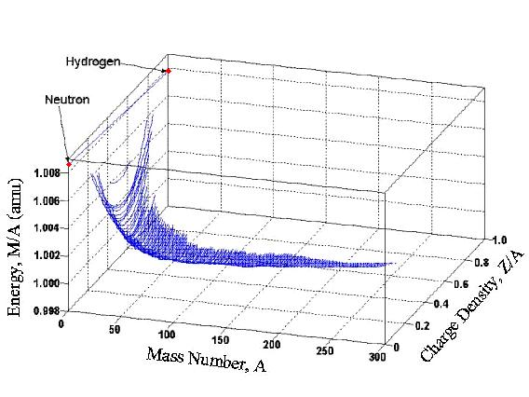
The “Cradle of the Nuclides” results when the chart of the nuclides and the parabolas are combined into one 3-D graph. It shows the ground states of all stable and radioactive nuclides. The stable and long-lived nuclides are located in the valley. The radioactive nuclides or those easily destroyed by fusion or fission occupy higher positions in the cradle.
Notes:
Proton-rich isobars on the right side of the valley decay to lower positions in the cradle by electron-capture or positron emission. Likewise, neutron rich isobars on the left side of the valley decay by negatron emission (Manuel et al., 2000a, b).
As noted by Manuel et al. (2000a, b), light-weight nuclides (low A) that are readily destroyed by fusion occupy relatively high positions in the cradle. The heavy nuclides (high A) that tend to decay by alpha-emission or by fission also populate relatively high positions. Among the stable nuclides, 1H has the highest position in the cradle, 56Fe has the lowest.

Slide 17
Most Common Particles Emitted by Radioactive Materials
Alpha = α, a helium nucleus,
Beta = β, an electron,
Gamma = γ, electromagnetic radiation
Neutron = a neutral particle,
with mass of about 1 amu or ~1 proton

Slide 18
Alpha Decay
Beta Decay
Occurs in nuclei with Z > 83.
Occurs in nuclei with a high neutron:proton ratio.
The loss of two protons and two neutrons moves the atom down and to the left toward the belt of stable nuclei.
A neutron is converted into a proton inducing
a shift down and to the right on the stability plot.

Slide 19
Positron Decay
Electron Capture Decay
Occurs in nuclei with a low neutron to proton ratio.
Electron capture is common in
heavier elements that have a low
neutron to proton ratio.
Gamma-ray Decay
Gamma-ray decay generally accompanies another radioactive decay process because it carries off any excess energy within the nucleus resulting from the radioactive decay.
A proton decays into a neutron and
an electron inducing a shift up and
to the left in the nuclear stability plot.

Slide 20
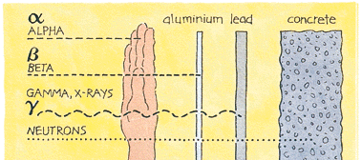
All particles produced by the decay of an atomic nucleus have the energy needed to penetrate substances - but to very differing distances.

Slide 21
Balancing Nuclear Decay Reactions
Radioactive decay results in a redistribution of the basic nuclear particles. The nuclear notation system keeps track of where they are both before and after a nuclear transformation has taken place.
To balance a nuclear decay reaction two rules must be followed.
1. Mass number is conserved in a nuclear decay reaction.
The sum of the mass numbers before the decay must equal
the sum of the mass numbers after the decay.
2. Electric charge is conserved in a nuclear decay reaction.
The total electric charge on subatomic particles and nuclei
before and after the decay must be equal.

Slide 22
Examples

Slide 23
Examples

Slide 24
Kinetics of Nuclear Decay
Radioactive decay processes and many chemical reactions show a direct correlation between the rate of reaction and the amount of reactant present.
That is, if the amount of reactant is changed, the rate of reaction changes by the same amount.
Rate = (slope)
dN/dt = -kN

Slide 25

The rate (slope) decreases with time and amount remaining.
The decay rate expresses the speed at which a substance disintegrates.
N : The number of nuclei remaining
N_{O} : The number of nuclei initially present
k : The rate of decay
t : the amount of time, t.

Slide 26
Linear Form of the Decay Equation
ln N / N_{o} = -kt →
If we rearrange the equation
ln N / N_{o} = -kt
we can get it in the form of a
straight line:
y = mx + b

Slide 27
Linear Form of the Decay Equation
ln N / N_{o} = -kt → ln N - ln N_{o} = - kt → ln N = - kt + ln N_{o}
This is the equation of a straight line,
y = mx + b
where
y = ln N (N = any given amount)
m = -k
x = t
b = ln N_{o} (N_{o} = the initial amount)
The linear form is useful for finding the initial amount present
when t = 0 data was not measured.

Slide 28
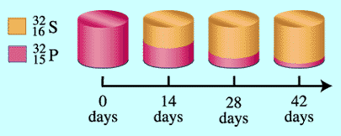
Half Life Calculations
Another characteristic of a radioactive process is the half life. The half life of a radioactive substance is the time required for half of the initial number of nuclei to disintegrate.
Half life
Rate of decay
Phosphorous-32 has a half life of 14.7 days

Slide 29
Example
The half life of a specific element was calculated to be 5200 years. Calculate the decay constant (k).

Slide 30
Example
The half life of a specific element was calculated to be 5200 years. Calculate the decay constant (k).
Recall: ln 2 = 0.693
So…

Slide 31
Example
The half life of a specific element was calculated to be 5200 years. Calculate the decay constant (k).
Recall: ln 2 = 0.693
So…

Slide 32
What about calculating lifetimes other than the half-life? How would you calculate the t_{3/4} or t_{7/8}?
*
*Notice that this is the reciprocal of ln (n/n_{o}) which was equal to –kt.
Therefore,
If you know the specific decay constant, k, you know the half-life, t_{1/2}.
OR
If you know the half-life, t_{1/2}, you know the specific decay constant, k.

Slide 33
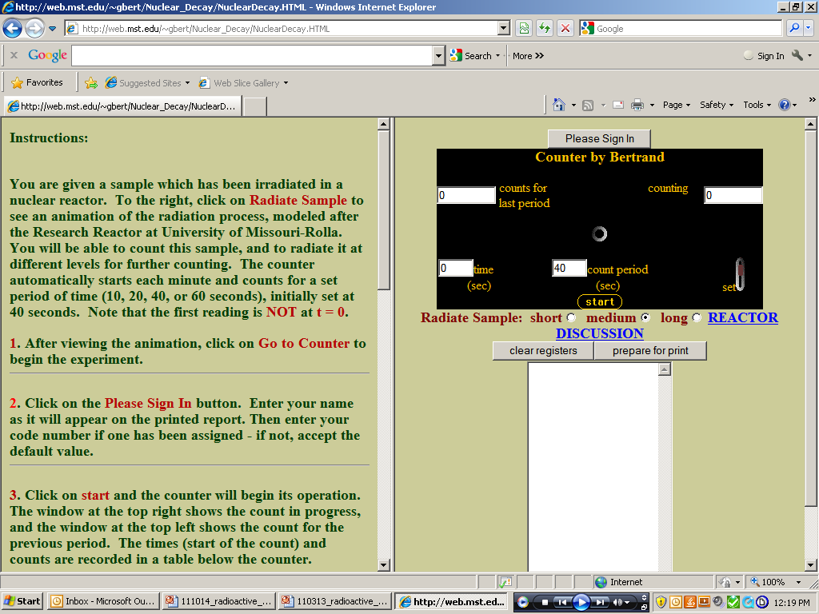
Today’s Experiment – Part 1
Computer Simulation:
Run simulation for unknown sample number assigned by TA.
Copy data into Excel. (Record data in book or plan to print a copy.)
Obtain second set of simulation data from your lab partner.
Plot in Excel exponential decay curve and linear plot for both sets of data.
(So you should have 4 scatterplot graphs for the simulation data)
Fit trendline equations to all 4 plots and use these to determine the k, t_{1/2}
lnA_{o} and A_{o} for both of the unknowns.
Sign in using your assigned unknown number.
Press start.
Minutes are simulated – stop at 32 simulated minutes.

Slide 34


Today’s Experiment – Part 2
Hands-On Activity:
Check out dice from the stockroom – 1 set for lab partners to share.
Roll dice to determine decay curve for unknown numbers assigned by TA.
(Record data on handout.)
Obtain three sets of data for each set of unknown numbers.
Calculate the average for each roll. Record.
Calculate the natural log of the average for each roll. Record.
Plot by hand the exponential decay curve and linear plot
for your average data for all 3 sets of data.
(Plot these 3 sets of data on the scatterplot graphs provided in the postlab handout.)
Calculate the k, t_{1/2} and the initial activity, lnA_{o} & A_{o} for each of the runs.
Show calculations for single run. Record values on datasheets.
Calculate the percent error for the half life, t_{1/2}, for all 3 of the unknown sets.
Show calculations for single run. Record values on datasheets.
Answer Postlab questions.

Slide 35
☺ ☺ March 26-30: No Class – Spring Break ☺ ☺
For April 2-5:
1. Turn in Nuclear Decay Lab (pp 27, 31-32)
and 4 Graphs for Simulation Data
and Hands-on Activity Datasheets
& Postlab.
2. Read over Colorimetry (pp 45-58).

