Slide 1
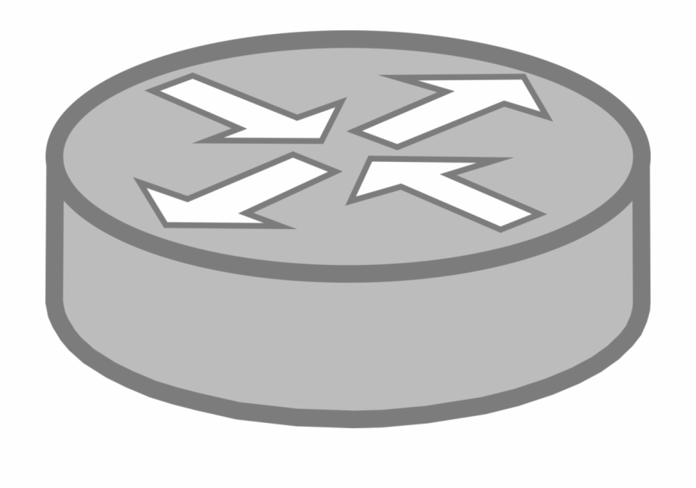
RIP
Routing Information Protocol
Uses shortest number of hops to determine the best path to a remote network
RIP is a dynamic routing protocol (automatic router table updating)
In RIP protocol routers learn about the destination networks from neighboring routers through the sharing process.
Routers running RIP protocol periodically broadcast the configured networks from all ports.
Listing routers will update their routing table based on this information.

Slide 2

Client 1
Router 2
Router 4
Router 1
Router 3
Router 5
Router 6
Network Topology
Client 2

Slide 3
Port 51200
Port 4110
Port 4114
Port 4106
Port 4112
Port 4116
Port 4117
Network Topology
Port 51201

Slide 4
Broadcast
I’m connected to network 4114 and 4106
Port 51200
Port 4110
Port 4114
Port 4106
Port 4112
Port 4116
Port 4117
Steps
Initialize all routers
Wait for router updates
RIP uses local broadcast to share routing information
RIP Protocol
1. Routing Updates
Port 51201

Slide 5
Port 51200
Port 4110
Port 4114
Port 4106
Steps
Increment metric of incoming routes in advertisements.
Add all new routes before update.
Replace old entry with new route for better information.
Ignore new route with worse information.
Port 4112
Port 4116
Port 4117
RIP Protocol
2. Convergence – Hop count metric
Port 51201

Slide 6
Hey from 51200
Port 51200
Port 4110
Port 4114
Port 4106
Port 4112
Port 4116
Port 4117
RIP Protocol
2. Convergence – Hop count metric
Port 51201

Slide 7
Hey from 51200
Port 51200
Port 4110
Port 4114
Port 4106
Port 4112
Port 4116
Port 4117
RIP Protocol
2. Convergence – Hop count metric
Hey from 51200
Port 51201

