Slide 1
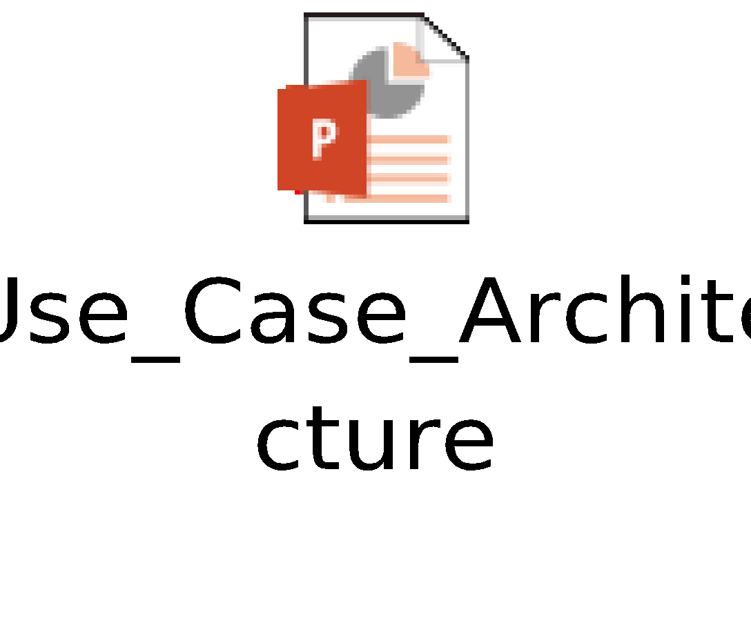
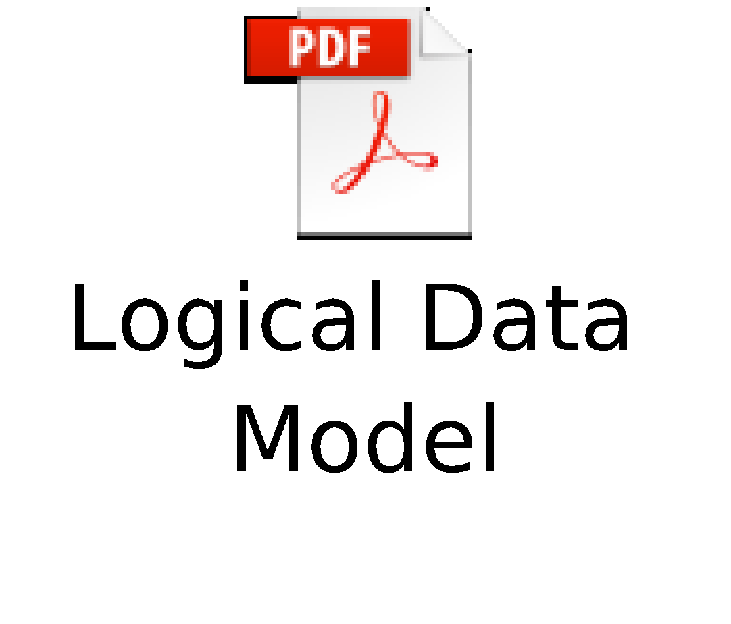
Round 2
Phase 2 – Proof Of Concept
Defined Deliverables | Sample
Detailed Use Case selected for POC | The developed POC focuses on building electronic medical history by tracking the user’s mood from audio recordings and symptoms from the corresponding transcript. Tracking of this data is useful to doctors and other medical professionals for diagnostic purposes. This data can also be provided to medical research labs and organizations for developing generalized statistics, as well as, targeted medical programs for people. To uplift mental health during sickness and otherwise, a Cognitive Behavioral Therapy (CBT) chatbot is also developed for the user so they can have a virtual therapy session and talk about their problems anytime, anywhere.
Solution Design and Architecture | Audio recordings from the Android app and the corresponding transcript is sent to the Flask server. The audio recording is stored locally, and trained models detect the user’s mood from the audio, and symptoms from the text. This information is stored in MongoDB and Elasticsearch respectively for further use in our analytic offerings and visualization systems. [Link]
Business Model | A Lean Canvas describing our detailed business model. [Link]
Test Data Set Availability with Test Results | An extensive guide to our machine learning models and how to train them. [Link]
Installation & Execution Guide | Step by step guide to install application with screenshots. [Link]
Business Model
Test Guide

