Slide 1
Final Assignment
Student ID: 1W22CF16
Name: Jimin Park

Slide 2
1. Understanding the Problem
Problem:
Structure Estimation[Predict sales based on storeʼs location conditions]
Explanatory variables:
Sales floor area, Walking time from station, Number of competing stores, Population density of the neighborhood, Parking space, Dining space, Whether or not facing a main street
Objective variable :
Sale [Quantitative, Observable]
Type of problem:
Regression

Slide 3
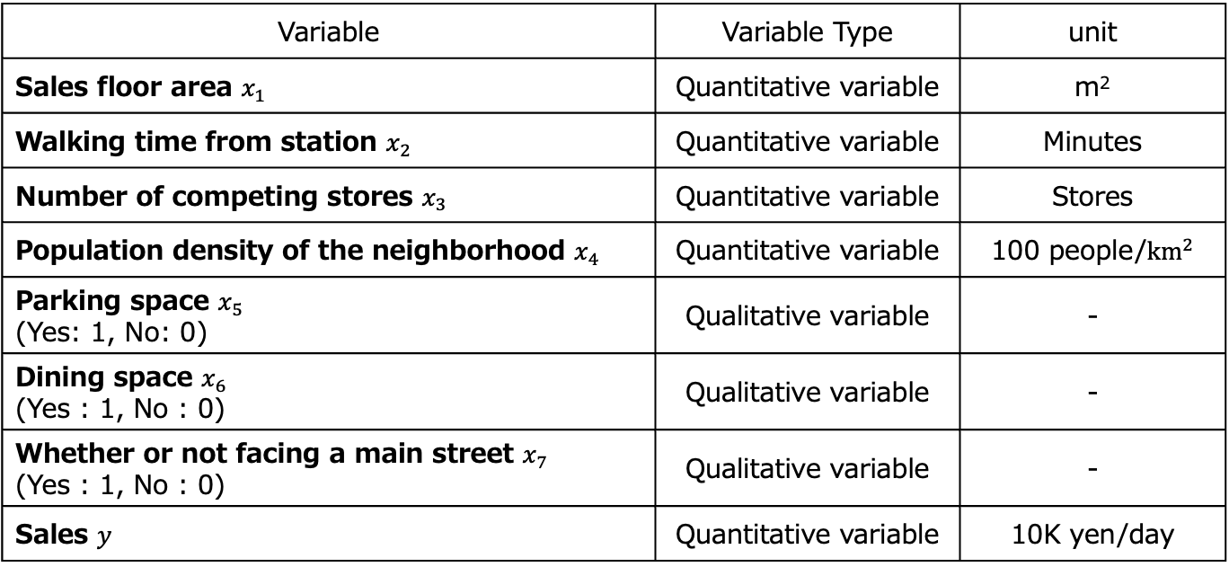
2. Confirmation of Inputs
Variable | Variable Type | unit
Sales floor area $x_{1}$ | Quantitative variable | m²
Walking time from station $x_{2}$ | Quantitative variable | Minutes
Number of competing stores $x_{3}$ | Quantitative variable | Stores
Population density of the neighborhood $x_{4}$ | Quantitative variable | 100 people/${km}^{2}$
Parking space $x_{5}$ (Yes: 1, No: 0) | Qualitative variable | -
Dining space $x_{6}$ (Yes : 1, No : 0) | Qualitative variable | -
Whether or not facing a main street $x_{7}$ (Yes : 1, No : 0) | Qualitative variable | -
Sales $y$ | Quantitative variable | 10K yen/day

Slide 4
3. Understanding the Data Characteristics

Slide 5
Understanding the Objectives
Objective: Understanding the data characteristics [understand the distribution of variables and the relationships between variables regarding sales of their current stores]

Slide 6
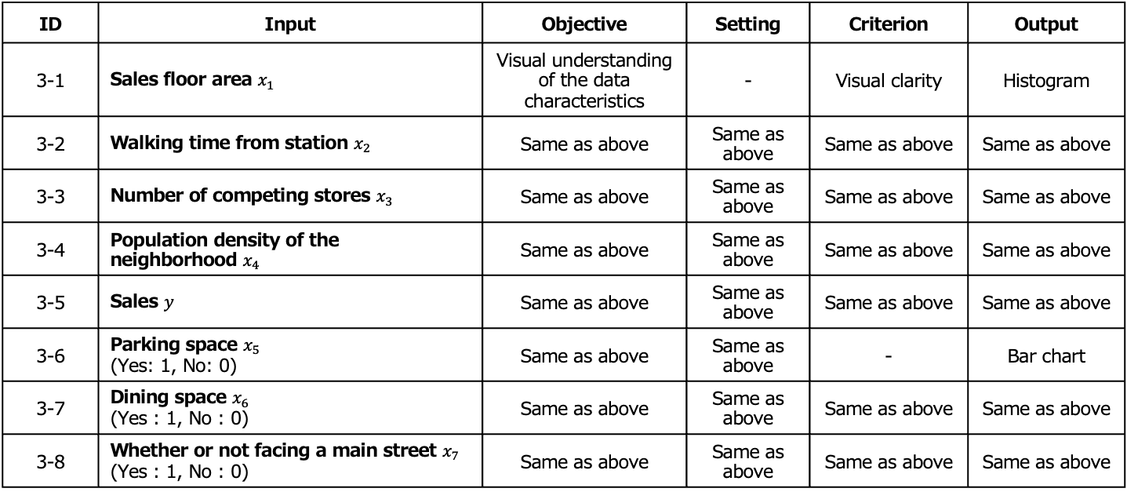
Determination of the Decision-making Map
ID | Input | Objective | Setting | Criterion | Output
3-1 | Sales floor area $x_{1}$ | Visual understanding of the data characteristics | - | Visual clarity | Histogram
3-2 | Walking time from station $x_{2}$ | Same as above | Same as above | Same as above | Same as above
3-3 | Number of competing stores $x_{3}$ | Same as above | Same as above | Same as above | Same as above
3-4 | Population density of the neighborhood $x_{4}$ | Same as above | Same as above | Same as above | Same as above
3-5 | Sales $y$ | Same as above | Same as above | Same as above | Same as above
3-6 | Parking space $x_{5}$ (Yes: 1, No: 0) | Same as above | Same as above | - | Bar chart
3-7 | Dining space $x_{6}$ (Yes : 1, No : 0) | Same as above | Same as above | Same as above | Same as above
3-8 | Whether or not facing a main street $x_{7}$ (Yes : 1, No : 0) | Same as above | Same as above | Same as above | Same as above

Slide 7
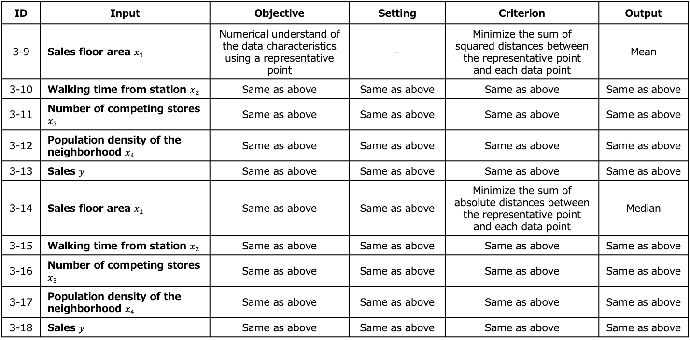
Determination of the Decision-making Map
ID | Input | Objective | Setting | Criterion | Output
3-9 | Sales floor area $x_{1}$ | Numerical understand of the data characteristics using a representative point | - | Minimize the sum of squared distances between the representative point and each data point | Mean
3-10 | Walking time from station $x_{2}$ | Same as above | Same as above | Same as above | Same as above
3-11 | Number of competing stores $x_{3}$ | Same as above | Same as above | Same as above | Same as above
3-12 | Population density of the neighborhood $x_{4}$ | Same as above | Same as above | Same as above | Same as above
3-13 | Sales $y$ | Same as above | Same as above | Same as above | Same as above
3-14 | Sales floor area $x_{1}$ | Same as above | Same as above | Minimize the sum of absolute distances between the representative point and each data point | Median
3-15 | Walking time from station $x_{2}$ | Same as above | Same as above | Same as above | Same as above
3-16 | Number of competing stores $x_{3}$ | Same as above | Same as above | Same as above | Same as above
3-17 | Population density of the neighborhood $x_{4}$ | Same as above | Same as above | Same as above | Same as above
3-18 | Sales $y$ | Same as above | Same as above | Same as above | Same as above

Slide 8
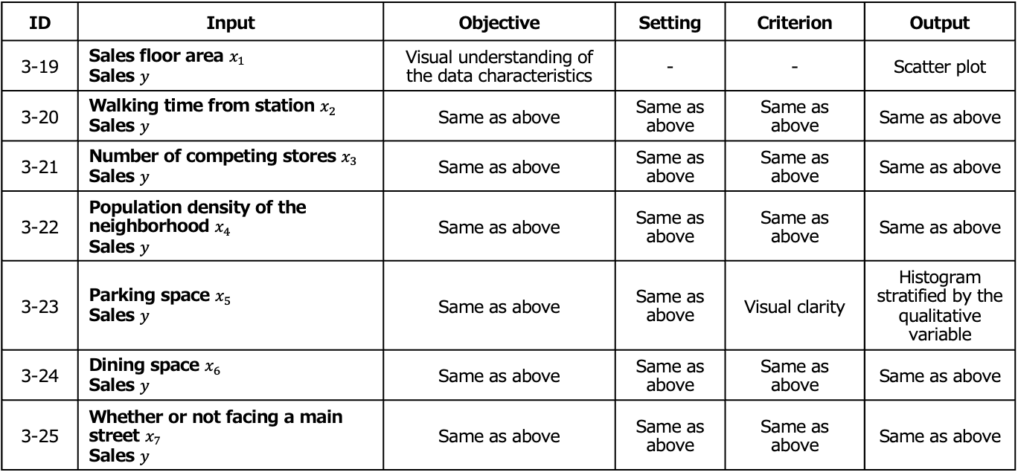
Determination of the Decision-making Map
ID | Input | Objective | Setting | Criterion | Output
3-19 | Sales floor area $x_{1}$ Sales $y$ | Visual understanding of the data characteristics | - | - | Scatter plot
3-20 | Walking time from station $x_{2}$ Sales $y$ | Same as above | Same as above | Same as above | Same as above
3-21 | Number of competing stores $x_{3}$ Sales $y$ | Same as above | Same as above | Same as above | Same as above
3-22 | Population density of the neighborhood $x_{4}$ Sales $y$ | Same as above | Same as above | Same as above | Same as above
3-23 | Parking space $x_{5}$ Sales $y$ | Same as above | Same as above | Visual clarity | Histogram stratified by the qualitative variable
3-24 | Dining space $x_{6}$ Sales $y$ | Same as above | Same as above | Same as above | Same as above
3-25 | Whether or not facing a main street $x_{7}$ Sales $y$ | Same as above | Same as above | Same as above | Same as above

Slide 9
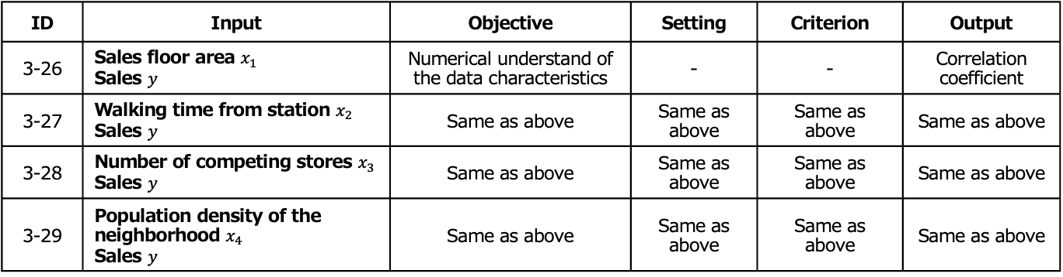
Determination of the Decision-making Map
ID | Input | Objective | Setting | Criterion | Output
3-26 | Sales floor area $x_{1}$ Sales $y$ | Numerical understand of the data characteristics | - | - | Correlation coefficient
3-27 | Walking time from station $x_{2}$ Sales $y$ | Same as above | Same as above | Same as above | Same as above
3-28 | Number of competing stores $x_{3}$ Sales $y$ | Same as above | Same as above | Same as above | Same as above
3-29 | Population density of the neighborhood $x_{4}$ Sales $y$ | Same as above | Same as above | Same as above | Same as above

Slide 10
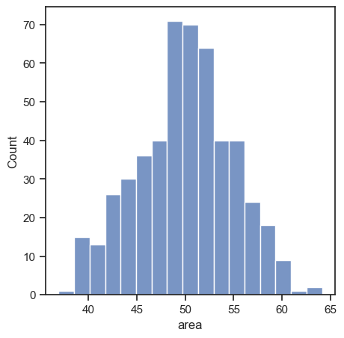
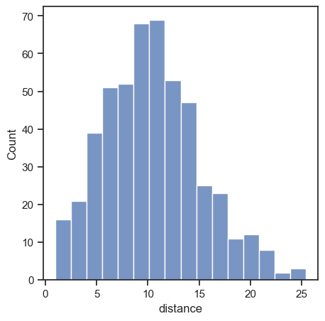
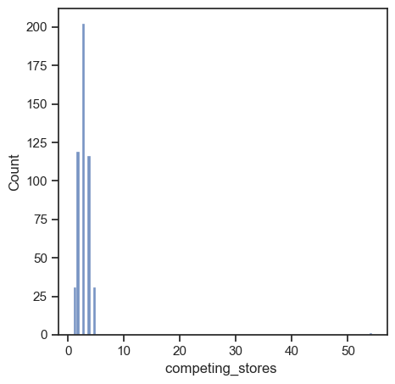
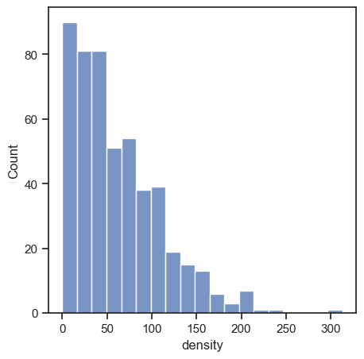
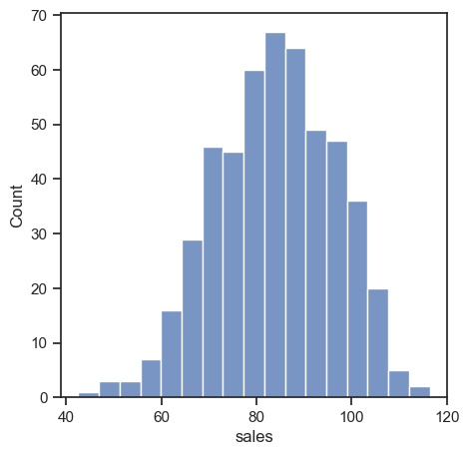
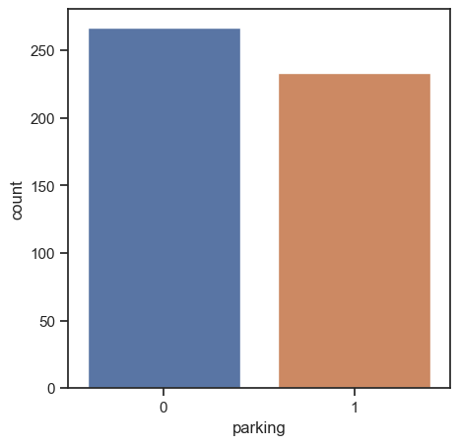
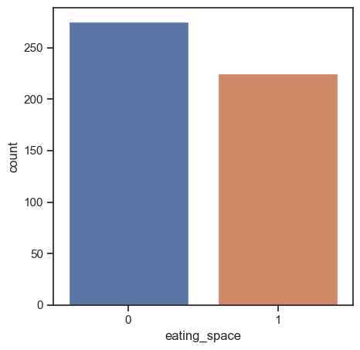
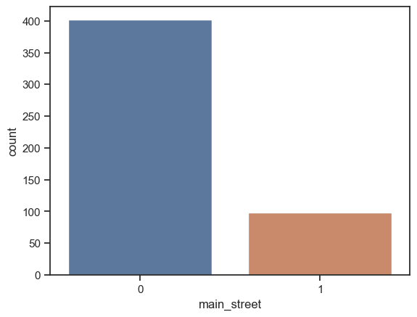
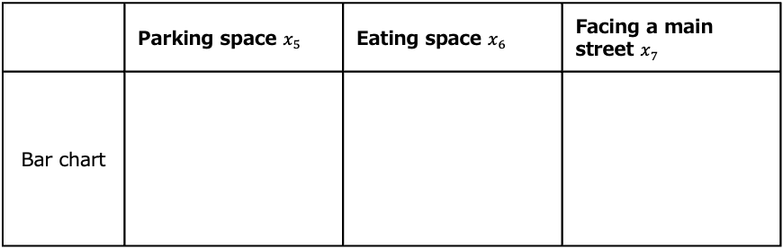
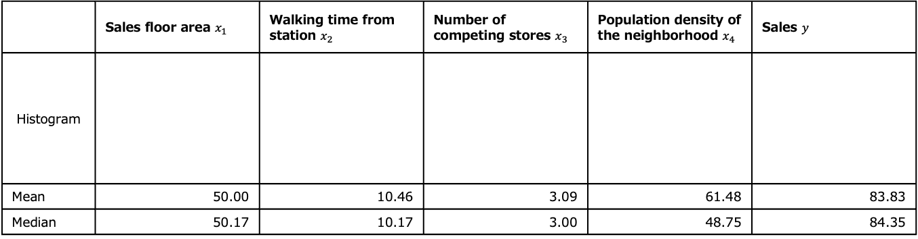
[3-1~3-18] Analysis
 | Sales floor area $x_{1}$ | Walking time from station $x_{2}$ | Number of competing stores $x_{3}$ | Population density of the neighborhood $x_{4}$ | Sales $y$
Histogram
Mean | 50.00 | 10.46 | 3.09 | 61.48 | 83.83
Median | 50.17 | 10.17 | 3.00 | 48.75 | 84.35
 | Parking space $x_{5}$ | Eating space $x_{6}$ | Facing a main street $x_{7}$
Bar chart

Slide 11
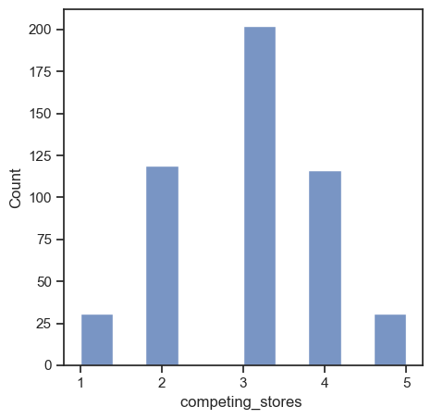
[3-1~3-18] Consideration
From the histogram of the competing stores, we can see that there is a decimal value, which should not be possible as valid competing stores value.
The value 54.35166776 is judged to be an outlier, and from here on, we will handle the data excluding the properties with decimal value.
The histogram, mean, and median of the competing stores data after exclusion of the outlier are shown below.
Mean | Median
2.993988 | 3.000000
Notes:
+ 해당 데이터를 다 지우는 건가? 아니면 이상한 부분만 빈칸으로 만드는 건가? >> 해당 데이터를 다 지우는 것 같음.

Slide 12
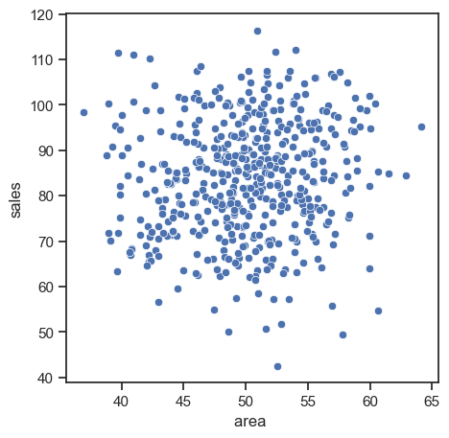
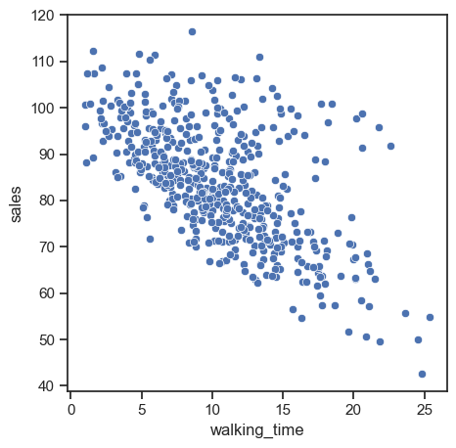
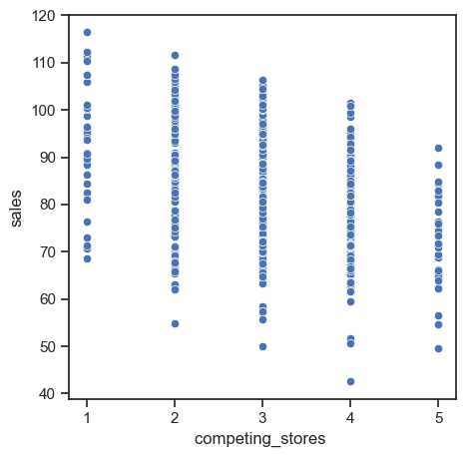
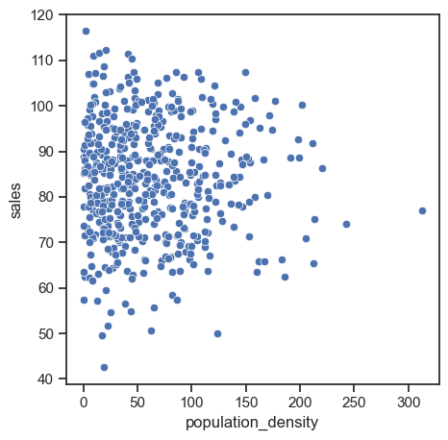
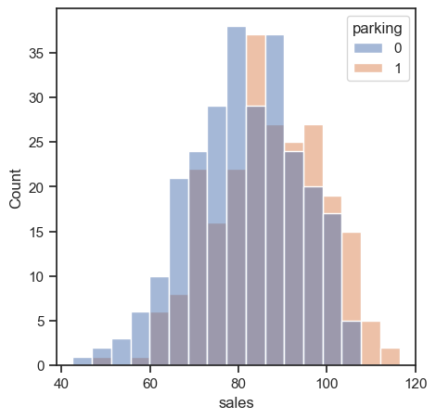
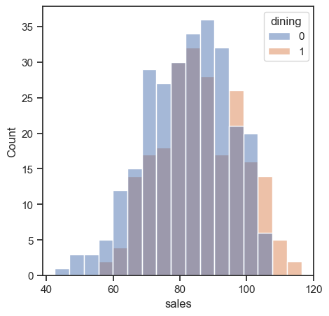
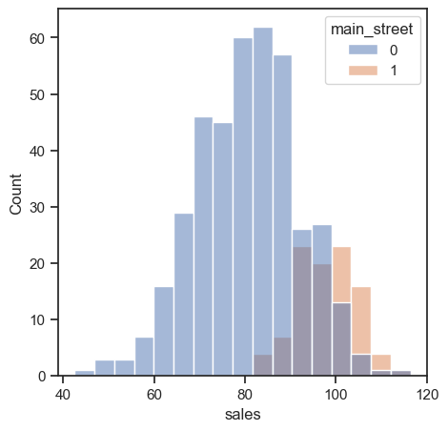
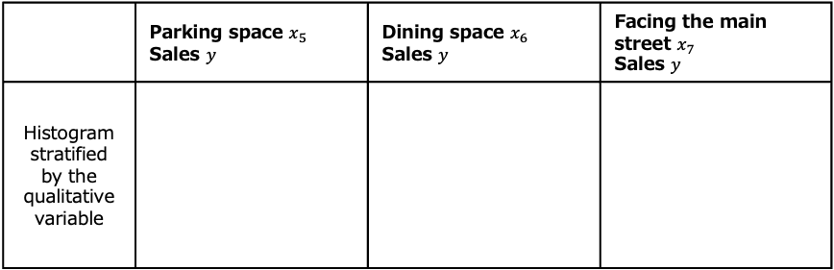
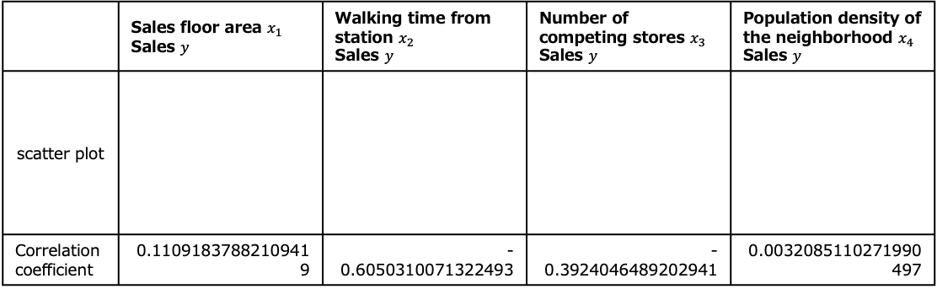
[3-19~3-29] Analysis
 | Sales floor area $x_{1}$ Sales $y$ | Walking time from station $x_{2}$ Sales $y$ | Number of competing stores $x_{3}$ Sales $y$ | Population density of the neighborhood $x_{4}$ Sales $y$
scatter plot
Correlation coefficient | 0.11091837882109419 | -0.6050310071322493 | -0.3924046489202941 | 0.0032085110271990497
 | Parking space $x_{5}$ Sales $y$ | Dining space $x_{6}$ Sales $y$ | Facing the main street $x_{7}$ Sales $y$
Histogram stratified by the qualitative variable
Notes:
Decimal 확인
특히 0.003…은 어떻게 해야하는지?

Slide 13
[3-19~3-29] Consideration
Here's a similar consideration section based on your analysis:
"The scatter plot and correlation coefficient of sales floor area and sales show that the correlation between these variables is very weak. The scatter plot and correlation coefficient of walking time from the station and sales indicate a moderate positive correlation between these variables. The scatter plot and correlation coefficient of the number of competing stores and sales show a weak positive correlation. The scatter plot and correlation coefficient of population density of the neighborhood and sales demonstrate a very weak correlation between these variables. The histogram of sales stratified by the availability of parking space suggests that stores with parking tend to have slightly higher sales. The histogram of sales stratified by dining space indicates that stores with dining space generally have higher sales. The histogram of sales stratified by whether the store faces the main street shows that stores on the main street tend to have higher sales compared to those that do not."
Notes:
챗지피티 그대로 카피

Slide 14
4. Analysis of the Problem

Slide 15
Understanding the Objectives
Objective: Structure Estimation[Predict sales based on storeʼs location conditions]

Slide 16
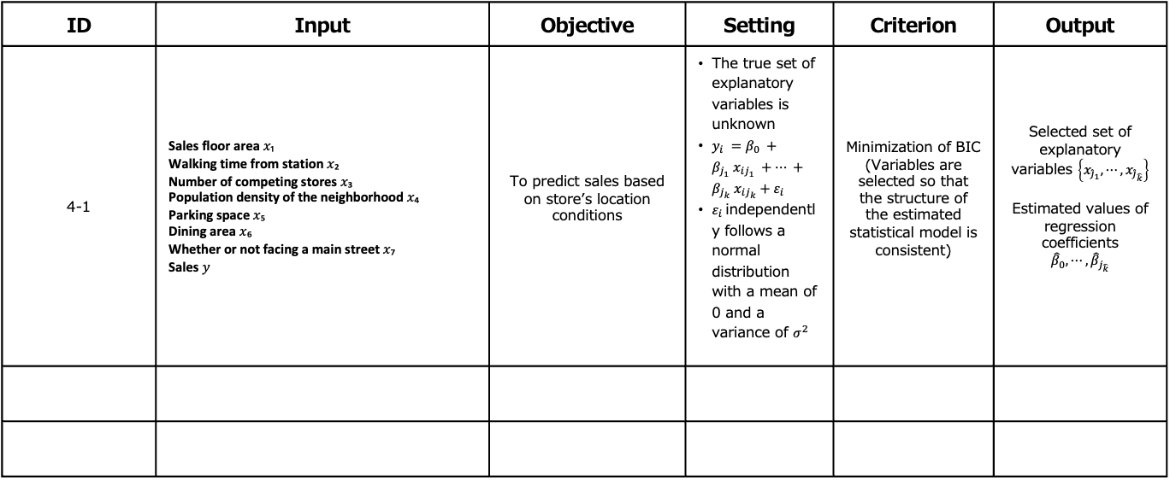
Determination of the Decision-making Map
ID | Input | Objective | Setting | Criterion | Output
4-1 | Sales floor area 𝑥₁ Walking time from station 𝑥₂ Number of competing stores 𝑥₃ Population density of the neighborhood 𝑥₄ Parking space 𝑥₅ Dining area 𝑥₆ Whether or not facing a main street 𝑥₇ Sales 𝑦 | To predict sales based on storeʼs location conditions | The true set of explanatory variables is unknown $y_{i} =β_{0} +β_{j_{1}} x_{ij_{1}} +⋯ +β_{j_{k}} x_{ij_{k}}+ε_{i}$ $ε_{i}$independently follows a normal distribution with a mean of 0 and a variance of $σ^{2}$ | Minimization of BIC (Variables are selected so that the structure of the estimated statistical model is consistent) | Selected set of explanatory variables $\left\{x_{{\hat{j}}_{1}}, ⋯,x_{{\hat{j}}_{\hat{k}}}\right\}$ Estimated values of regression coefficients $${\hat{β}}_{0}, ⋯, {\hat{β}}_{j_{\hat{k}}}$$

Slide 17
[4-1] Analysis
BIC values were obtained for all combinations of explanatory variables
BIC | formula
3953 | sales ~ area
3732 | sales ~ walking_time
3876 | sales ~ competing_stores
3959 | sales ~ population_density
3936 | sales ~ parking
3947 | sales ~ dining
3774 | sales ~ main_street
3729 | sales ~ area + walking_time
3875 | sales ~ area + competing_stores
3959 | sales ~ area + population_density
3936 | sales ~ area + parking
3946 | sales ~ area + dining
3776 | sales ~ area + main_street
3567 | sales ~ walking_time + competing_stores
3738 | sales ~ walking_time + population_density
3729 | sales ~ walking_time + parking
BIC | formula
3720 | sales ~ walking_time + dining
3381 | sales ~ walking_time + main_street
3882 | sales ~ competing_stores + population_density
3849 | sales ~ competing_stores + parking
3861 | sales ~ competing_stores + dining
3689 | sales ~ competing_stores + main_street
3943 | sales ~ population_density+ parking
3954 | sales ~ population_density+ dining
2934 | sales ~ walking_time + competing_stores + population_density + parking + dining + main_street
2902 | sales ~ area + walking_time + competing_stores + population_density + parking + dining + main_street
Notes:
Area 뒤나 competing_stores뒤에 스페이스를 두어야하는지?

Slide 18
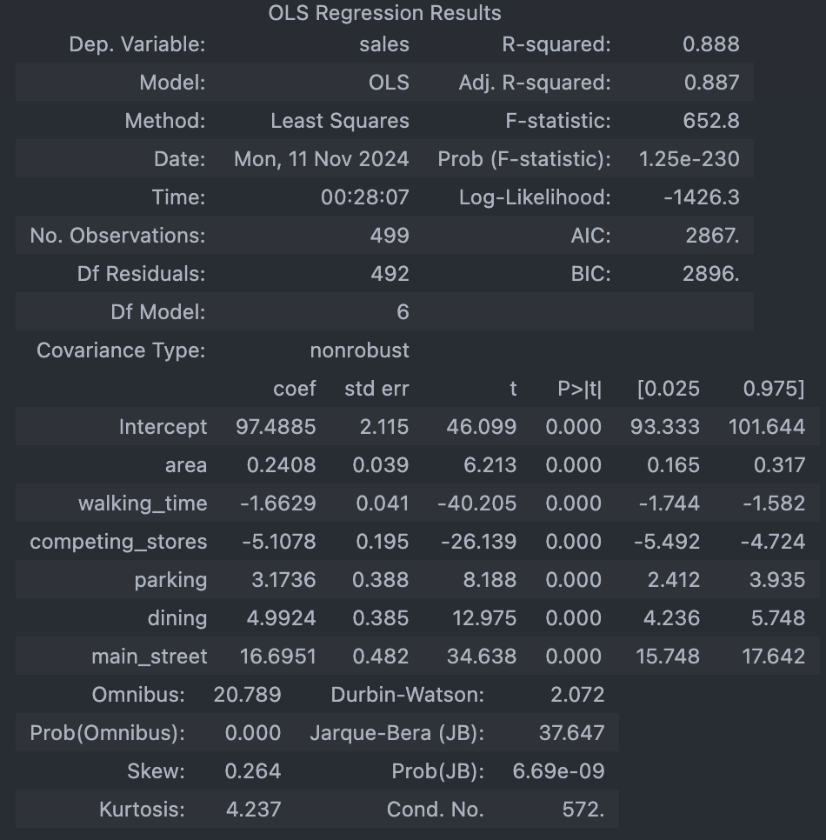
[4-1] Analysis

Slide 19
[4-1] Analysis
Minimum BIC: 2902

Slide 20
[ ] Consideration

Slide 21
X. XXXXXXXXXX

Slide 22
Understanding the Objectives
Objective: [ ]

Slide 23
Determination of the Decision-making Map
ID | Input | Objective | Setting | Criterion | Output

Slide 24
[ ] Analysis

Slide 25
[ ] Consideration

Slide 26
Conclusion

