Slide 1
An Example of Data Analysis
Center for Data Science
Global Education Center
Waseda University

Slide 2
Contents
An example of data analysis
How to use the worksheet for the final assignment

Slide 3
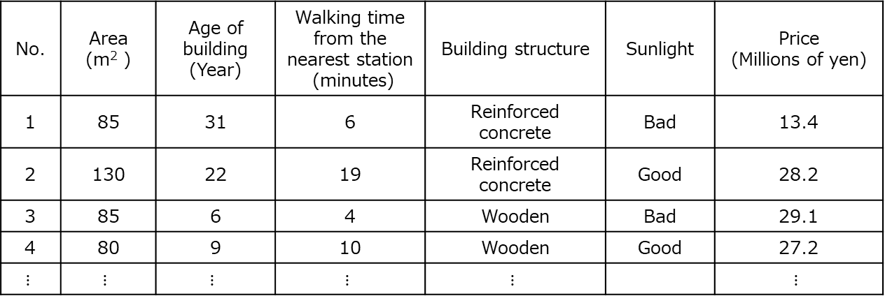
An Example of Data Analysis
Example: Sales of used homes
A real estate company has data on previously sold used homes.
They want to know how the price is determined from the property information.
No. | Area (m² ) | Age of building (Year) | Walking time from the nearest station (minutes) | Building structure | Sunlight | Price (Millions of yen)
1 | 85 | 31 | 6 | Reinforced concrete | Bad | 13.4
2 | 130 | 22 | 19 | Reinforced concrete | Good | 28.2
3 | 85 | 6 | 4 | Wooden | Bad | 29.1
4 | 80 | 9 | 10 | Wooden | Good | 27.2
$$⋮$$ | $$⋮$$ | $$⋮$$ | $$⋮$$ | $$⋮$$ |  | $$⋮$$

Slide 4


Overall Structure of the Worksheet
Sheet types
Understanding the Problem
Confirmation of Input
Understanding the Objectives
Determination of Decision-making Map
Analysis
Consideration
Conclusion
Review of settings (Verification of Settings)
└ Understanding the Objectives
└ Determination of Decision-making Map
└ Analysis
└ Consideration
$⋮$
Review of settings (Review of the Regression Equation)
└ Understanding the Objectives
└ Determination of Decision-making Map
└ Analysis
└ Consideration
$⋮$
Review of settings (Verification of Settings)
└ Understanding the Objectives
└ Determination of Decision-Making Map
└ Analysis
└ Consideration
$⋮$
Conclusion
Understanding the Problem
Confirmation of Input
Understanding the Data Characteristics
└ Understanding the Objectives
└ Determination of Decision-making Map
└ Analysis
└ Consideration
$⋮$
Analysis of the Problems
└ Understanding the Objectives
└ Determination of Decision-making Map
└ Analysis
└ Consideration
$⋮$

Slide 5


Overall Structure of the Worksheet
Final assignment
Analysis with the pre-specified decision-making maps
Additional decision-making maps can be considered
To be prepared for your own analysis
Review of settings (Verification of Settings)
└ Understanding the Objective
└ Determination of Decision-making Map
└ Analysis
└ Consideration
$⋮$
Review of settings (Review of the Regression Equation)
└ Understanding the Objective
└ Determination of Decision-making Map
└ Analysis
└ Consideration
$⋮$
Review of settings (Verification of Settings)
└ Understanding the Objective
└ Determination of Decision-Making Map
└ Analysis
└ Consideration
$⋮$
Conclusion
Understanding the Problem
Confirmation of Input
Understanding the Data Characteristics
└ Understanding the Objective
└ Determination of Decision-making Map
└ Analysis
└ Consideration
$⋮$
Analysis of the Problems
└ Understanding the Objective
└ Determination of Decision-making Map
└ Analysis
└ Consideration
$⋮$

Slide 6
1. Understanding the Problem
Fill in “Structure Estimation” or “Prediction”
Express the objective specifically in sentences
Fill in whether the objective variable is quantitative or qualitative, observable or unobservable
Problem:
Structure Estimation [estimate the structure that determines the price from property information]
Explanatory Variable:
Area, Age of Building, Walking time from the nearest station, Building structure, Sunlight
Objective variable:
Price [Quantitative, Observable]
Type of problem:
Regression
Determine from the objective variable and fill in
Objective variable | Quantitative | Qualitative
Observable | Regression | Classification
Unobservable | Dimensionality reduction | Clustering

Slide 7



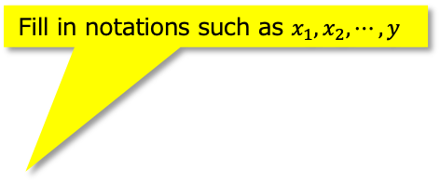



2. Confirmation of Inputs
Fill in notations such as $x_{1},x_{2}, ⋯,y$
Variable | Variable Type | Unit
Area | Quantitative variable | m²
Age of building | Quantitative variable | Year
Walking time from the nearest station | Quantitative variable | Minutes
Building Structure (Reinforced concrete: RC, Wooden: W) | Qualitative variable | -
Sunlight (Good or Bad) | Qualitative variable | -
Price | Quantitative variable | Millions of yen
$$x_{1}$$
$$x_{2}$$
$$x_{3}$$
$$x_{4}$$
$$x_{5}$$
$$y$$

Slide 8
Write the chapter number
Write the name of the analysis step
3. Understanding the Data Characteristics

Slide 9
Understanding the Objectives
Express the objective specifically in sentences
Objective: Understanding the data characteristics [understand the distribution of variables and the relationships between variables regarding the sales of used homes data]

Slide 10
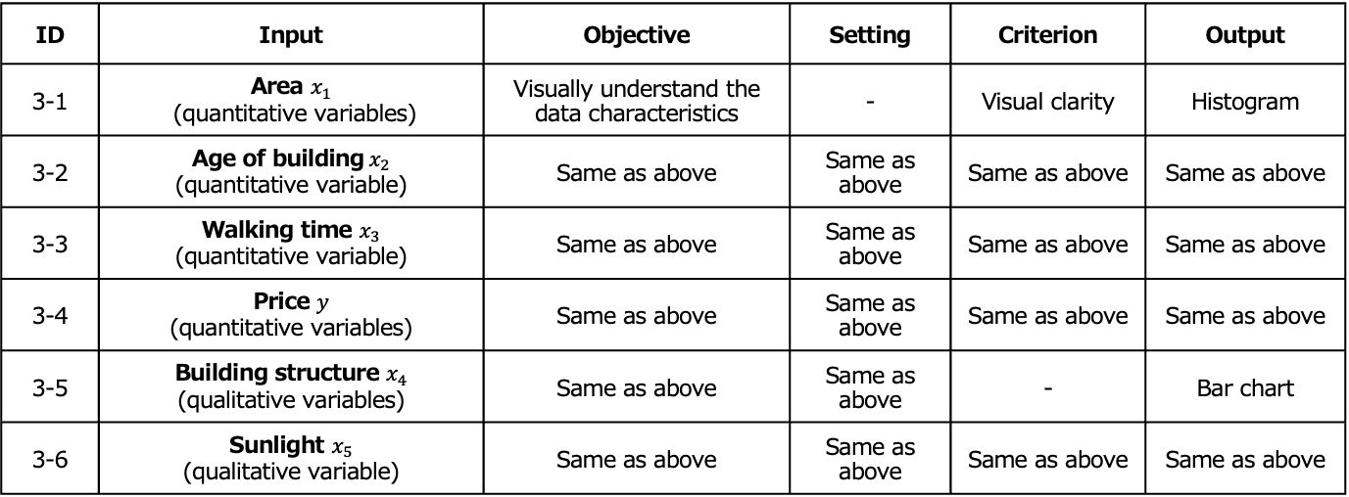
Determination of the Decision-making Map
ID number should be formatted in the form of "chapter number - serial number".
*Use ID numbers to link the decision-making maps in this sheet with those in the "Analysis" and ”Consideration” sheets.
If there is nothing to be filled in, indicate so by writing "-” or ”N/A”.
ID | Input | Objective | Setting | Criterion | Output
3-1 | Area $x_{1}$ (quantitative variables) | Visually understand the data characteristics | - | Visual clarity | Histogram
3-2 | Age of building$x_{2}$ (quantitative variable) | Same as above | Same as above | Same as above | Same as above
3-3 | Walking time $x_{3}$ (quantitative variable) | Same as above | Same as above | Same as above | Same as above
3-4 | Price $y$ (quantitative variables) | Same as above | Same as above | Same as above | Same as above
3-5 | Building structure $x_{4}$ (qualitative variables) | Same as above | Same as above | - | Bar chart
3-6 | Sunlight $x_{5}$ (qualitative variable) | Same as above | Same as above | Same as above | Same as above

Slide 11
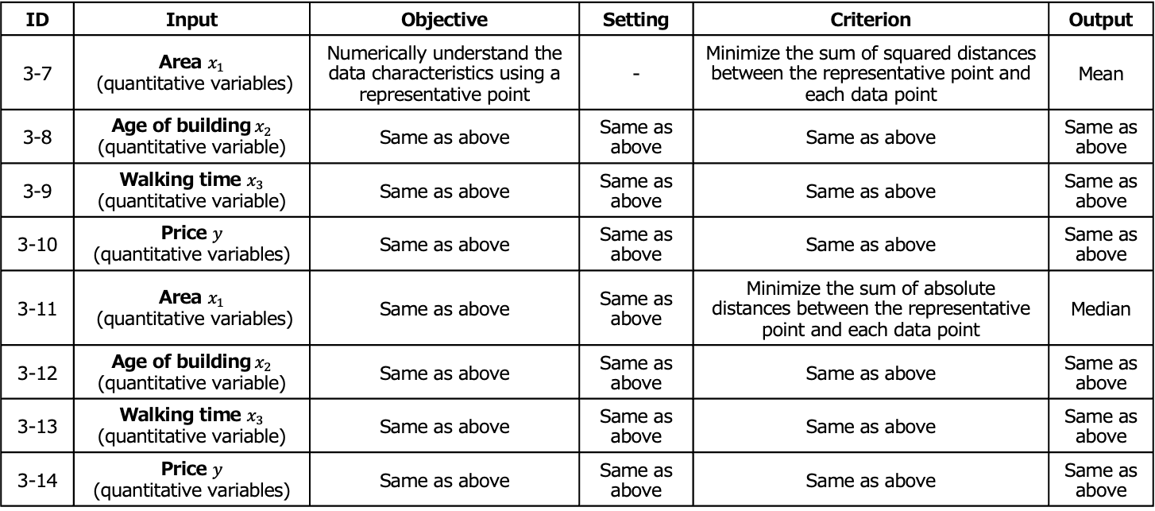
Determination of the Decision-making Map
ID | Input | Objective | Setting | Criterion | Output
3-7 | Area $x_{1}$ (quantitative variables) | Numerically understand the data characteristics using a representative point | - | Minimize the sum of squared distances between the representative point and each data point | Mean
3-8 | Age of building$x_{2}$ (quantitative variable) | Same as above | Same as above | Same as above | Same as above
3-9 | Walking time $x_{3}$ (quantitative variable) | Same as above | Same as above | Same as above | Same as above
3-10 | Price $y$ (quantitative variables) | Same as above | Same as above | Same as above | Same as above
3-11 | Area $x_{1}$ (quantitative variables) | Same as above | Same as above | Minimize the sum of absolute distances between the representative point and each data point | Median
3-12 | Age of building$x_{2}$ (quantitative variable) | Same as above | Same as above | Same as above | Same as above
3-13 | Walking time $x_{3}$ (quantitative variable) | Same as above | Same as above | Same as above | Same as above
3-14 | Price $y$ (quantitative variables) | Same as above | Same as above | Same as above | Same as above

Slide 12
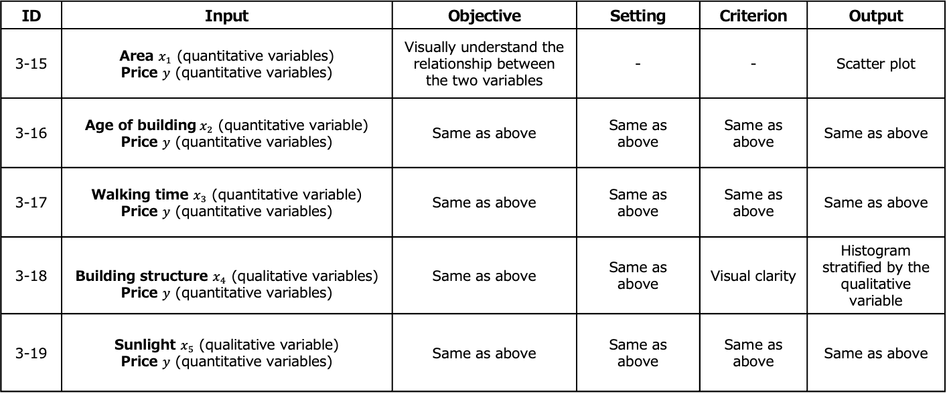
Determination of the Decision-making Map
ID | Input | Objective | Setting | Criterion | Output
3-15 | Area $x_{1}$ (quantitative variables) Price $y$ (quantitative variables) | Visually understand the relationship between the two variables | - | - | Scatter plot
3-16 | Age of building$x_{2}$ (quantitative variable) Price $y$ (quantitative variables) | Same as above | Same as above | Same as above | Same as above
3-17 | Walking time $x_{3}$ (quantitative variable) Price $y$ (quantitative variables) | Same as above | Same as above | Same as above | Same as above
3-18 | Building structure $x_{4}$ (qualitative variables) Price $y$ (quantitative variables) | Same as above | Same as above | Visual clarity | Histogram stratified by the qualitative variable
3-19 | Sunlight $x_{5}$ (qualitative variable) Price $y$ (quantitative variables) | Same as above | Same as above | Same as above | Same as above

Slide 13
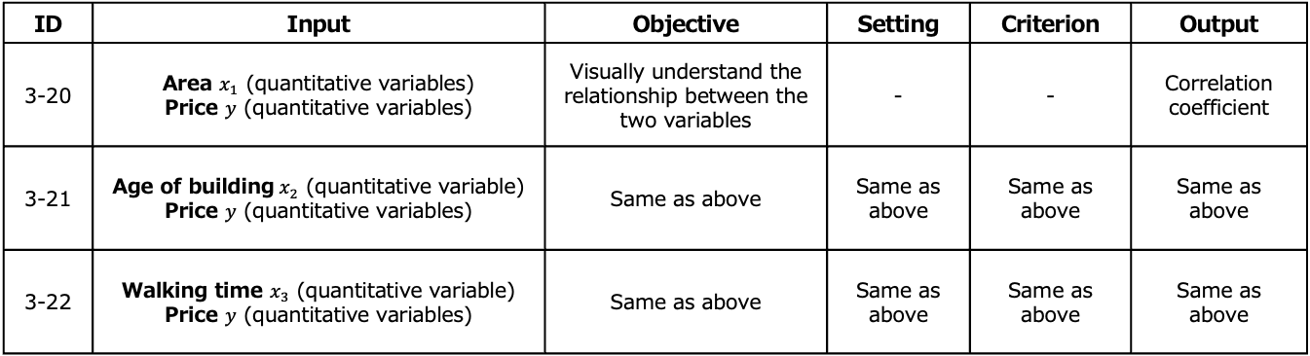
Determination of the Decision-making Map
ID | Input | Objective | Setting | Criterion | Output
3-20 | Area $x_{1}$ (quantitative variables) Price $y$ (quantitative variables) | Visually understand the relationship between the two variables | - | - | Correlation coefficient
3-21 | Age of building$x_{2}$ (quantitative variable) Price $y$ (quantitative variables) | Same as above | Same as above | Same as above | Same as above
3-22 | Walking time $x_{3}$ (quantitative variable) Price $y$ (quantitative variables) | Same as above | Same as above | Same as above | Same as above

Slide 14
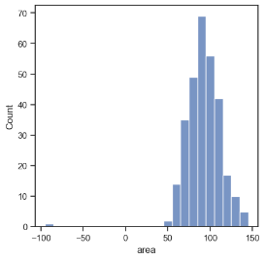
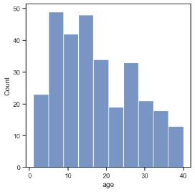
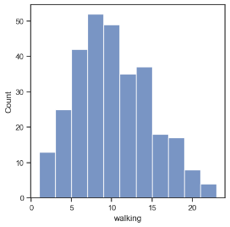
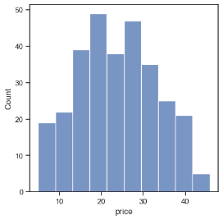
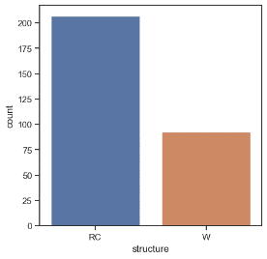
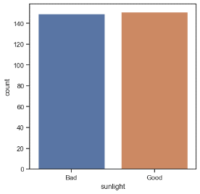
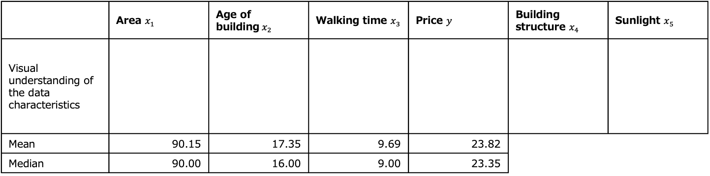
[3-1~3-14] Analysis
Fill in the ID number of decision-making maps specified in the sheet of [Determination of the Decision-making Map].
Fill in the results of the analysis corresponding to the decision-making maps specified by the ID numbers.
 | Area $x_{1}$ | Age of building$x_{2}$ | Walking time $x_{3}$ | Price $y$ | Building structure $x_{4}$ | Sunlight $x_{5}$
Visual understanding of the data characteristics
Mean | 90.15 | 17.35 | 9.69 | 23.82
Median | 90.00 | 16.00 | 9.00 | 23.35

Slide 15
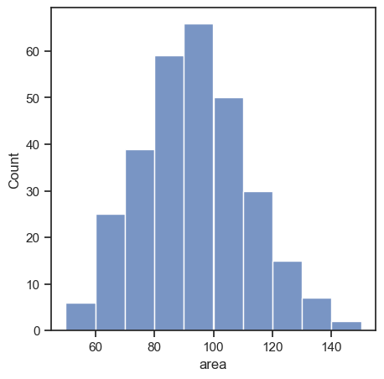
[3-1~3-14] Consideration
From the histogram of the area, we can see that there are negative values, which should not be possible as valid area values.
The negative area values are judged to be outliers, and from here on, we will handle the data excluding the properties with negative values.
The histogram, mean, and median of the area after exclusion of the outliers are shown below.
Mean | Median
90.76 | 90.00

Slide 16
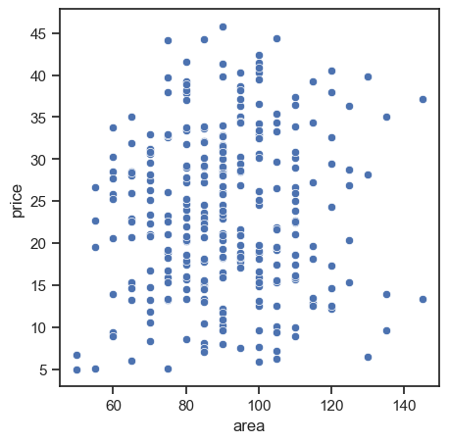
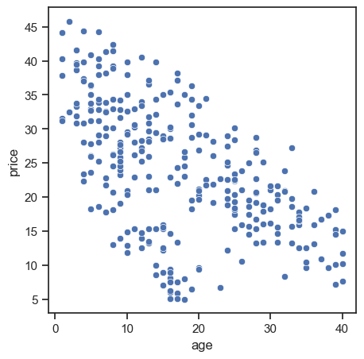
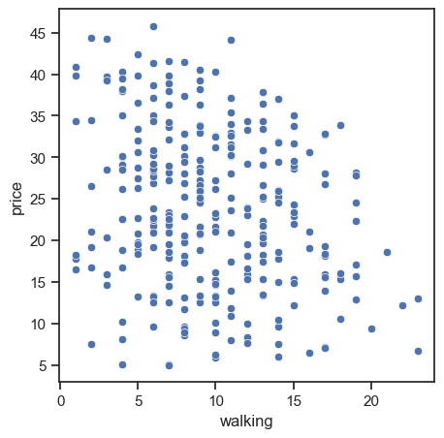
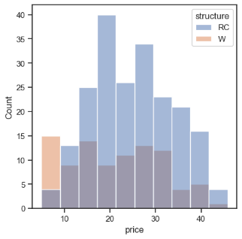
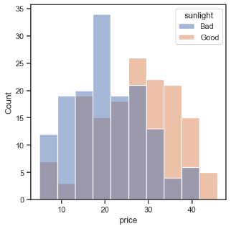
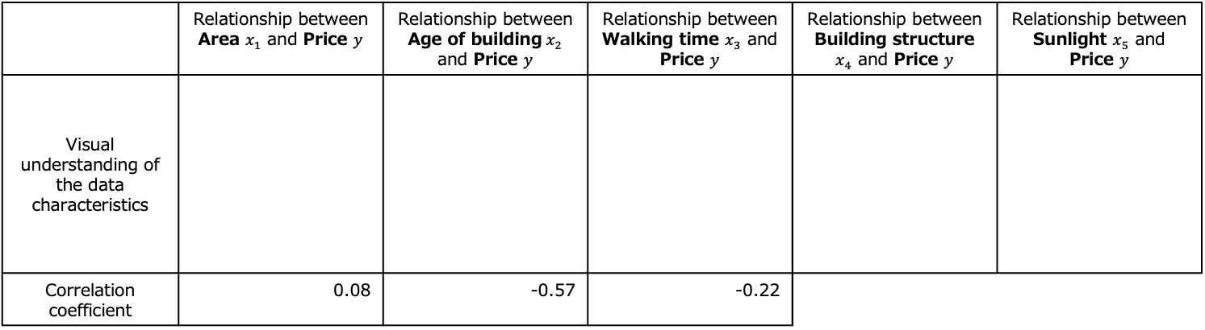
[3-15~3-22] Analysis
 | Relationship between Area $x_{1}$ and Price $y$ | Relationship between Age of building$x_{2}$ and Price $y$ | Relationship between Walking time $x_{3}$ and Price $y$ | Relationship between Building structure $x_{4}$ and Price $y$ | Relationship between Sunlight $x_{5}$ and Price $y$
Visual understanding of the data characteristics
Correlation coefficient | 0.08 | -0.57 | -0.22

Slide 17
[3-15~3-22] Consideration
Fill in the ID number of the decision-making maps specified in the sheet of [Determination of the Decision-making Map]. Fill in the consideration corresponding to the decision-making maps specified by the ID number.
The scatter plot and the correlation coefficient of area and price show that the correlation between these variables is very weak.
The scatter plot and correlation coefficient of age of building and price show that there is a negative correlation between these variables.
The scatter plot of age of building and price shows that the relationship between these variables is not a simple linear relationship.
The scatter plot and correlation coefficient of walking time and price show that there is a weak negative correlation between these variables.
The histogram of price stratified by building structure indicates that prices tend to be higher for reinforced concrete structures compared to wooden structures.
The histogram of price stratified by sunlight indicates that prices tend to be higher in cases of good sunlight compared to those with poor sunlight.
Write in a way that clearly shows which analysis results led to each consideration.

Slide 18
4. Analysis of the Problem

Slide 19
Understanding the Objectives
Objective: Structural estimation [determine a regression equation that estimates prices of used homes based on property information]

Slide 20
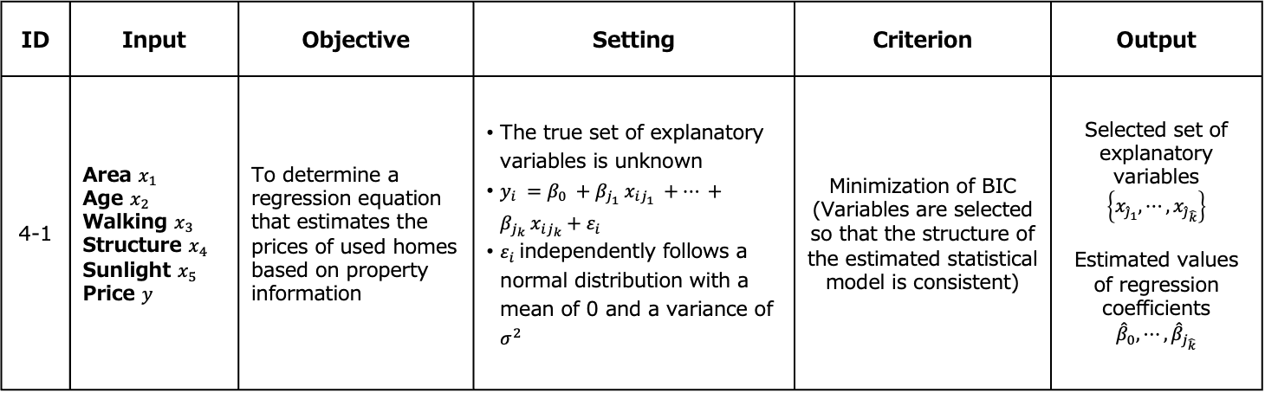
Determination of the Decision-making Map
ID | Input | Objective | Setting | Criterion | Output
4-1 | Area $x_{1}$ Age $x_{2}$ Walking $x_{3}$ Structure $x_{4}$ Sunlight $x_{5}$ Price $y$ | To determine a regression equation that estimates the prices of used homes based on property information | The true set of explanatory variables is unknown $y_{i} =β_{0} +β_{j_{1}} x_{ij_{1}} +⋯ +β_{j_{k}} x_{ij_{k}}+ε_{i}$ $ε_{i}$independently follows a normal distribution with a mean of 0 and a variance of $σ^{2}$ | Minimization of BIC (Variables are selected so that the structure of the estimated statistical model is consistent) | Selected set of explanatory variables $\left\{x_{{\hat{j}}_{1}}, ⋯,x_{{\hat{j}}_{\hat{k}}}\right\}$ Estimated values of regression coefficients $${\hat{β}}_{0}, ⋯, {\hat{β}}_{j_{\hat{k}}}$$

Slide 21
[4-1] Analysis
BIC values were obtained for all combinations of explanatory variables.
BIC | formula
2200 | price ~ area
2082 | price ~ age
2187 | price ~ walking
2191 | price ~ structure
2165 | price ~ sunlight
2084 | price ~ area + age
2190 | price ~ area + walking
2194 | price ~ area + structure
2168 | price ~ area + sunlight
2048 | price ~ age + walking
1912 | price ~ age + structure
2046 | price ~ age + sunlight
2186 | price ~ walking + structure
2143 | price ~ walking + sunlight
2156 | price ~ structure + sunlight
2047 | price ~ area + age + walking
BIC | formula
1900 | price ~ area + age + structure
2045 | price ~ area + age + sunlight
2188 | price ~ area + walking + structure
2144 | price ~ area + walking + sunlight
2158 | price ~ area + structure + sunlight
1877 | price ~ age + walking + structure
1982 | price ~ age + walking + sunlight
1821 | price ~ age + structure + sunlight
2138 | price ~ walking + structure + sunlight
1858 | price ~ area + age + walking + structure
1976 | price ~ area + age + walking + sunlight
1795 | price ~ area + age + structure + sunlight
2138 | price ~ area + walking + structure + sunlight
1727 | price ~ age + walking + structure + sunlight
1677 | price ~ area + age + walking + structure + sunlight

Slide 22
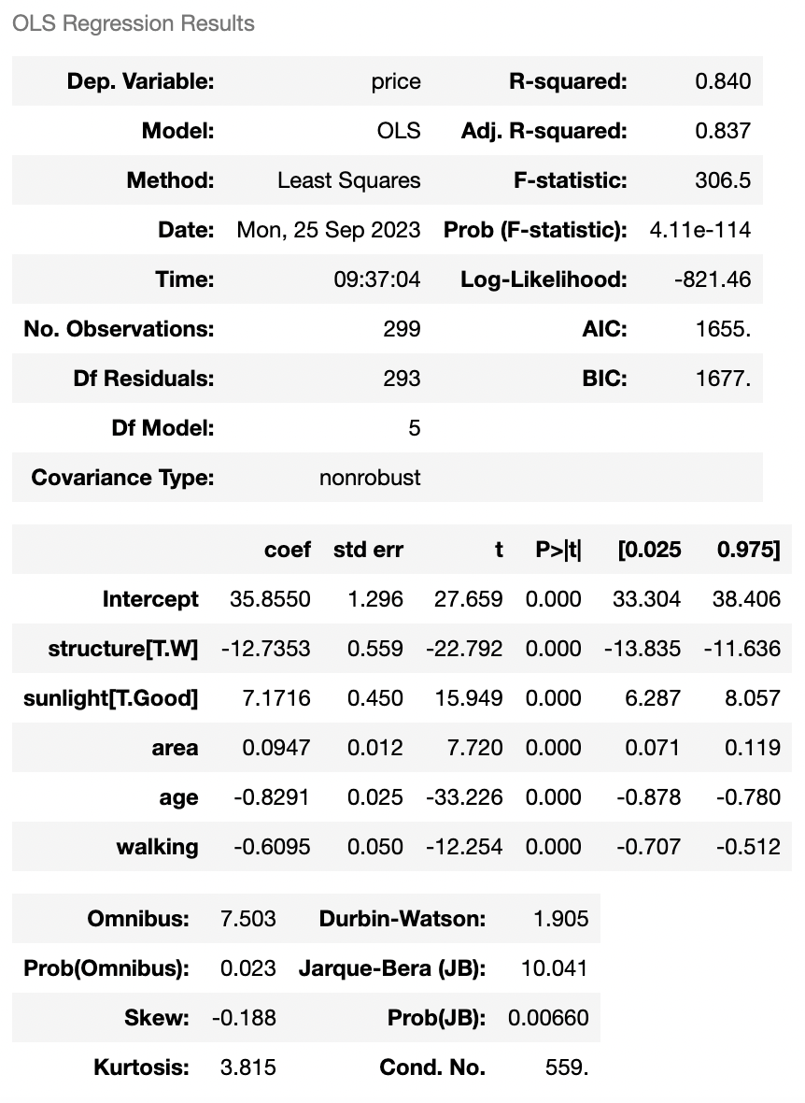
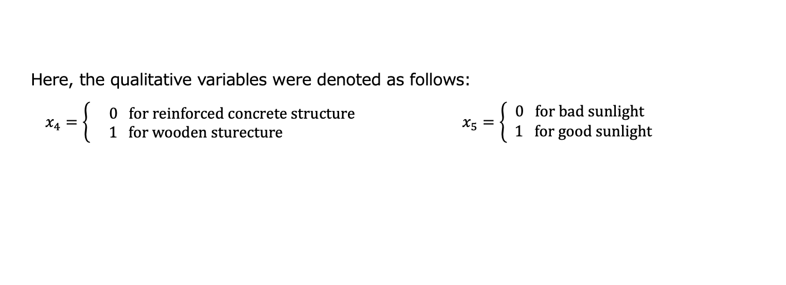
[4-1] Analysis
The results for the regression equation that minimizes the BIC are shown below:
Here, the qualitative variables were denoted as follows:
$x_{4}=\left\{\begin{matrix}0 for reinforced concrete structure \\ 1 for wooden sturecture \end{matrix}\right.$ $x_{5}=\left\{\begin{matrix}0 for bad sunlight \\ 1 for good sunlight\end{matrix}\right.$

Slide 23
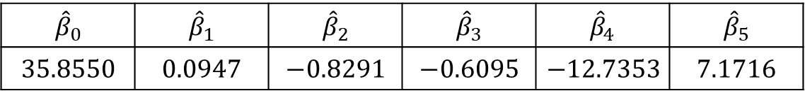

[4-1] Analysis
Minimum BIC: 1677
Estimated set of explanatory variables:
Area $x_{1}$, Age $x_{2}$, Walking time $x_{3}$, Structure $x_{4}$, Sunlight $x_{5}$
Estimated regression coefficients:
$${\hat{β}}_{0}$$ | $${\hat{β}}_{1}$$ | $${\hat{β}}_{2}$$ | $${\hat{β}}_{3}$$ | $${\hat{β}}_{4}$$ | $${\hat{β}}_{5}$$
$$35.8550$$ | $$0.0947$$ | $$−0.8291$$ | $$−0.6095$$ | $$−12.7353$$ | $$7.1716$$

Slide 24

[4-1] Consideration
The following regression equation minimized the BIC:
$$y=35.8550+0.0947 x_{1}−0.8291 x_{2}−0.6095 x_{3}−12.7353 x_{4}+7.1716 x_{5}$$
However, since the settings for the error $ε_{i}$have not been verified, we will proceed to do so.

Slide 25
5. Review of Settings (Verification of Settings)

Slide 26
Understanding the Objectives
Objective: Verification of settings [validate the setting of the errors in the statistical model].

Slide 27
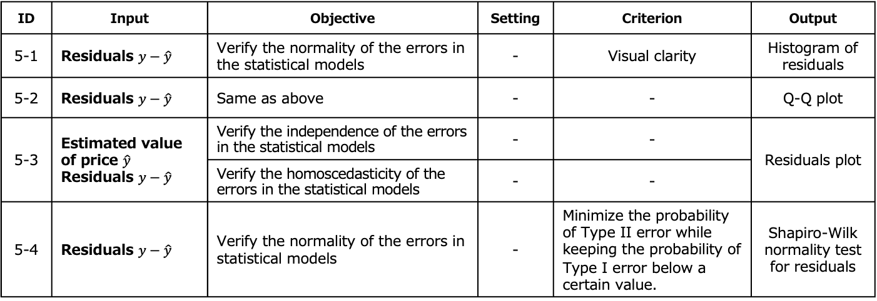
Determination of the Decision-making Map
ID | Input | Objective | Setting | Criterion | Output
5-1 | Residuals $y−\hat{y}$ | Verify the normality of the errors in the statistical models | - | Visual clarity | Histogram of residuals
5-2 | Residuals $y−\hat{y}$ | Same as above | - | - | Q-Q plot
5-3 | Estimated value of price $\hat{y}$ Residuals $y−\hat{y}$ | Verify the independence of the errors in the statistical models | - | - | Residuals plot
 |  | Verify the homoscedasticity of the errors in the statistical models | - | -
5-4 | Residuals $y−\hat{y}$ | Verify the normality of the errors in statistical models | - | Minimize the probability of Type II error while keeping the probability of Type I error below a certain value. | Shapiro-Wilk normality test for residuals

Slide 28
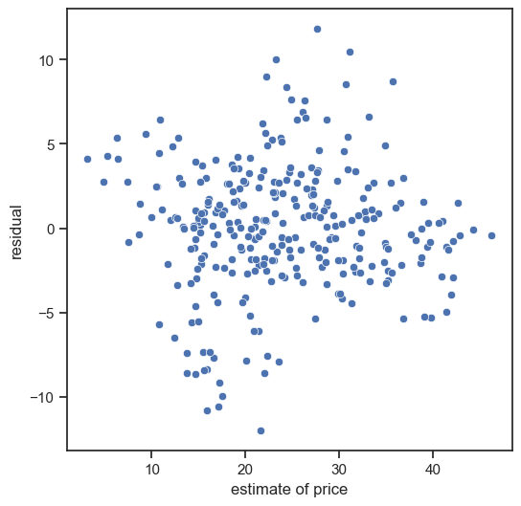
[5-1~5-3] Analysis
Histogram of residuals
Q-Q plot
Residual plot

Slide 29
[5-4] Analysis
Shapiro-Wilk normality test for residuals
A Shapiro-Wilk normality test with a significance level of 5% provided the following test statistics and p-values.
Test statistic | p-value

Slide 30
［5-1~5-4] Consideration
The histogram of residuals shows that , suggesting that .
The Q-Q plot shows that , suggesting that .
The residuals plot shows a cross-shaped pattern, indicating that the settings for independence and homoscedasticity of the errors do not hold.
The Shapiro-Wilk normality test for residuals resulted in , indicating that .
Based on the above, it is necessary to revise the current settings, so we will revise the settings of the regression equation.

Slide 31
6. Review of Settings
(Revision of the Regression Equation)

Slide 32
Understanding Objectives
Objective: Revision of the regression equation [reconsider the regression equation]

Slide 33
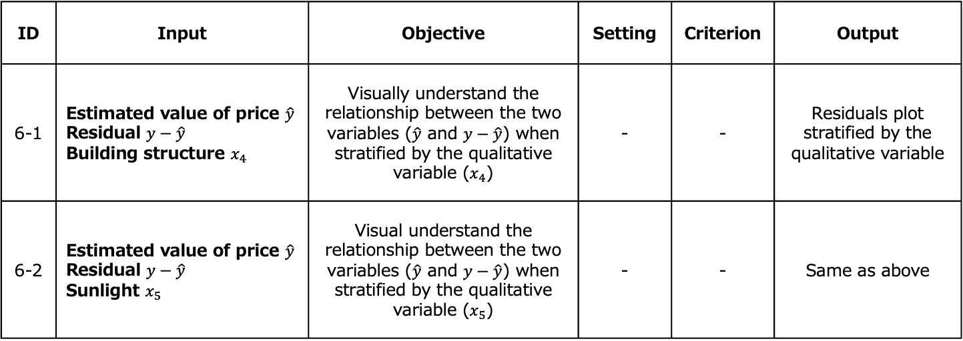
Determination of the Decision-making Map
ID | Input | Objective | Setting | Criterion | Output
6-1 | Estimated value of price $\hat{y}$ Residual $y−\hat{y}$ Building structure $x_{4}$ | Visually understand the relationship between the two variables ($\hat{y}$ and $y−\hat{y}$) when stratified by the qualitative variable ($x_{4}$) | - | - | Residuals plot stratified by the qualitative variable
6-2 | Estimated value of price $\hat{y}$ Residual $y−\hat{y}$ Sunlight $x_{5}$ | Visual understand the relationship between the two variables ($\hat{y}$ and $y−\hat{y}$) when stratified by the qualitative variable ($x_{5}$) | - | - | Same as above

Slide 34
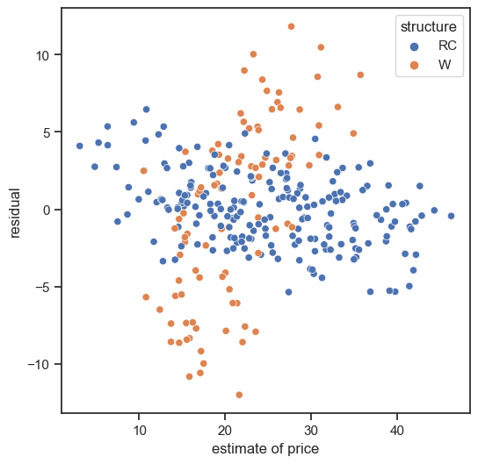
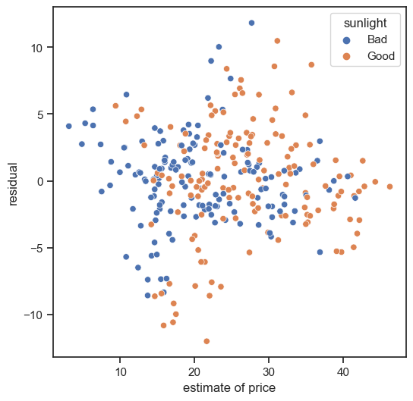
[6-1~6-2] Analysis
Stratified
by Building structure
Stratified
by Sunlight

Slide 35
［6-1~6-2] Consideration
In the residual plot stratified by building structure, the cross-shaped pattern is split into two band-like plots, suggesting that the cross-shaped pattern appears due to the influence of building structure.
We will reconsider the data characteristics by focusing on the building structure.

Slide 36
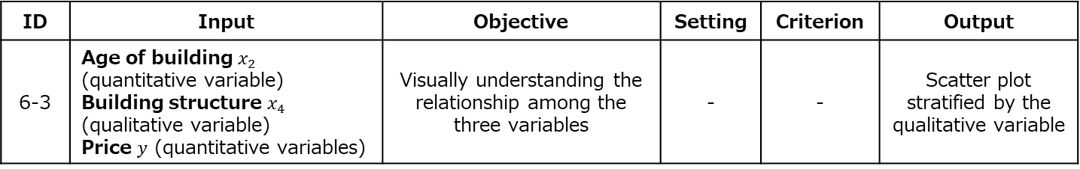
Determination of the Decision-making Map
ID | Input | Objective | Setting | Criterion | Output
6-3 | Age of building$x_{2}$ (quantitative variable) Building structure $x_{4}$ (qualitative variable) Price $y$ (quantitative variables) | Visually understanding the relationship among the three variables | - | - | Scatter plot stratified by the qualitative variable

Slide 37
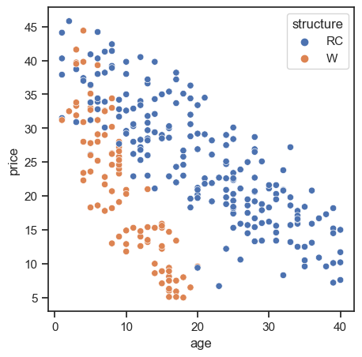
[6-3] Analysis
Scatter plot of Age and Price stratified by Building structure

Slide 38
[6-3] Consideration
Assuming a linear relationship between age and price, the slope of the line appears to differ depending on building structure.
Given that the slopes of the lines differ, it is necessary to include an interaction term between Age and Structure in the regression equation.
We will revise the regression equation by including this interaction term.

Slide 39
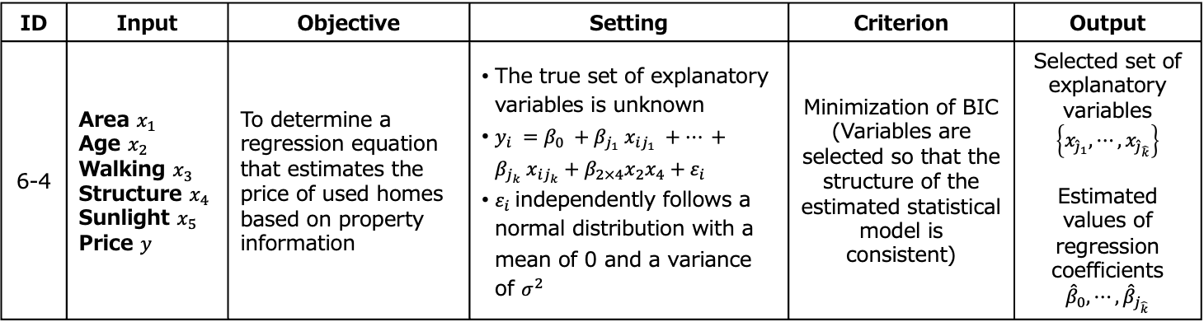
Determination of the Decision-making Map
ID | Input | Objective | Setting | Criterion | Output
6-4 | Area $x_{1}$ Age $x_{2}$ Walking $x_{3}$ Structure $x_{4}$ Sunlight $x_{5}$ Price $y$ | To determine a regression equation that estimates the price of used homes based on property information | The true set of explanatory variables is unknown $y_{i} =β_{0} +β_{j_{1}} x_{ij_{1}} +⋯ +β_{j_{k}} x_{ij_{k}}+{β_{2×4}x}_{2}x_{4}+ε_{i}$ $ε_{i}$independently follows a normal distribution with a mean of 0 and a variance of $σ^{2}$ | Minimization of BIC (Variables are selected so that the structure of the estimated statistical model is consistent) | Selected set of explanatory variables $\left\{x_{{\hat{j}}_{1}}, ⋯,x_{{\hat{j}}_{\hat{k}}}\right\}$ Estimated values of regression coefficients $${\hat{β}}_{0}, ⋯, {\hat{β}}_{j_{\hat{k}}}$$

Slide 40
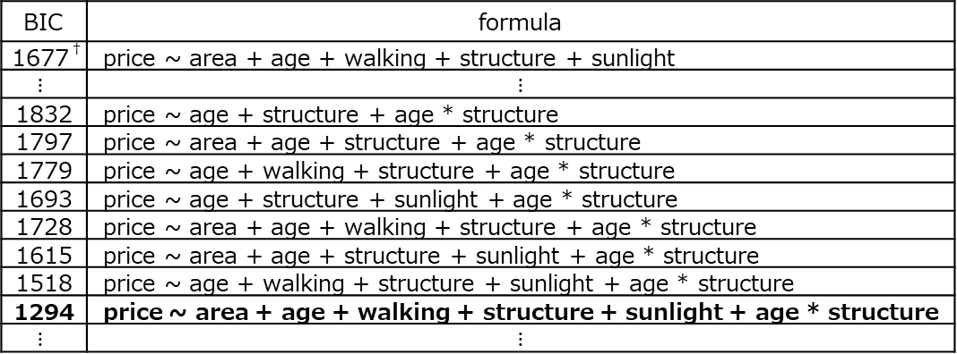
[6-4] Analysis
Ensure to fill in not only the results of your analysis but also the methods used
For the regression equation that includes an interaction term between Age and Structure, BIC values were calculated for all combinations of explanatory variables.
BIC | formula
1677† | price ~ area + age + walking + structure + sunlight
$$⋮$$ | $$⋮$$
1832 | price ~ age + structure + age * structure
1797 | price ~ area + age + structure + age * structure
1779 | price ~ age + walking + structure + age * structure
1693 | price ~ age + structure + sunlight + age * structure
1728 | price ~ area + age + walking + structure + age * structure
1615 | price ~ area + age + structure + sunlight + age * structure
1518 | price ~ age + walking + structure + sunlight + age * structure
1294 | price ~ area + age + walking + structure + sunlight + age * structure
$$⋮$$ | $$⋮$$
You may omit some parts of the model selection process if there are too many candidates to fill in but must show the selected model.
†Show the values of BIC for the regression equation obtained in the step of “Analysis of the Problem”, so that the minimum BIC values can be compared before and after the revision of the regression equation.

Slide 41
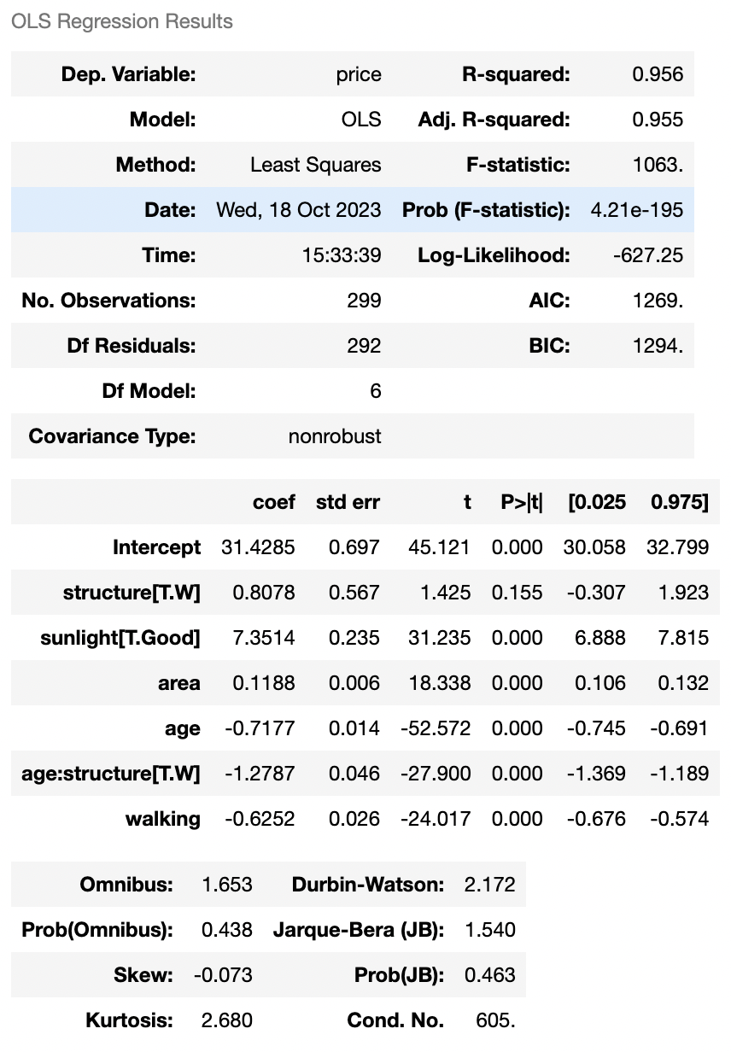
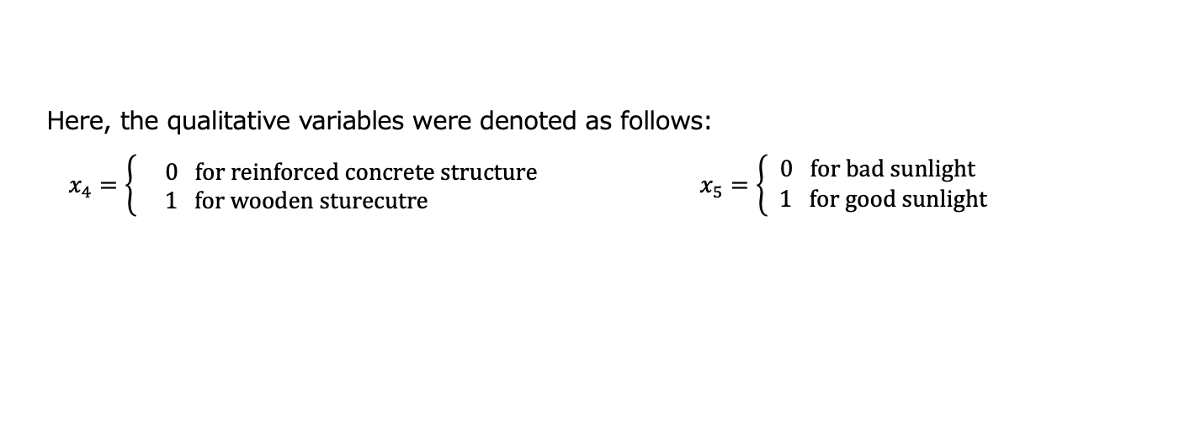
[6-4] Analysis
The results for the regression equation that minimizes the BIC are shown below:
Here, the qualitative variables were denoted as follows:
$x_{4}=\left\{\begin{matrix}0 for reinforced concrete structure \\ 1 for wooden sturecutre \end{matrix}\right.$ $x_{5}=\left\{\begin{matrix}0 for bad sunlight \\ 1 for good sunlight\end{matrix}\right.$

Slide 42
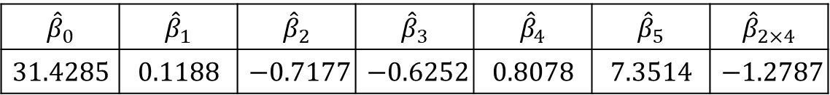

[6-4] Analysis
Minimum BIC: 1294
Estimated set of explanatory variables:
Area $x_{1}$, Age $x_{2}$, Walking time $x_{3}$, Structure $x_{4}$, Sunlight $x_{5}$
Estimated regression coefficients:
$${\hat{β}}_{0}$$ | $${\hat{β}}_{1}$$ | $${\hat{β}}_{2}$$ | $${\hat{β}}_{3}$$ | $${\hat{β}}_{4}$$ | $${\hat{β}}_{5}$$ | $${\hat{β}}_{2×4}$$
$$31.4285$$ | $$0.1188$$ | $$−0.7177$$ | $$−0.6252$$ | $$0.8078$$ | $$7.3514$$ | $$−1.2787$$

Slide 43
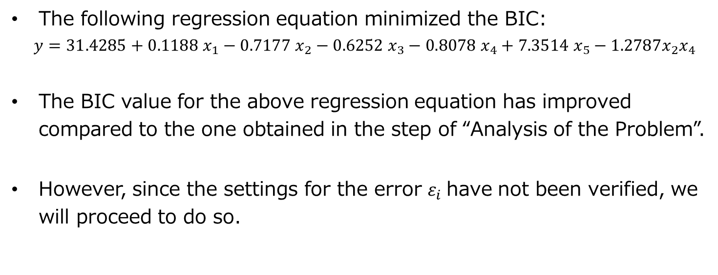
[6-4] Consideration
The following regression equation minimized the BIC:
$$y=31.4285+0.1188 x_{1}−0.7177 x_{2}−0.6252 x_{3}−0.8078 x_{4}+7.3514 x_{5}−1.2787x_{2}x_{4}$$
The BIC value for the above regression equation has improved compared to the one obtained in the step of “Analysis of the Problem”.
However, since the settings for the error $ε_{i}$have not been verified, we will proceed to do so.

Slide 44
7. Review of Settings
(Verification of the Settings)

Slide 45
Understanding the Objectives
Objective: Verification of settings [validate the setting of the errors in the statistical model].

Slide 46
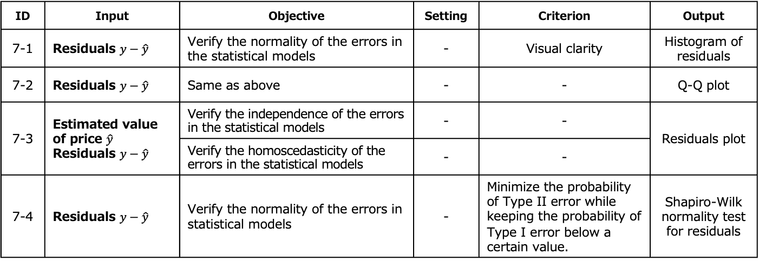
Determination of the Decision-making Map
ID | Input | Objective | Setting | Criterion | Output
7-1 | Residuals $y−\hat{y}$ | Verify the normality of the errors in the statistical models | - | Visual clarity | Histogram of residuals
7-2 | Residuals $y−\hat{y}$ | Same as above | - | - | Q-Q plot
7-3 | Estimated value of price $\hat{y}$ Residuals $y−\hat{y}$ | Verify the independence of the errors in the statistical models | - | - | Residuals plot
 |  | Verify the homoscedasticity of the errors in the statistical models | - | -
7-4 | Residuals $y−\hat{y}$ | Verify the normality of the errors in statistical models | - | Minimize the probability of Type II error while keeping the probability of Type I error below a certain value. | Shapiro-Wilk normality test for residuals

Slide 47
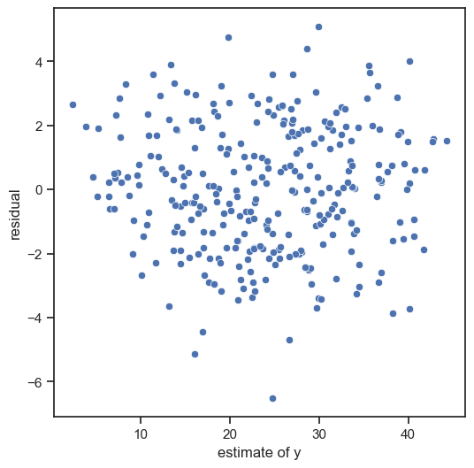
[7-1~7-3] Analysis
Histogram of residuals
Q-Q plot
Residual plot

Slide 48
[7-4] Analysis
Shapiro-Wilk normality test for residuals
A Shapiro-Wilk normality test with a significance level of 5% provided the following test statistics and p-values:
Test statistic | p-value
Notes:
:

Slide 49
［7-1~7-4] Consideration
The histogram of residuals shows that , suggesting that .
The Q-Q plot shows that , suggesting that .
The residuals plot shows no noticeable patterns or changes in variation, indicating that the settings for independence and homoscedasticity of the errors are valid.
The Shapiro-Wilk normality test for residuals resulted in , indicating that .
Based on the above, it is concluded that the settings regarding the errors are valid.

Slide 50
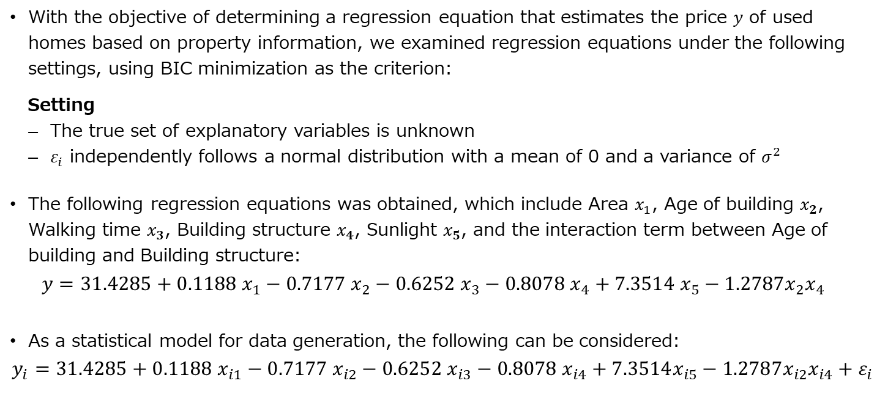
8. Conclusion
With the objective of determining a regression equation that estimates the price $y$ of used homes based on property information, we examined regression equations under the following settings, using BIC minimization as the criterion:
Setting
The true set of explanatory variables is unknown
$ε_{i}$ independently follows a normal distribution with a mean of 0 and a variance of $σ^{2}$
The following regression equations was obtained, which include Area $x_{1}$, Age of building $x_{2}$, Walking time $x_{3}$, Building structure $x_{4}$, Sunlight $x_{5}$, and the interaction term between Age of building and Building structure: $y=31.4285+0.1188 x_{1}−0.7177 x_{2}−0.6252 x_{3}−0.8078 x_{4}+7.3514 x_{5}−1.2787x_{2}x_{4}$
As a statistical model for data generation, the following can be considered:
$$y_{i}=31.4285+0.1188 x_{i1}−0.7177 x_{i2}−0.6252 x_{i3}−0.8078 x_{i4}+7.3514x_{i5}−1.2787x_{i2}x_{i4}+ε_{i}$$

Slide 51
Copyright
This material may not be reproduced or distributed without the permission of the authors.
Waseda Education team of Data Science (WEDS)

