Slide 1
Final Assignment
Student ID: 1W22CF16
Name: Jimin Park

Slide 2
1. Understanding the Problem
Problem:
Structure Estimation[Predict sales based on storeʼs location conditions]
Explanatory variables:
Sales floor area, Walking time from station, Number of competing stores, Population density of the neighborhood, Parking space, Dining area, Whether or not facing a main street
Objective variable :
Sales [Quantitative, Observable]
Type of problem:
Regression

Slide 3
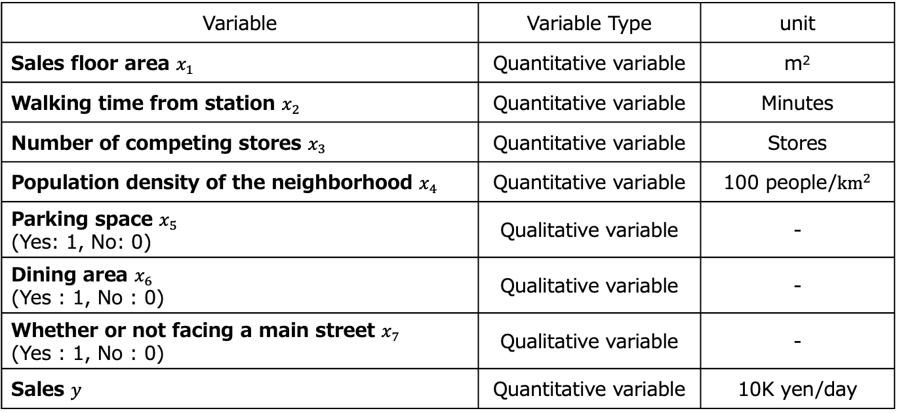
2. Confirmation of Inputs
Variable | Variable Type | unit
Sales floor area $x_{1}$ | Quantitative variable | m²
Walking time from station $x_{2}$ | Quantitative variable | Minutes
Number of competing stores $x_{3}$ | Quantitative variable | Stores
Population density of the neighborhood $x_{4}$ | Quantitative variable | 100 people/${km}^{2}$
Parking space $x_{5}$ (Yes: 1, No: 0) | Qualitative variable | -
Dining area $x_{6}$ (Yes : 1, No : 0) | Qualitative variable | -
Whether or not facing a main street $x_{7}$ (Yes : 1, No : 0) | Qualitative variable | -
Sales $y$ | Quantitative variable | 10K yen/day

Slide 4
3. Understanding the Data Characteristics

Slide 5
Understanding the Objectives
Objective: Understanding the data characteristics [understand the distribution of variables and the relationships between variables regarding sales of their current stores]

Slide 6
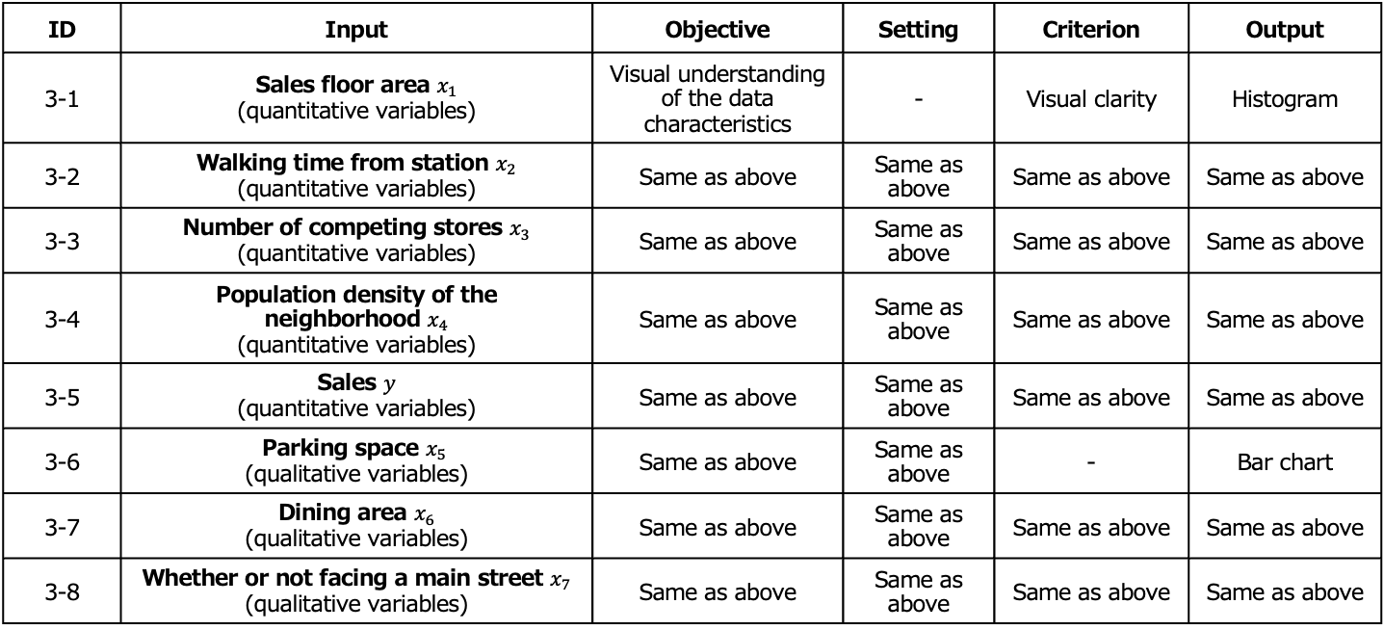
Determination of the Decision-making Map
ID | Input | Objective | Setting | Criterion | Output
3-1 | Sales floor area $x_{1}$ (quantitative variables) | Visual understanding of the data characteristics | - | Visual clarity | Histogram
3-2 | Walking time from station $x_{2}$ (quantitative variables) | Same as above | Same as above | Same as above | Same as above
3-3 | Number of competing stores $x_{3}$ (quantitative variables) | Same as above | Same as above | Same as above | Same as above
3-4 | Population density of the neighborhood $x_{4}$ (quantitative variables) | Same as above | Same as above | Same as above | Same as above
3-5 | Sales $y$ (quantitative variables) | Same as above | Same as above | Same as above | Same as above
3-6 | Parking space $x_{5}$ (qualitative variables) | Same as above | Same as above | - | Bar chart
3-7 | Dining area $x_{6}$ (qualitative variables) | Same as above | Same as above | Same as above | Same as above
3-8 | Whether or not facing a main street $x_{7}$ (qualitative variables) | Same as above | Same as above | Same as above | Same as above

Slide 7
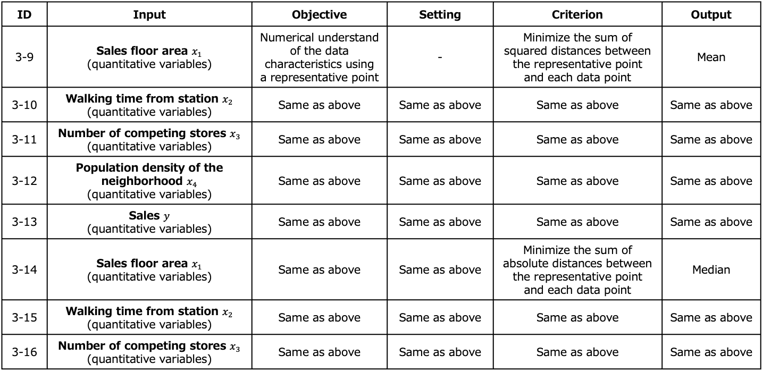
Determination of the Decision-making Map
ID | Input | Objective | Setting | Criterion | Output
3-9 | Sales floor area $x_{1}$ (quantitative variables) | Numerical understand of the data characteristics using a representative point | - | Minimize the sum of squared distances between the representative point and each data point | Mean
3-10 | Walking time from station $x_{2}$ (quantitative variables) | Same as above | Same as above | Same as above | Same as above
3-11 | Number of competing stores $x_{3}$ (quantitative variables) | Same as above | Same as above | Same as above | Same as above
3-12 | Population density of the neighborhood $x_{4}$ (quantitative variables) | Same as above | Same as above | Same as above | Same as above
3-13 | Sales $y$ (quantitative variables) | Same as above | Same as above | Same as above | Same as above
3-14 | Sales floor area $x_{1}$ (quantitative variables) | Same as above | Same as above | Minimize the sum of absolute distances between the representative point and each data point | Median
3-15 | Walking time from station $x_{2}$ (quantitative variables) | Same as above | Same as above | Same as above | Same as above
3-16 | Number of competing stores $x_{3}$ (quantitative variables) | Same as above | Same as above | Same as above | Same as above

Slide 8
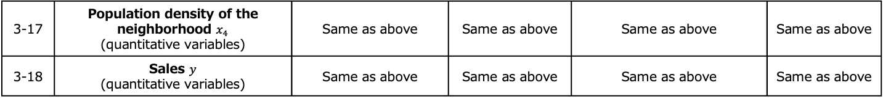
Determination of the Decision-making Map
3-17 | Population density of the neighborhood $x_{4}$ (quantitative variables) | Same as above | Same as above | Same as above | Same as above
3-18 | Sales $y$ (quantitative variables) | Same as above | Same as above | Same as above | Same as above

Slide 9
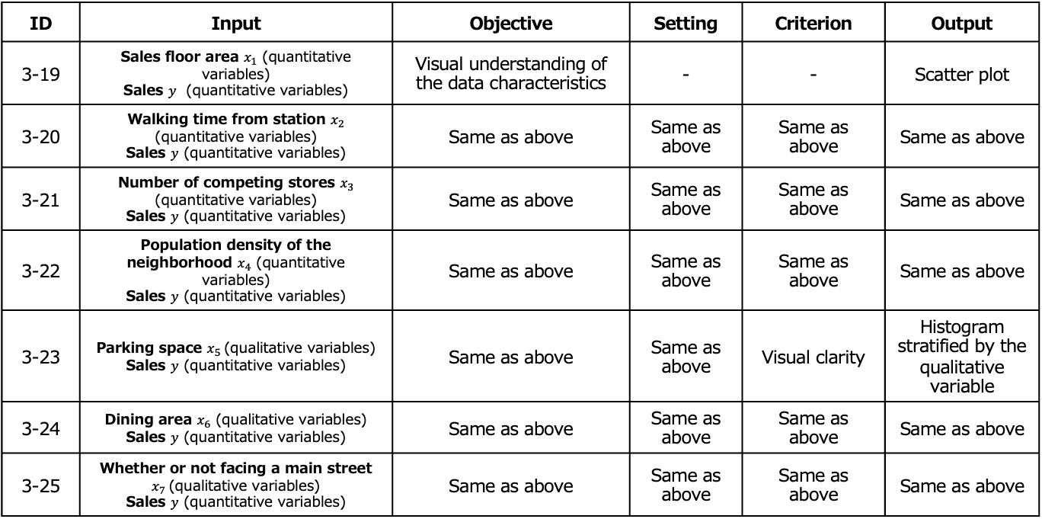
Determination of the Decision-making Map
ID | Input | Objective | Setting | Criterion | Output
3-19 | Sales floor area $x_{1}$ (quantitative variables) Sales $y$ (quantitative variables) | Visual understanding of the data characteristics | - | - | Scatter plot
3-20 | Walking time from station $x_{2}$ (quantitative variables) Sales $y$ (quantitative variables) | Same as above | Same as above | Same as above | Same as above
3-21 | Number of competing stores $x_{3}$ (quantitative variables) Sales $y$ (quantitative variables) | Same as above | Same as above | Same as above | Same as above
3-22 | Population density of the neighborhood $x_{4}$ (quantitative variables) Sales $y$ (quantitative variables) | Same as above | Same as above | Same as above | Same as above
3-23 | Parking space $x_{5}$(qualitative variables) Sales $y$ (quantitative variables) | Same as above | Same as above | Visual clarity | Histogram stratified by the qualitative variable
3-24 | Dining area $x_{6}$ (qualitative variables) Sales $y$ (quantitative variables) | Same as above | Same as above | Same as above | Same as above
3-25 | Whether or not facing a main street $x_{7}$(qualitative variables) Sales $y$ (quantitative variables) | Same as above | Same as above | Same as above | Same as above

Slide 10
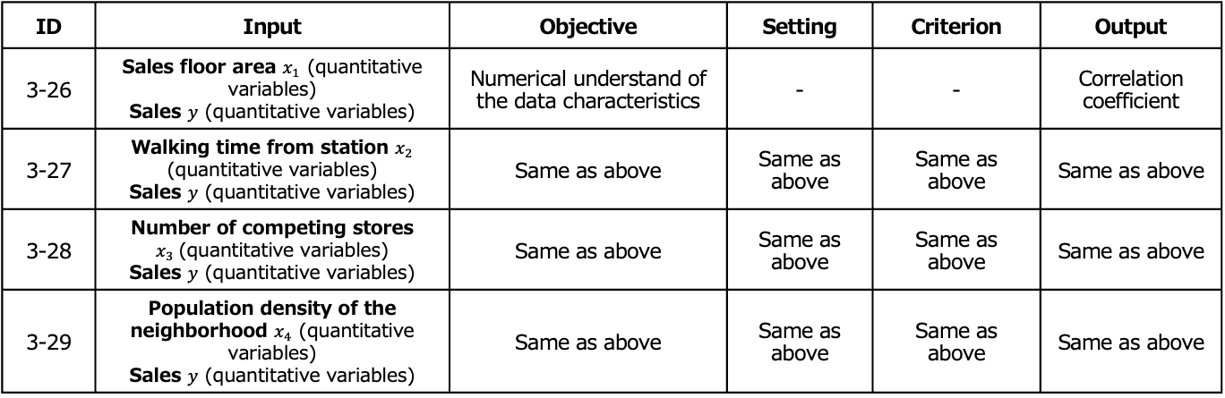
Determination of the Decision-making Map
ID | Input | Objective | Setting | Criterion | Output
3-26 | Sales floor area $x_{1}$ (quantitative variables) Sales $y$ (quantitative variables) | Numerical understand of the data characteristics | - | - | Correlation coefficient
3-27 | Walking time from station $x_{2}$ (quantitative variables) Sales $y$ (quantitative variables) | Same as above | Same as above | Same as above | Same as above
3-28 | Number of competing stores $x_{3}$(quantitative variables) Sales $y$ (quantitative variables) | Same as above | Same as above | Same as above | Same as above
3-29 | Population density of the neighborhood $x_{4}$ (quantitative variables) Sales $y$ (quantitative variables) | Same as above | Same as above | Same as above | Same as above

Slide 11
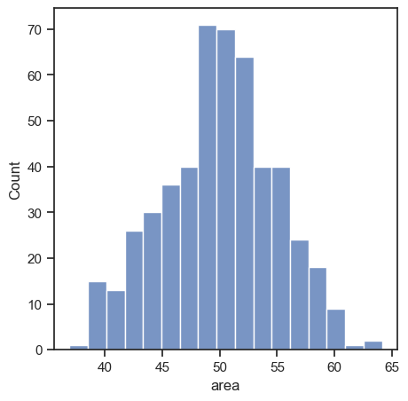
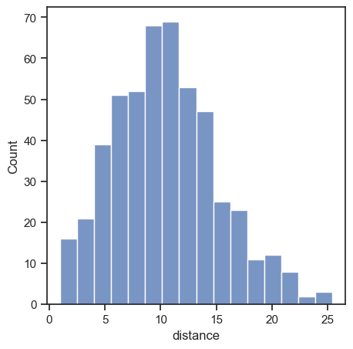
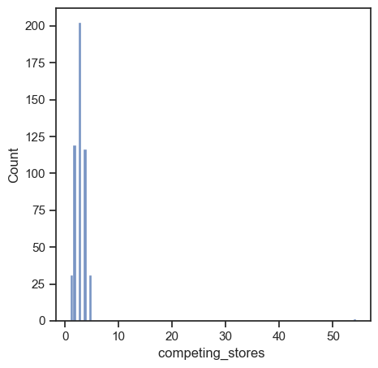
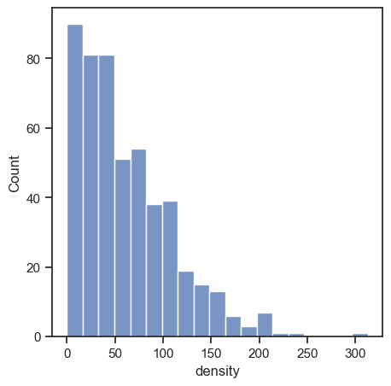
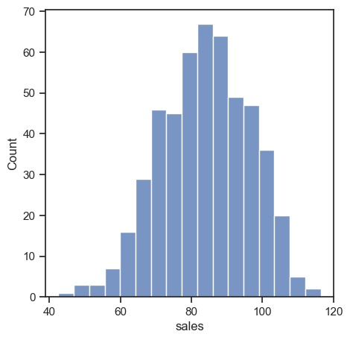
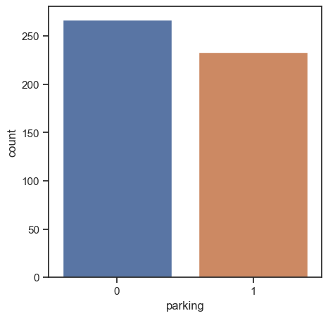
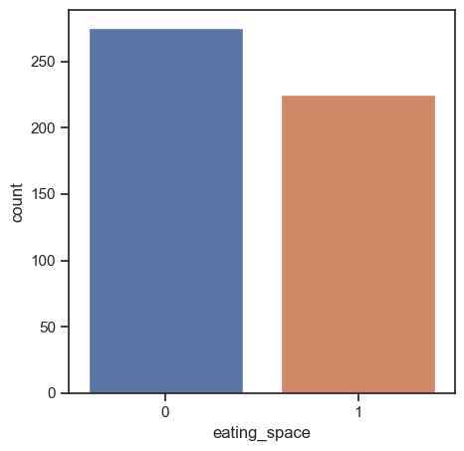
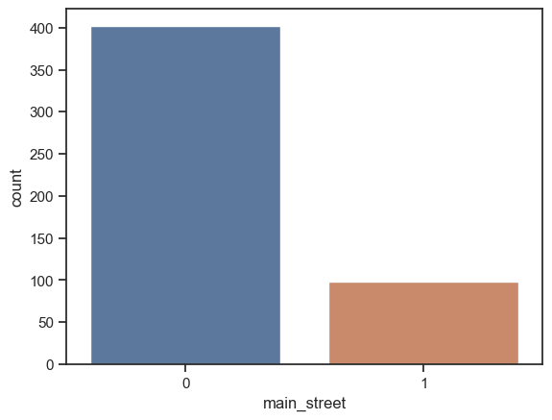
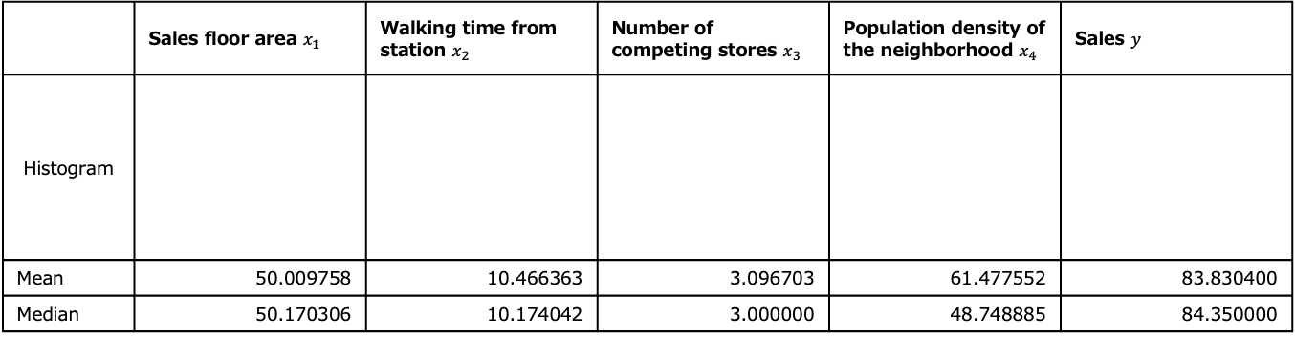
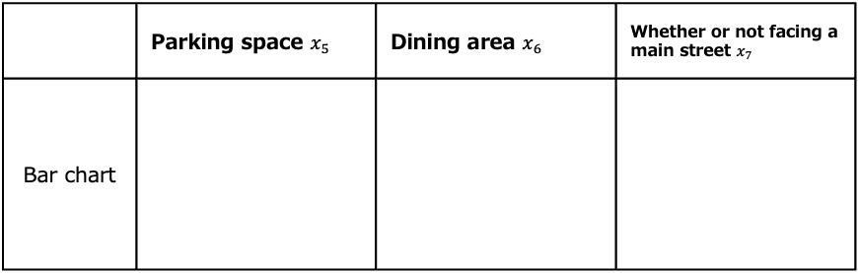
[3-1~3-18] Analysis
 | Sales floor area $x_{1}$ | Walking time from station $x_{2}$ | Number of competing stores $x_{3}$ | Population density of the neighborhood $x_{4}$ | Sales $y$
Histogram
Mean | 50.009758 | 10.466363 | 3.096703 | 61.477552 | 83.830400
Median | 50.170306 | 10.174042 | 3.000000 | 48.748885 | 84.350000
 | Parking space $x_{5}$ | Dining area $x_{6}$ | Whether or not facing a main street $x_{7}$
Bar chart

Slide 12
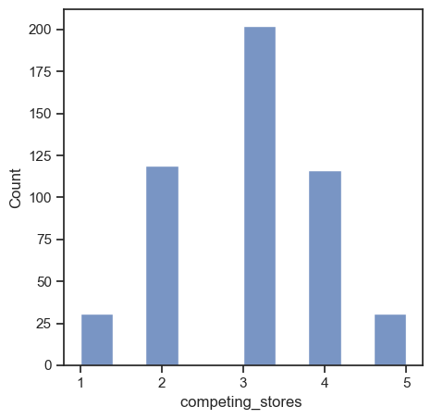
[3-1~3-18] Consideration
From the histogram of the competing stores, we can see that there is a decimal value, which should not be possible as valid competing stores value.
The value 54.35166776 is judged to be an outlier, and from here on, we will handle the data excluding the properties with decimal value.
The histogram, mean, and median of the competing stores data after exclusion of the outlier are shown below.
# The analysis onward deals
with data without the outlier.
# Additionally, please note that
spaces after some attributes
names were removed for better
analysis outcome.
Mean | Median
2.993988 | 3.000000

Slide 13
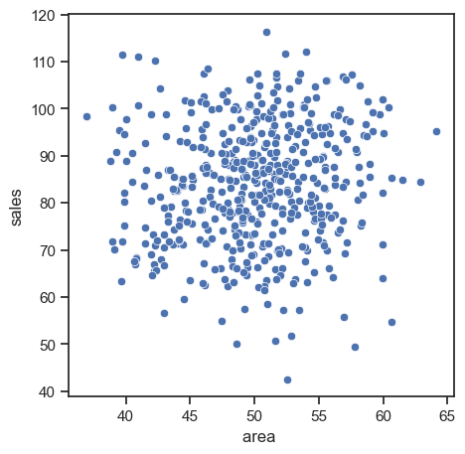
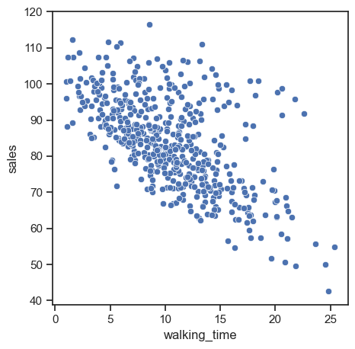
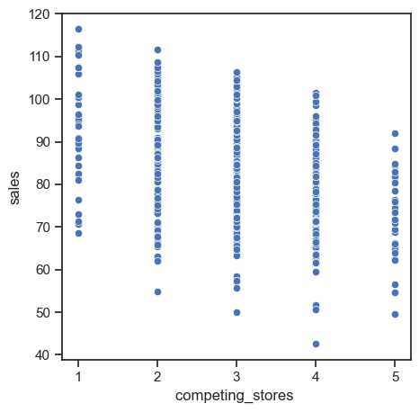
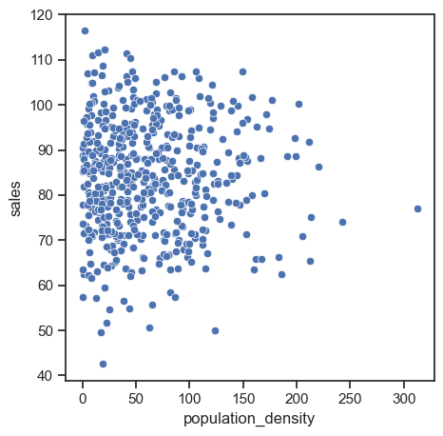
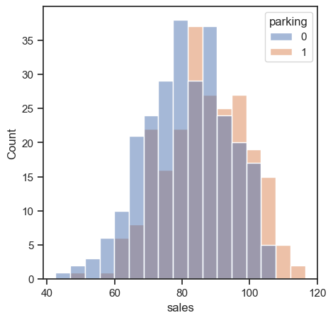
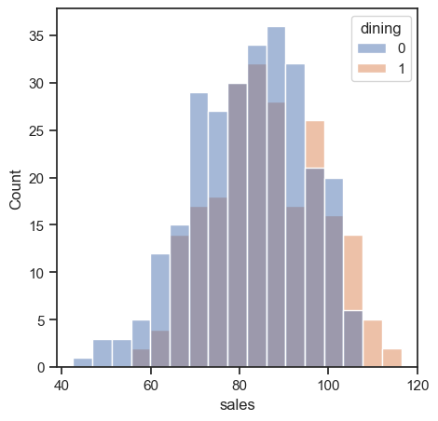
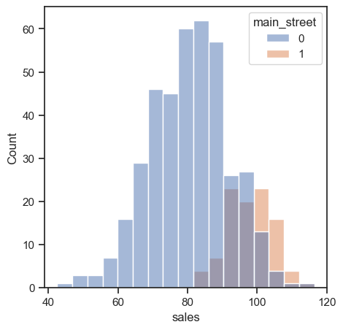
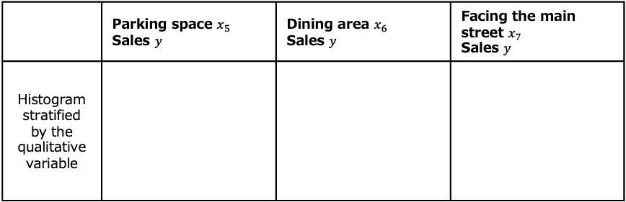
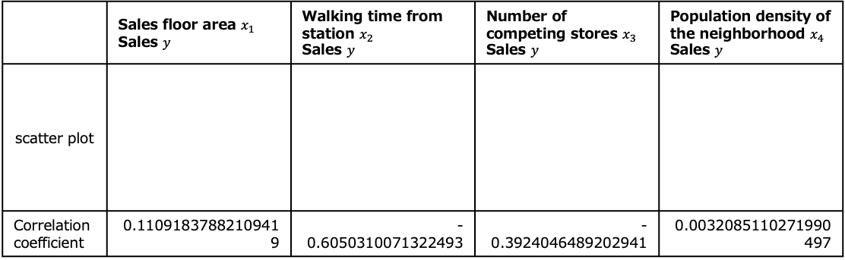
[3-19~3-29] Analysis
 | Sales floor area $x_{1}$ Sales $y$ | Walking time from station $x_{2}$ Sales $y$ | Number of competing stores $x_{3}$ Sales $y$ | Population density of the neighborhood $x_{4}$ Sales $y$
scatter plot
Correlation coefficient | 0.11091837882109419 | -0.6050310071322493 | -0.3924046489202941 | 0.0032085110271990497
 | Parking space $x_{5}$ Sales $y$ | Dining area $x_{6}$ Sales $y$ | Facing the main street $x_{7}$ Sales $y$
Histogram stratified by the qualitative variable

Slide 14
[3-19~3-29] Consideration
The scatter plot and correlation coefficient of sales floor area and sales show that the correlation between these variables is weak.
The scatter plot and correlation coefficient of walking time from the station and sales indicate a negative correlation between these variables.
The scatter plot and correlation coefficient of the number of competing stores and sales show a weak negative correlation.
The scatter plot and correlation coefficient of population density of the neighborhood and sales demonstrate a very weak correlation between these variables.
The histogram of sales stratified by the availability of parking space suggests that stores with parking tend to have higher sales.
The histogram of sales stratified by dining area indicates that stores with dining space generally have higher sales.
The histogram of sales stratified by whether the store faces the main street shows that stores on the main street tend to have higher sales compared to those that do not.

Slide 15
4. Analysis of the Problem

Slide 16
Understanding the Objectives
Objective: Structure Estimation[Predict sales based on storeʼs location conditions]

Slide 17
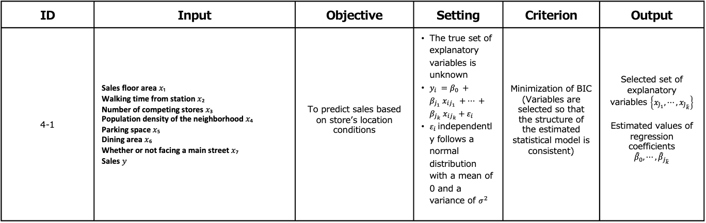
Determination of the Decision-making Map
ID | Input | Objective | Setting | Criterion | Output
4-1 | Sales floor area 𝑥₁ Walking time from station 𝑥₂ Number of competing stores 𝑥₃ Population density of the neighborhood 𝑥₄ Parking space 𝑥₅ Dining area 𝑥₆ Whether or not facing a main street 𝑥₇ Sales 𝑦 | To predict sales based on storeʼs location conditions | The true set of explanatory variables is unknown $y_{i} =β_{0} +β_{j_{1}} x_{ij_{1}} +⋯ +β_{j_{k}} x_{ij_{k}}+ε_{i}$ $ε_{i}$independently follows a normal distribution with a mean of 0 and a variance of $σ^{2}$ | Minimization of BIC (Variables are selected so that the structure of the estimated statistical model is consistent) | Selected set of explanatory variables $\left\{x_{{\hat{j}}_{1}}, ⋯,x_{{\hat{j}}_{\hat{k}}}\right\}$ Estimated values of regression coefficients $${\hat{β}}_{0}, ⋯, {\hat{β}}_{j_{\hat{k}}}$$

Slide 18
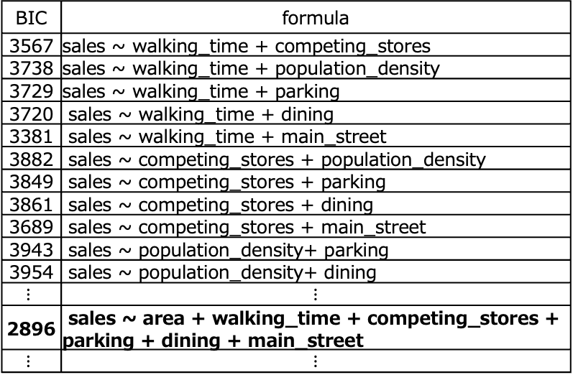
[4-1] Analysis
BIC values were obtained for all combinations of explanatory variables
BIC | formula
3953 | sales ~ area
3732 | sales ~ walking_time
3876 | sales ~ competing_stores
3959 | sales ~ population_density
3936 | sales ~ parking
3947 | sales ~ dining
3774 | sales ~ main_street
3729 | sales ~ area + walking_time
3875 | sales ~ area + competing_stores
3959 | sales ~ area + population_density
3936 | sales ~ area + parking
3946 | sales ~ area + dining
3776 | sales ~ area + main_street
BIC | formula
3567 | sales ~ walking_time + competing_stores
3738 | sales ~ walking_time + population_density
3729 | sales ~ walking_time + parking
3720 | sales ~ walking_time + dining
3381 | sales ~ walking_time + main_street
3882 | sales ~ competing_stores + population_density
3849 | sales ~ competing_stores + parking
3861 | sales ~ competing_stores + dining
3689 | sales ~ competing_stores + main_street
3943 | sales ~ population_density+ parking
3954 | sales ~ population_density+ dining
$$⋮$$ | $$⋮$$
2896 | sales ~ area + walking_time + competing_stores + parking + dining + main_street
$$⋮$$ | $$⋮$$

Slide 19
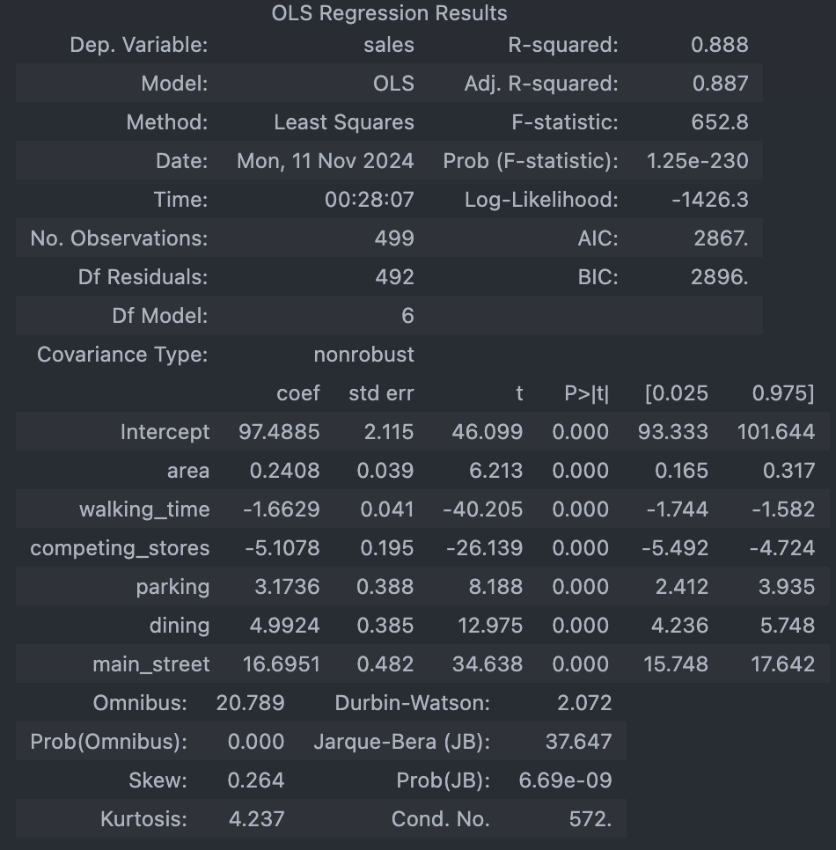
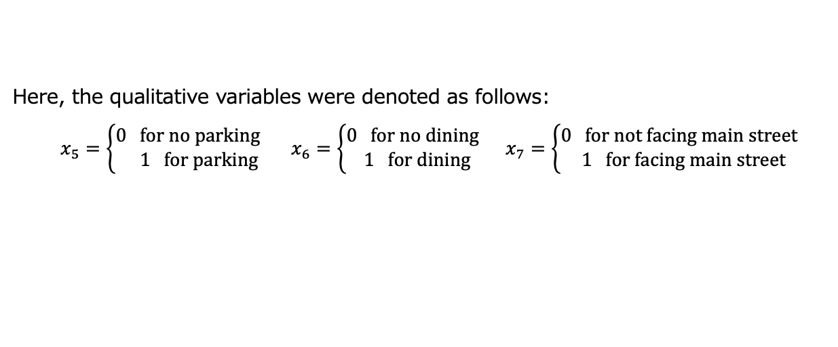
[4-1] Analysis
The results for the regression equation that minimizes the BIC are shown below:
Here, the qualitative variables were denoted as follows:
$x_{5}=\left\{\begin{matrix}0 for no parking \\ 1 for parking\end{matrix}\right.$ $x_{6}=\left\{\begin{matrix}0 for no dining \\ 1 for dining\end{matrix}\right.$ $x_{7}=\left\{\begin{matrix}0 for not facing main street \\ 1 for facing main street\end{matrix}\right.$

Slide 20
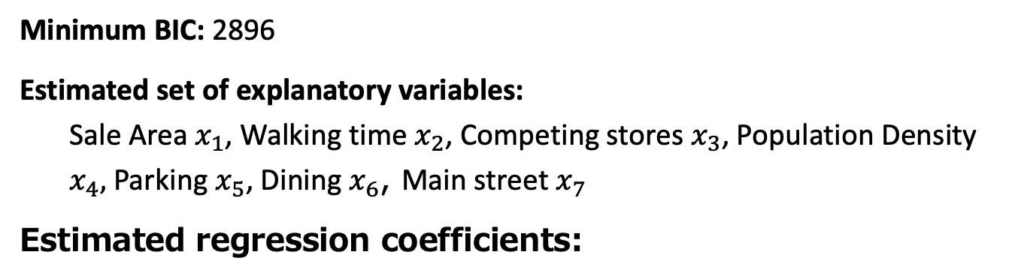
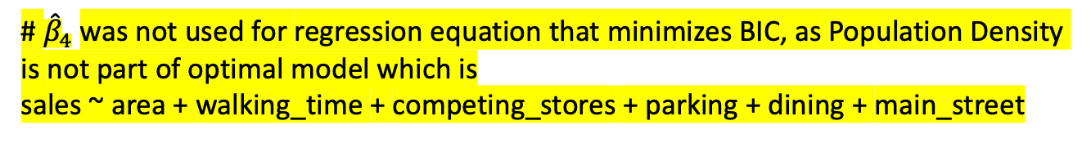
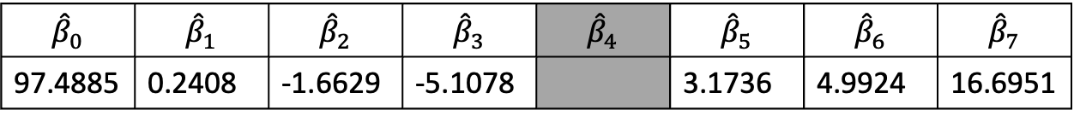
[4-1] Analysis
Minimum BIC: 2896
Estimated set of explanatory variables:
Sale Area $x_{1}$, Walking time $x_{2}$, Competing stores $x_{3}$, Population Density $x_{4},$ Parking $x_{5}$, Dining $x_{6}$, Main street $x_{7}$
Estimated regression coefficients:
$${\hat{β}}_{0}$$ | $${\hat{β}}_{1}$$ | $${\hat{β}}_{2}$$ | $${\hat{β}}_{3}$$ | $${\hat{β}}_{4}$$ | $${\hat{β}}_{5}$$ | $${\hat{β}}_{6}$$ | $${\hat{β}}_{7}$$
97.4885 | 0.2408 | -1.6629 | -5.1078 |  | 3.1736 | 4.9924 | 16.6951
# ${\hat{β}}_{4}$was not used for regression equation that minimizes BIC, as Population Density is not part of optimal model which is
sales ~ area + walking_time + competing_stores + parking + dining + main_street

Slide 21

[4-1] Consideration
The following regression equation minimized the BIC:
$$y=97.4885+0.2408{ x}_{1}−1.6629 x_{2}−5.1078{ x}_{3}+3.1736 x_{5}+4.9924{ x}_{6}+ 16.6951{ x}_{7}$$
However, since the settings for the error $ε_{i}$have not been verified, we will proceed to do so.

Slide 22
5. Review of Settings (Verification of Settings)

Slide 23
Understanding the Objectives
Objective: Verification of settings [validate the setting of the errors in the statistical model].

Slide 24
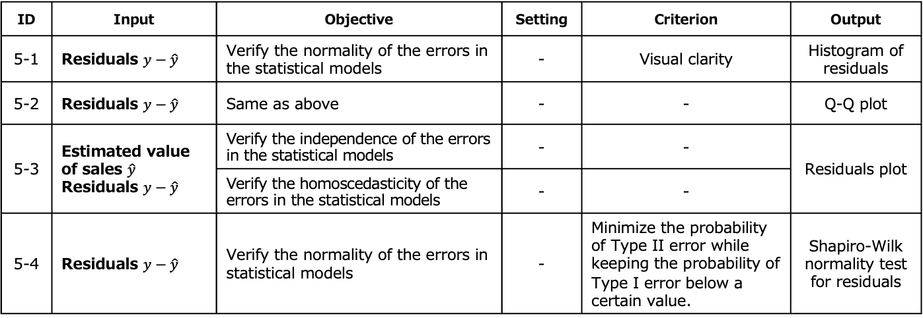
Determination of the Decision-making Map
ID | Input | Objective | Setting | Criterion | Output
5-1 | Residuals $y−\hat{y}$ | Verify the normality of the errors in the statistical models | - | Visual clarity | Histogram of residuals
5-2 | Residuals $y−\hat{y}$ | Same as above | - | - | Q-Q plot
5-3 | Estimated value of sales $\hat{y}$ Residuals $y−\hat{y}$ | Verify the independence of the errors in the statistical models | - | - | Residuals plot
 |  | Verify the homoscedasticity of the errors in the statistical models | - | -
5-4 | Residuals $y−\hat{y}$ | Verify the normality of the errors in statistical models | - | Minimize the probability of Type II error while keeping the probability of Type I error below a certain value. | Shapiro-Wilk normality test for residuals

Slide 25
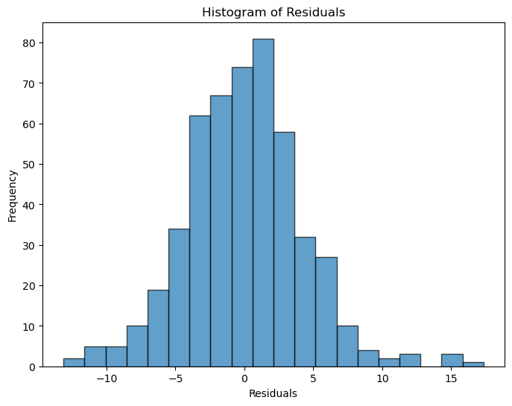
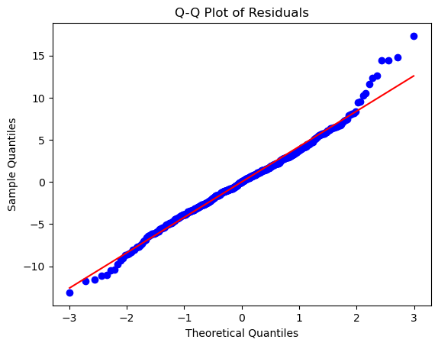
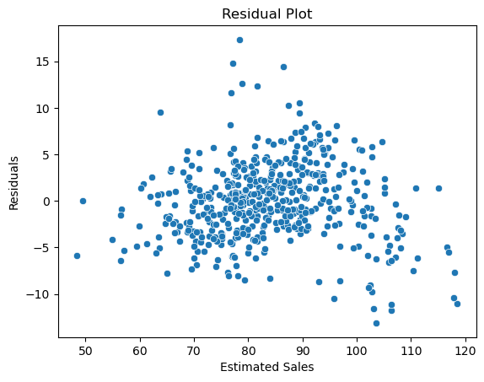
[5-1~5-3] Analysis
Histogram of residuals
Q-Q plot
Residual plot

Slide 26
[5-4] Analysis
Shapiro-Wilk normality test for residuals
A Shapiro-Wilk normality test with a significance level of 5% provided the following test statistics and p-values.
Test statistic | p-value
0.98660568314871 | 0.00015077287498812476

Slide 27
[5-1~5-4] Consideration
The histogram of residuals shows that the residuals are approximately symmetric around zero, suggesting that the residuals slightly follow a normal distribution.
The Q-Q plot shows that most of the points fall on the red diagonal line, suggesting that the residuals mostly follow a normal distribution but may have slight deviations, particularly with extreme values.
The residuals plot shows a cross-shaped pattern, indicating that the settings for independence and homoscedasticity of the errors do not hold.
The Shapiro-Wilk normality test for residuals resulted in p-value that is less than 0.05, indicating that the residuals does not follow a normal distribution.
Based on the above, it is necessary to revise the current settings, so we will revise the settings of the regression equation.

Slide 28
6. Review of Settings
(Revision of the Regression Equation)

Slide 29
Understanding Objectives
Objective: Revision of the regression equation [reconsider the regression equation]

Slide 30
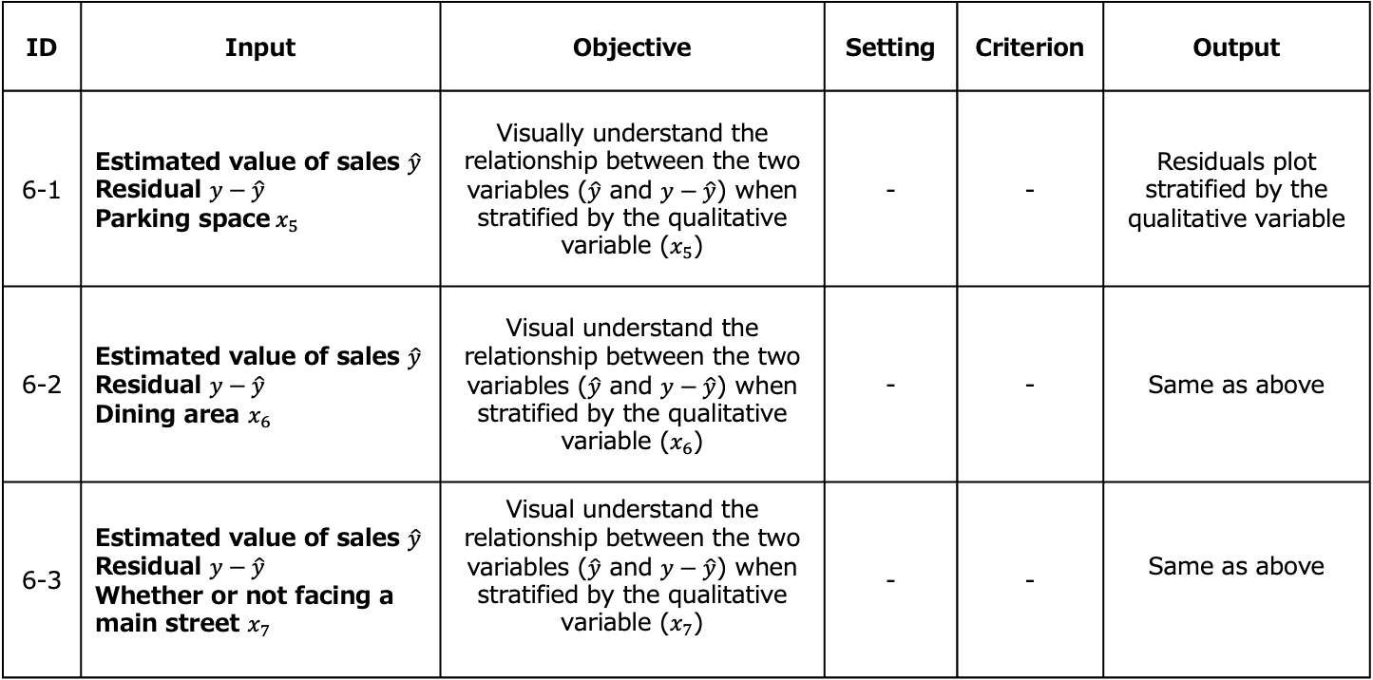
Determination of the Decision-making Map
ID | Input | Objective | Setting | Criterion | Output
6-1 | Estimated value of sales $\hat{y}$ Residual $y−\hat{y}$ Parking space$x_{5}$ | Visually understand the relationship between the two variables ($\hat{y}$ and $y−\hat{y}$) when stratified by the qualitative variable ($x_{5}$) | - | - | Residuals plot stratified by the qualitative variable
6-2 | Estimated value of sales $\hat{y}$ Residual $y−\hat{y}$ Dining area $x_{6}$ | Visual understand the relationship between the two variables ($\hat{y}$ and $y−\hat{y}$) when stratified by the qualitative variable ($x_{6}$) | - | - | Same as above
6-3 | Estimated value of sales $\hat{y}$ Residual $y−\hat{y}$ Whether or not facing a main street $x_{7}$ | Visual understand the relationship between the two variables ($\hat{y}$ and $y−\hat{y}$) when stratified by the qualitative variable ($x_{7}$) | - | - | Same as above

Slide 31
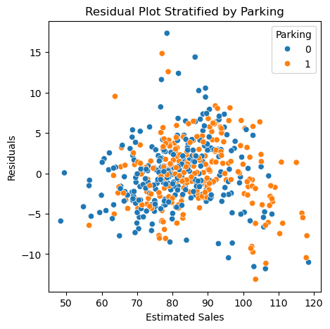
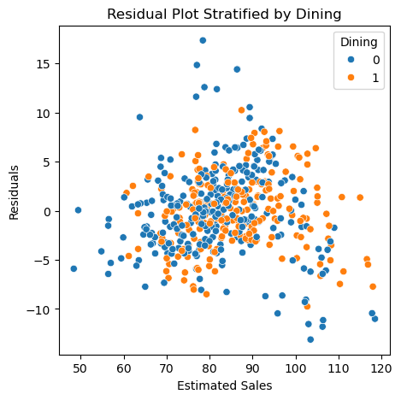
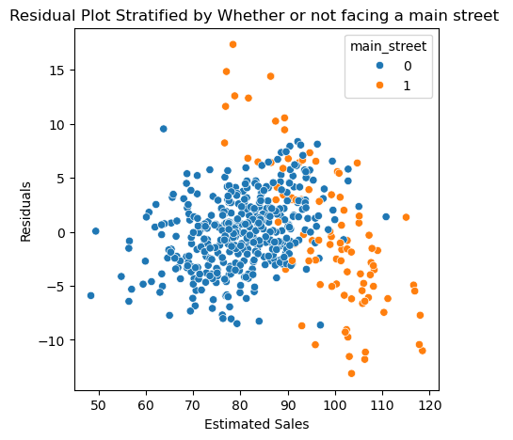
[6-1~6-3] Analysis
Stratified
by Dining Area
Stratified
by Whether or not facing a main street
Stratified
by Parking Space

Slide 32
［6-1~6-3] Consideration
In the residual plot stratified by whether or not facing a main street , the cross-shaped pattern is split into two band-like plots, suggesting that the cross-shaped pattern appears due to the influence of whether the store is facing a main street.
We will reconsider the data characteristics by focusing on the whether or not facing a main street.

Slide 33
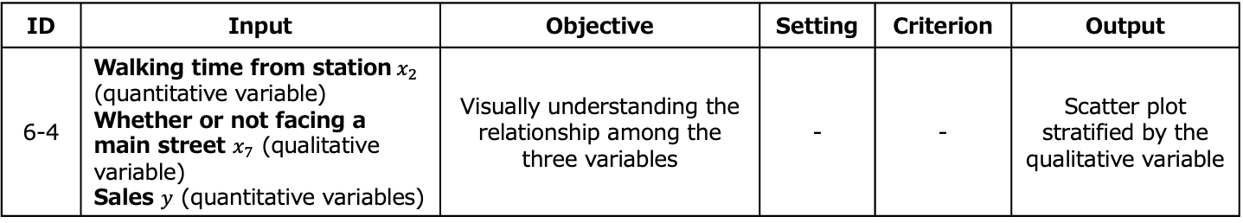
Determination of the Decision-making Map
ID | Input | Objective | Setting | Criterion | Output
6-4 | Walking time from station$x_{2}$ (quantitative variable) Whether or not facing a main street $x_{7}$ (qualitative variable) Sales $y$ (quantitative variables) | Visually understanding the relationship among the three variables | - | - | Scatter plot stratified by the qualitative variable

Slide 34
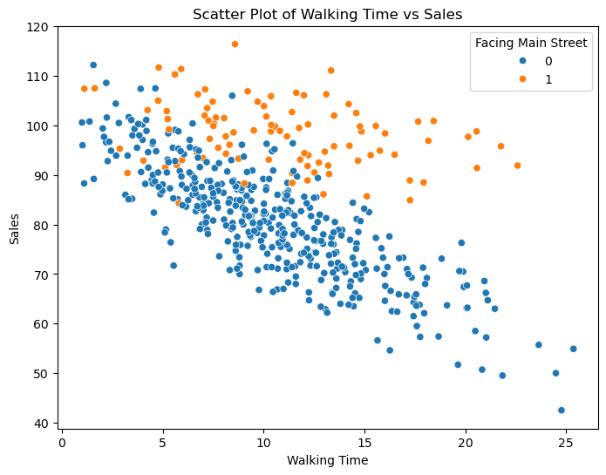
[6-4] Analysis
Scatter plot of Walking time and sales stratified by Whether or not facing a main street

Slide 35
[6-4] Consideration
Assuming a linear relationship between walking time and sales, the slope of the line appears to differ depending on whether the store is a facing a main street.
Given that the slopes of the lines differ, it is necessary to include an interaction term between walking time and sales in the regression equation.
We will revise the regression equation by including this interaction term.

Slide 36
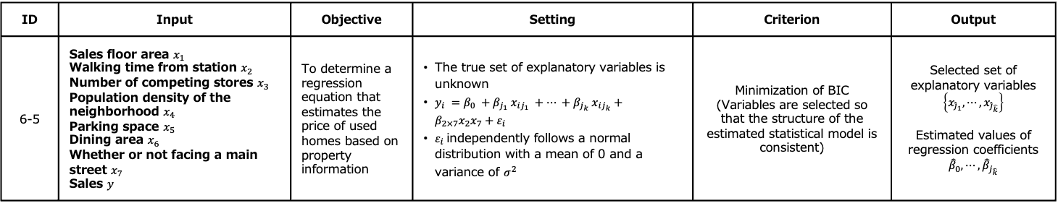
Determination of the Decision-making Map
ID | Input | Objective | Setting | Criterion | Output
6-5 | Sales floor area $x_{1}$ Walking time from station $x_{2}$ Number of competing stores $x_{3}$ Population density of the neighborhood $x_{4}$ Parking space $x_{5}$ Dining area $x_{6}$ Whether or not facing a main street $x_{7}$ Sales $y$ | To determine a regression equation that estimates the price of used homes based on property information | The true set of explanatory variables is unknown $y_{i} =β_{0} +β_{j_{1}} x_{ij_{1}} +⋯ +β_{j_{k}} x_{ij_{k}}+{β_{2×7}x}_{2}x_{7}+ε_{i}$ $ε_{i}$independently follows a normal distribution with a mean of 0 and a variance of $σ^{2}$ | Minimization of BIC (Variables are selected so that the structure of the estimated statistical model is consistent) | Selected set of explanatory variables $\left\{x_{{\hat{j}}_{1}}, ⋯,x_{{\hat{j}}_{\hat{k}}}\right\}$ Estimated values of regression coefficients $${\hat{β}}_{0}, ⋯, {\hat{β}}_{j_{\hat{k}}}$$

Slide 37
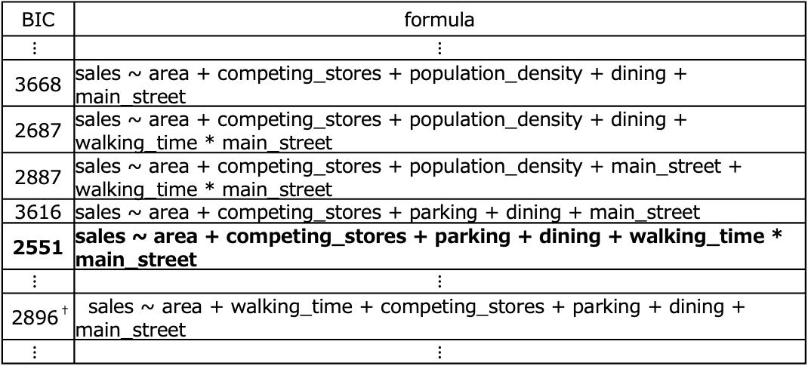
[6-5] Analysis
For the regression equation that includes an interaction term between walking time and main street, BIC values were calculated for all combinations of explanatory variables.
BIC | formula
$$⋮$$ | $$⋮$$
3668 | sales ~ area + competing_stores + population_density + dining + main_street
2687 | sales ~ area + competing_stores + population_density + dining + walking_time * main_street
2887 | sales ~ area + competing_stores + population_density + main_street + walking_time * main_street
3616 | sales ~ area + competing_stores + parking + dining + main_street
2551 | sales ~ area + competing_stores + parking + dining + walking_time * main_street
$$⋮$$ | $$⋮$$
2896† | sales ~ area + walking_time + competing_stores + parking + dining + main_street
$$⋮$$ | $$⋮$$
†Show the values of BIC for the regression equation obtained in the step of “Analysis of the Problem”, so that the minimum BIC values can be compared before and after the revision of the regression equation.

Slide 38
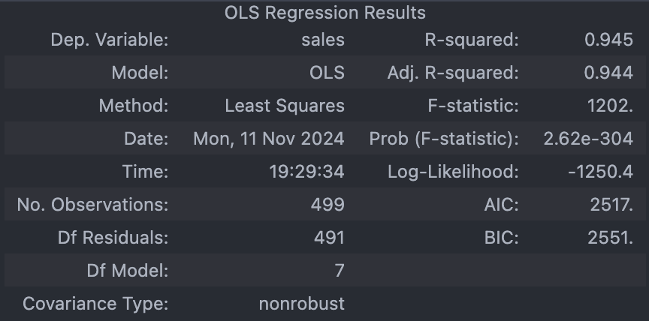
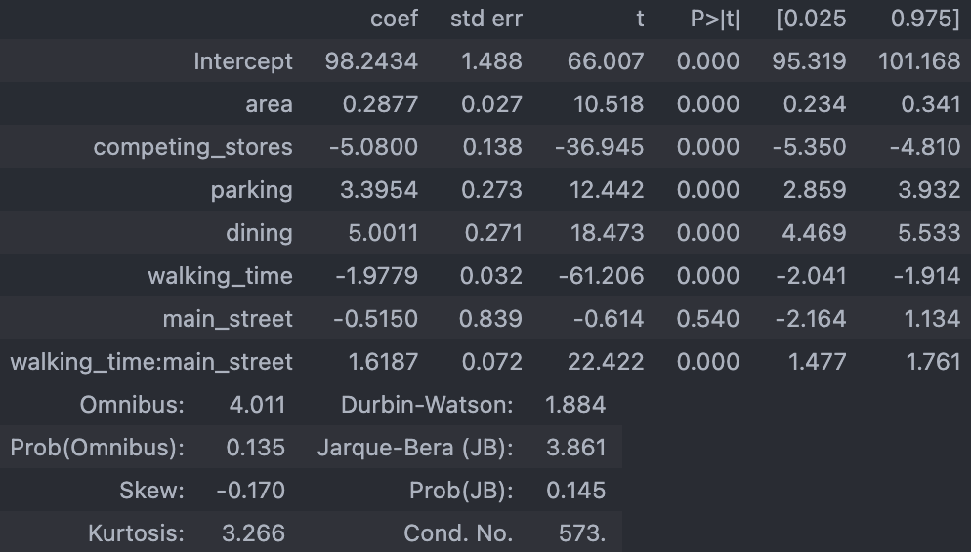
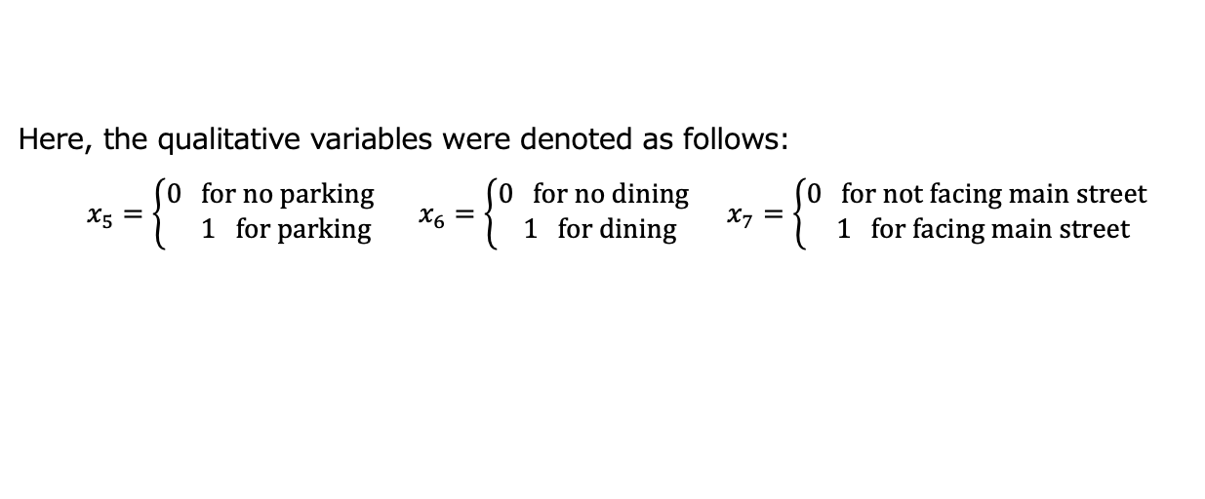
[6-5] Analysis
The results for the regression equation that minimizes the BIC are shown below:
Here, the qualitative variables were denoted as follows:
$x_{5}=\left\{\begin{matrix}0 for no parking \\ 1 for parking\end{matrix}\right.$ $x_{6}=\left\{\begin{matrix}0 for no dining \\ 1 for dining\end{matrix}\right.$ $x_{7}=\left\{\begin{matrix}0 for not facing main street \\ 1 for facing main street\end{matrix}\right.$

Slide 39
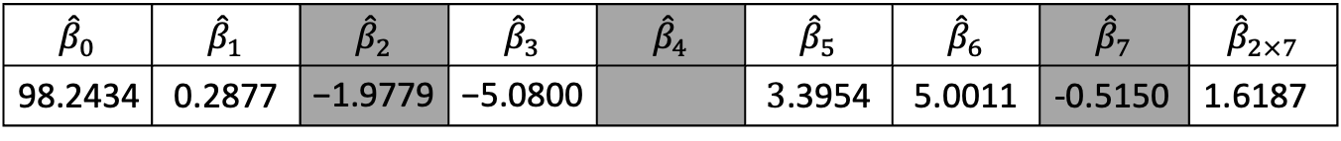


[6-5] Analysis
Minimum BIC: 2551
Estimated set of explanatory variables:
Sale Area $x_{1}$, Walking time $x_{2}$, Competing stores $x_{3}$, Population Density $x_{4},$ Parking $x_{5}$, Dining $x_{6}$, Main street $x_{7}$
Estimated regression coefficients:
$${\hat{β}}_{0}$$ | $${\hat{β}}_{1}$$ | $${\hat{β}}_{2}$$ | $${\hat{β}}_{3}$$ | $${\hat{β}}_{4}$$ | $${\hat{β}}_{5}$$ | $${\hat{β}}_{6}$$ | $${\hat{β}}_{7}$$ | $${\hat{β}}_{2×7}$$
$$\text{98.2434}$$ | $$\text{0.2877}$$ | $$\text{−1.9779}$$ | $$\text{−5.0800}$$ |  | $$\text{3}\text{.}\text{3954}$$ | $$\text{5.0011}$$ | -0.5150 | 1.6187
# ${\hat{β}}_{2}$, ${\hat{β}}_{4}$, ${\hat{β}}_{7}$ were not used for regression equation that minimizes BIC, as Walking Time, Population Density, Main Street variables are not part of optimal model which is
sales ~ area + competing_stores + parking + dining + walking_time * main_street

Slide 40

[6-5] Consideration
The following regression equation minimized the BIC:
$$y=98.2434+0.2877{ x}_{1}−5.0800{ x}_{3}+3.3954 x_{5}+5.0011{ x}_{6}+1.6187{ x}_{2}{ x}_{7}$$
The BIC value for the above regression equation has improved compared to the one obtained in the step of “Analysis of the Problem”.
However, since the settings for the error $ε_{i}$have not been verified, we will proceed to do so.

Slide 41
7. Review of Settings
(Verification of the Settings)

Slide 42
Understanding the Objectives
Objective: Verification of settings [validate the setting of the errors in the statistical model].

Slide 43

Determination of the Decision-making Map
ID | Input | Objective | Setting | Criterion | Output
7-1 | Residuals $y−\hat{y}$ | Verify the normality of the errors in the statistical models | - | Visual clarity | Histogram of residuals
7-2 | Residuals $y−\hat{y}$ | Same as above | - | - | Q-Q plot
7-3 | Estimated value of Sales $\hat{y}$ Residuals $y−\hat{y}$ | Verify the independence of the errors in the statistical models | - | - | Residuals plot
 |  | Verify the homoscedasticity of the errors in the statistical models | - | -
7-4 | Residuals $y−\hat{y}$ | Verify the normality of the errors in statistical models | - | Minimize the probability of Type II error while keeping the probability of Type I error below a certain value. | Shapiro-Wilk normality test for residuals

Slide 44



[7-1~7-3] Analysis
Histogram of residuals
Q-Q plot
Residual plot

Slide 45
[7-4] Analysis
Shapiro-Wilk normality test for residuals
A Shapiro-Wilk normality test with a significance level of 5% provided the following test statistics and p-values:
Test statistic | p-value
0.9944355985982737 | 0.06648082318313216

Slide 46
［7-1~7-4] Consideration
The histogram of residuals shows that the residuals are approximately symmetric and centered around zero, suggesting that the residuals may follow a normal distribution.
The Q-Q plot shows that most of the residuals align closely with the diagonal line, suggesting that the residuals follow a normal distribution, while there is a slight deviations due to outliers.
The residuals plot shows no noticeable patterns or changes in variation, indicating that the settings for independence and homoscedasticity of the errors are valid.
The Shapiro-Wilk normality test for residuals resulted in p-value greater than the significance level of 0.05, indicating that the residuals may follow a normal distribution.
Based on the above, it is concluded that the settings regarding the errors are valid.

Slide 47

Conclusion
With the objective of determining a regression equation that estimates the sales $y$ of new stores based on store's location conditions, we examined regression equations under the following settings, using BIC minimization as the criterion:
Setting
The true set of explanatory variables is unknown
$ε_{i}$ independently follows a normal distribution with a mean of 0 and a variance of $σ^{2}$
The following regression equations was obtained, which include Sale Area $x_{1}$, Walking time $x_{2}$, Competing stores $x_{3}$, Population Density $x_{4}$, Parking $x_{5}$, Dining $x_{6}$, Main street $x_{7}$, and the interaction term between Walking time $x_{2}$and Main street $x_{7}$: $$y=98.2434+0.2877{ x}_{1}−5.0800{ x}_{3}+3.3954 x_{5}+5.0011{ x}_{6}+1.6187{ x}_{2}{ x}_{7}$$
As a statistical model for data generation, the following can be considered:
$$y_{i}=98.2434+0.2877x_{i1}−5.0800x_{i3}+3.3954x_{i5}+5.0011x_{i6}+1.6187x_{i2}x_{i7}+ε_{i}$$

Slide 48
Copyright
This material may not be reproduced or distributed without the permission of the authors.
Waseda Education team of Data Science (WEDS)

