Slide 1
Permutations and tower of hanoi
資財系 109705011 陳盈均

Slide 2
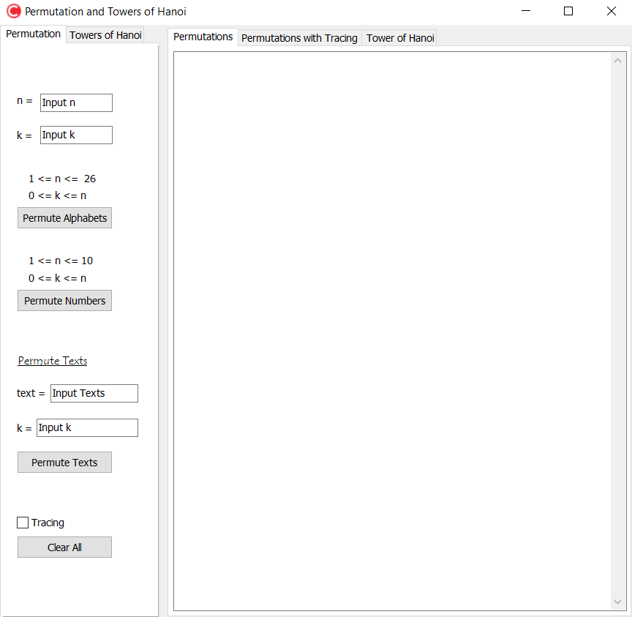
Permutations
There are three kinds of permutations.
1. Permutation of alphabets [a-z]
2. Permutation of Numbers [0-9]
3. Permutation of Texts [Eng & 中]

Slide 3
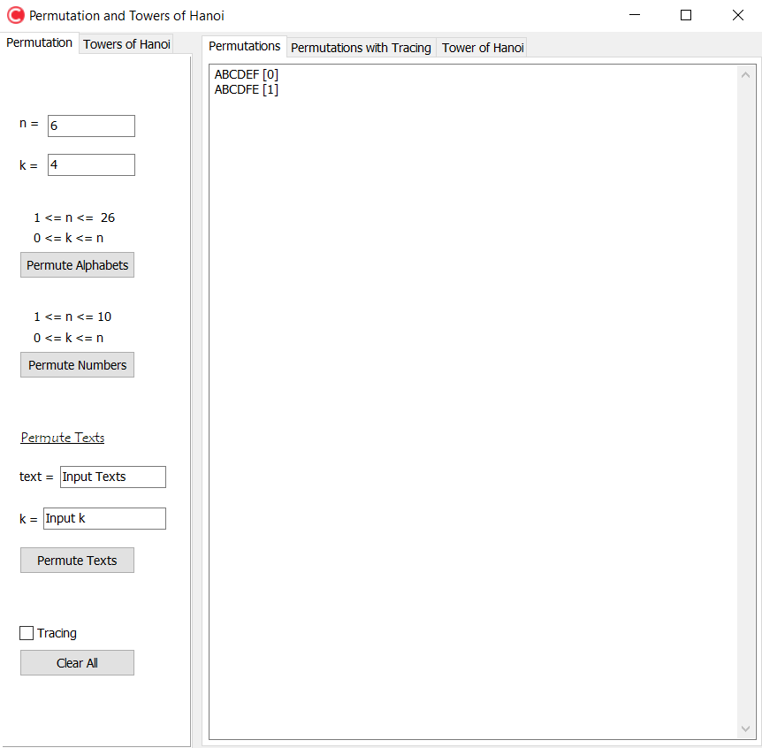
Permutation of alphabets
Input how many alphabets (n) you want to permute and where to start (k).
Here’s the range of n and k
The result of the permutation will be shown here!
Click here to start permuting!

Slide 4
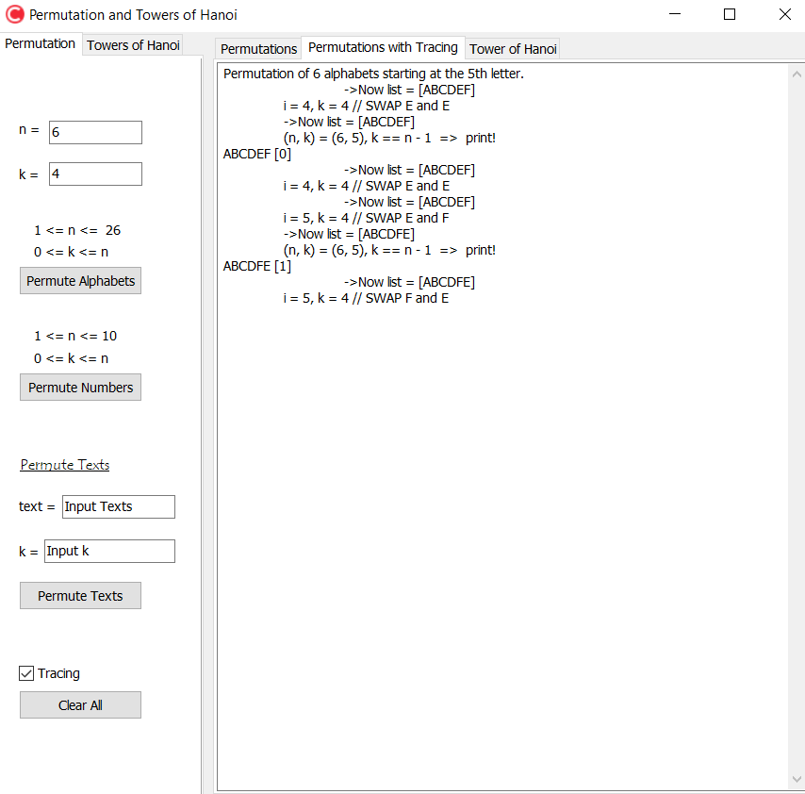
Permutation of alphabets with tracing
When the checkbox “Tracing” is checked, the process of the permutation in the program will be shown.

Slide 5
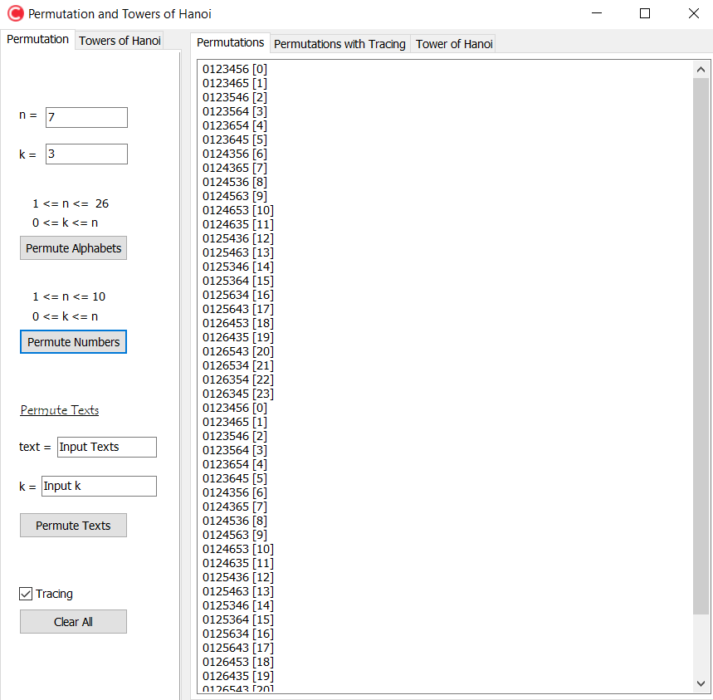
Permutation of Numbers
Input how many numbers (n) you want to permute and where to start (k).
Here’s the range of n and k
The result of the permutation will be shown here!
Click here to start permuting!

Slide 6
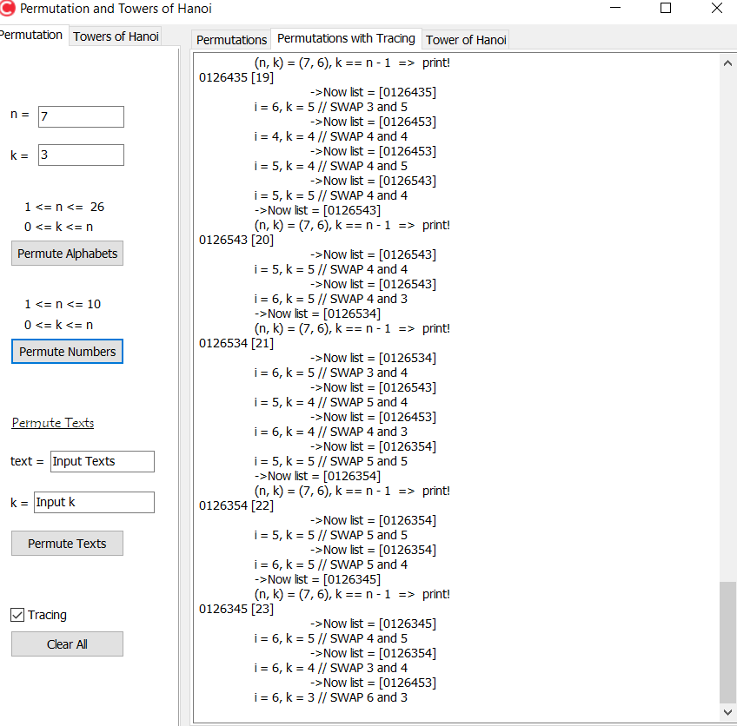
Permutation of Numbers with tracing
When the checkbox “Tracing” is checked, the process of the permutation in the program will be shown.

Slide 7
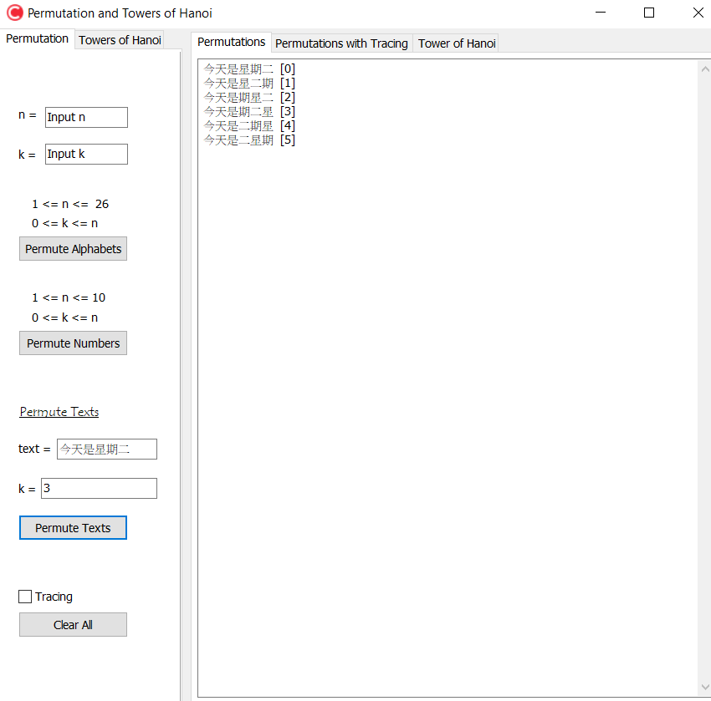
Permutation of Texts (中文&Eng)
Input the text you want to permute and where to start
The result of the permutation will be shown here!
Click here to start permuting!

Slide 8
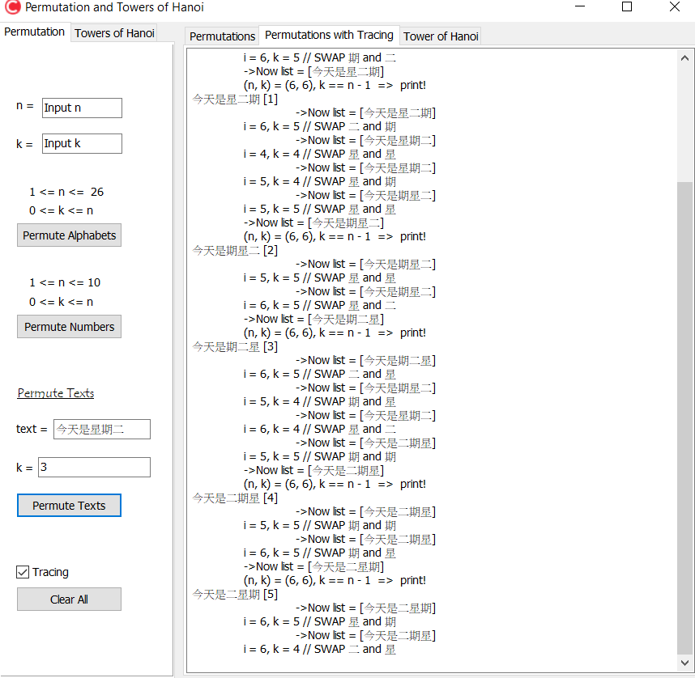
Permutation of Texts (中文&Eng)
When the checkbox “Tracing” is checked, the process of the permutation in the program will be shown.

Slide 9
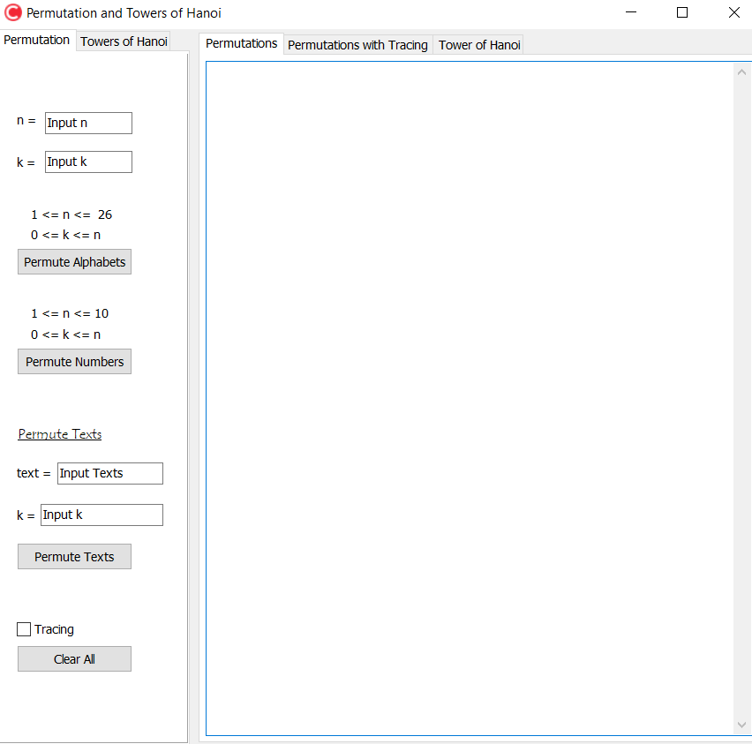
Clear all
Click “Clear All” button, then the interface will be as new as when it just started!

Slide 10
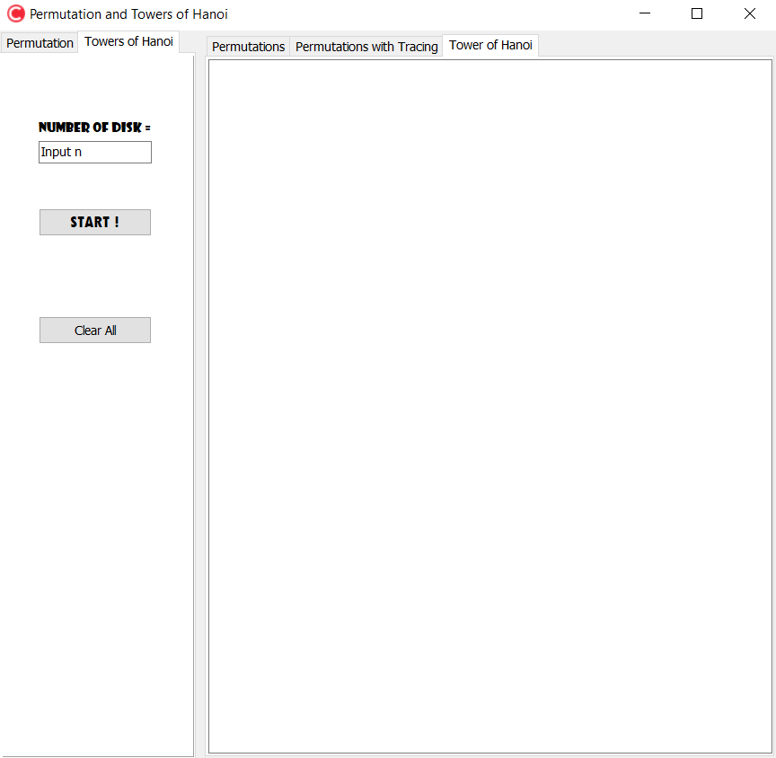
Tower of hanoi
Tower of Hanoi is a game that the objective of the puzzle is to move the entire stack to the last rod, obeying the following rules:
1. Only one disk may be moved at a time.
2. Each move consists of taking the upper disk from one of the stacks and placing it on top of another stack or on an empty rod.
3. No disk may be placed on top of a disk that is smaller than it.

Slide 11
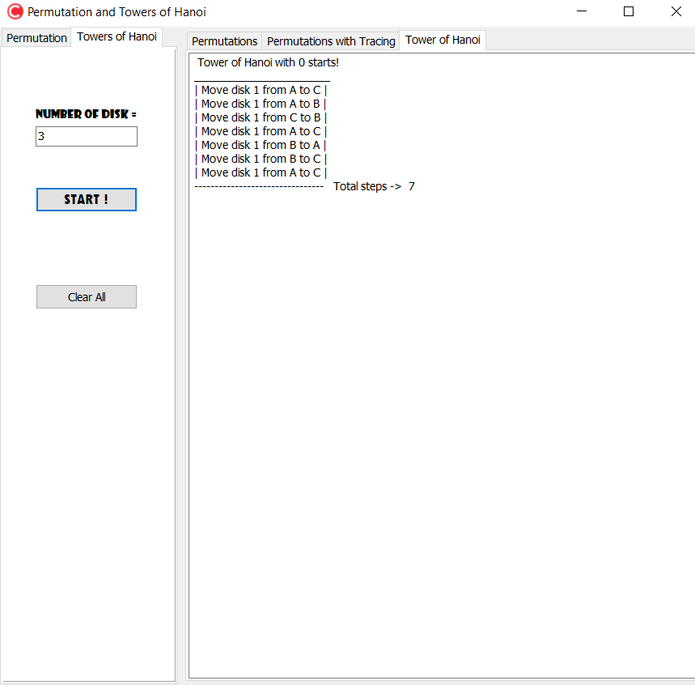
Tower of hanoi
Enter how many disks you want the puzzle have
Each step of moving disks will be shown here!
Click her to start!
Click “Clear All” button, then the interface will be as new as when it just started!

Slide 12
The ENd

