Slide 1
ASKAMEDIA Name : Jay, Dhruv, Vishal, Ankit and Jimit

Slide 2
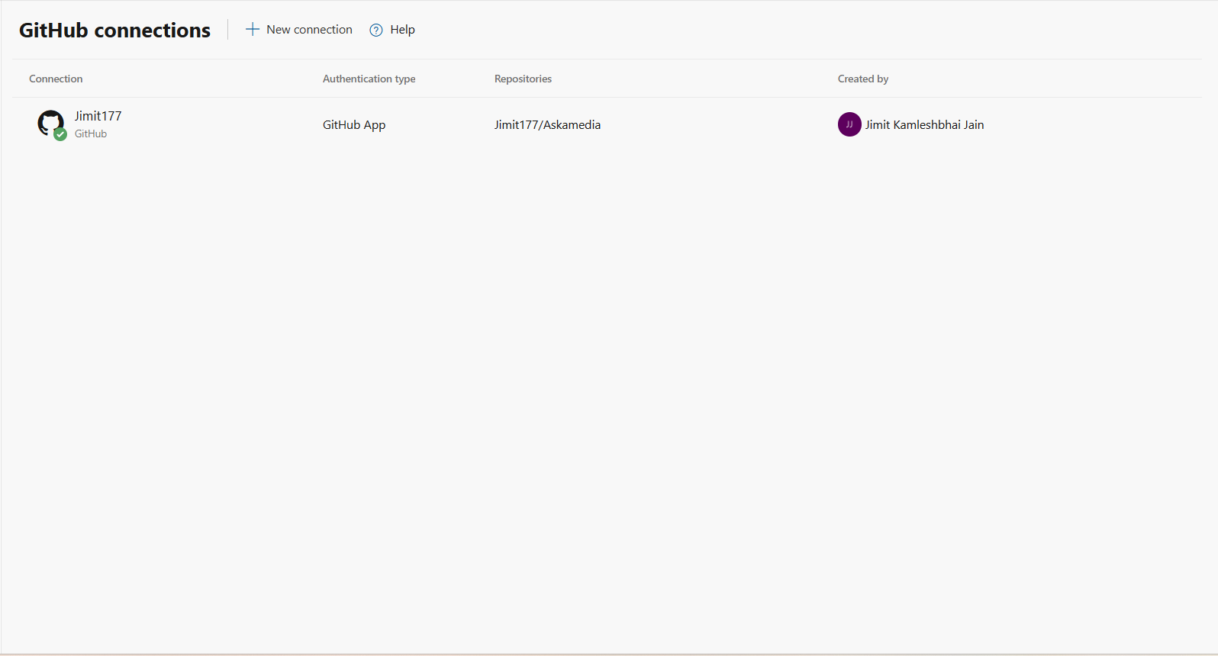
GitHub Repository Connection

Slide 3
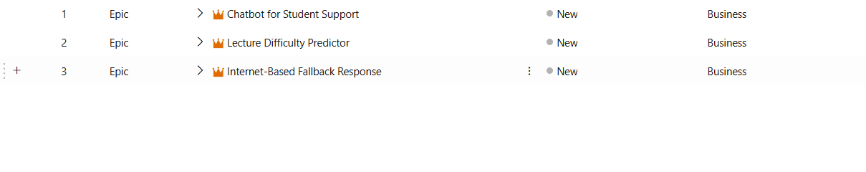
Defined Epics

Slide 4
Use Case 1
Chat bot for Student Support :
This epic focuses on building the core AI chatbot that interacts with students. The chatbot uses course-specific materials (like PDFs, PPTs, DOCX) to answer queries, ensuring responses are aligned with what’s taught in class.

Slide 5
Use Case 2
Lecture Difficulty Predictor :
This component analyzes the complexity of course content. By processing lectures and extracting linguistic features (like sentence length, vocabulary, etc.), the system predicts how difficult a lecture might be for students and helps instructors tailor support accordingly.

Slide 6
Use Case 3
Internet-Based Fallback Response :
When the chatbot cannot confidently answer a query using the provided course materials, this module triggers a fallback mechanism that fetches validated answers from online sources (e.g., OpenAI APIs) to maintain response completeness and accuracy

Slide 7
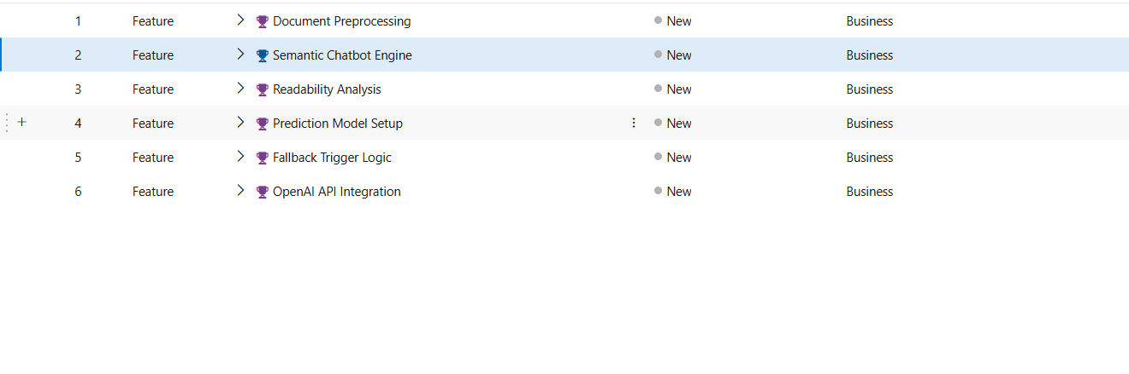
Feature Breakdown

Slide 8
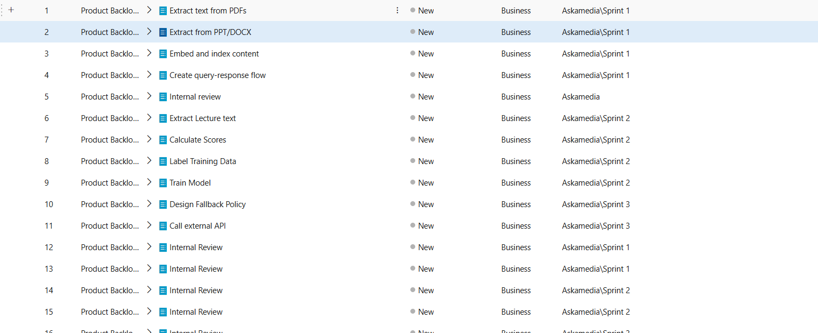
Product Backlog Items

Slide 9
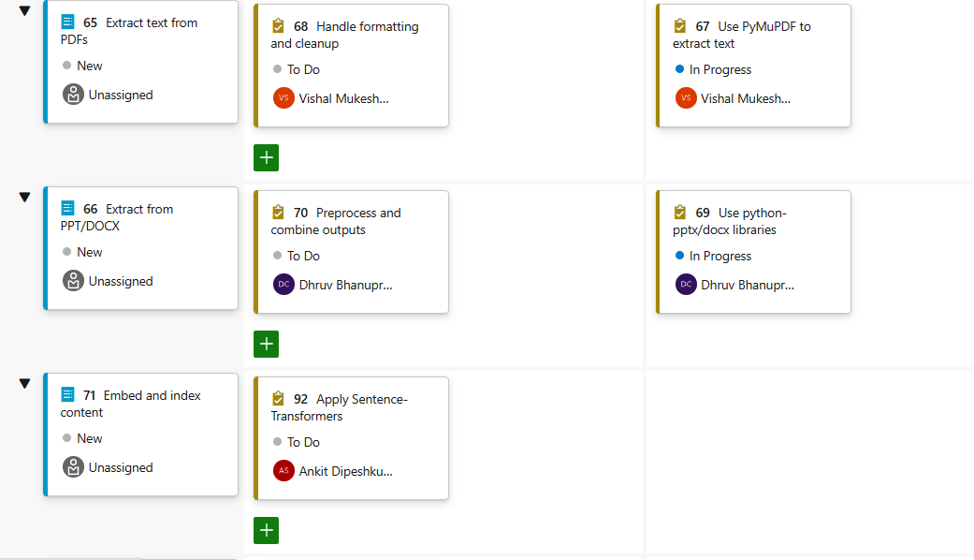
Sprint Board with Assigned Tasks

