Slide 1
Research on Collaborative Learning with Non-IID and Small Data
23 December 2020

Slide 2
Outline
Background and Problem
Challenges and Method
Preliminary Result

Slide 3
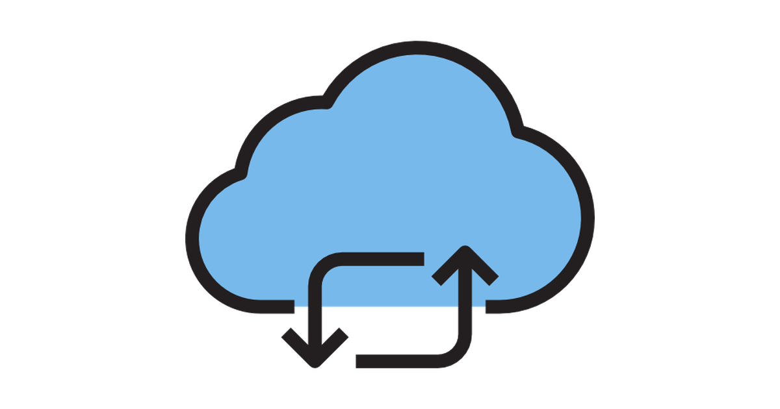

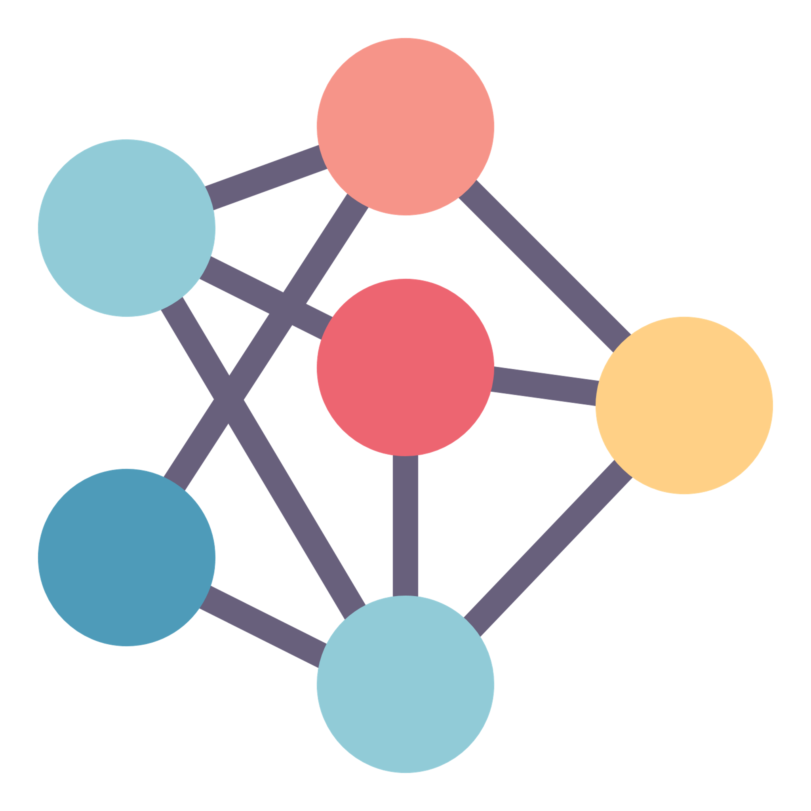
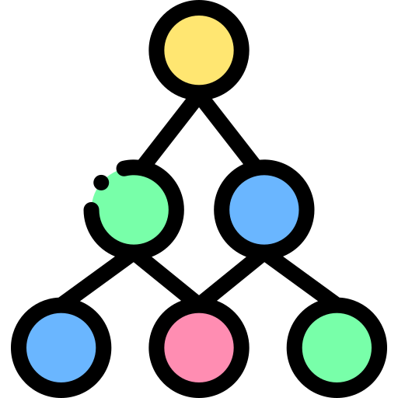
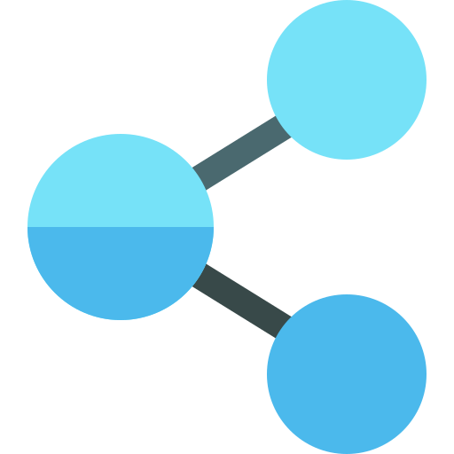

Background
Example (Smart Building): current buildings usually have smart air controllers that can automatically set the optimal temperature without much energy consumption. Such automation depends on high-quality AI service.
Formulate: given multi-parties with their private local data, how to provide highly accurate machine learning service for them?
AI Service Provider
Input: multiple parties with their training and test dataset
Constraints: data privacy, model independency
Output: the models with high accuracy that are verified on the test dataset of each party
Party A
Party B
Party C
Data
Data
Data
Notes:
描述一下输入和输出
场景特点
数据NonIID
Small data
要求保护数据隐私，数据不可共享
甲方需求
一套算法：每个参与方可能使用不同的模型，且不一定是神经网络，因此算法需要与模型无关
目标：为每个参与放提供一个模型，并在每个参与方上的测试数据集验证，得到尽可能高的精度

Slide 4
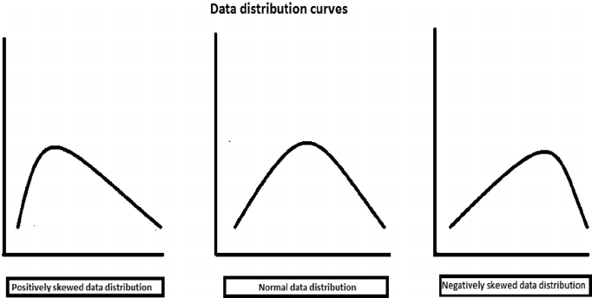
Federated Learning
Federated Learning (FL): provides a practical approach for building AI models using local data in all parties
However, typical FL learning a global model for all parties has three main challenges
Properties
Defects
Small Data
High Overfit
Non-IID Data
Low Adaptivity
Models Diversity
No-aggregation
Notes:
Overfit:
描述一下输入和输出
场景特点
数据NonIID
Small data
要求保护数据隐私，数据不可共享
甲方需求
一套算法：每个参与方可能使用不同的模型，且不一定是神经网络，因此算法需要与模型无关
目标：为每个参与放提供一个模型，并在每个参与方上的测试数据集验证，得到尽可能高的精度

Slide 5
Small data
Few-shot learning: relies on extra large-scale dataset or prior knowledge [6]
Augmentation:
Transformations:
cropping, flipping, scaling, color jittering, and region masking [4,5]
due to privacy constraint, can only make augmentation using local data
GAN based:
generate data in cloud
Problem:
how to generate data in a distributed manner
while preserving the privacy of local data ?
Refers | Description
﻿﻿FAug[1] | Single G and D
FL-GAN[2] | Multiple G and D (distributed)
MD-GAN[2] | Single G, multiple D (distributed)
G
D
G
Parameters
Error
Error
G1
D1
G2
D2
G3
D3
D1
swap
D2
swap
D3
swap
Notes:
Can only make augmentation using local data , 在自己数据集数量小时，效果有限；只能对当前数据做排列组合式的变化，难以本质增加自己数据的多样性
Generate data in cloud, causing privacy leakage
达到需求的技术：
Collaborative Learning → Federated Learning. However, … there are three main challenges…
在这页简要说明，下面逐步展开。
Small data
FedAug
NonIID
Cluster FedAug
Model agnostic
Distillation

Slide 6
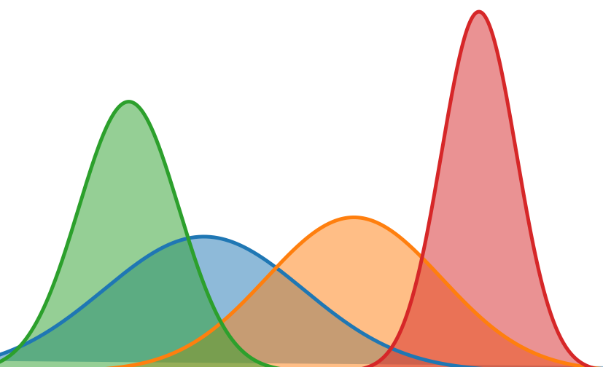






Mitigating Small Data
via Generative Network based Data Augmentation
FL Server
Core idea：
Cooperative training: each client will be both classifier and discriminator.
Split Generator: weighted aggregation according to data distribution and adaptive splitting layer
Random noise
Generator
features
error
$logits_{avg}$
$logits_{1}$
Client A
Client B
Client C
Method:
Total objective function in each client:
$$L_{i}\left(θ\right)=min_{θ} [f\left(θ\right)+L_{KD}\left(p_{i}\right| p_{g})]$$
Objective function in G:
$$L_{G}\left(w\right)=min_{w} L_{KD}( \frac{1}{N}\sum_{i=1}^{N}{α_{i}p_{i}}| p_{g})$$
Shared
Data
Data
Shared
Data
Shared
Data
Data
Data
Notes:
（1）传统GAN在 多方判别 下难以 定义 生成数据的真实性， 如何聚合多个判别器？
（2）把数据下放到每个client上，用数据距离来衡量，尽量生成整体数据的中心
（3）同一个模型即用作判别器又用作分类器，如何协同训练？
Model parameter : 效果好，但是要求结构相同
Logits： 效果差
[1] Wang H, Kaplan Z, Niu D, et al. Optimizing Federated Learning on Non-IID Data with Reinforcement Learning. INFOCOM, 2020 (CCF A), pp.1698-1707..
[2] Wang Z, Song M, Zhang Z, et al. Beyond inferring class representatives: User-level privacy leakage from federated learning[C]//IEEE INFOCOM 2019 (CCF A), pp.2512-2520.
[3] Zhu L, Liu Z, Han S. Deep leakage from gradients[C]//Advances in Neural Information Processing Systems. NeurIPS, 2019 (CCF A and Core A), pp. 14774-14784.

Slide 7
References
[1] ﻿﻿Jeong, E., Oh, S., Kim, H., Park, J., Bennis, M., & Kim, S.-L. (2018). Communication-Efficient On-Device Machine Learning: Federated Distillation and Augmentation under Non-IID Private Data. Retrieved from http://arxiv.org/abs/1811.11479
[2] ﻿Hardy, C., Le Merrer, E., & Sericola, B. (2019). MD-GAN: Multi-discriminator generative adversarial networks for distributed datasets. IPDPS 2019.
[3] Zhao, S., Liu, Z., Lin, J., Zhu, J. Y., & Han, S. (2020). Differentiable Augmentation for Data-Efficient GAN Training. In arXiv. NeurIPS 2020.
[4] Terrance DeVries and Graham W Taylor. Improved regularization of convolutional neural networks with cutout. arXiv, 2017. 2, 3, 6
[5] Alex Krizhevsky, Ilya Sutskever, and Geoffrey E Hinton. ImageNet Classification with Deep Convolutional Neural Networks. In Conference on Neural Information Processing Systems (NeurIPS), 2012. 1, 2, 3
[6] Shorten, Connor, and Taghi M. Khoshgoftaar. "A survey on image data augmentation for deep learning." Journal of Big Data 6, no. 1 (2019): 60.

Slide 8
Non-IID data
Refers | Description
 | Generalization | Adaptiveness
Global [1] | √ | X
Specific [2] | X | √
Ours | √ | √
How to solve Non-IID?
Generating global data to all parties [1]
Generating specific data for each individual party [2]
Generating global data
Generating specific data
G
D
G
D
G
G
D1
D2
D3
D
Notes:
为每个client生成数据，生成的数据分布一致，adaptiveness很高，但是gan生成的效果很差
全局采用一个质量则相反

Slide 9




Data Distribution Matching
based Personalized Augmentation
Core Idea：
Search a Delicate Balance between Generalization and Adaptiveness：
build suitable generators to generate multiple datasets with various distribution
Adaptively match party and generator:
each party adaptively selects the generator according to their matchness
Generator 1
Generator 2
Generator 3
Method:
…
Matchness：
Loss over generated data $ℓ(p_{g}^{j})$
Similarity between local data and generated data, e.g., KL distance${ L}_{KD}(p_{i};p_{g}^{j}|i ∈D_{Gj})$
Shared Data
$$ℓ(p_{g}^{1})$$
Client A
Client B
Client C
Client D
$$ℓ(p_{g}^{1})$$
Data
$$L_{KD}(p_{i};p_{g}^{1})$$
Data
Data
Data

Slide 10
References
[1]. Fallah, Alireza, Aryan Mokhtari, and Asuman Ozdaglar. "Personalized Federated Learning with Theoretical Guarantees: A Model-Agnostic Meta-Learning Approach." NeurIPS 2020.
[2]. Jeong, E., Oh, S., Kim, H., Park, J., Bennis, M., & Kim, S.-L. (2018). Communication-Efficient On-Device Machine Learning: Federated Distillation and Augmentation under Non-IID Private Data. Retrieved from http://arxiv.org/abs/1811.11479

Slide 11
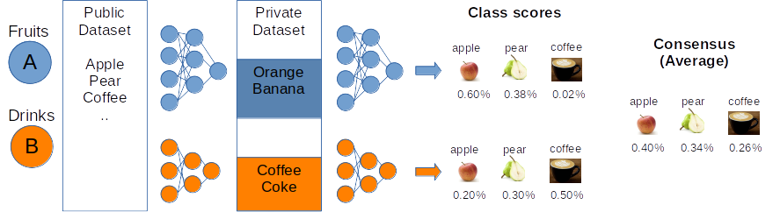
Model Agnostic
Challenge: traditional collaborative learning framework assume that each party holds on a same model architecture which is impractical in real-world
Federated Distillation: computes the average of logits of multiple parties
However, direct average will learn a global representation for all models, leading to performance degradation for Non-IID data
Refers | Description
 | Model agnostic | Distillation | NonIID data
FedAvg[1] | X | X | X
FD[2], FedMD[3], FedDF[4] | √ | √ | X
Our method | √ | √ | √

Slide 12
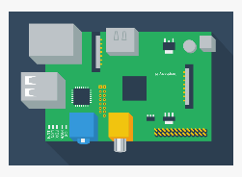

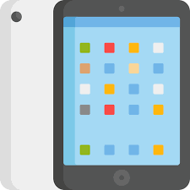
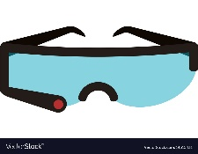






Model-agnostic Meta Mutual Learning
Core idea：
Mutual Learning: each party views itself as a student and the other parties as its teachers
Meta Learning: each party aggregates logits from other teachers with different weights adaptively tuned in a learning way
$$ω_{2}$$
AI Service Provider
$$ω_{1}$$
$$ω_{3}$$
$$ω_{4}$$
Method:
Final objective function:
$$L(θ)=min_{θ} f(θ)$$
Alternatively :
$${L(ω)=min_{ω} f(θ}^{∗}\left(ω\right))$$
Student
Teacher 1
Teacher 2
Teacher 3
$$θ$$
Notes:
[1] Lin, T., Kong, L., Stich, S. U., & Jaggi, M. (2020). Ensemble Distillation for Robust Model Fusion in Federated Learning. NeurIPS, 2020 (CCF B and Core A).
[2] Li, D., & Wang, J. (2019). FedMD: Heterogenous Federated Learning via Model Distillation. NeurIPs 2019 Workshop.
[3] Hinton G, Vinyals O, Dean J. Distilling the knowledge in a neural network[J]. NeurIPS, 2015 (CCF B and Core A)

Slide 13
References
[1] McMahan, Brendan, et al. "Communication-efficient learning of deep networks from decentralized data." Artificial Intelligence and Statistics. PMLR, 2017.
[2]. Jeong, E., Oh, S., Kim, H., Park, J., Bennis, M., & Kim, S.-L. (2018). Communication-Efficient On-Device Machine Learning: Federated Distillation and Augmentation under Non-IID Private Data. Retrieved from http://arxiv.org/abs/1811.11479
[3]. ﻿Li, D., & Wang, J. (2019). FedMD: Heterogenous federated learning via model distillation. NeurIPS 2018 workshop
[4]. Lin, T., Kong, L., Stich, S. U., & Jaggi, M. (2020). Ensemble Distillation for Robust Model Fusion in Federated Learning. NeurIPS 2020

Slide 14
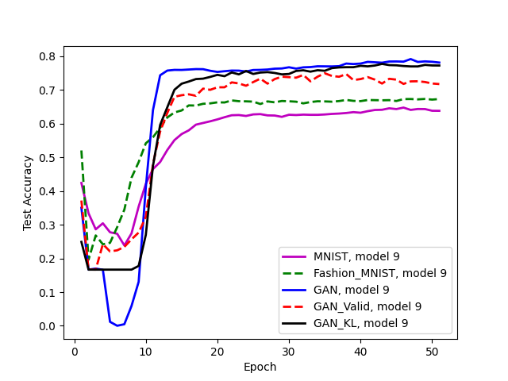



Preliminary Results
FL Server
Findings: GAN with direct distillation receives the best results as compared to methods with or without public dataset
GAN
+
$$logits$$
$$global_logits$$
+
$$data sample$$
Client A
Client B
Client C
Data
Data
Data
Shared
Data
Shared
Data
Shared
Data

Slide 15
Thank you.

