Slide 1
AWE with WorkQueue

Slide 2
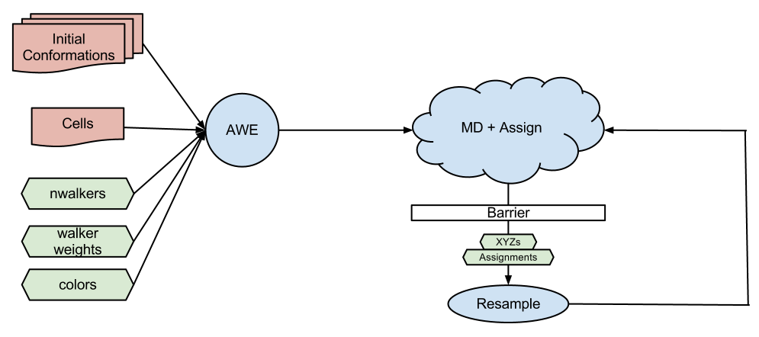
Architecture

Slide 3
Task Overhead
Solvated DHFR*: 23569 atoms
Gromacs 4.5.3
Time to load system
Average: 0.67 seconds, std: 0.01
1000 steps:
Single threaded:
Average: 113.4 seconds, std: 0.4
Multi threaded (24 cores)
Average: 6.96 seconds, std: 0.02
Data Transfer time
Average 5.82 milliseconds, std: 0.76
Overhead: 10% worst case
*System retreived from www.gromacs.org/GPU

Slide 4
Setup
1000 steps in each simulation
Gromacs
50 workers
DHFR (23569 atoms)
10 cells
10 walkers / cell
100 concurrent tasks
10 iterations

Slide 5
DHFR times
Time to complete an iteration (submit, wait, resample)
Average: 6.85 min, std: 58.6 s
Time to resample*:
Average 138.35 ms, std: 4.8
Task execution time
Average: 136.0 s, std: 14.1
Average transfer time
Average: 34.7 ms, std: 47.2
*DHFR resampling was run with identity function. Resampling timings here are taken from a previous run.

Slide 6
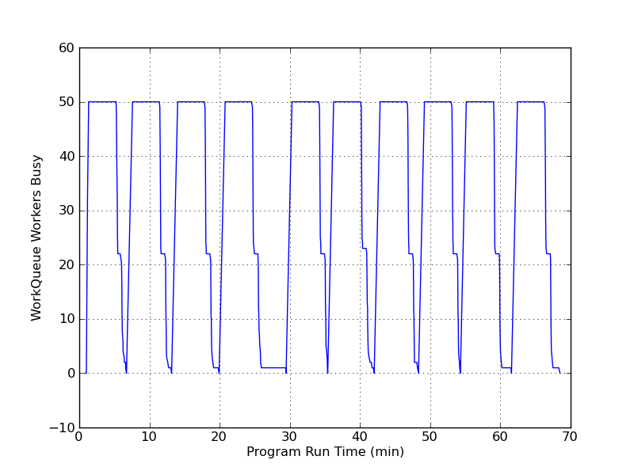
WorkQueue workers busy
Workers are busy with tasks between iterations.
Workers join, then oscillate between “busy” and “waiting” as the master enters and exits the barrier.
Note: during iteration 4 a worker failed and the task was automatically rescheduled.

Slide 7
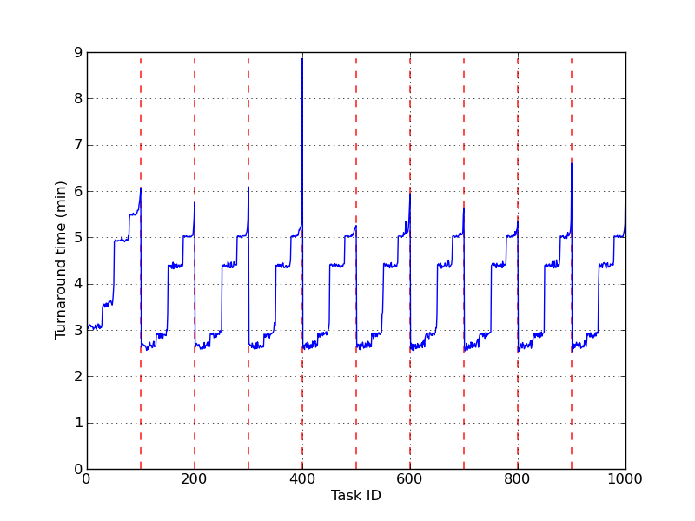
Task turnaround time
Turnaround time is the duration of the task:
Turnaround time = completion time – submit time
Tasks will not be immediately executed on submission if nworkers < ntasks.
Red dashed lines group tasks into iterations.
Note: during iteration 4 a worker failed and the task was automatically rescheduled.

Slide 8
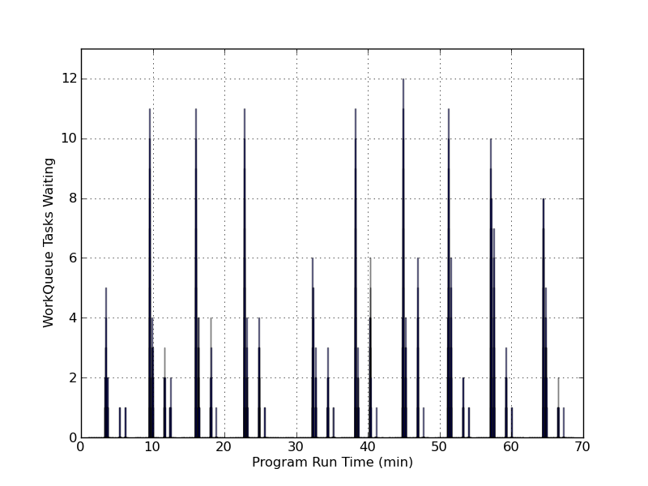
WorkQueue tasks complete
WorkQueue handles completed tasks sequentially. A task is marked as “complete” if it has finished executing but is waiting to be processed by the master.

