Slide 1
AWE-WQ

Slide 2
Setup
5000 steps in each simulation
Binary cached on workers’ first execution
50 workers
Alanine dipeptide
100 cells
10 walkers / cell
1000 concurrent tasks
30 iterations

Slide 3
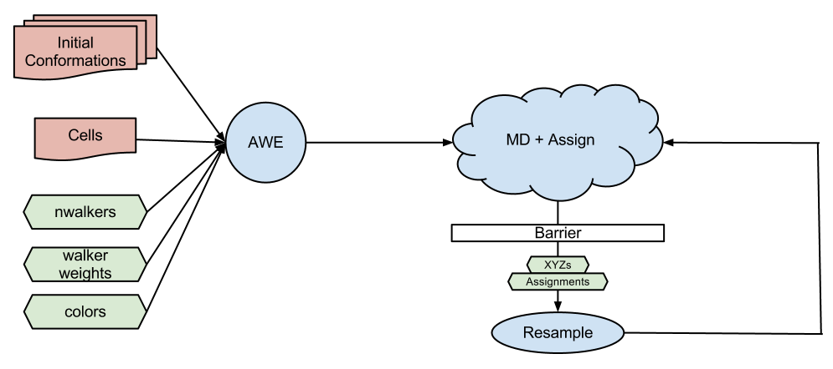
Architecture

Slide 4
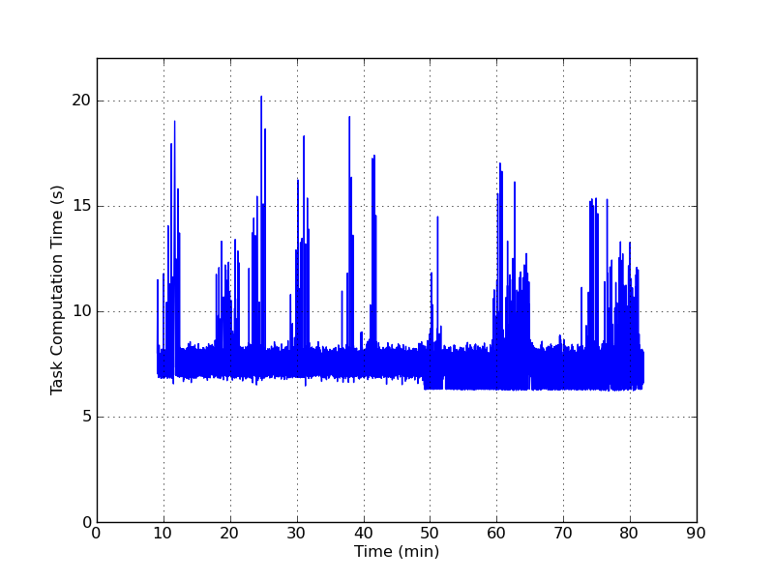
Tasks computation time
Computation time: Time to execute command on worker

Slide 5
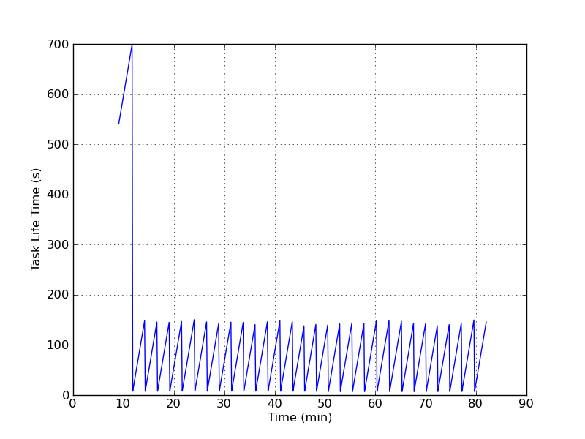
Task life time
Life time is the duration of the task:
life time = completion time – submit time

Slide 6
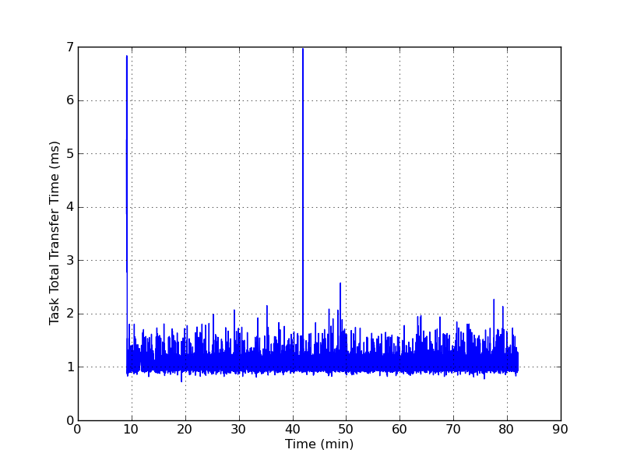
Task total transfer time
Total transfer time: time to send and receive data to worker

Slide 7
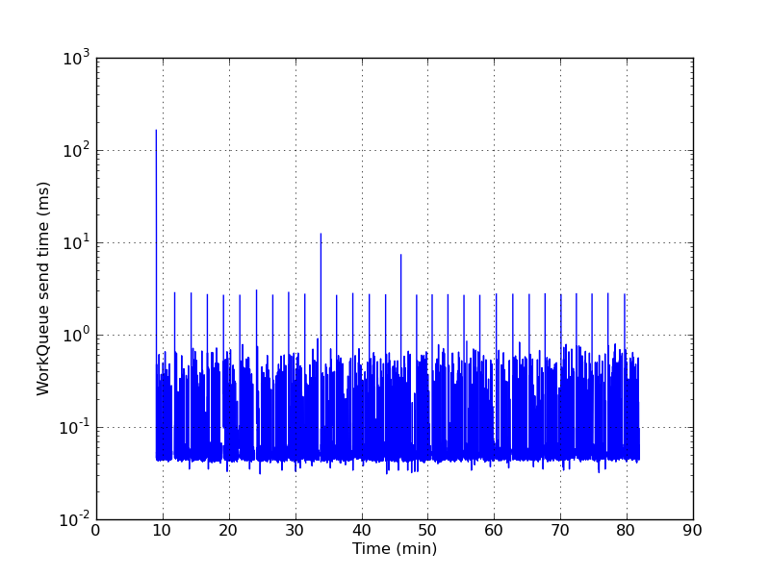
WorkQueue send time
Time to send data to workers

Slide 8
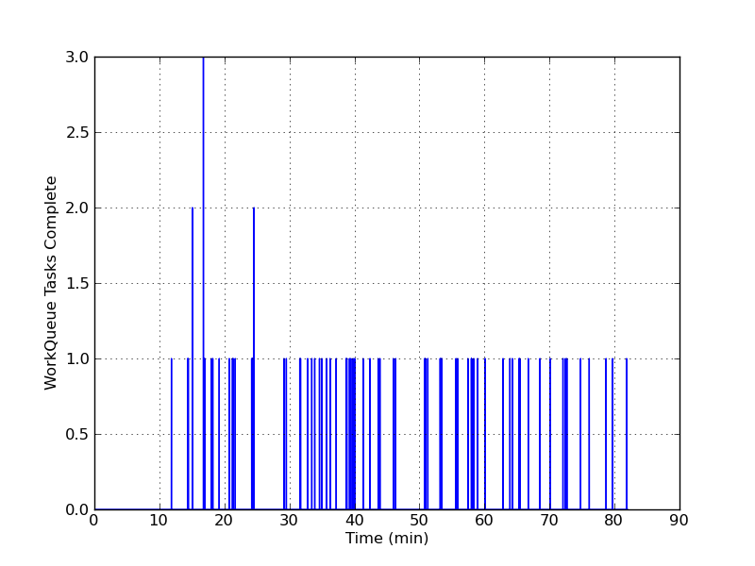
WorkQueue tasks complete
WorkQueue handles completed tasks sequentially. A task is marked as “complete” if it has finished executing but is waiting to be processed by the master.

Slide 9
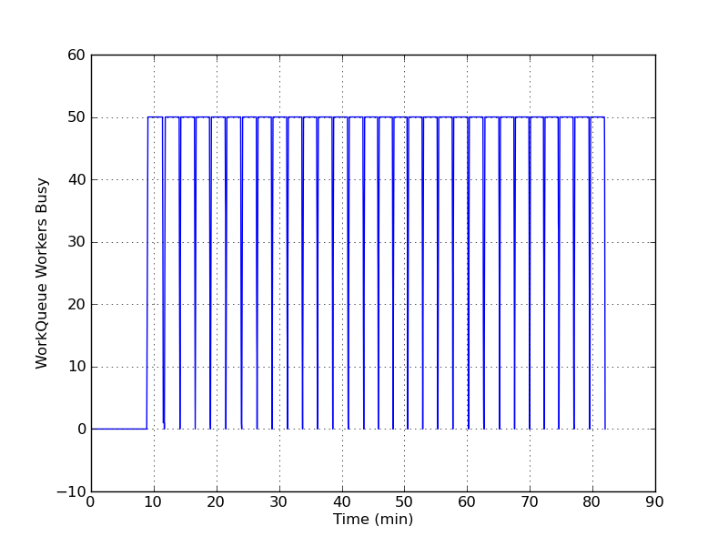
WorkQueue workers busy
Workers are busy with tasks between iterations.

Slide 10
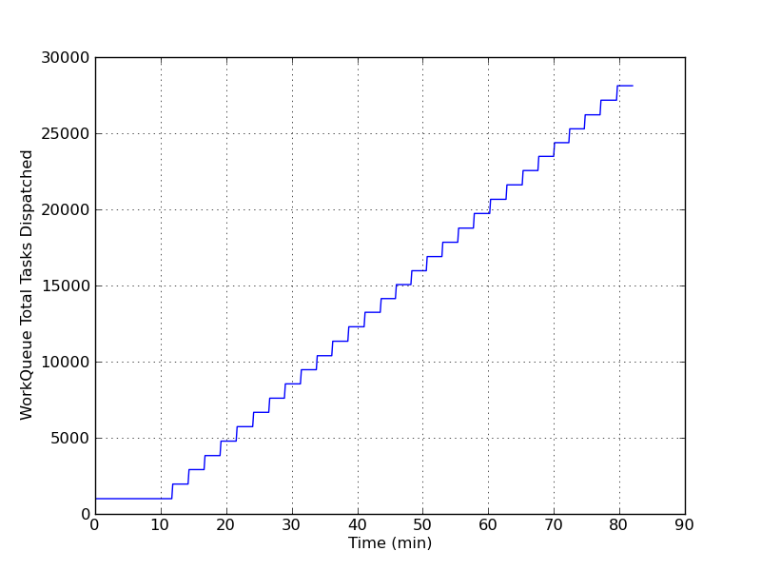
WorkQueue total tasks dispatched

Slide 11
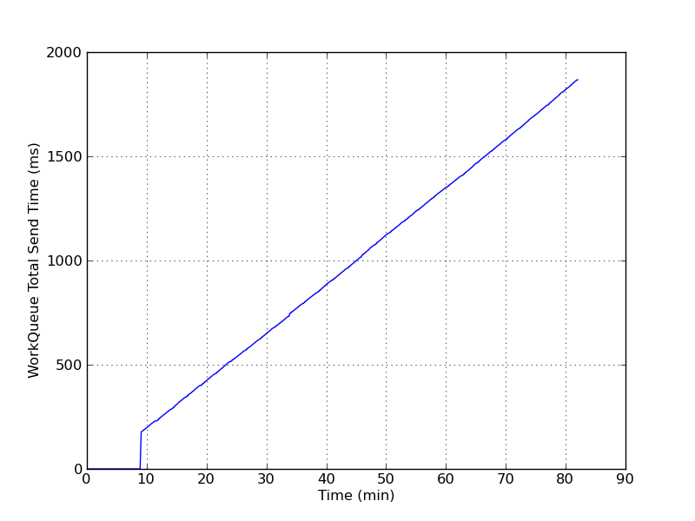
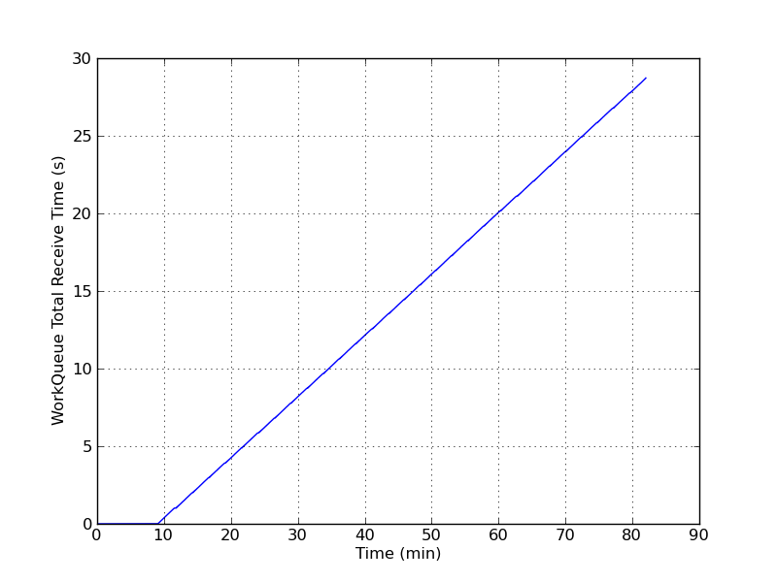
WorkQueue Send/Receive times
Total send time
Total receive time

Slide 12
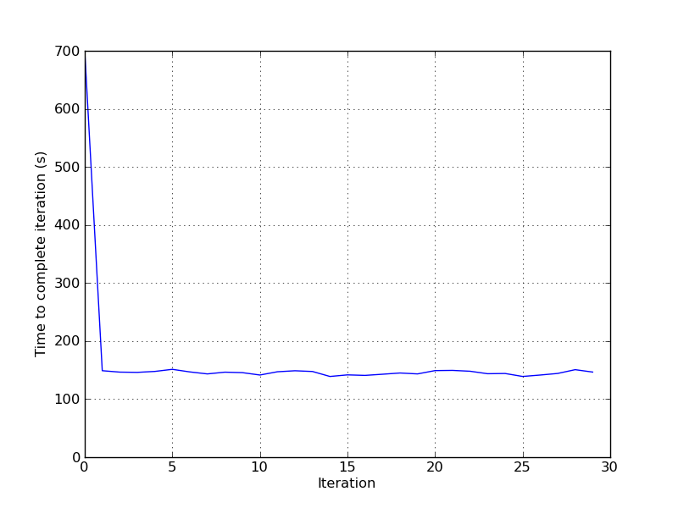
AWE Iteration time
The time taken to complete each iteration. An iteration = submission of tasks, barrier, resampling.
The initial spike is the time to download the MD program binary to the workers.

Slide 13
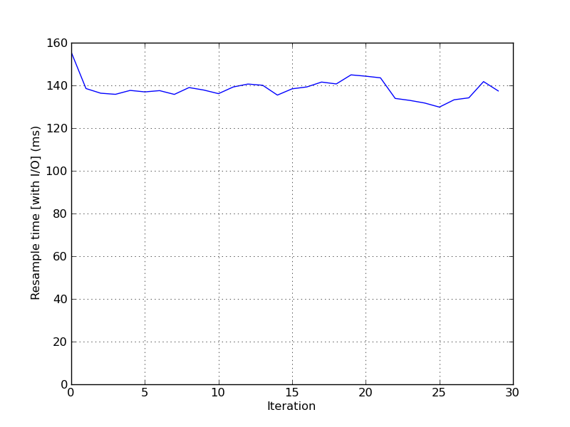
AWE Resampling time
Caveat: each call to resample saves the weights to file.

