Slide 1
Project 6, Movie Popularity and Rating Trends Analysis
Haoyuan Jiang, Mengxi Zhao, Yan Song, Zecheng Qiu
Reporter: Zecheng Qiu & Haoyuan Jiang

Slide 2
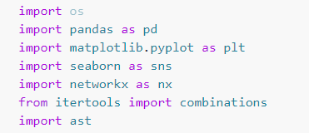
Introduction to the Dataset
We will be analyzing a dataset of movies with various attributes including ratings, popularity, and genres.
Here is some libraries and the document loading part.
Networkx is a Python package for the creation, manipulation, and study of the structure, dynamics, and functions of complex networks.
Itertools is a module in Python's standard library that provides functions that perform various operations on iterable objects, including combinations.
ast is a module for working with Abstract Syntax Trees (ASTs), which are used in areas including compilers, interpreters, and static analysis tools.

Slide 3
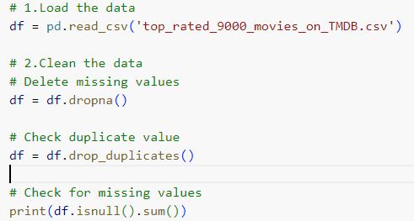
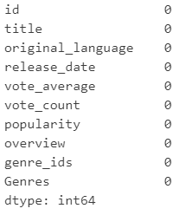
Task 1
Data Cleaning
In this step, we read the data in the file and check the integrity of the file and the uniqueness of the data.

Slide 4
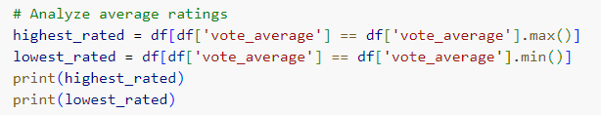
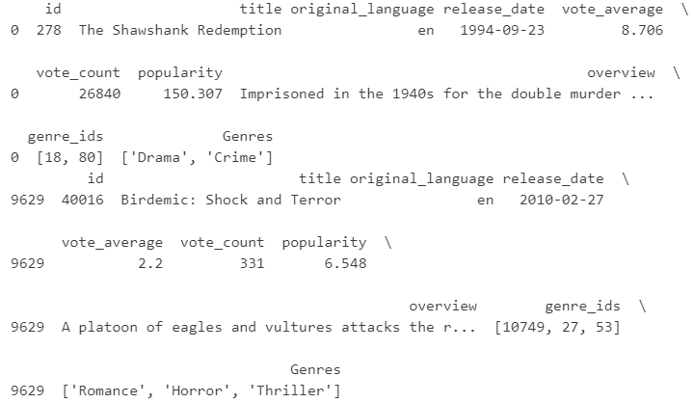
Task 2
Movie Rating Analysis
In this step, we found the two movies in the data with the highest and lowest median values in the "vote_average" category.
As you can see, Shawshank Redemption
has the highest rate
and Birdemic: Shock and Terror is the lowest.
( Has anybody heard of this ?)

Slide 5
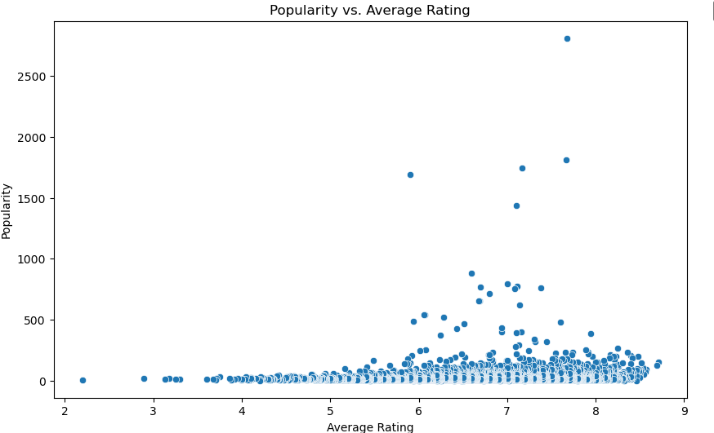
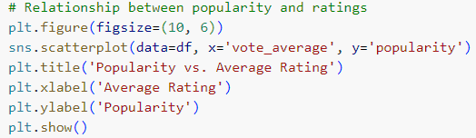
Task 3
Popularity Analysis
In this step, we use both "popularity" and "average vote" data to create a chart that more clearly shows the conclusion that the higher the" average vote "of the film, the higher the general" popularity ".

Slide 6
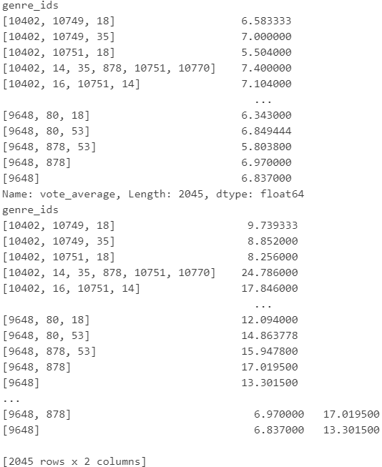
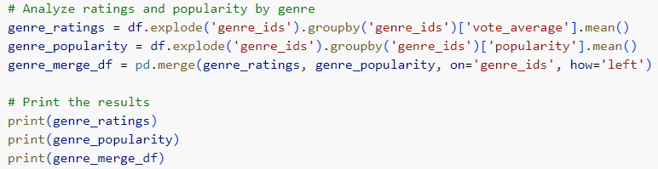
Task 4-1
Genre Analysis
In this step, we merged the same movies by genre and calculated their average rating and popularity. We then merge the new dataframe based on "genre_ids”.

Slide 7
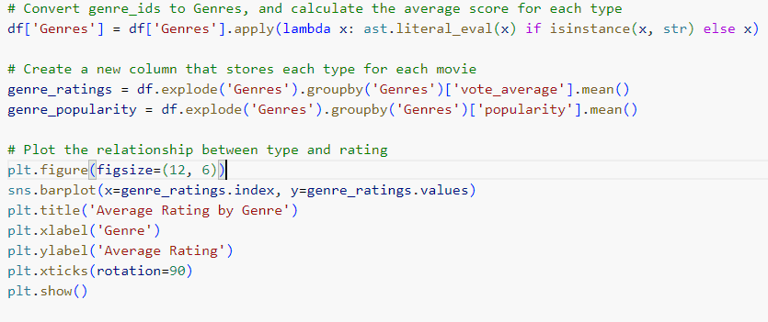
Task 4-2
Genre Analysis
In this step, we visualized the data based on the newly synthesized dataframe. They concluded “films with higher average ratings are generally more popular.

Slide 8
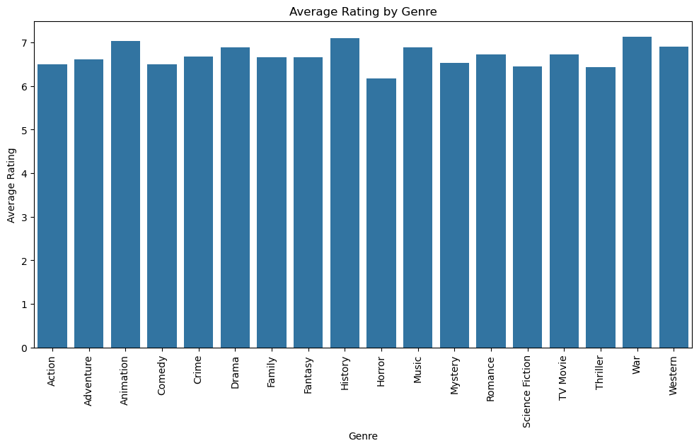

Slide 9
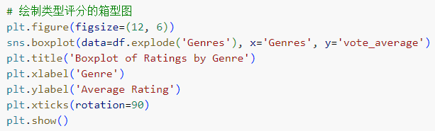
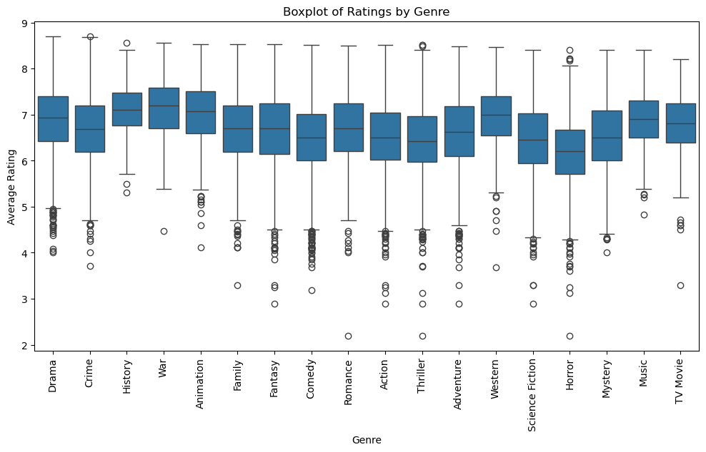

Slide 10
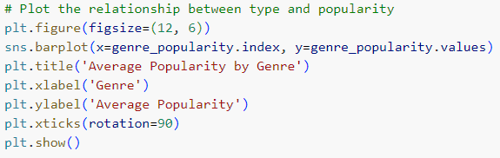
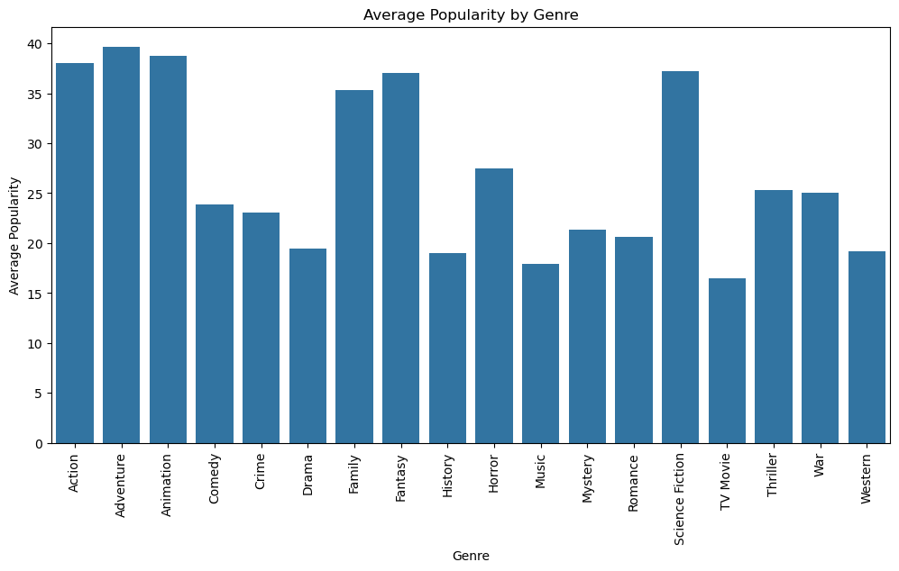

Slide 11
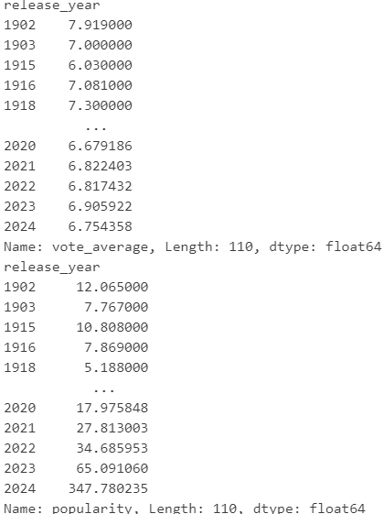
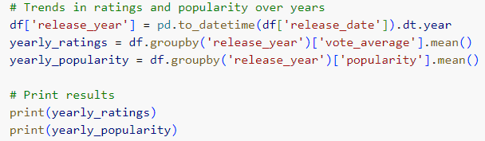
Task5
Temporal Analysis
In this step, we calculated the average rating and popularity of each released film for each year and made dataframes.

Slide 12
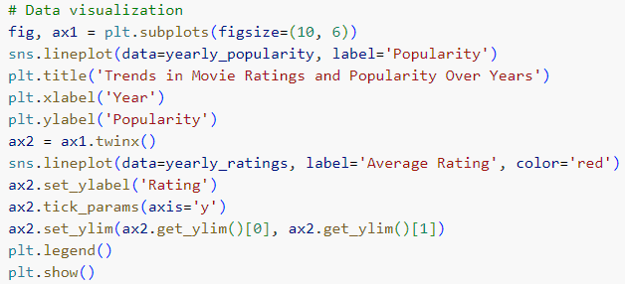
In this step, we visualize the two dataframes we obtained in the previous step. Two conclusions were drawn.

Slide 13
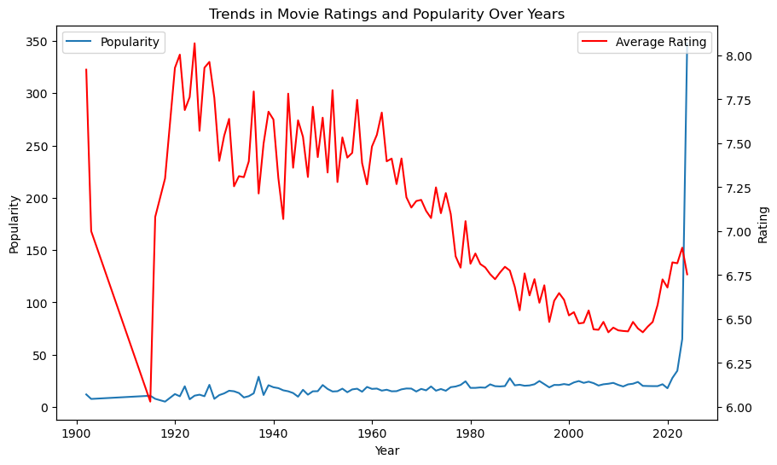
Conclusion 1:In general, the more recent the films, the more popular they are. And there will be an explosive growth in movies after 2020.It shows that people pay more attention to movies released in recent years.
Conclusion 2:In general, older films have higher average ratings. Despite the downward trend in the overall rating, the average rating has rebounded in the past five years. It reflects people's praise for the past classics and their dissatisfaction with the quality of recent films.

Slide 14
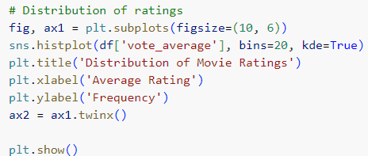
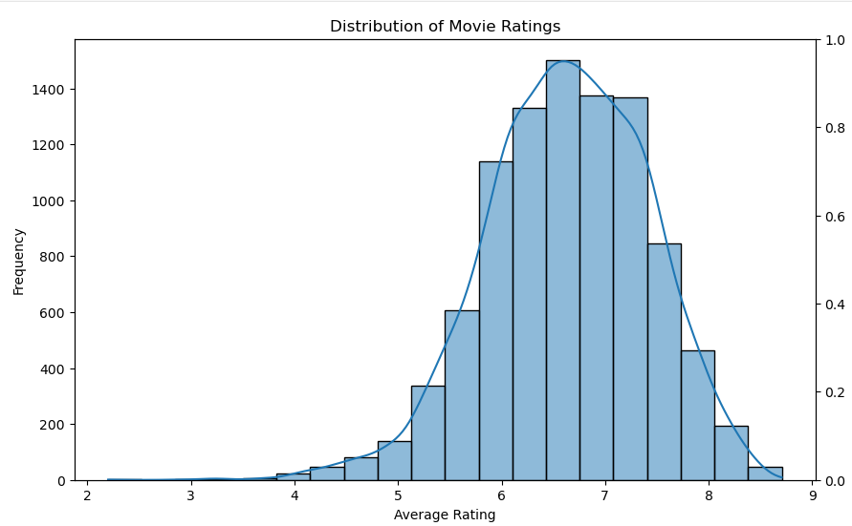
Task 6
Data Visualization
In this step, we realized the data visualization of movie rating distribution and popularity. Two conclusions are drawn
.
1. The movie rating distribution presents an elliptical distribution. Most of them are between 5.5 and 7.5. This means that the average level of film production is around 6.5, with not many films either very good or very bad.
2. The popularity of a film increases with its rating. It also shows that rating is powerful in judging whether a film is an excellent film recognized by the public.

Slide 15
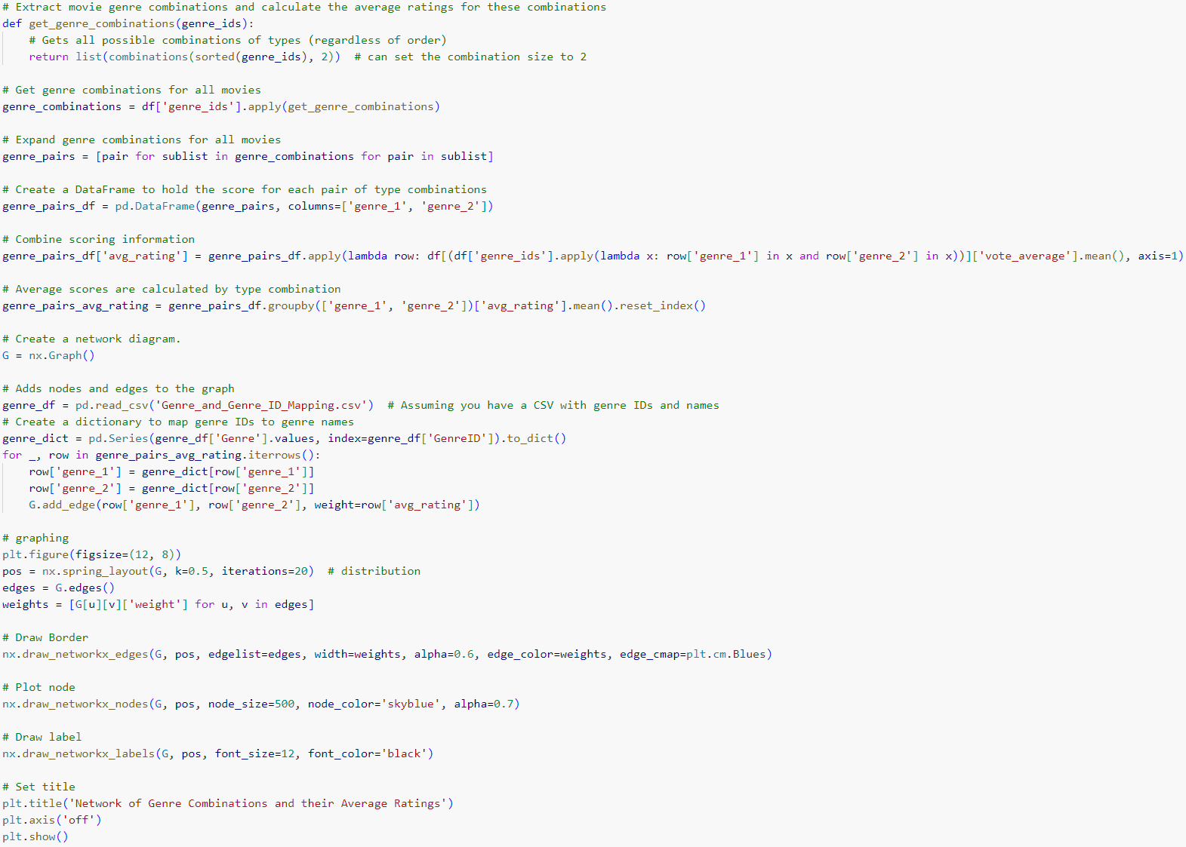

Slide 16
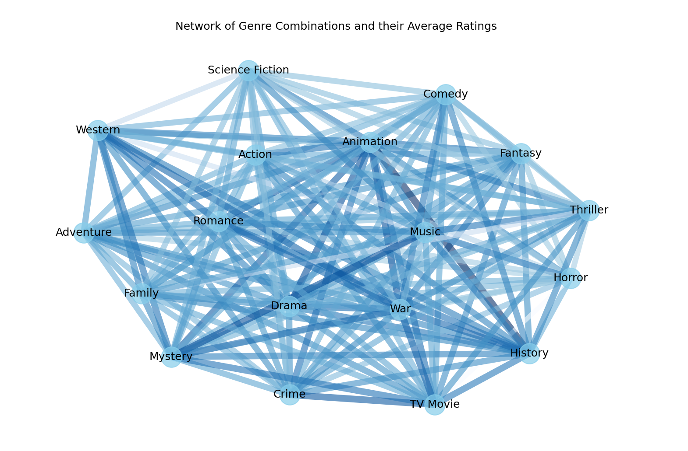
In this step, we draw a network diagram that shows the strong correlation and fit between the various movie genres.

Slide 17
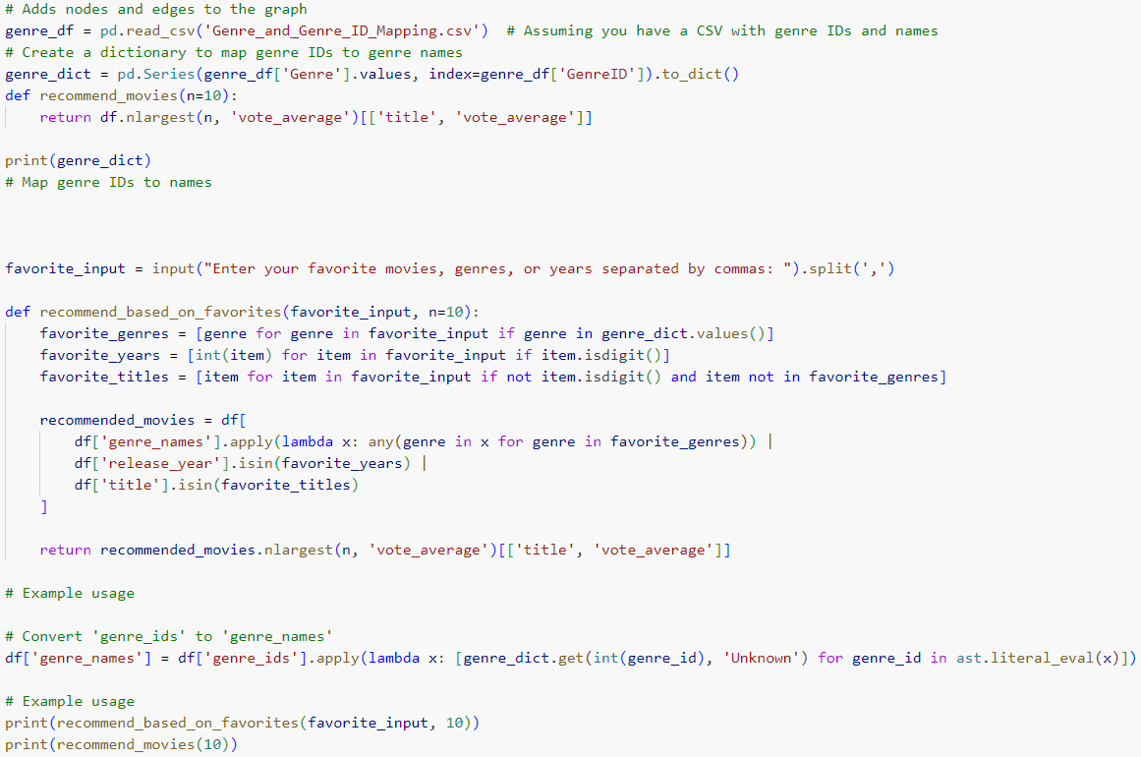
Task 7
Recommendation System Basics
In this step, we can analyze preferences by genre name, release year and title, and finally make recommendations based on ratings and popularity.

Slide 18
Extra Content:
Graphical Interface of the recommendation system
Reporter: Haoyuan Jiang

Slide 20
Thanks for watching

