Slide 1
Word
uDev
Kernel
Userland

Slide 2
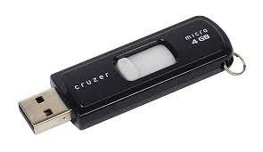
Word
uDev
Kernel
Userland

Slide 3
Word
uDev
Kernel
Userland

Slide 4
uDev
Kernel
Userland
8572

Slide 5
uDev
Kernel
Userland
8572

Slide 6
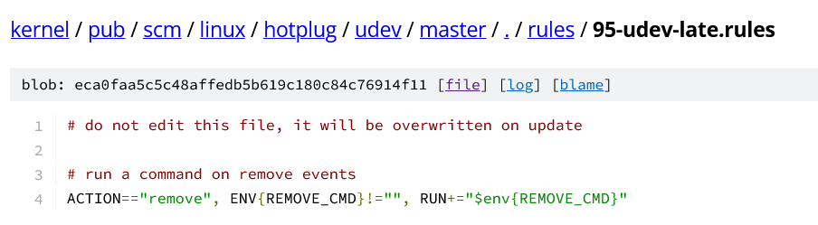
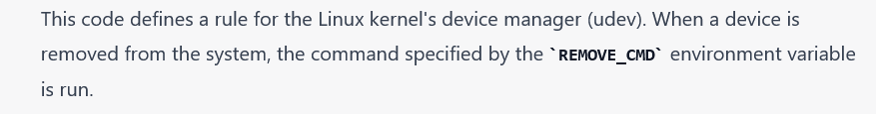
95uDev-late.rules

Slide 7
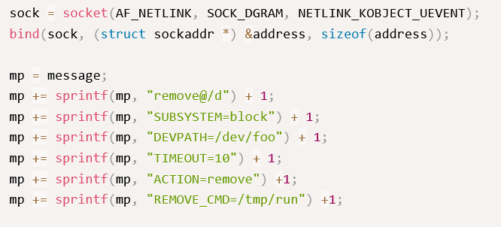
usr/share/exploitdb/exploits/linux/local/8572.c

Slide 8
uDev
Kernel
Userland
8572
root@/bin/bash

Slide 9
Hacks
Password cracking
DDoS
MITM
Mac Spoofing
Packet sniffing
DNS/ARP poisoning
Website cloning
Back doors (use, instillation)
SQL Injections
XXS
Privilege Escalation

Slide 10
Tools
Linux
nmap
Wireshark
John
Ettercap
Dig
Pi Rogue
Metasploit

