Slide 1

NY COVID-19 Data Warehouse & ETL
CS779 Term Project
Presented by: Jimmy Ma

Slide 2
Rapid insights into NY COVID-19 trends
Datasets:
Statewide testing by county
Fatalities by county
Fatalities by sex
Fatalities by age group
Raw CSV exports are cumbersome to query at scale. A well-designed star schema lets analysts slice and dice the data quickly
Motivation & Data Sources

Slide 3
ETL Pipeline Overview
Extract: CSV → tables in database
Load: MySQL dims & facts
Transform: Clean & dimension lookup

Slide 4
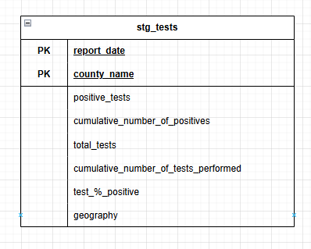
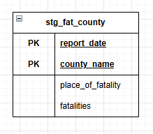
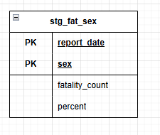
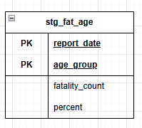
Staging & Normalized Schema
Staging Tables (3NF):

Slide 5
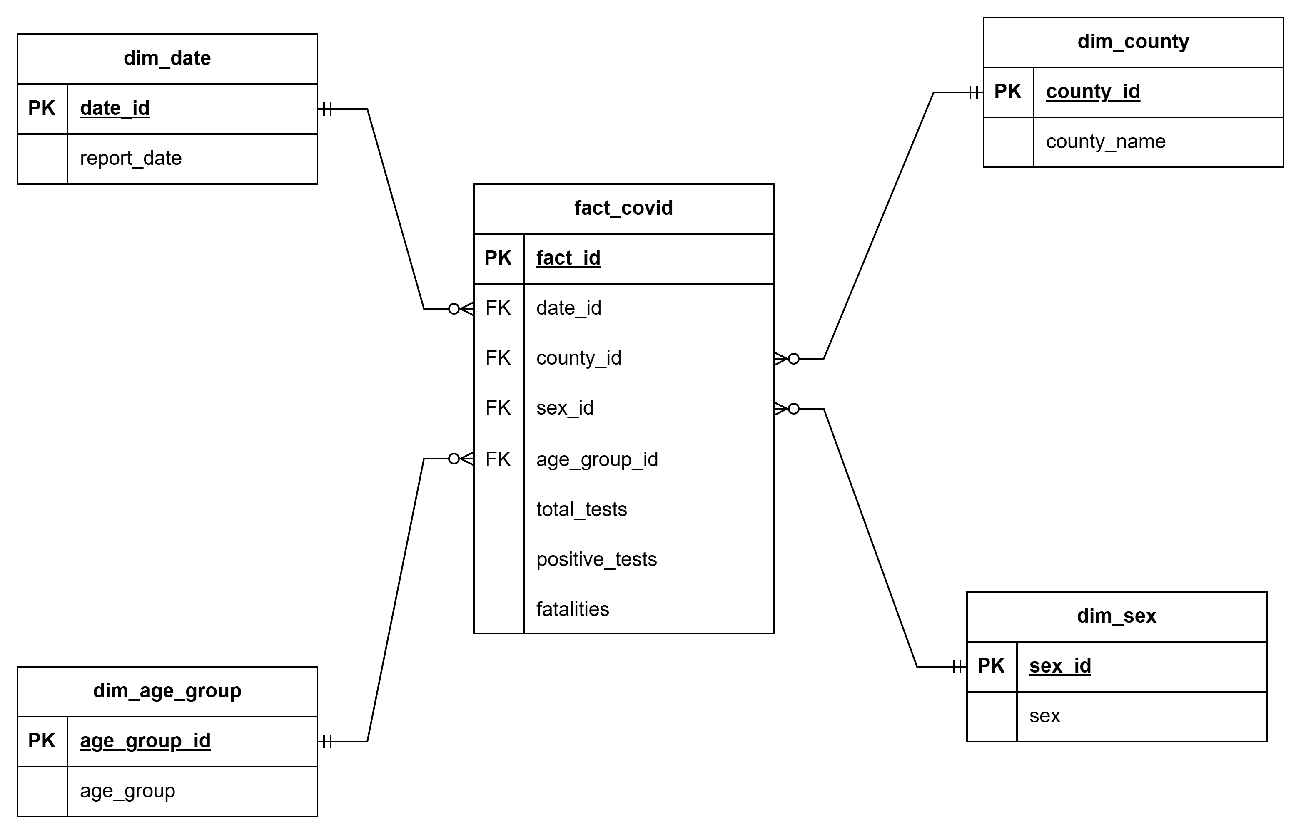
Dimensional Star Schema

Slide 6
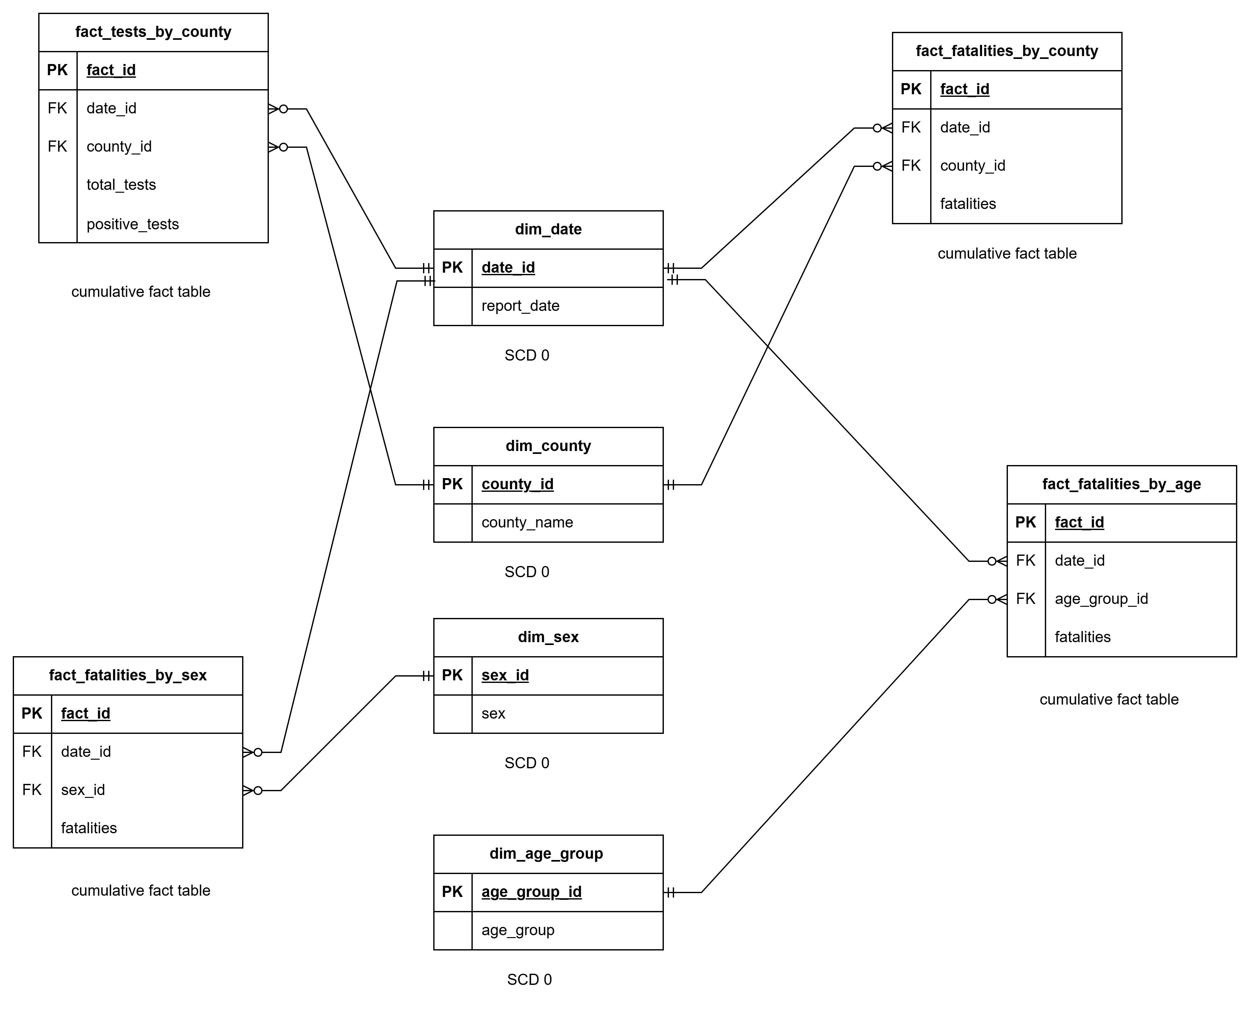
Constellation Schema

Slide 7

ETL Code Highlights
Dynamic CSV loading & renaming
Streaming inserts for facts
Dimension lookup maps
ON DUPLICATE KEY for dims

Slide 8
Lessons Learned
How to build a Datawharehouse
Star vs. constellation trade-offs
Don’t rely too much on AI

Slide 9

References
Apache Airflow on GitHub (https://github.com/apache/airflow): Date Posted: Initial release around May 2015 Date Accessed: March 18, 2025 This repository offers a mature, open-source platform for orchestrating complex ETL workflows, providing valuable insights into designing scalable ETL processes. Its comprehensive documentation and community examples serve as a practical guide for workflow management in data warehousing projects.
Kimball, R. & Ross, M. (2013). The Data Warehouse Toolkit: The Definitive Guide to Dimensional Modeling.
This book provides comprehensive methodologies for dimensional modeling that will guide my schema design. Its practical examples and best practices are directly applicable to building scalable data warehousing solutions.
Meltano on GitHub (https://github.com/meltano/meltano): Date Posted: Initial commit dated October 1, 2018 Date Accessed: March 18, 2025 Meltano is an open-source ELT platform that demonstrates best practices for building and managing data integration pipelines, which is essential for automating and scaling ETL processes. Its active community and detailed documentation make it a useful resource for understanding modern data integration techniques.

Slide 10

Thank you for listening

