Slide 1
A longtime analysis of resting-state fMRI data with DCM in MS patients
Translational Neuromodeling Spring2020

Slide 2
Overview
Introduction
First level DCM analysis
Spectral DCM
Regression DCM (rDCM)
Group level analysis
Parametric Empirical Bayes (PEB)
Results
Outlook

Slide 3
Introduction
Resting State fMRI study of the team of Fleischer et al.
12 MS patients & 12 Healthy Controls
MS: 5 sessions
HC: 2 sessions
4 Questions
Effect of Time ?
Effect of Disease ?
Effect of the Interaction between Time/Disease ?
Change of node strength over time ?
7 superordinate regions

Slide 4
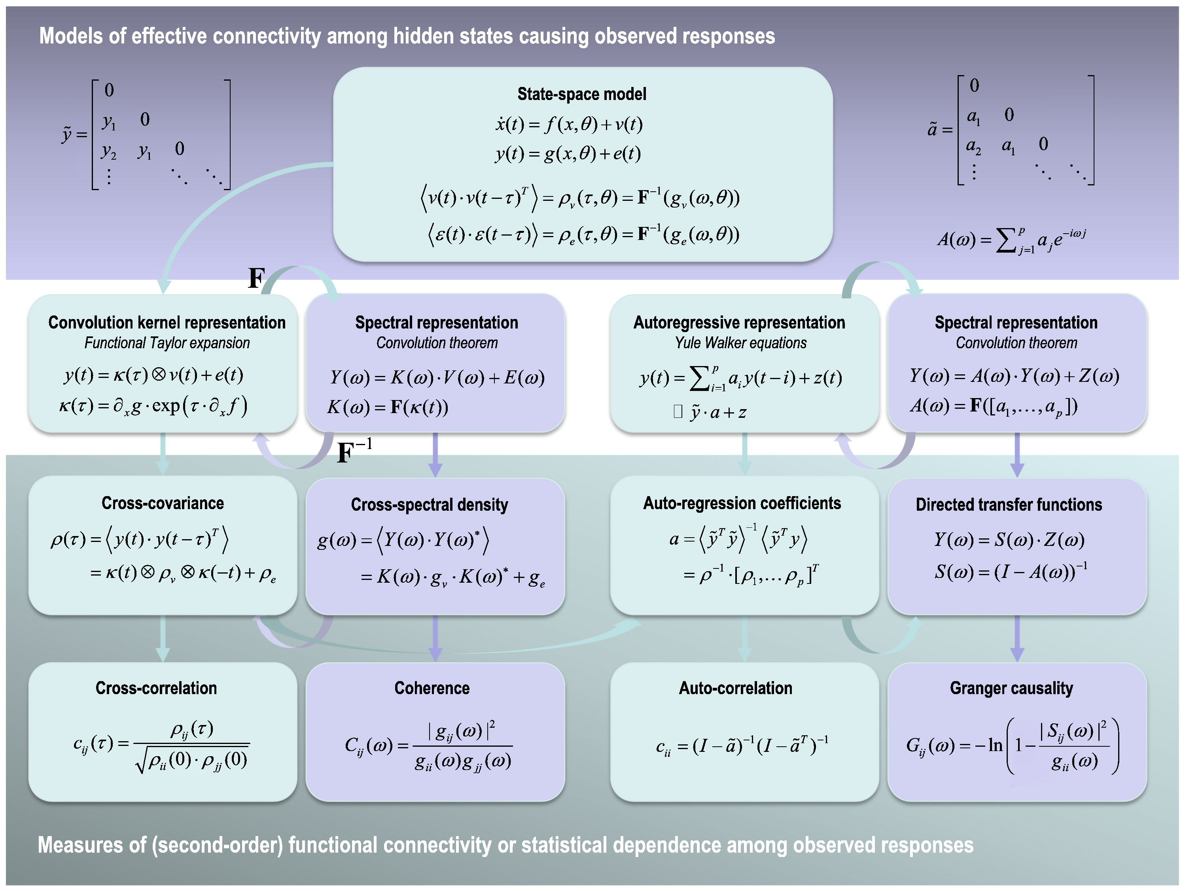
First level DCM analysis
Spectral DCM
- Fits the data in spectral domain, using cross spectral densities
- Computationally efficient
- Deterministic
- Well suited for resting state data

Slide 5
First level DCM analysis
Regression DCM
Converts the time series to a GLM in spectral domain with Fourier
Computationally efficient
Showed promising results wehn used for resting state analysis

Slide 6

Fully connected model
Parietal
Region
Frontal Lobe
Occipital Lobe
Prefrontal Lobe
Temporal Lobe
Deep Grey Matter Nuclei
Cerebellum

Slide 7
Model with only self connections
Parietal
Region
Frontal Lobe
Occipital Lobe
Prefrontal Lobe
Temporal Lobe
Deep Grey Matter Nuclei
Cerebellum

