Slide 1
Real-Time Face Recognition System
Shubham Jain AU1940315
Gaurav Bajaj AU1940169
Raj Chauhan AU1940215
Raj Gariwala AU1940118

Slide 2
Introduction
Face recognition is a method of identifying or verifying identity of an individual using their face.
Use Cases of Face recognition System -
Biometric Authentication
Public Safety Systems
Retail Store Systems
Criminal Identification and Tracking
And many more…
In the initial days, speed of face recognition was quite slow and was less accurate.
With the development of CNNs and Deep Learning models, accuracy and speed of such systems have greatly improved.

Slide 3
Problem Statement
Our aim is to solve the problem of face recognition in real time with high accuracy.
Real Time - recognizing faces live, using laptop webcam or cameras installed in a room.
Aim: Design a real-time face recognition system using a model capable of effectively identifying and recognizing person from cameras and videos.

Slide 4

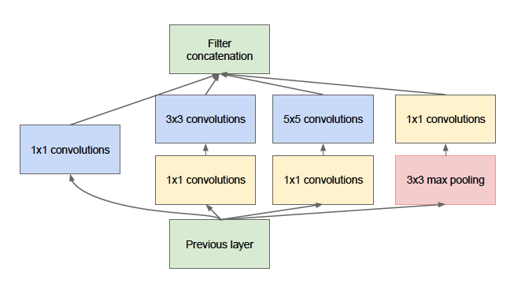
Existing Body Of Work
Deep Convolutional Neural Networks
What are Deep Convolutional Neural Networks?
Face Detection - Haar Cascade, MTCNN
Face Recognition - FaceNet (GoogleNet) , MobileNet V2
FaceNet - Inception Architecture
FaceNet trains CNNs using Stochastic Gradient Descent (SGD) with standard backprop and AdaGrad.
Complex model - low calculation speed, more parameters, and multiple layers.
There are 7.5M parameters in FaceNet while only 3.4M in MobileNet V2.
Fig-1 : FaceNet Architecture
Fig-2 : FaceNet Inception Module
Notes:
FaceNet uses deep convolutional neural network (CNN). The network is trained such that the squared L2 distance between the embeddings correspond to face similarity.
FaceNet, a face recognition system developed by Google, uses deep neural networks to map images to Euclidean space. It is based on the concept that the distance between pictures of similar people in Euclidean space is little, and the distance between pictures of different people in Euclidean space is huge. FaceNet has provided over 99% accuracy in the Labelled Faces in the Wild. The FaceNet basic architecture includes 5 blocks - the input layers (batch), the deep convolutional architecture,L2 normalization, leading to face embedding data, and lastly utilizing triplet loss to minimize the distance between similar faces.
The main idea behind Inception network architecture is that of using multiple filters of different sizes simultaneously. In any other traditional network architecture we usually choose a filter of let’s say size 3*3 , 5*5 etc, but in Inception architecture we use multiple filters simultaneously and concatenate their results.
In Fig 11 (a), we are using multiple filters of size 1*1, 3*3 and 5*5 along with a max pooling layer, and then we have concatenated the results. This is the main intuition behind Inception network architecture. The problem with this approach is that it is computationally very expensive. So, in order to avoid this problem we use 1*1 convolutions for dimensionality reduction. In Fig 11 (b), we will use a 1*1 filter with every other convolution in order to reduce dimensionality and make this architecture computationally feasible.
AdaGrad is used to generate variable learning rates. Fixed learning rates do not work well in deep learning. In case of CNNs where each layer is used to detect a different feature (edges, patterns etc.), a fixed learning will just not work, as different layers in our network require different learning rates to work optimally.
It is an optimisation technique that is used to optimise our loss function. The two axes (x and y) represent weights and the third axis (z) represents the loss with respect to those two weights.
Let’s call this red point as point A. We will start our journey from this point A. The intuition behind SGD is that we want to traverse this hill-like structure in such a way that we reach the global minima (lowest point of this hill). Now you might have understood the Descent part of SGD. So now let’s focus on the Gradient part.
Gradient just gives us the direction of the steepest ascent in a n- dimensional plane (similar to a derivative, which determines the slope of a line ).

Slide 5
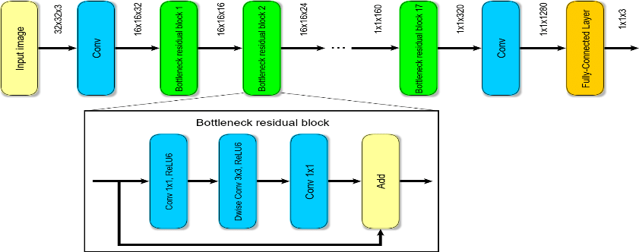
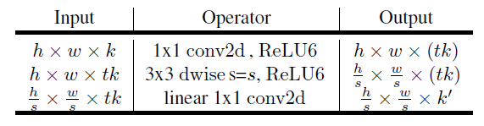
Existing Body Of Work
5. Why MobileNet V2 ?
A lightweight deep neural network, having separable convolutions layers and blocks.
Fast computation speed, low model size. Efficient and effective when implemented with architecture of FaceNet with Triplet Loss and Embeddings.
Convolution layers with 32 filters and 19 residual bottleneck layers.
7.5M parameters in FaceNet while only 3.4M in MobileNet V2.
There are two types of blocks:
residual block with stride of 1.
block with stride of 2 for downsizing.
There are 3 layers for both types of blocks.
1×1 convolution with ReLU6.
The depthwise convolution.
1×1 convolution but without any non-linearity.
Fig-3 : MobileNet V2 Architecture
Fig-4 : Bottleneck residual block
Notes:
MobileNet architecture seems to be a good fit as it is a lightweight deep neural network, built upon deep separable convolutions layers and blocks. Its fast computation speed and low model size makes it the most practical model for real-time face recognition. It consists of convolution layers with about 32 filters along with 19 residual bottleneck layers. Moreover, we can see that there are 7.5M parameters in FaceNet while only 4.2M in MobileNet V2.
A good fit as it is a lightweight deep neural network, built upon deep separable convolutions layers and blocks.
Its fast computation speed and low model size makes it the most practical model for real-time face recognition.
It consists of convolution layers with about 32 filters along with 19 residual bottleneck layers.
Moreover, we can see that there are 7.5M parameters in FaceNet while only 3.4M in MobileNet V2.
In MobileNetV2, there are two types of blocks. One is residual block with stride of 1. Another one is block with stride of 2 for downsizing. There are 3 layers for both types of blocks. This time, the first layer is 1×1 convolution with ReLU6. The second layer is the depthwise convolution. The third layer is another 1×1 convolution but without any non-linearity. It is claimed that if ReLU is used again, the deep networks only have the power of a linear classifier on the non-zero volume part of the output domain. And there is an expansion factor t. And t=6 for all main experiments. If the input got 64 channels, the internal output would get 64×t=64×6=384 channels.

Slide 6
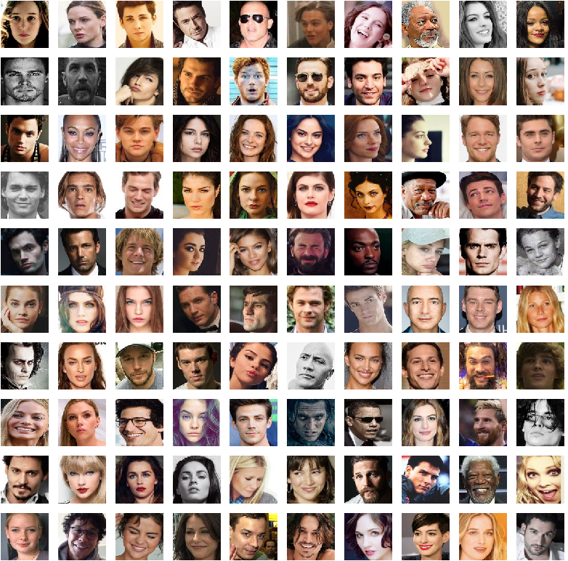
Approach
Dataset
105_classes_pins available at Kaggle
105 celebrities, 17534 faces
Well cropped and labelled so less amount of pre-processing
Model Used
MobileNetV2 (Developed by Google team)
Why?
Provides High performance architecture with hyperparameters.
Model is relatively smaller than other models
Provides high computation speed which makes it fit for real time applications
Initial approach is to train the model using the dataset and experience how it classifies images.
Fig-5. Some faces from dataset

Slide 7
Approach
Preparing Dataset for Training
Splitted the dataset into training and testing in the ratio 4:1 with proper shuffling.
For generalizability of the model, we aimed at introducing random transformations in batch of training samples.
Random Transformations like - scaling, rotation, shearing, etc.
For this, ImageDataGenerator function of Keras library was used.

Slide 8
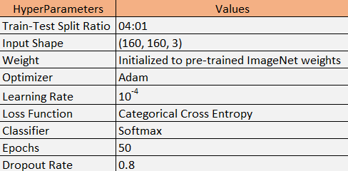
Approach
Training the Model
MobileNetV2 is trained using Transfer Learning.
Pre-trained weights from ImageNet are used for the already present layers.
Unfreezed all the pre-trained layers to re-train them for our dataset.
Extra Layers are added - Global Average Pooling, Dropout and a Dense Layer for classifying into 105 classes.
Model is compiled with loss function as categorical cross-entropy and optimizer as Adam (10⁻⁴)
Model is fitted over the data by running through 50 epochs.
Fig-6. Hyperparameters

Slide 9
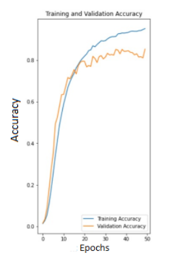
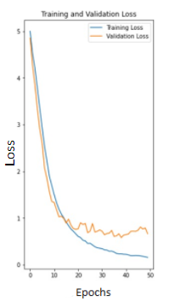
Initial Results
The Accuracy Vs Epoch graph (Fig. 7) suggests that Training and Validation Accuracy increases with increase in Epochs.
The Loss vs Epoch graph (Fig. 8) suggests that Loss of both data decreases with increase in Epochs.
Our model is training and learning well, but as we can see from the graphs there is overfitting observed.
Results:
Training accuracy: 95%
Training loss: 18%
Validation accuracy: 85%
Validation loss: 62%
Fig-7. Accuracy vs Epoch
Fig-8. Loss vs Epoch

Slide 10
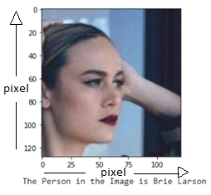
Initial Results
Tested if our model was working well with the classification.
Took a picture of “Brie Larson” from internet.
Fetched the image to the model for classification.
Trained model successfully classified and recognized the image of actress “Brie Larson”.
The model was able to classify and recognize the image well even though face was not clearly visible and pose was different (not towards the camera)
Fig-9. Successful recognition/classification of static image by the model

Slide 11
Role Of Each Group Member In The Project
Raj Gariwala - Literature Reviews, Generating Results and Testing images on the model
Raj Chauhan - Literature Review, Training Data Augmentation
Gaurav Bajaj - Literature Reviews, Dataset Splitting into Train and Test Sets
Shubham Jain - Literature reviews, Model Training and Fitting, Triplet Loss

Slide 12
Constraints on Face Recognition
Illuminations: The images taken from real-time may have high or low illuminations or shadows. This may result in no or false face detection in real-time.
Distance: An important factor while detecting faces in real-time can be the distance of the camera from the face. If the distance is large, the human face might appear smaller in the camera.
Orientation: Orientation of the human face and the angle to the camera impacts the rate of face detection and recognition in real-time.
Face Occlusion: In some images, human faces may be partially hidden by objects like glasses, hats, hairs, scarves, masks, etc. This affects the detection and recognition rate of a face.

Slide 13
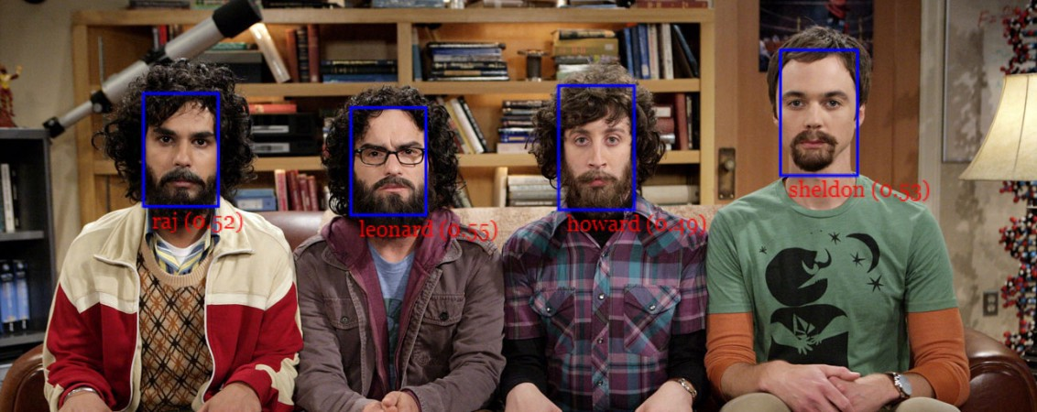
Future Work
Fig-10. Real-time face recognition desired final result
Further develop this system for face recognition in real-time, i.e., through webcam and videos.
For this, we are planning to add a DNN layer of 128 dimensionality and train the model with triplet loss as the loss function.
Once the model is trained, we would store the 128D embeddings (feature vector) for all the images in the dataset.
For new faces to add to the system, we just need to run them through the model, generate their embeddings and store them along with others already stored (no need to re-train model for new faces).
We would capture and detect person’s image from webcam using an appropriate face detection algorithm and generate its 128D embedding from the model.
Comparison would be made between its embedding and embeddings stored of the dataset using similarity measures like L2 distance or Cosine Similarity. In this way, we are aiming to recognize images in real-time.
If time permits, we would aim to extend this system as an Attendance counting system.

Slide 14
References
X. Xu, M. Du, H. Guo, J. Chang, and X. Zhao, “Lightweight FaceNet based on mobilenet,” International Journal of Intelligence Science, 01-Dec-2020. [Online]. Available: https://www.scirp.org/journal/paperinformation.aspx?paperid=104599. [Accessed: 20-Mar-2022].
“Face recognition,” Electronic Frontier Foundation, 15-Feb-2021. [Online]. Available: https://www.eff.org/pages/face-recognition. [Accessed: 20-Mar-2022].
“Why is facial recognition important - 5 key benefits - NEC New Zealand,” NEC, 26-Jan-2021. [Online]. Available: https://www.nec.co.nz/market-leadership/publications-media/why-is-facial-recognition-important-5-key-benefits/. [Accessed: 20-Mar-2022].
S. Ghosh, “How to create a face recognition model using FaceNet Keras?,” Medium, 10-Jul-2020. [Online]. Available: https://medium.com/clique-org/how-to-create-a-face-recognition-model-using-facenet-keras-fd65c0b092f1. [Accessed: 20-Mar-2022].
D. Kumar, “Introduction to facenet : A unified embedding for face recognition and clustering,” Medium, 21-Jun-2020. [Online]. Available: https://medium.com/analytics-vidhya/introduction-to-facenet-a-unified-embedding-for-face-recognition-and-clustering-dbdac8e6f02. [Accessed: 20-Mar-2022].
S.-H. Tsang, “Review: MOBILENETV2 - light weight model (image classification),” Medium, 01-Aug-2019. [Online]. Available: https://towardsdatascience.com/review-mobilenetv2-light-weight-model-image-classification-8febb490e61c#:~:text=MobileNetV2%20Overall%20Architecture&text=In%20typical%2C%20the%20primary%20network,and%20uses%203.4%20million%20parameters. [Accessed: 20-Mar-2022].
Mark Sandler, “MobileNetV2: Inverted Residuals and Linear Bottlenecks”, Cornell University, 21st March 2019. [Online] Available:https://arxiv.org/abs/1801.04381v4 [Accessed: 20-Mar-2022]

