Slide 1
Real-Time Face Recognition System
Shubham Jain AU1940315
Raj Chauhan AU1904215
Raj Gariwala AU1940118
Gaurav Bajaj AU1940169

Slide 2
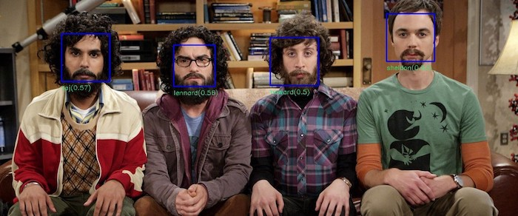
Introduction
Face Recognition: method of identifying or verifying and individual using their face.
In the initial days, speed of face recognition was quite slow and was less accurate. With the development of CNNs and Deep Learning models, accuracy and speed of such systems have greatly improved.
Use cases: Biometric Authentication, Public safety systems, retail store systems, criminal Identification and tracking, etc.
https://towardsdatascience.com/real-time-mobile-video-object-detection-using-tensorflow-a75fa0c5859d https://www.eff.org/pages/face-recognition

Slide 3
Problem Statement
Aim: Solve the problem of Real-Time Face recognition cross-platform
Metrics to evaluate performance: Speed and Accuracy
Real-time in the sense that recognizing faces live from mobile or laptop webcams (with more priority towards mobile devices as these are constrained in terms of memory and RAM)

Slide 4
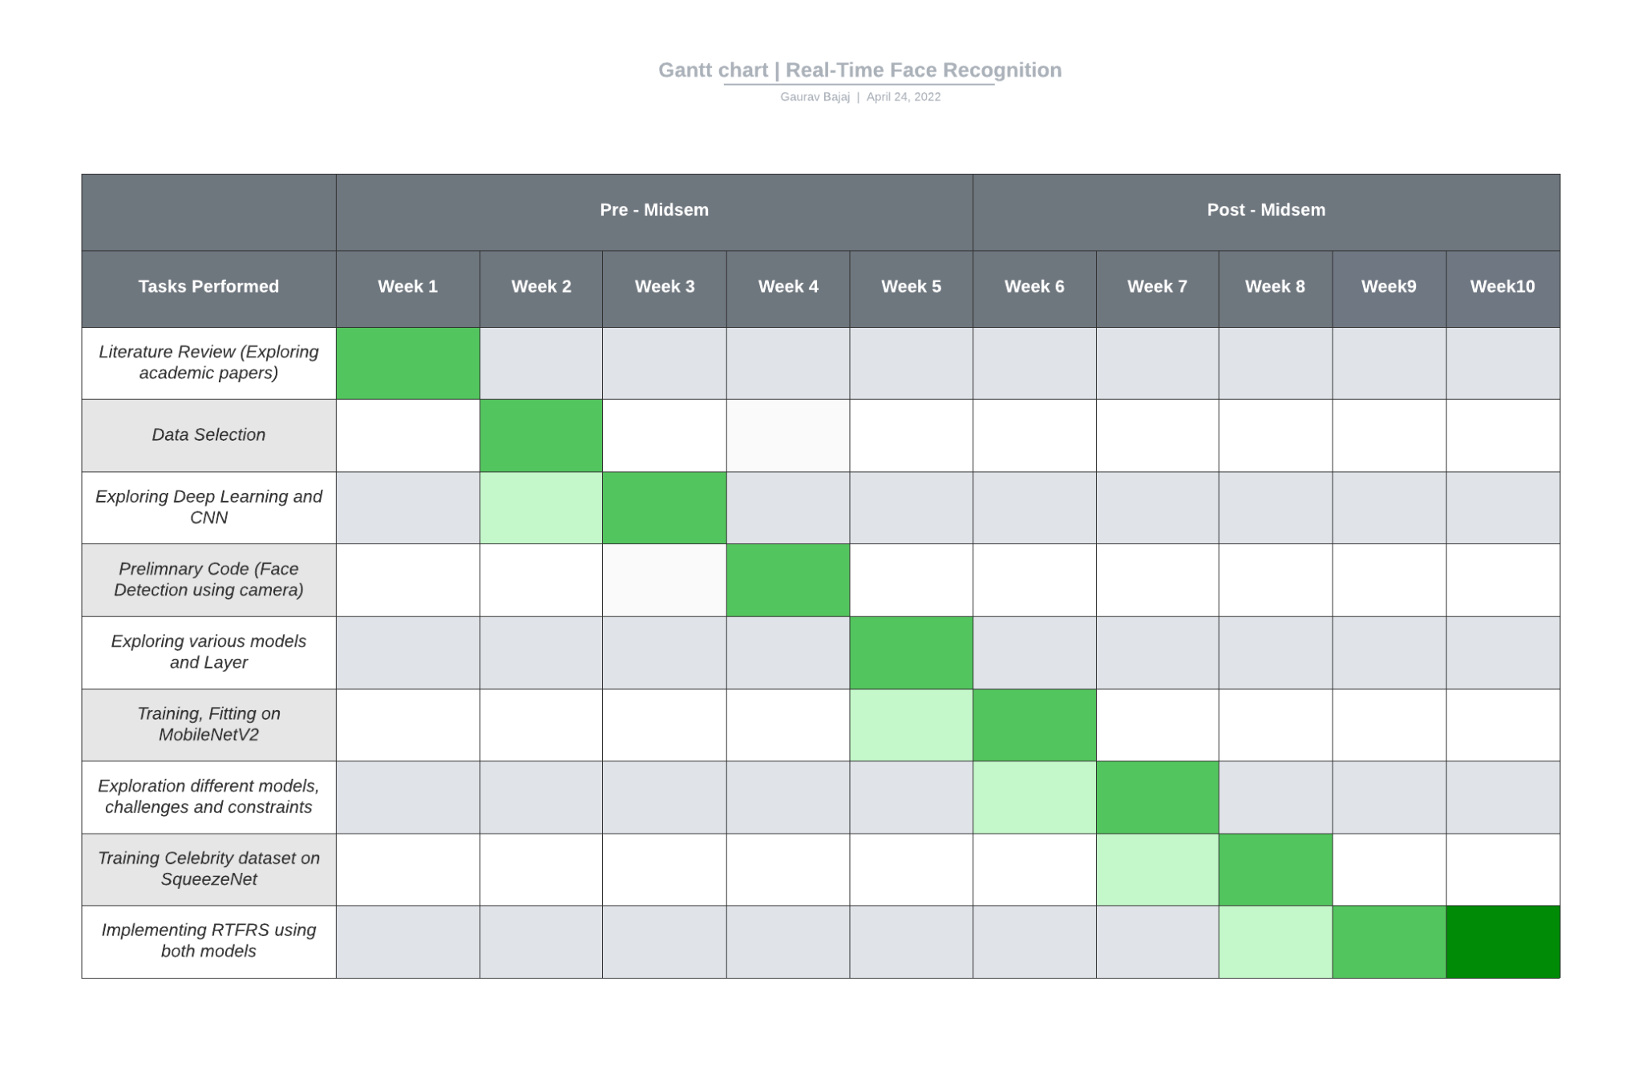
GANTT Chart

Slide 5
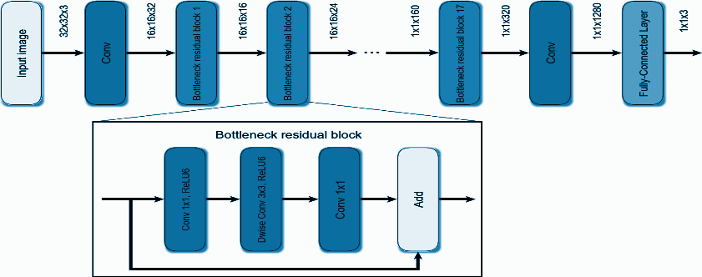
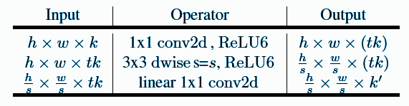
Existing Body Of Work
MobileNet V-2:
A 53-layered deep CNN having separable convolutions layers and blocks.
3 layers for both blocks are:
1x1 convolution with ReLU6.
The depthwise convolution.
1x1 convolution but without any non-linearity.
Convolution layers with 32 filters and 19 residual bottleneck layers.
Block output collected at bottleneck residual block.
If stride=2 residual connection will not occur.
Fig. MobileNet V-2 Architecture
A. Michele, V. Colin, and D. D. Santika, “MobileNet convolutional neural networks and support vector machines for Palmprint recognition,” Procedia Computer Science, 01-Oct-2019. [Online]. Available: https://www.sciencedirect.com/science/article/pii/S1877050919310658. [Accessed: 24-Apr-2022].
Fig. Bottleneck residual block
Notes:
References:
A. Michele, V. Colin, and D. D. Santika, “MobileNet convolutional neural networks and support vector machines for Palmprint recognition,” Procedia Computer Science, 01-Oct-2019. [Online]. Available: https://www.sciencedirect.com/science/article/pii/S1877050919310658. [Accessed: 24-Apr-2022].
S.-H. Tsang, “Review: MOBILENETV2 - light weight model (image classification),” Medium, 01-Aug-2019. [Online]. Available: https://towardsdatascience.com/review-mobilenetv2-light-weight-model-image-classification-8febb490e61c#:~:text=MobileNetV2%20Overall%20Architecture&text=In%20typical%2C%20the%20primary%20network,and%20uses%203.4%20million%20parameters. [Accessed: 24-Apr-2022].

Slide 6
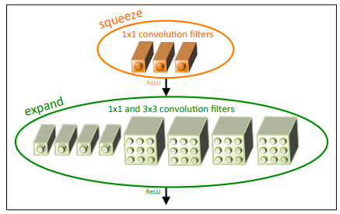
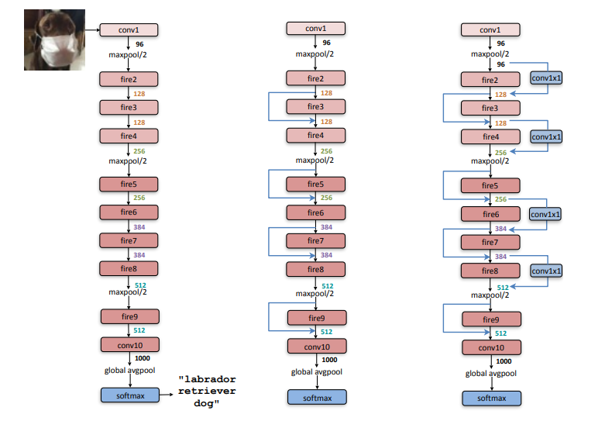
Existing Body Of Work
SqueezeNet:
AlexNet level accuracy and 50x fewer parameters.
Model size: <=0.5 MB
Architectural Design Strategies:
Replacing 3x3 filters with 1x1 filters.
Decreasing number of input channels to 3x3 filters.
Late Downsampling, so convolution layers have large activation maps.
Fire Module: squeezed convolution layer having only 1x1 filters. It feeds to an expand layer having 1x1 and 3x3 convolution filters.
Architecture: convolution layer(conv1), 8 fire modules (fire 2-9) and final convolution layer (conv10).
Fig. Fire Module
F. N. Iandola, S. Han, M. W. Moskewicz, K. Ashraf, W. J. Dally, and K. Keutzer, “Squeezenet: Alexnet-level accuracy with 50X ... - arxiv.org,” SqueezeNet: AlexNet-level accuracy with 50x fewer parameters and &lt;0.5MB model size, 2017. [Online]. Available: https://arxiv.org/pdf/1602.07360v3.pdf. [Accessed: 24-Apr-2022].
Fig. Macro Architectural view of SqueezeNet

Slide 7
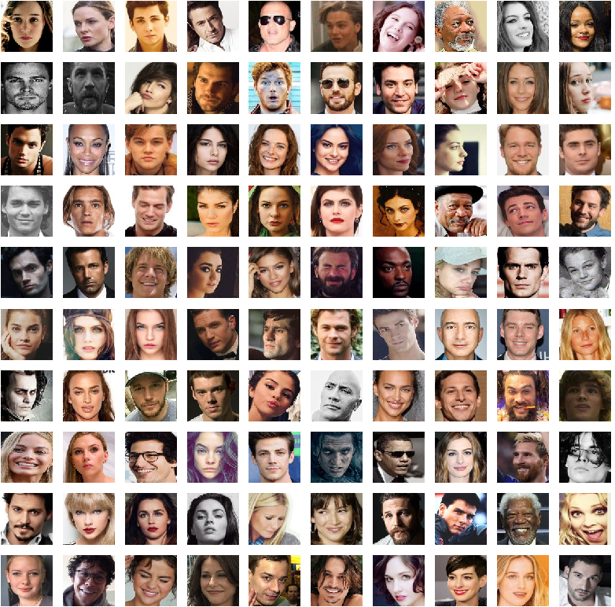
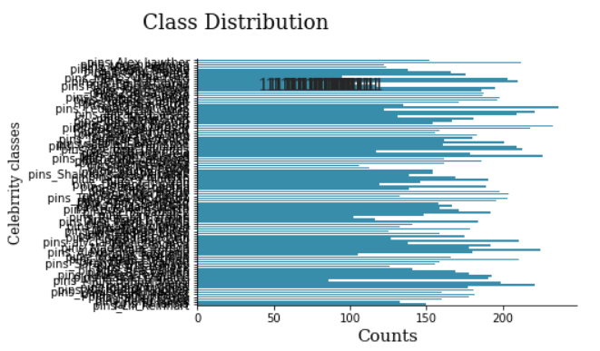
Approach
Comparison between 2 models - MobileNetV2 and SqueezeNet.
Metrics to look after - speed and accuracy.
Dataset - 105_celeb_pins dataset.
Available over Kaggle
17534 images, 105 celebrities classes
Well-cropped and Well-labelled images
Fig. Sample Images from Dataset
https://www.kaggle.com/datasets/hereisburak/pins-face-recognition
Fig. Face Class Distribution Analysis

Slide 8
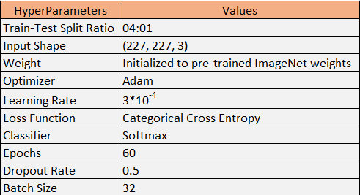
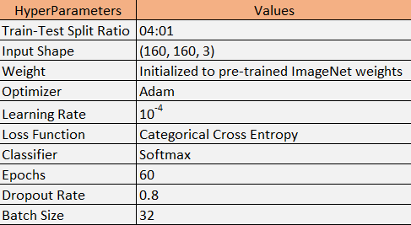
Approach
Split the dataset into 4:1 ratio
Data Augmentation to prevent overfitting
Initialized Models with ImageNet weights
Monitored accuracy and loss over 60 epochs.
Results are provided in Results section.
Fig. Squeezenet Model Hyperparameters
https://github.com/rcmalli/keras-squeezenet
https://blog.roboflow.com/how-to-train-mobilenetv2-on-a-custom-dataset/
Fig. MobilenetV2 Model Hyperparameters

Slide 9
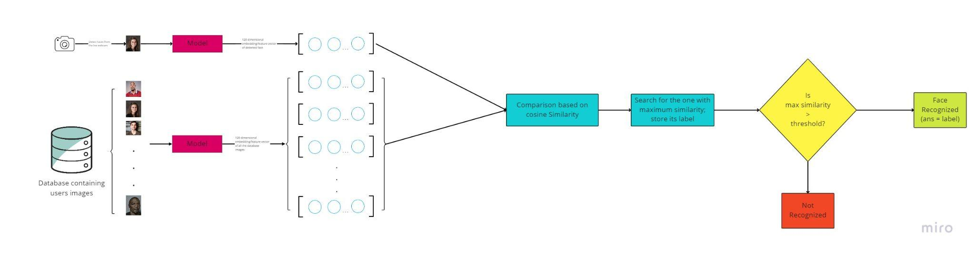
Approach
Replace the last classification layer with 120 dimension Dense layer for obtaining feature vector.
Generate Feature vector for images in the database.
Face Detection using Haar Cascade.
Generate Feature vector for the faces detected from the image.
Compare the feature vector of detected face and those of database faces using cosine similarity.
If max similarity is less than threshold, then it’s an unrecognized face, else display the label of most similar vector as the answer.
Fig. Face Recognition Process Flow
https://towardsdatascience.com/face-detection-with-haar-cascade-727f68dafd08

Slide 10
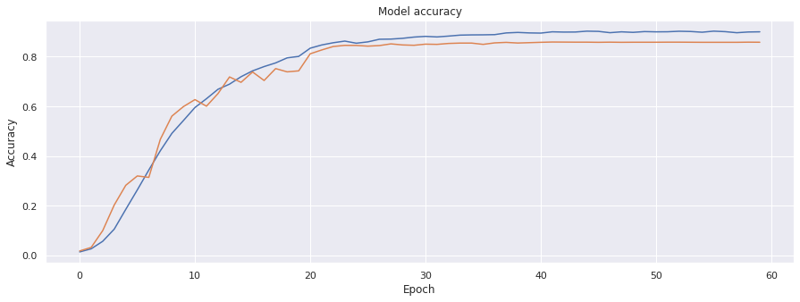
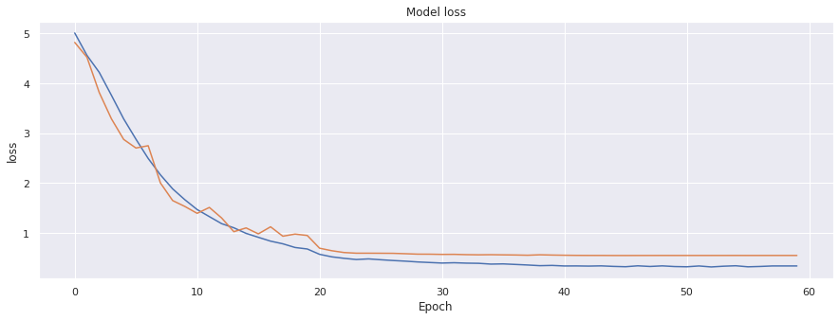
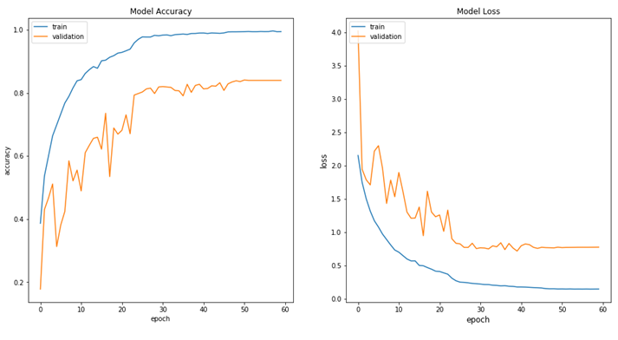
Final Results
Fig: MobiletNetV2 accuracy vs epoch
Fig: MobiletNetV2 loss vs epoch
 | Training Accuracy | Training Loss | Validation Accuracy | Validation Loss
MobileNetV2 | 90 | 3 | 85 | 5
Notes:
When the dataset was trained on the models, these were the data we got. There were some overfitting, but the levels of the overfitting were very less or negligible, and you can notice that
Compared to mid semester, Over-fitting was reduced significantly , by adding more dataset and adding drop out layers.

Slide 11
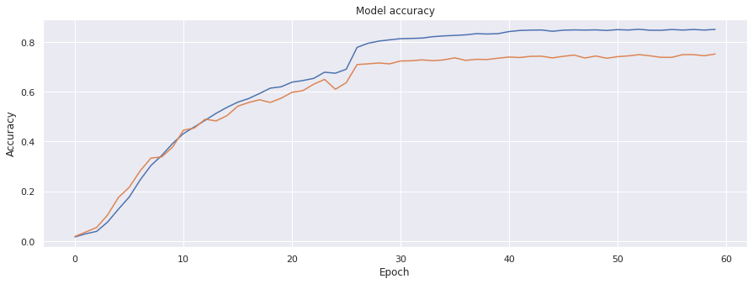
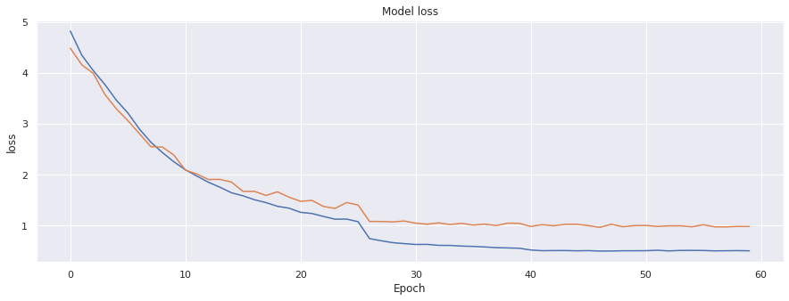
Final Results
Fig: SqueezeNet accuracy vs epoch
Fig: SqueezeNet loss vs epoch
 | Training Accuracy | Training Loss | Validation Accuracy | Validation Loss
SqueezeNet | 85 | 3 | 75 | 10

Slide 12
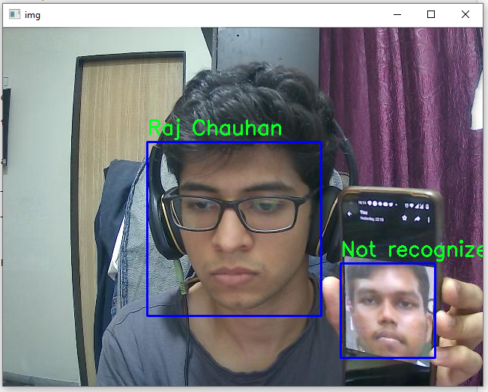
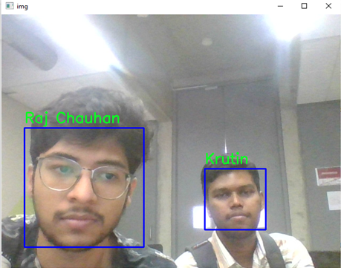
Final Results
MobileNetV2
Tested using MobileNetV2 Model.
Input size is 160x160.
False Positives and Low Accuracy.
Requires more thresholding.
SqueezeNet
Tested using SqueezeNet Model.
Input size are 227x227.
Slow but Accurate.
Requires less Thresholding.
Fig. MobileNetV2 - RTFRS
Fig: SqueezeNet
Real Time Face Recognition

Slide 13
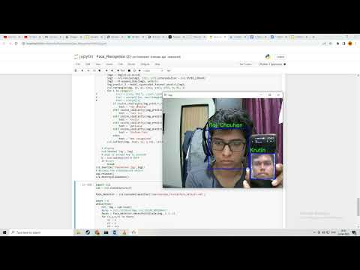
Final Results
Video: Real Time Face Recognition Demonstration

Slide 14
Conclusions
SqueezeNet performs better in terms of latency, accuracy and efficiency.
Makes feasible option to use it in Real Time Face Recognition.
How could our System be made more efficient and accurate ?
Triplet Loss
Setting appropriate thresholding after experimenting
Solved Distance Problem.
What are our group’s inferences and learning?
Notes:
Which is better model in order to implement SqueezeNet model.

Slide 15
Role Of Each Member
Group Member | Literature Review | PPT & Report | SqueezeNet Training | MobiletNetV2 Training | Face Detection Study and Implementation | Implementing Real Time FR in MobileNet | Implementing Real Time FR in Squeezenet | Generating Results
Gaurav Bajaj | ✅ | ✅ | ✅ |  | ✅ | ✅
Shubham Jain | ✅ | ✅ | ✅ |  | ✅ | ✅ |  | ✅
Raj Chauhan | ✅ | ✅ |  | ✅ | ✅ |  | ✅ | ✅
Raj Gariwala | ✅ | ✅ |  | ✅ | ✅ |  | ✅

Slide 16
References
X. Xu, M. Du, H. Guo, J. Chang, and X. Zhao, “Lightweight FaceNet based on mobilenet,” International Journal of Intelligence Science, 01-Dec-2020. [Online]. Available: https://www.scirp.org/journal/paperinformation.aspx?paperid=104599. [Accessed: 20-Mar-2022].
“Face recognition,” Electronic Frontier Foundation, 15-Feb-2021. [Online]. Available: https://www.eff.org/pages/face-recognition. [Accessed: 20-Mar-2022].
“Why is facial recognition important - 5 key benefits - NEC New Zealand,” NEC, 26-Jan-2021. [Online]. Available: https://www.nec.co.nz/market-leadership/publications-media/why-is-facial-recognition-important-5-key-benefits/. [Accessed: 20-Mar-2022].
S. Ghosh, “How to create a face recognition model using FaceNet Keras?,” Medium, 10-Jul-2020. [Online]. Available: https://medium.com/clique-org/how-to-create-a-face-recognition-model-using-facenet-keras-fd65c0b092f1. [Accessed: 20-Mar-2022].
D. Kumar, “Introduction to facenet : A unified embedding for face recognition and clustering,” Medium, 21-Jun-2020. [Online]. Available: https://medium.com/analytics-vidhya/introduction-to-facenet-a-unified-embedding-for-face-recognition-and-clustering-dbdac8e6f02. [Accessed: 20-Mar-2022].
S.-H. Tsang, “Review: MOBILENETV2 - light weight model (image classification),” Medium, 01-Aug-2019. [Online]. Available: https://towardsdatascience.com/review-mobilenetv2-light-weight-model-image-classification-8febb490e61c#:~:text=MobileNetV2%20Overall%20Architecture&text=In%20typical%2C%20the%20primary%20network,and%20uses%203.4%20million%20parameters. [Accessed: 20-Mar-2022].
Mark Sandler, “MobileNetV2: Inverted Residuals and Linear Bottlenecks”, Cornell University, 21st March 2019. [Online] Available:https://arxiv.org/abs/1801.04381v4 [Accessed: 20-Mar-2022]
S.-H. Tsang, “Review: MOBILENETV2 - light weight model (image classification),” Medium, 01-Aug-2019. [Online]. Available: https://towardsdatascience.com/review-mobilenetv2-light-weight-model-image-classification-8febb490e61c#:~:text=MobileNetV2%20Overall%20Architecture&text=In%20typical%2C%20the%20primary%20network,and%20uses%203.4%20million%20parameters. [Accessed: 24-Apr-2022].
F. N. Iandola, S. Han, M. W. Moskewicz, K. Ashraf, W. J. Dally, and K. Keutzer, “Squeezenet: Alexnet-level accuracy with 50X ... - arxiv.org,” SqueezeNet: AlexNet-level accuracy with 50x fewer parameters and &lt;0.5MB model size, 2017. [Online]. Available: https://arxiv.org/pdf/1602.07360v3.pdf. [Accessed: 24-Apr-2022].

