Slide 1


Q&A Chatbot with Specific data Using RAG
Team members:
Mohamed Gamal Abdul Raheem (21043005)
Mahmoud Mohamed AbdelHady (21024766)
Mostafa AbdelRaheem Mostafa (21002901)
Youssef Mohamed Moftah (21050236)
Ahmed Mohamed Ahmed (21005658)

Slide 2
Agenda
Introduction
What is Retrieval-Augmented Generation (RAG)?
Problems Solved by RAG
Key Concepts and Terminology
How the RAG App Works
NLP Cycle Overview
Streamlit and User Interaction
Code demonstration
Azure Services for Scalability
Challenges Encountered
Future Work
Conclusion

Slide 3
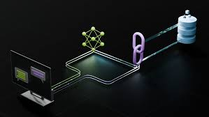
Introduction
Brief Overview:
Built a RAG (Retrieval-Augmented Generation) app.
Users can upload PDFs and ask interactive questions.
The app maintains chat history and provides context-rich responses.

Slide 4
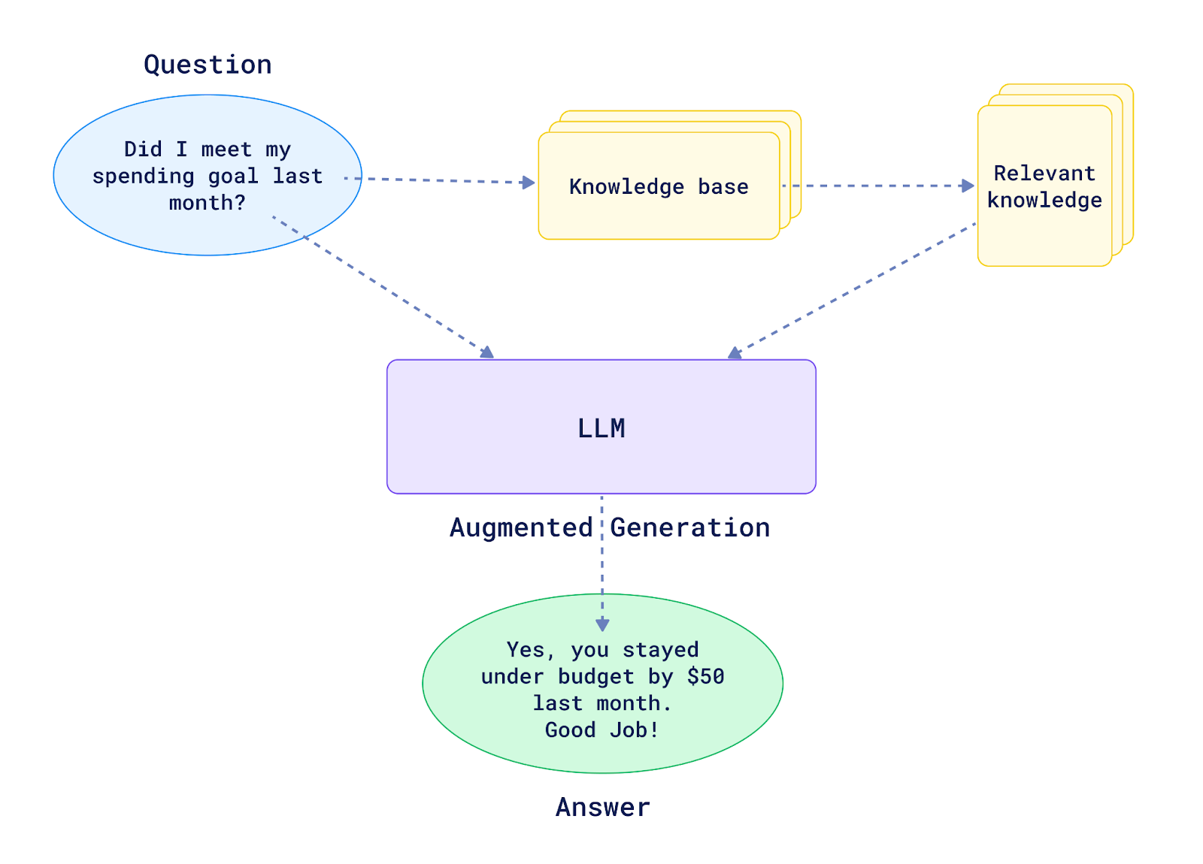
What is RAG?
RAG stands for Retrieval Augmented Generation:
Retrieval - Seeking relevant information from a source given a query. For example, getting relevant passages of Wikipedia text from a database given a question.
Augmented - Using the relevant retrieved information to modify an input to a generative model (e.g. an LLM).
Generation - Generating an output given an input. For example, in the case of an LLM, generating a passage of text given an input prompt.

Slide 5
Why Using RAG?
Main Goal:
The main goal of RAG is to improve the generation outputs of LLMs.
Preventing hallucinations - LLMs are incredible but they are prone to potential hallucination, as in, generating something that looks correct but isn't. RAG pipelines can help LLMs generate more factual outputs by providing them with retrieved inputs.
Work with custom data - Many LLMs are trained with internet-scale text data. however, they often lack specific knowledge. RAG systems can provide LLMs with domain-specific data.

Slide 6
Use cases of RAG?
Use Cases:
Question and Answering System.
Document Summarization.
Customer support, academic research, Product Recommendations.

Slide 7
How It Works
Step-by-Step:
User uploads PDF.
App splits the text into chunks and creates embeddings.
Embeddings stored in a vector database.
User queries → Relevant documents retrieved → LLM generates a response.

Slide 8
NLP Cycle Overview
NLP Cycle:
Text Preprocessing.
Embedding Generation.
Similarity Search.
Language Generation.
How RAG Uses NLP: Each query follows this cycle to return a contextually rich response.

Slide 9
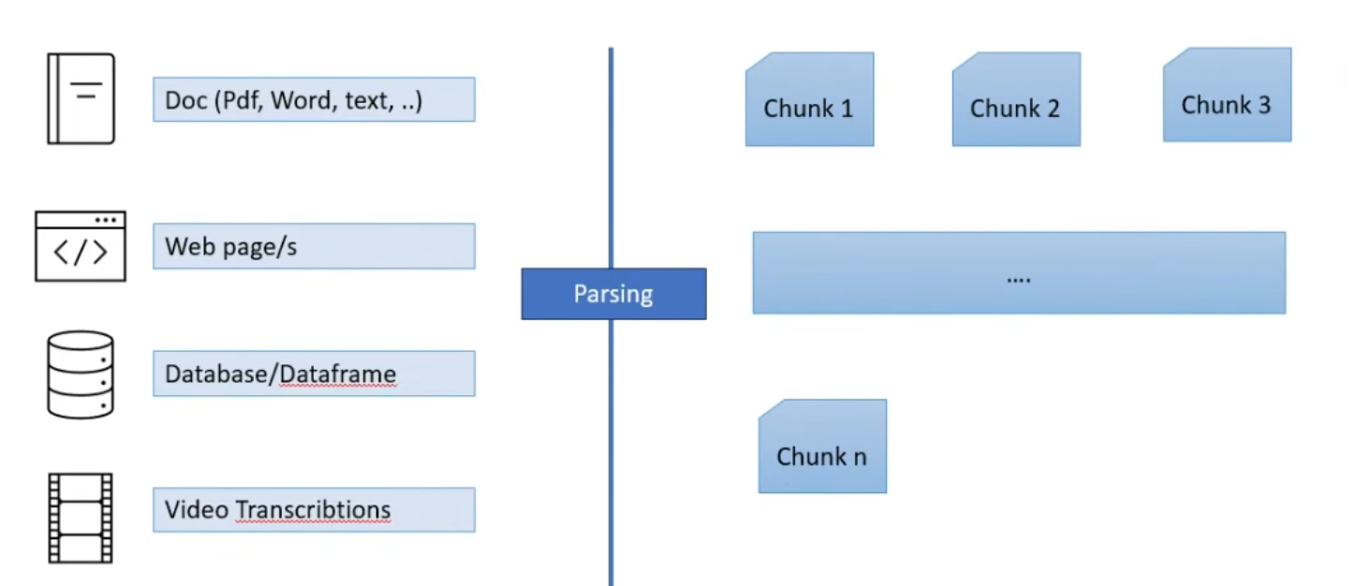
Architecture and System Flow
Data Parsing
Objective: Parse and prepare raw data for efficient processing and retrieval.
Step 1: Load data from various sources (e.g., PDFs, text files, CSVs).
Step 2: Preprocess the data:
Clean the text (remove noise, special characters).
Tokenize the data (split text into sentences, words, or tokens).
Step 3: Chunking the data:
Split the preprocessed data into smaller, manageable chunks.

Slide 10
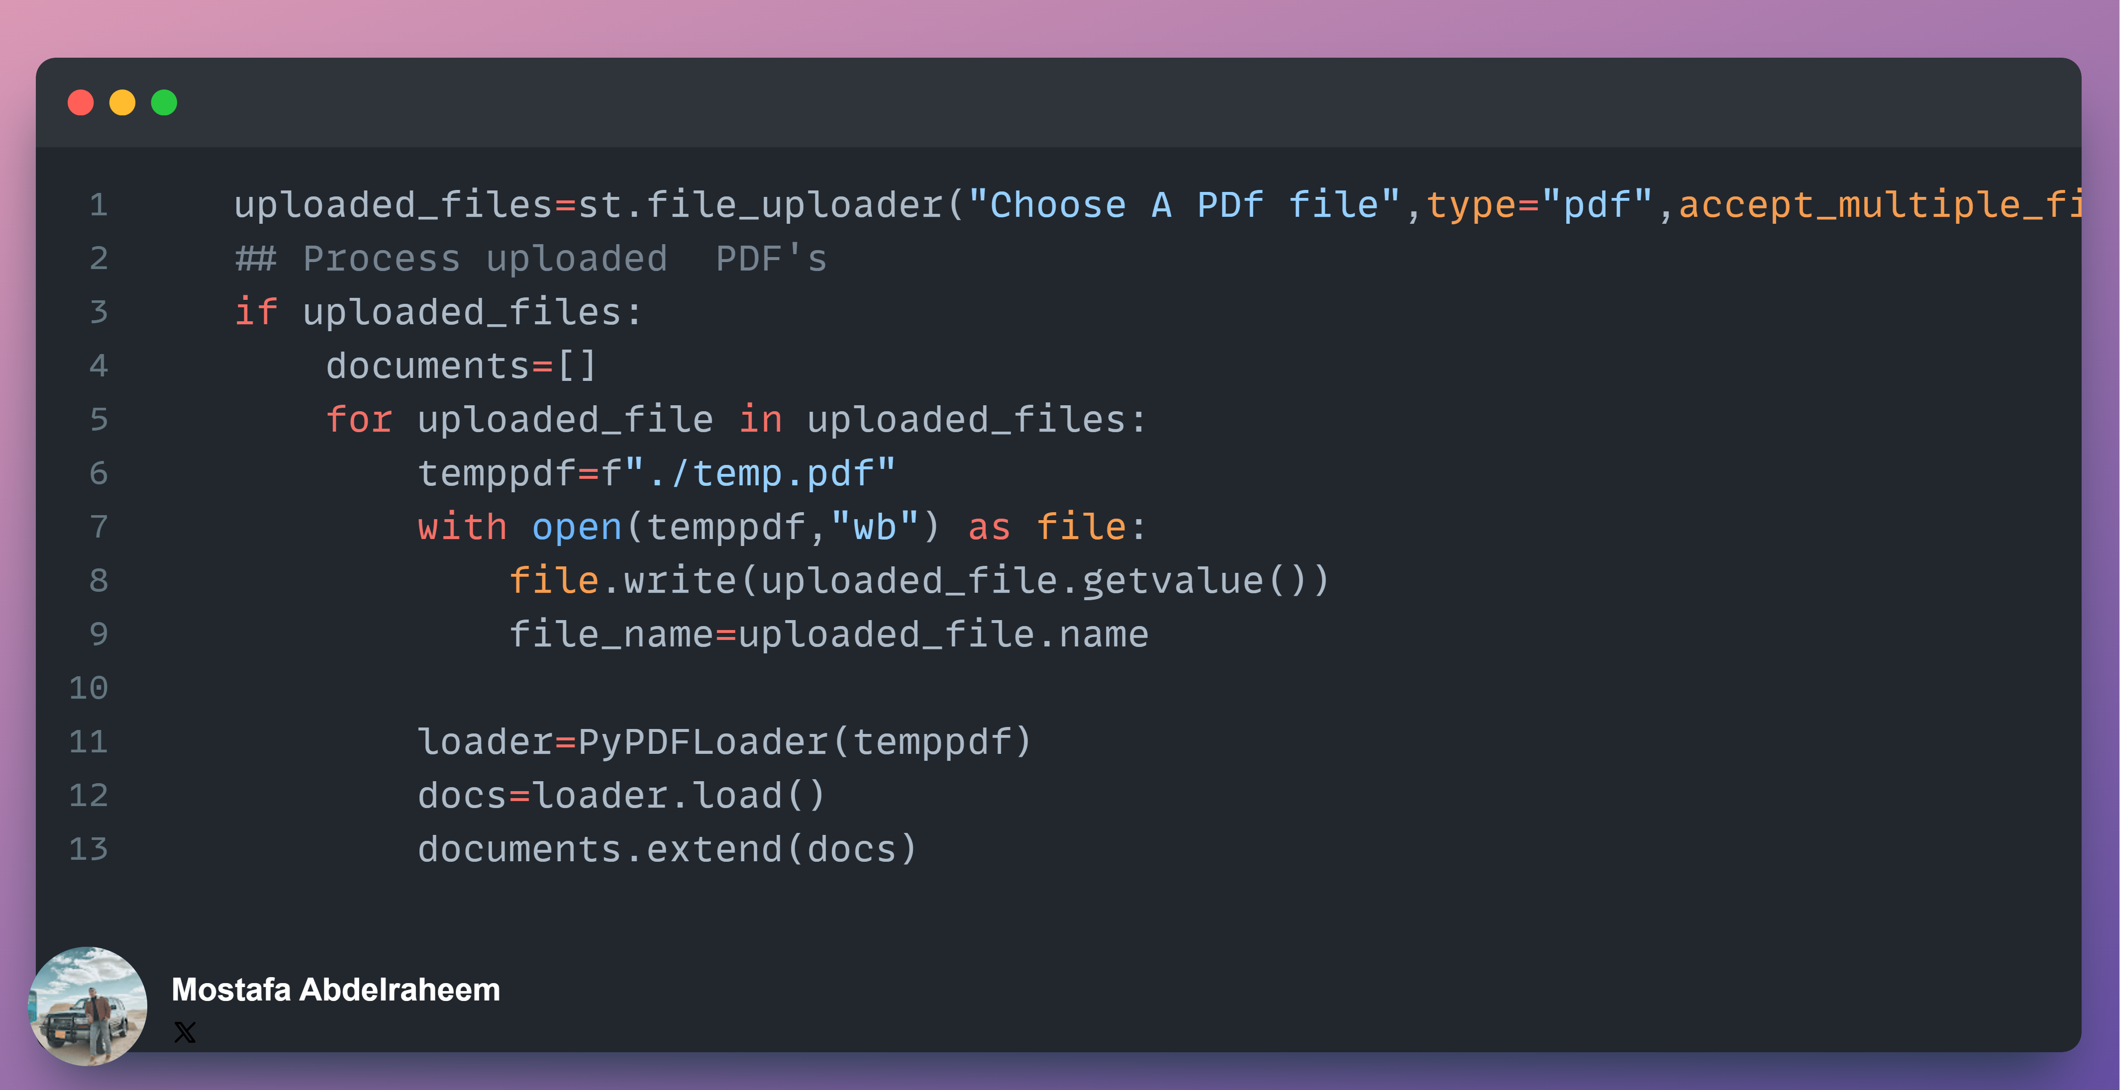
Snippet from uploading data

Slide 11
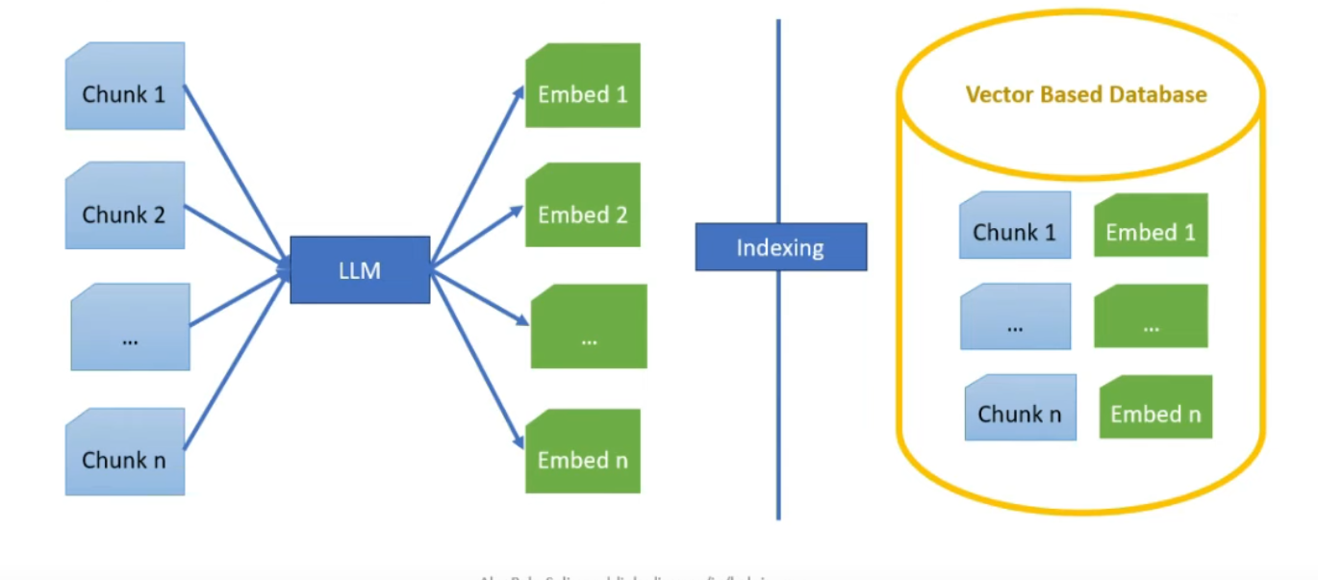
Architecture and System Flow
Indexing
Objective: Index parsed data for fast and efficient retrieval.
Step 1: Convert parsed chunks into embeddings using a pre-trained
model (e.g., BERT, Sentence Transformers).
Step 2: Store these embeddings in a vector database (e.g., Chroma DB)
Why Index?
Embedding vectors allow quick similarity-based searches.

Slide 12
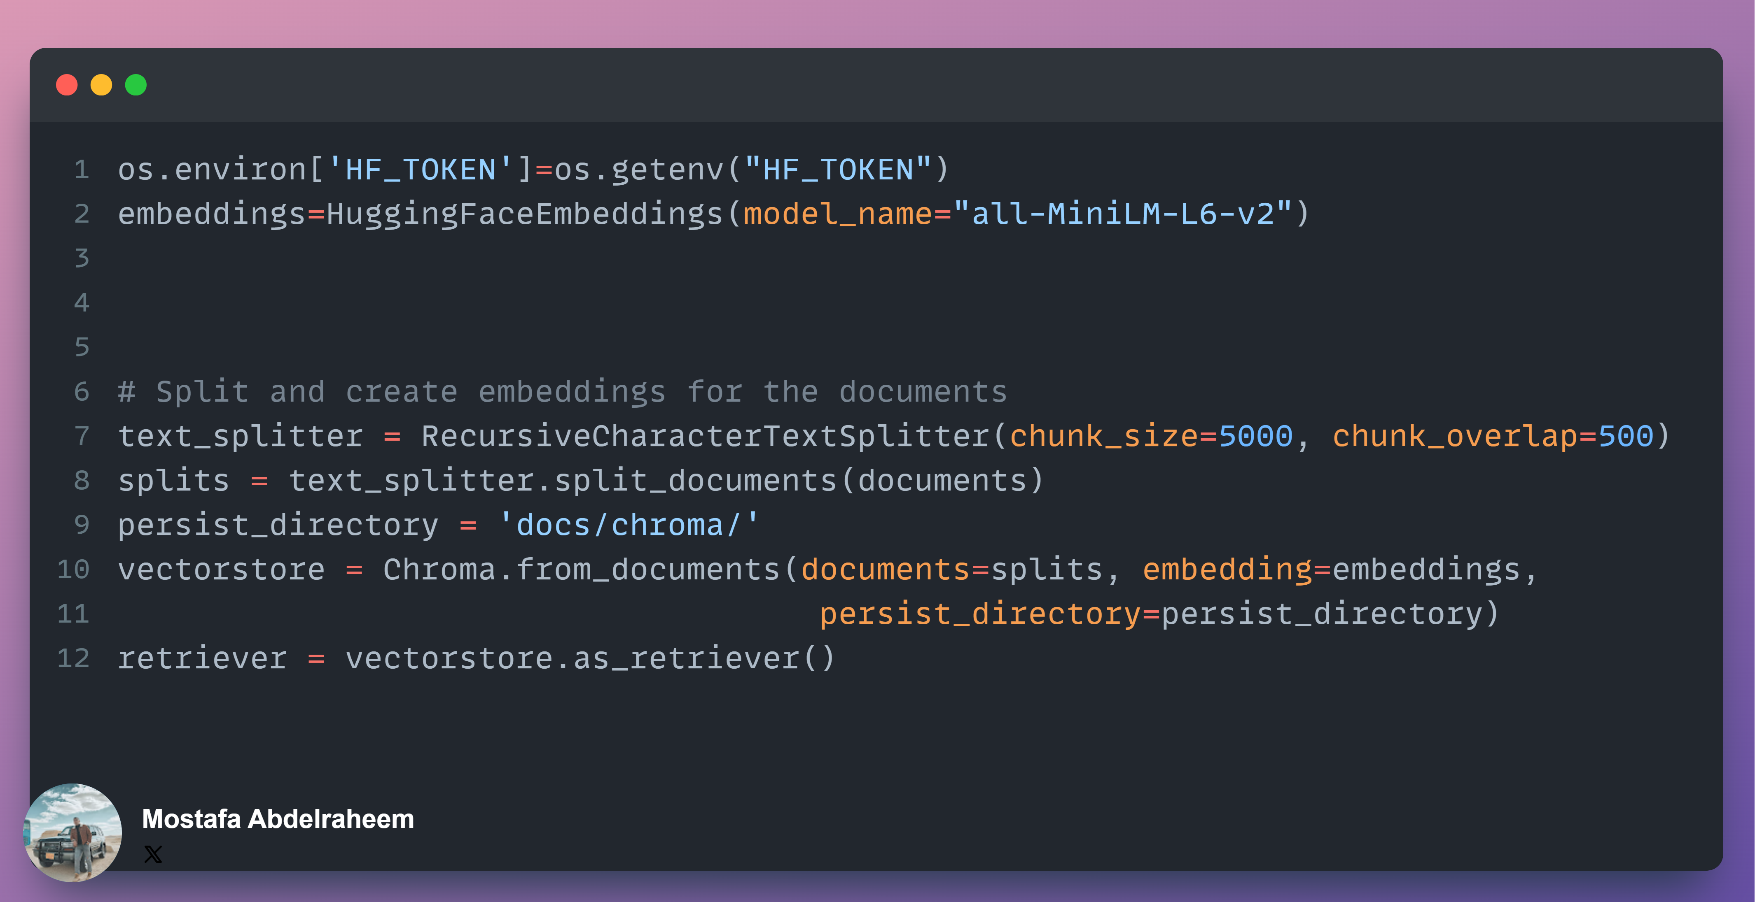
Snippet from Embedding process

Slide 13
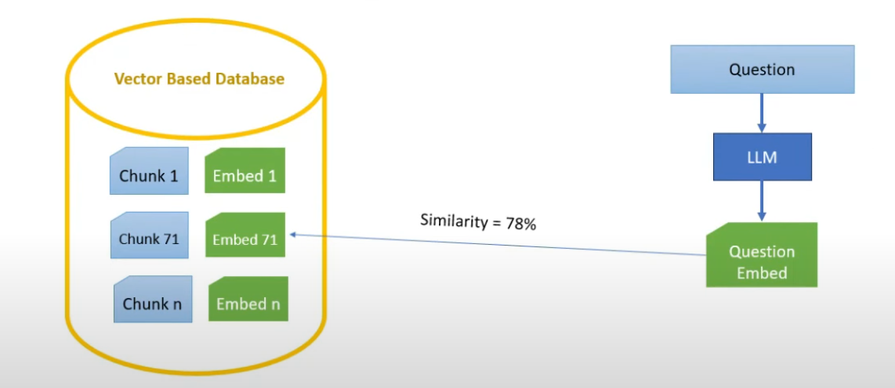
Architecture and System Flow
Asking
Accept a user question and retrieve relevant information.
Step 1: Accept a user question and convert it into an embedding using
the same model used during indexing.
Step 2: Retrieve relevant chunks by performing similarity search on the
indexed embeddings.
Step 3: Rank the retrieved chunks by relevance based on similarity scores.

Slide 14
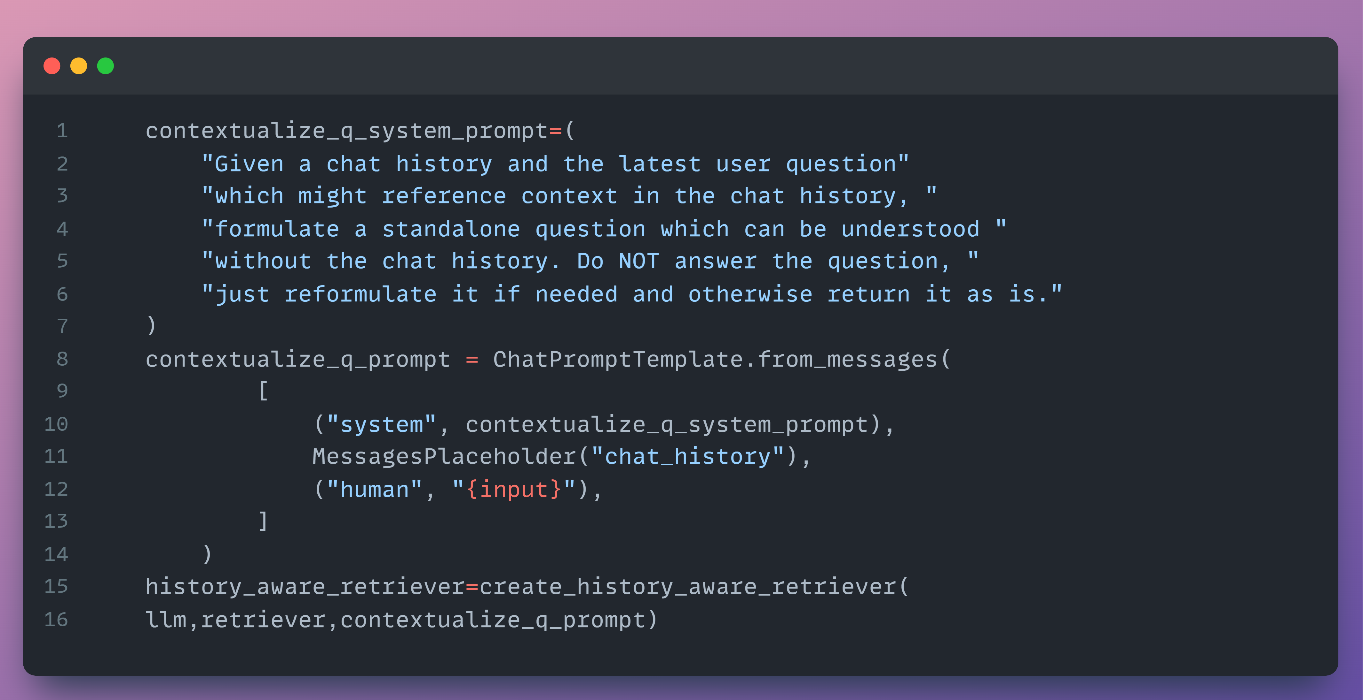
Snippet from preparing Question

Slide 15
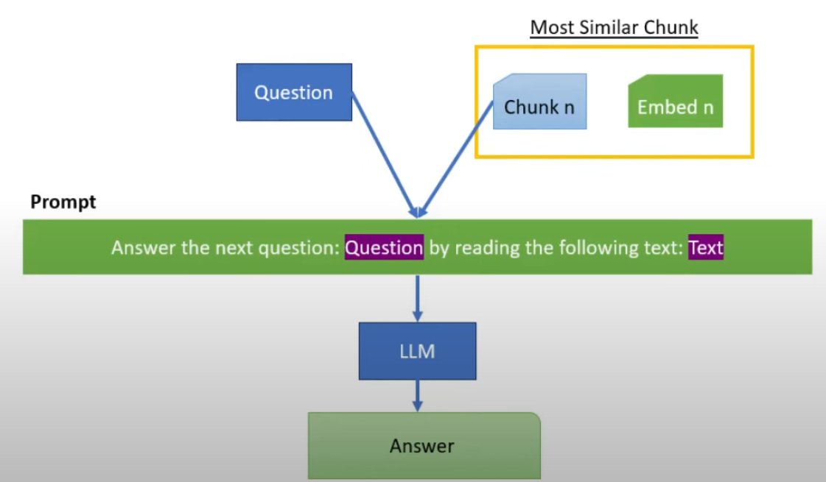
Architecture and System Flow
Answering
Generate an answer by using both retrieved information and a language model.
Step 1: Form a prompt by combining the user question with retrieved document chunks.
Step 2: Send the prompt to a large language model (LLM) (e.g., GPT, LLaMA, Jais).
Step 3: Receive and display the generated answer from the LLM.
Why Use an LLM?
LLMs enhance answers with reasoning and natural language understanding.
Combining retrieved information with LLM knowledge results in accurate and
informative responses.

Slide 16
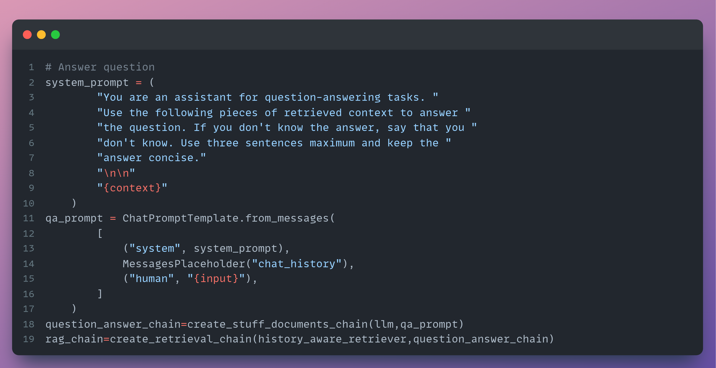
Snippet from preparing Answer

Slide 17
Technologies Used
Core Tools:
Groq AI inference: Pre-trained models (e.g., mixtral-8x7b-32768).
LangChain: Framework for integrating LLMs.
Chroma: Vector store for document embeddings.
Streamlit: Web app framework for the user interface.
Hugging Face: Pre-trained models (e.g., all-MiniLM-L6-v2).

Slide 18
Streamlit for the Deployment
Streamlit:
Easy-to-use Python web framework.
Facilitates building the interactive interface for uploading PDFs and displaying answers.
Why Streamlit?: Rapid prototyping, user-friendly, integrates well with data processing libraries.

Slide 19
Project Demo

Slide 20
MLflow Use Cases (If Applicable)
Why Use MLflow?:
Experiment tracking (e.g., different embedding models).
Model versioning for testing different configurations.
Deployment management (if serving models).

Slide 21
Azure Services
Why Azure?:
Provides cloud infrastructure to handle app scaling.
Potential for future features like hosting embeddings, managing APIs.
Azure Features:
Data storage, compute power, ML services.

Slide 22
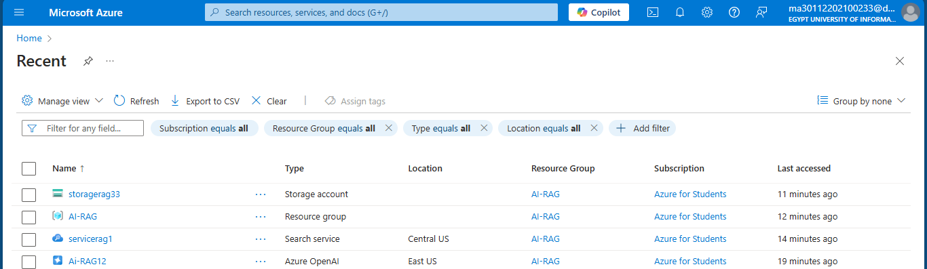
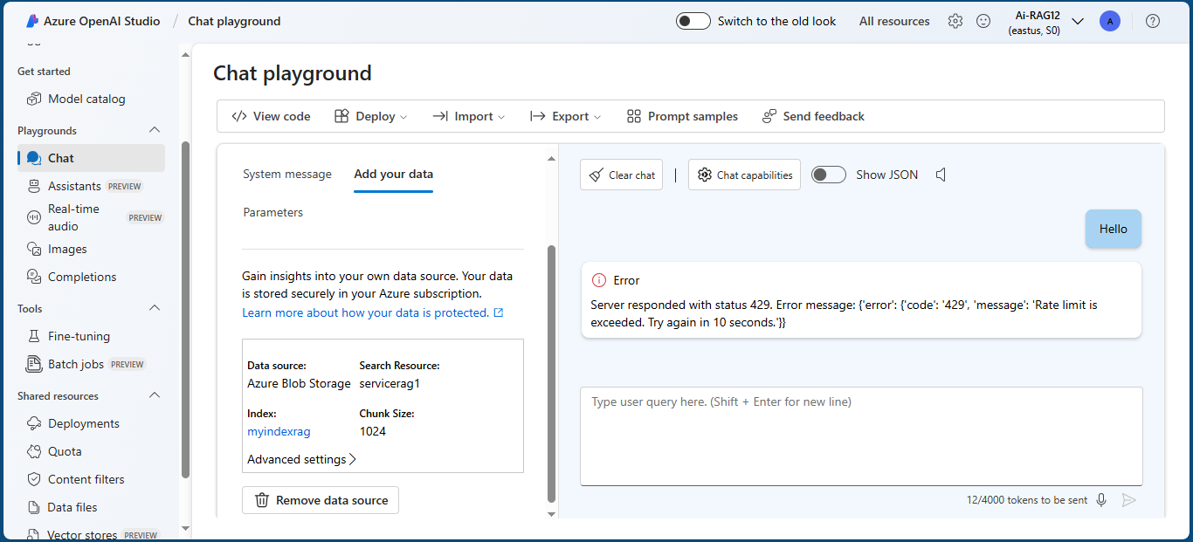
Azure

Slide 23

Challenges Encountered
Challenges:
Managing large PDF documents.
Optimizing the retrieval and response time.
Integrating multiple open-source libraries.
Solutions:
Used Chroma for vector storage and optimized embeddings for faster retrieval.
Used long-chain framework to handle multiple open-source libraries

Slide 24
Future Improvements
Ideas for Future:
Expand to handle more document formats (e.g., Word, Excel, Video).
Use fine-tuned LLMs for domain-specific knowledge.
Introduce multi-document querying.

Slide 25
Conclusion
Key Takeaways:
RAG apps enhance interactive querying with rich contextual answers.
Your project demonstrates efficient PDF processing using state-of-the-art retrieval and generation techniques.
This project can scale into a robust solution for various industries.

Slide 26

Thank You!

