Slide 1
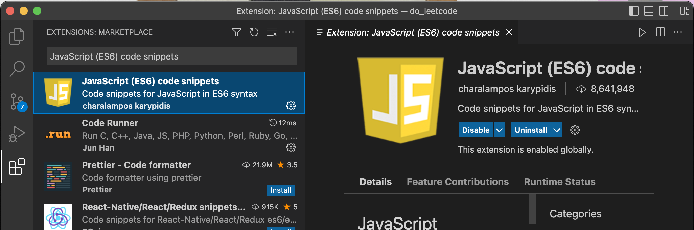
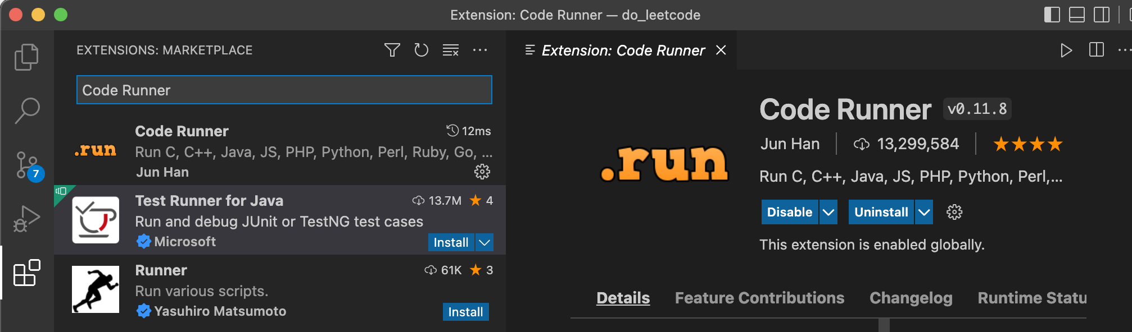
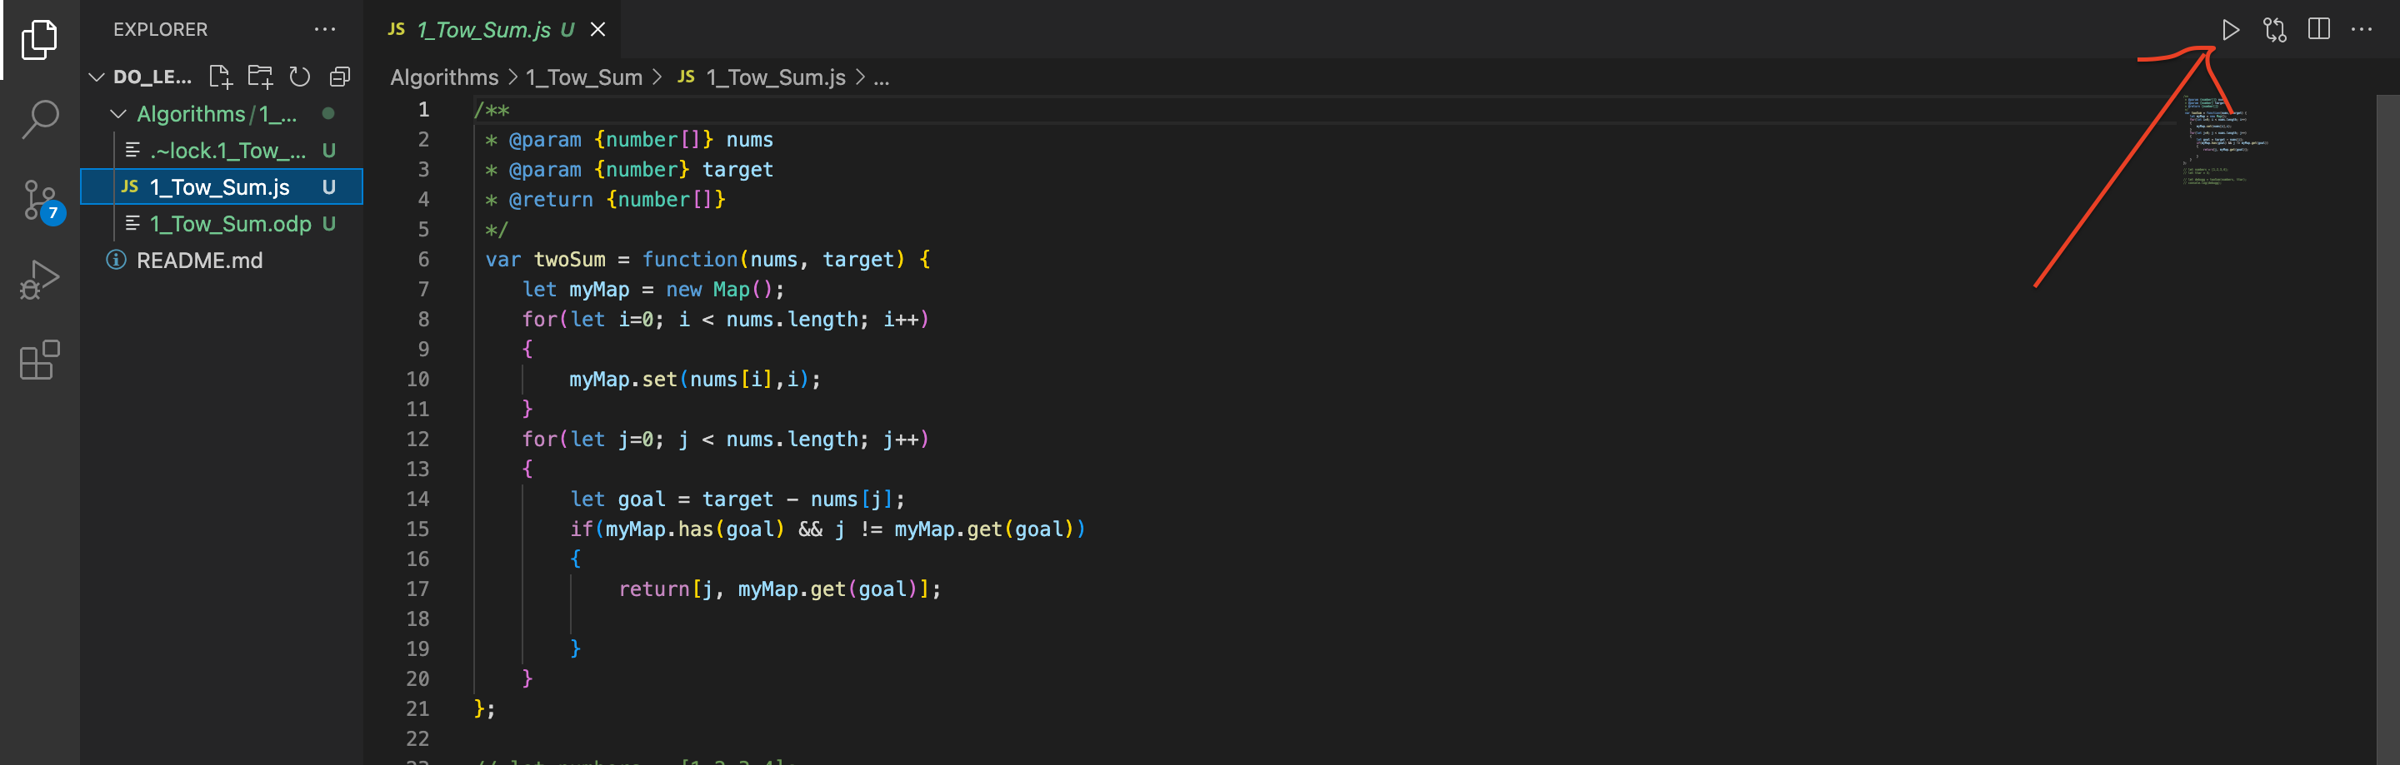
Mac VSCode JavaScript environment setting
1. Download and install node.js here: https://nodejs.org/en/
2. Open VSCode and install JavaScript (ES6) code snippets
3. install .run
4. press control + option + N , then this will show

Slide 2
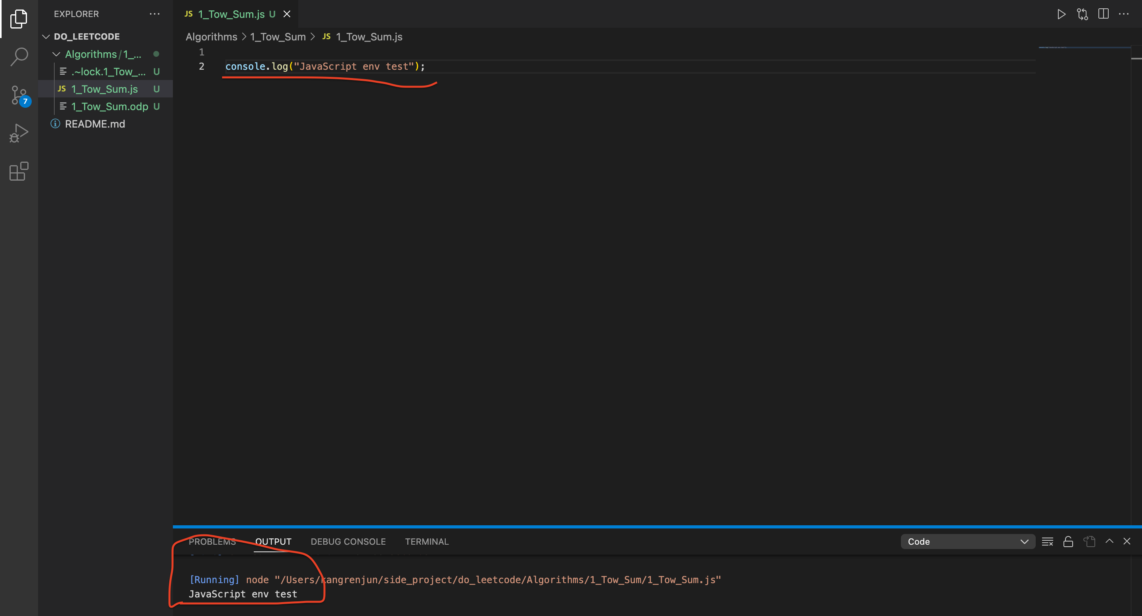
5. press it, then console will show
Reference: https://techdecodetutorials.com/web-development/how-to-run-javascript-in-visual-studio-code-on-mac-os-big-sur/

