Slide 1
Internet Speed Checker

Slide 2
Team Member
Ali Alyami
Jimmy Blundell
Christopher Aram Swayne

Slide 3
Project Story
Problem Statement:
Everyone is using internet now a days and it is becoming common in our day-to-day life. As the use of internet is increasing people want to know that what bandwidth/speeds they have. Currently usage of internet on smartphones is also common. As we have advancement in the form of 3G, 4G and even 5G cellular networks people often prefer to use internet on their smartphones instead of using a dialup modem. There is also a key feature that in modern networks there are many bandwidth and latency issues that users would like resolved. On the same token, everyone wants to know that the internet speeds they are getting match with what they are paying for. Additionally, users would benefit from knowing the details about the daily internet usage between wifi and cellular data.

Slide 4
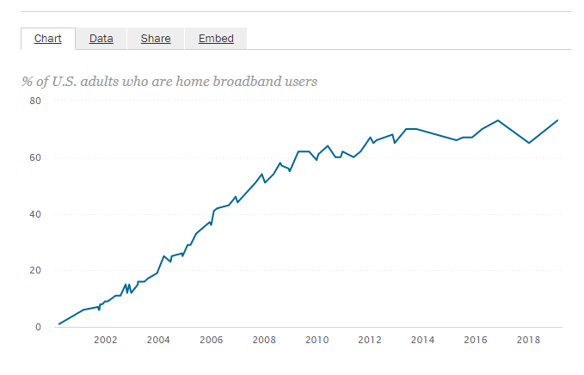
Project Story
Data:
What is the Dataset about?
In today’s era as the internet is growing rapidly, there are many respective surveys regarding internet usage. Home broadband connections are obviously trending upwards, as seen in this report form the PEW Research Center.

Slide 5
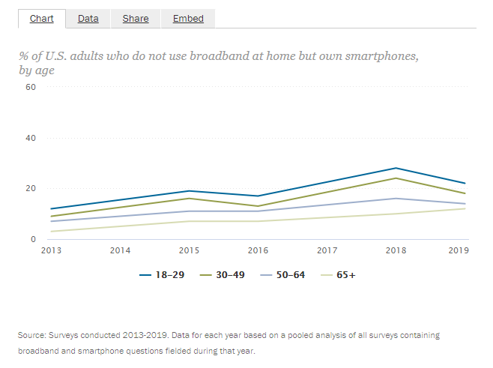
Project Story
Another research from PEW shows the percentage of US adults who own a smartphone rather than having a broadband connection at home.

Slide 6
Project Story
Application:
Who is the target audience?
Individuals want to know their internet speed for the reasons listed above. Additionally, companies want to know the internet speed at a deployment end. For example, an ISP (Internet Service Provider) can test the internet speed of the latest deployed connection by just connecting to that network and running a speed test on an android device.
What can the application do?
The application can test the internet speed at an end point of the network, e.g. A person wants to check their internet speed on their current network and other information such as the download, upload, ping of the connected internet connection. It can either be a cellular connection or WiFi connection. Also, this app will help to get the usage statistics of the previous 30 days. From this data users can estimate what internet bundle they need based on their daily usage of the internet.

Slide 7
Project Story
When can the user use this application?
They can use this application anytime in the day. As it is a mobile application, they need only an internet connection using either a 3G, 4G, 5G, or WiFi.
Where will the application be deployed?
The application can be deployed on the Google PlayStore from where everyone can download and use it to get the information about their connection.
Why the Visualization/Application is useful?
The application provides the clear information about the user’s internet information on the current network. We can see the information of network speed from the gauges and other information is about ping is also described in text. We also can see the history of internet tests as well as a summary of total daily usage of both wifi and cellular data.

Slide 8
Project Story
How will the Users use this Application to Make Changes?
If someone is using a 50 Mbps connection and getting speed of only 20Mbps to 30 Mbps or even lower, then they can challenge their ISP to provide them with the exact speed they are paying for. This application will also help them if they need to upgrade their connection or not on the basis of the usage statistics, such as if they need more data for the month or they need a better internet speed. These are all very helpful features to the user.

Slide 9
Work Distribution
Ali was working with the UI of the app and Google Admob to show ads in the app. We have used test ads but we can get the actual ads and then we can earn by publishing the app to PlayStore.
Christopher Aram Swayne was working with SQLite integration and connections to save the data online.
Jimmy Blundell was working on the backend programming for the app to make all the functionalities possible as well as worked with UI and other components of the app.

Slide 10
References
Demographics of Home broadbands and Internet Usage from https://www.pewresearch.org/internet/fact-sheet/internet-broadband/
Adapters in Android from https://developer.android.com/reference/android/widget/Adapter
4G average Internet Speed in U.S and other 77 countries from https://9to5mac.com/2019/02/20/4g-speeds-us-performance/#:~:text=At%20a%20national%20level%2C%20average,Mbps%20at%20the%20quietest%20hour.
achartengine library https://github.com/ddanny/achartengine

