Slide 1
Thirsting for Treatment:
Understanding Substance Abuse Treatment Deserts Through Data
Nitu Bola, Holly Bourgeois, Pushpa Chhetri, and Jim Cockerham
Notes:
Holly, team 3: substance abuse treatment deserts in the united states

Slide 2
DEFINING A DESERT
“Medical Desert”
Areas where population healthcare needs are partially or totally unmet
Five Dimensions of access:
Availability
Accessibility
Accommodation
Affordability
Acceptability
Contributing factors:
Insufficient resources in health or facilities
Long waiting times
Disproportionate high costs of services
Socio-cultural barriers
Defining medical deserts—an international consensus-building exercise, European Journal of Public Health, Volume 33, Issue 5, October 2023
Notes:
Holly
Insufficient Human Resources: Lack of healthcare professionals.
Inadequate Facilities: Insufficient or improper quality of healthcare facilities.
Long Waiting Times: Delays in receiving care.
High Costs: Services are disproportionately expensive.
Socio-Cultural Barriers: Other barriers impacting access to care.
**OUR GROUP/DATA FOCAL POINTS:
LOCATION
SERVICES
PAYMENT
AGE

Slide 3

TEDS-A 2019 & N-SSATS 2019
National Survey of Substance Abuse Treatment Services
Designed to collect data from all public and private facilities
Survey methods: web-based questionnaire, paper/mailed, telephone interviews
Voluntary survey
*2019 had a 9% facility non-response rate
Substance Abuse and Mental Health Services Administration, National Survey of Substance Abuse Treatment Services (N-SSATS): 2019. Data on Substance Abuse Treatment Facilities. Rockville,MD: Substance Abuse and Mental Health Services Administration, 2020.
Treatment Episode Data Set - Admissions
Demographic, clinical, and substance use data
State-licensed or certified treatment centers
Centers receive public funding
Collected from state-specific administrative data systems
*no data collected from OR/WA
Substance Abuse and Mental Health ServicesAdministration, Treatment Episode Data Set(TEDS): 2019. Rockville, MD: Substance Abuse and Mental Health Services Administration, 2021.
Notes:
Jim C
Data collected via the TEDS-A and N-SSATS 2019 surveys as collected by the Department of Health & Human Services through the Substance Abuse & Mental Health Services Administration
WHY WE CHOSE 2019:
Latest data sets available - 2021 (TEDS) / 2020 (NSSATS **moved into a new survey starting in 2021 that includes mental health treatment)
Pre-COVID - data isn’t skewed by pandemic-era admissions policies, only two states non-reported for TEDS
More recent data is restricted use and therefore unavailable to the public

Slide 4
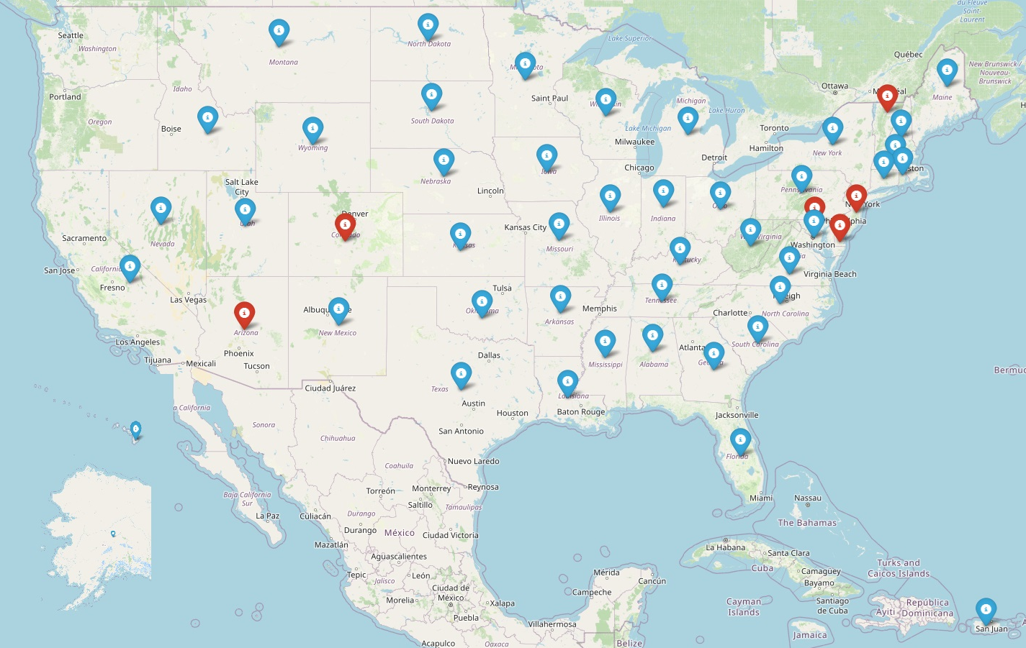
Ratio of Total Capacity by State
Ratio
Total Admissions by State : Facilities/Services Offered
Threshold = 480
For every one available “spot” in a treatment facility, there are 480 people waiting for a spot. (mean plus 1 standard deviation)
States with a ratio higher than the threshold are considered a “treatment desert”
Legend:
Red - identified desert state based on threshold value
Notes:
Nitu:
The capacity is total capacity of beds in each state. The red states indicate low capacity based on the mean plus 1 standard deviation.

Slide 5
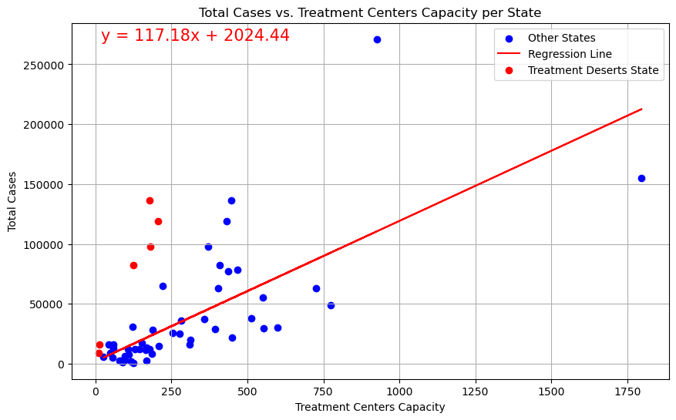
Total Cases vs. Treatment Centers Capacity Per State
Treatment Deserts Identified Based on Capacity Ratio
STATE Capacity Ratio
Arizona 763:1
Colorado 652:1
Delaware 1156:1
Maryland 576:1
New Jersey 541:1
Vermont 926:1
Notes:
Nitu:
What the scatterplot shows:
Why we chose the scatterplot as an alternative visualization (how is it different than the map)

Slide 6
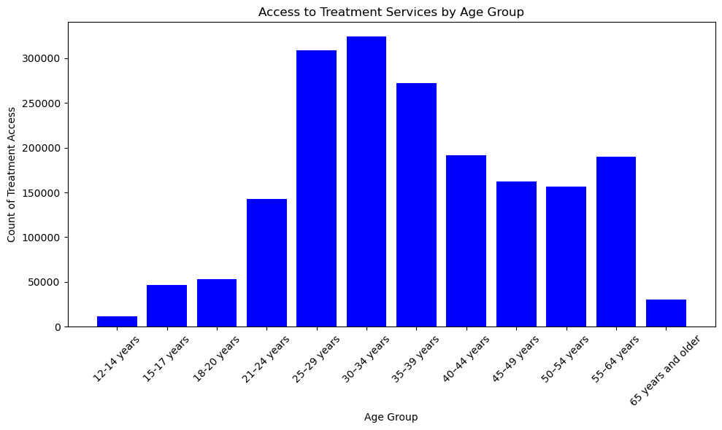
Access to Treatment Services by Age Group
Notes:
Pushpa:
The graph highlights that the predominant age groups for admissions are those who have access to income, reliable transportation, and are not currently enrolled in school.
Mention the
AVAILABILITY / ACCOMMODATION - juvenile treatment facilities are considered a “specialty” service - these are limited in availability and demand is high
ACCESSIBILITY / ACCEPTABILITY - transportation is a barrier for juvenile admits (especially with outpatient treatment) as they rely on family members or public transportation for access; acceptability: the stigma associated with substance abuse - especially in younger patients - creates a barrier in that patients are reluctant to start treatment, they may not think it’s “bad enough” to merit treatment, or there is a “family legacy” of substance abuse wherein relatives may not want to be responsible for transportation/payment/support

Slide 7
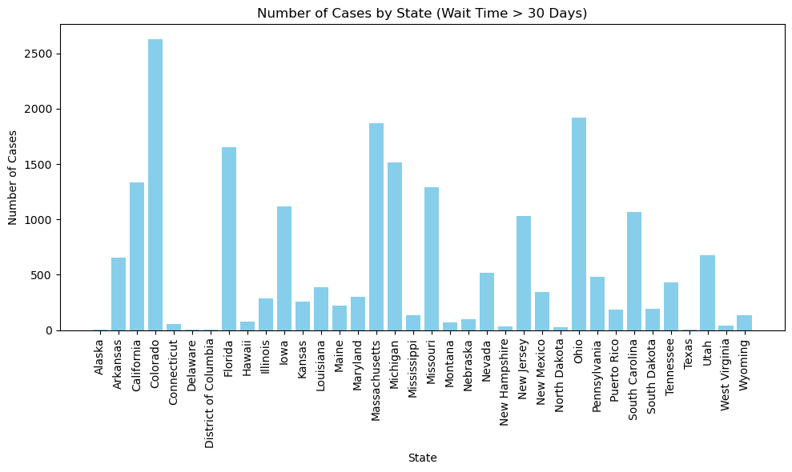
Number of Cases by State (Wait Time > 30 Days)
Notes:
Pushpa:
Note: Arizona did not report wait times.
Graph highlight - availability / accessibility / accommodation / affordability / acceptability
Contributing factors to long wait times -
Inpatient/short term/long term rehab - detox may be required for admission - if the detox is not within the facility the patient must go through detox and then get admitted - the “care continuum” is disrupted; demand is higher than supply; private health insurance may require pre-authorization before a patient can be admitted

Slide 8
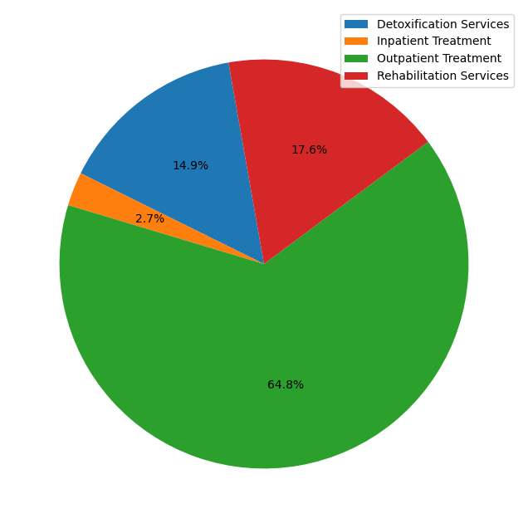
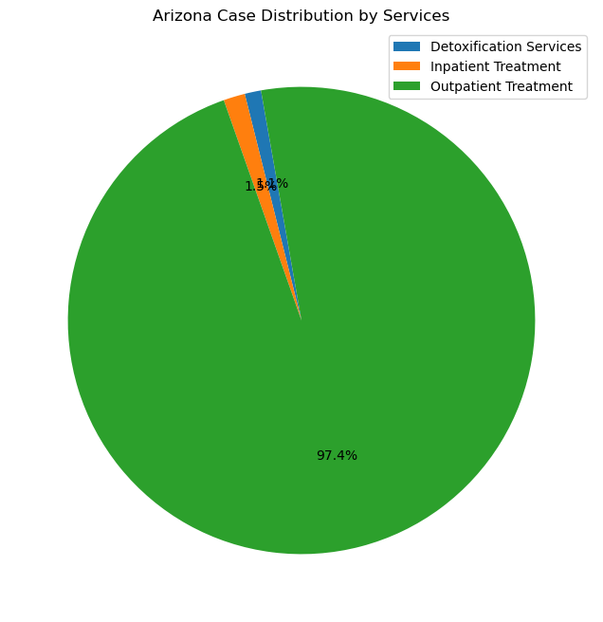
Case Distribution by Services
All States
Arizona
Notes:
Pushpa:
All states and the offer of services
WHAT ARIZONA SHOWS US: “desert states” show a trend towards outpatient treatment - requires less staff, fewer specialty certifications, lower cost
WHY IT’S NOT ENOUGH - outpatient treatment requires transportation, which is not always available; oversight and medication management is limited; because it’s outpatient, caseloads are larger and treatment is less intensive

Slide 9
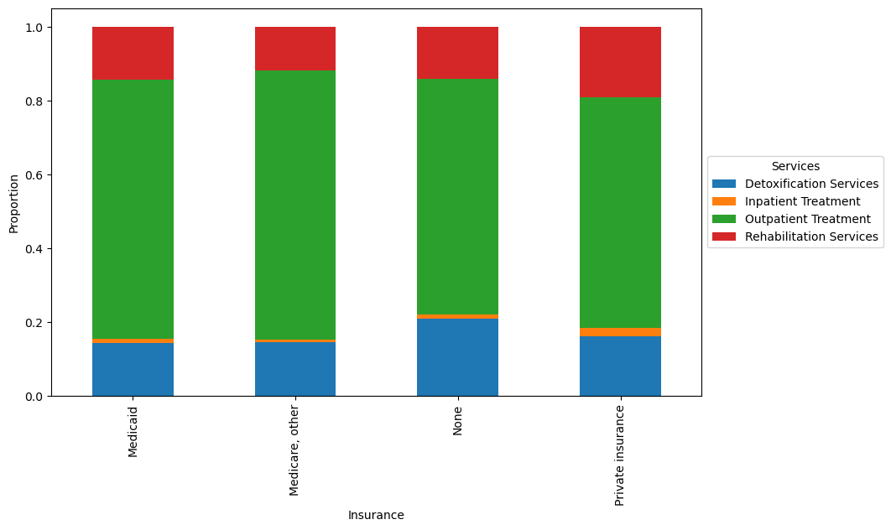
Services Received Based on Health Insurance
*data filtered to remove cases with no reported payment method
Notes:
Jim:
The teds data frame was filtered to remove cases that did not provide a the payment method of treatment.
ANOVA test results F-statistic: 0.4675476751194555, P-value: 0.519637175760407
Due to the low F-statistic there is no significant difference in the types of services received.

Slide 10
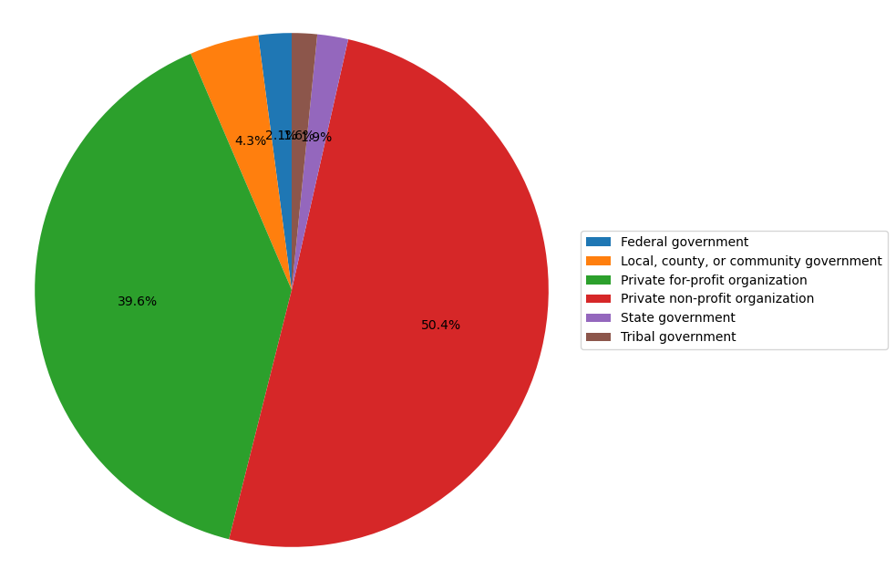
Treatment Centers Distribution by
Ownership Types (All States)
Notes:
Holly:
PRIMARY OWNERSHIP - PRIVATE COMPANIES
How it relates: private companies choose where and how they want to conduct business and how much they want to charge; federal and local government bureaucracy and lack of funding reduce availability of affordable, public treatment

Slide 11
Substance Abuse Treatment Deserts through Data
Conclusions
The “medical desert” dimensions identified in the EJPH article are evident from a substance abuse treatment standpoint
Data indicates 6 “treatment deserts” in the US
Privately-owned facilities dominate the treatment landscape, largely dictating where and how treatment is available
Recommendations
Increase publicly-available funding to patients and facilities
Improve continuum of care (transfer from detox, short/long term rehabilitation outpatient, and aftercare)
Increase facility count; staffing; specialty programs
Notes:
There are six state in the US that stand out as potential deserts with Arizona and Colorado standing out due to the low availability of services other than outpatient in Arizona and long wait times in Colorado. We recommend a deeper study in these states to identify the demographics of those getting treatment along with the cost across ownership of the facilities. We would also recommend an effort to gain additional federal funding to increase the overall capacity of available beds in all 6 states identified as potential deserts.

Slide 12



